Slide 1
Problem Gambling 101
Presentation Year 2021

Slide 2
Session Topics
1. Overview of DPG
2. Gambling in Arizona
4. Defining Problem Gambling
3. The Progression of Gambling
5. Youth & Gambling
Notes:
Your topics for this module include overview and basic knowledge, history and scope of gambling, national prevalence of gambling issues, describing gambling disorder, and screening and assessment.

Slide 3
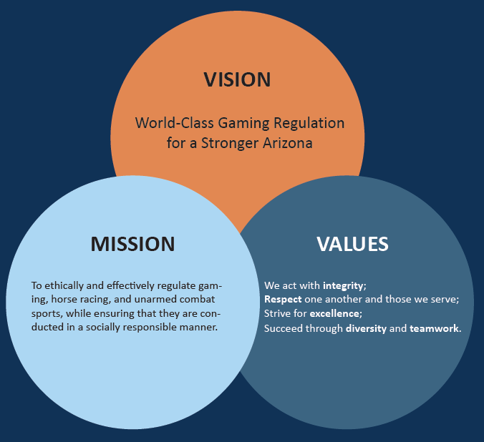

The Arizona Department of Gaming uses their mission statement to:
  Promote Fair and Effective Regulation While Fostering Social Responsibility;
  Strengthen Resource Networks;
  Provide a World-Class Customer Experience;
  Increase Operational Effectiveness, Compliance, and Efficiency; and
  Develop a World Class Team.
Notes:
The Arizona Department of gaming uses their mission statement to promote fair and effective regulation while fostering social responsibility, strengthen resource networks, provide a world-class customer experience, increase operational effectiveness, compliance, and efficiency, and develop a world-class team. You’re able to read our vision mission and values on the slide. Once you have completed reading through our organizational goals and qualities please feel free to advance to the next slide.

Slide 4
Division of Problem Gambling (DPG)
DPG is funded through Tribal Casino & Arizona State Lottery contributions. No taxpayer money is used to support DPG’s mission.
DPG’s MISSION:
To prevent problem gambling and reduce its effect.

Slide 5

DPG Programs & Services
Operates the 24/7 Helpline for Problem Gambling in the state of Arizona
Manages Self-Exclusion from gambling locations across the state
Organizes the Tribal & State Funded Treatment Program for problem gambling
Offers training for treatment providers
Conducts outreach efforts to expand awareness of gambling issues
Implements funds for Prevention of At-Risk Populations across Arizona
Notes:
The Arizona Department of gaming provides various services to our residents in our state. We operate the 24 seven helpline for problem gambling for the state of Arizona. We also manage the self exclusion process for gambling locations across the state. This allows people to sign themselves out legally from being able to gamble as a form of self-directed control over their gambling behavior. We organize the tribal and state-funded treatment program for problem gambling. This allows callers of the helpline or people who view our website to reach out to qualified counselors in our state and be able to receive treatment at a subsidized rate or free of charge. We offer training for treatment providers throughout the year in order to assist them with their continuing education needs as well as their specialization in treating gambling related issues. We conduct outreach efforts to expand awareness of gambling issues in our communities across the state. Finally, we implement the funds for prevention of at-risk populations to gambling issues across the state.

Slide 6
DPG Services - Arizona Casino Self-Exclusion
DPG Manages the Self- Exclusion list for Arizona Tribal Casinos.
Individuals can ban themselves from AZ Casinos for 1, 5, or 10 years.
Self-Exclusion is not revocable once it is completed and received.
The Self-Exclusion process can be completed in the office by appointment or the form can be filled out electronically (although it would need to be printed & notarized) and sent in either electronically or by mail.

Slide 7
DPG – Treatment Services
DPG subsidizes treatment services with contracted providers.
Treatment can be for both the gambler or anyone affected by a problem gambler.
Treatment options include:
  In-person Individual & group sessions
  Virtual individual & group sessions
Treatment is anonymous and an individual’s personal information is not shared with ADG or DPG.
With Tele-Health Practice Coverage is available State Wide in Arizona.

Slide 8
DPG – Prevention, Education, & Outreach
DPG has offered Prevention Grants to agencies working with youth.
DPG participates in community outreach and presentations to groups educating them on services available.
DPG Manages a 24/7 Helpline for Problem Gamblers and people affected by Gambling :
1-800-NEXT-STEP

Slide 9

Forms of Gambling
Notes:
The next section will explore various forms of gambling.

Slide 10
Defining Gambling
Any time you bet money or RISK something of value on an event of uncertain outcome, you are
GAMBLING.
Gambling is among the most popular pastimes, and most people enjoy the activity without any harm. However, for many Arizonans, gambling becomes a
PROBLEM.
Notes:
In order to define gambling, it is important to identify an understanding that all gambling activities can connect with in a basic way. In order to do this, the national Council on problem gambling continues to adhere to the following definition:
Any time you bet money or RISK something of value on an event of uncertain outcome, you are
GAMBLING.
Gambling is among the most popular pastimes in recorded human history, and most people enjoy the activity without any harm. However, for many Arizonan's gambling becomes a problem.

Slide 11
Forms of Gambling
Lottery
Land-based casinos
Bingo
Slot, poker, or other gambling machines (not at a casino)
Office pools, raffles, or charitable small stakes gambling
Trading or “chase” cards
Flipping coins
Native American casinos
Numbers
Floating casinos
Jai-Alai
Stock or Commodities trading
Cards for money, not at a casino
Sports Betting/Fantasy
Internet (not legal in U.S.)
Dares
Horse/Dog racing
Dice games, not at a casino
Games of skill for money
Other
Notes:
Gambling occurs in many forms. There are multiple categories of different styles of games for which chance prompts people to place wagers to make the outcome of the game more exciting. The list above is an example of all the different ways people can place bets in the locations for where these bets can be placed. These include the lottery, casinos whether on land or on boat, slot machines and other electronic video machines, poker and other card style games, office pools, raffles, or charitable small stakes gambling, coin tosses, Native American casinos, highlight, stocks or commodity trading, in-home card games or card games not located at a casino, sports betting including fantasy sports, wagering on the Internet which is not legal in the US, completing dares with other people, horse and dog racing tracks, dice games, and wagering money on any game of skill where the victor will receive an allotment of money from the other wagers placed.

Slide 12
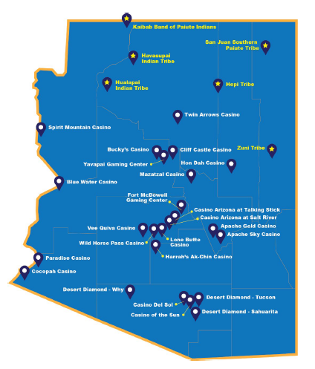
Review of Arizona
Details from the 2020 Department of Gaming Annual Report
Arizona contains 22 Compacted Tribes (16 with casinos)
Arizona Lottery: $1.08 billion in sales for 2019
  Scratcher Games amounted to $750.3 million in sales
Division of Racing
Arizona Division of Problem Gambling
  Involved in Prevention, Education, & Outreach
  Treatment: DPG coordinated services for 887 distinct clients in 2019
  Self-Exclusion: 2,423 active participants at close of FY20
Notes:
This slide provides a brief synopsis of the 2020 Department of gaming annual report. Arizona currently contains 22 compacted tribes, 16 of which operate casinos. The Arizona lottery was able to receive $1.08 billion in sales for 2019, with scratcher games amounting to 750 million of those sales. Arizona also contains a division of racing. The Arizona division of problem gambling who is hosting this training is involved in prevention education and outreach services for the state. In addition, they operate the treatment program which gamblers can benefit from by getting their counseling process endorsed at varying levels by the division’s treatment program. The ADP/DPG also operates the self exclusion list for the state of Arizona, which at the time of programming in this training had over 2400 active participants.

Slide 13


Overview of
Arizona
Also provides regulation for
Racing
Boxing & Mixed Martial Arts
Sports Betting
Notes:
The Arizona Department of gaming also provides regulation for the state lottery, racing, and fighting sports such as boxing and mixed martial arts. This slide contains a graphic which shows the names and seals for the tribal nations who inhabit the state of Arizona and notes which casinos exist in connection with tribal operations. This amounts to around 20 casinos being operated through this relationship with the state and tribal nations. You will note there are six tribes that do not operate a casino indicated on the right side of the graphic.

Slide 14
Problem Gambling 101
We know that for most people gambling will be a source of entertainment, for a small group of people, gambling will be/or become problematic.

Slide 15
A Public Health Perspective of Problem Gambling
Notes:
A public health perspective of problem gambling

Slide 16
What are “Public Health Issues?”
Public Health research explores the distribution and determinants of disease, disability, and death in a defined population
These studies inform public policy to help prevent, eliminate, or control the problem’s occurrence and rate of escalation across the defined group of people
Notes:
Public-health research explores the distribution and determinants of disease disability and death in a defined population
These studies inform public policy to help prevent eliminate or control the problems occurrence and rate of escalation across the defined group of people.

Slide 17
Gambling as a Public Health Issue
Gambling affects the person placing the bets and numerous people in their lives (friends, family, co-workers, employer)
Gambling activity can influence the development of multiple pathologies in addition to Gambling Disorder
There is a need to improve prevention strategies for those who are at-risk of developing a gambling problem
Society will benefit from efforts to acknowledge the health impacts of gambling activity and further support activities that enhance life satisfaction and developing adaptive coping strategies
Notes:
Gambling affects the person placing the bets and numerous people in their lives. Cabling activity can influence the development of multiple pathologies in addition to gambling disorder. This can include depression, anxiety, relationship problems, and many other problem categories that take the extent of the gambling problem far beyond the financial decision to place a bet.
There is a need to improve prevention strategies for those who are at risk of developing a gambling problem. Society will benefit from efforts to acknowledge the health impacts of gambling activity and further support activities that enhance life satisfaction in developing adaptive coping strategies.

Slide 18
Conceptualizing Gambling Behavior
Gambling is conceptualized on a continuum ranging from non-gambling, healthy gambling, and then problem gambling.
Healthy Gambling
Problem Gambling
Notes:
As we seek to conceptualize gambling behavior, is important to realize that many people have a healthy relationship to gambling and that gambling activity enhances the amount of enjoyment they have as they play or watch different styles of games. Gambling is currently conceptualized on a continuum ranging from non-gambling, healthy gambling, and then problem gambling. Is important to get to know your client and understand the many ways gambling is affecting them. It is often not as simple as expecting that stopping the gambling activity will automatically lead to a fulfilling and healthy life experience. Because gambling is more nuanced than this, the point where gambling stops is often the place where the true therapeutic work begins.

Slide 19
How Can Gambling Be Healthy?
Healthy Gambling is generally…
A well-informed choice regarding probabilities of winning
A pleasurable experience involving low personal and financial risk
Done by involving affordable / sensible amounts
Mostly serve to improve a gambling person’s well-being or satisfaction with life
Involves a lack of negative consequences.
Notes:
You may be asking yourself “how can gambling be healthy?”
Healthy gambling is generally a well-informed choice regarding probabilities of winning, a pleasurable experience involving low personal and financial risk. It is often done by involving affordable and sensible amounts in the wagering process. Healthy gambling mostly serves to improve the gambling person’s well-being or satisfaction with life, and as such will involve a lack of negative consequences for the individual, their family and friends, and others around them.

Slide 20
Recreational Gamblers
Recreational Gamblers
Sets Limits
Wagers are Affordable
No Negative Consequences
Plays just for Fun
Gambling Is Just A Game
Has Realistic Expectations
Fun is not just from Gambling
Notes:
For those people who do not experience a problem related to their gambling behavior, we can classify them as recreational gamblers. A recreational gambler does several things differently than a problem gambler. They will set limits, their wagers will be affordable to them, the players just for fun and feels like a game, the bettor has realistic expectations for how their bets will resolve themselves. As a result, there are no negative consequences to this gambling behavior and is also not the only source of fund that this kind of gambler will experience across the areas of their life.

Slide 21
How Does Gambling
Become Unhealthy?
Notes:
With this in mind, how does gambling become unhealthy?

Slide 22
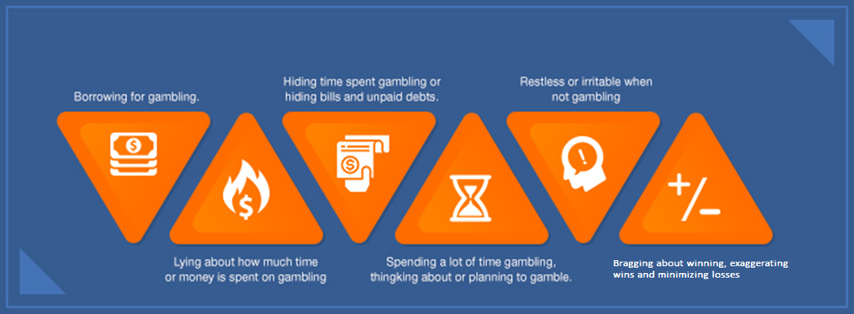
Warning Signs of Problem Gambling
Notes:
The warning signs for problem gambling can be wide-ranging and individualized from person-to-person. The themes that we see regardless of the individual and their circumstance include some of the following: borrowing for gambling, lying about how much time or money is spent on gambling, hiding time spent gambling or hiding bills and unpaid debts in order to free up more money for gambling, spending a lot of time gambling thinking about or planning to gamble, restless or irritable this when not gambling including treating people that matter to them poorly because they start to see them as an obstacle to their gambling activity, bragging about winning exaggerating and or minimizing losses

Slide 23
Defining Addiction
Addiction
Salience
Withdrawal
Tolerance
Conflict
Relapse
Mood Modification
“Historically, addiction has been understood in various ways—a sin, a disease, a bad habit—each a reflection of a variety of social, cultural, and scientific conceptions.”
(Hammer et al., 2012, p. 713)
Notes:
In any lineup of clinicians, the definition for addiction can vary. “Historically addiction has been understood in various ways —a sin, a disease, a bad habit—each a reflection of a variety of social, cultural, and scientific conceptions.”
The components of addiction remain recognizable, and can include salience, withdrawal, tolerance, conflict, relapse, and mood modification. After understanding addiction in terms of historical understanding and components recognition, what is it about gambling that leads us to understand it in terms of addiction terminology?

Slide 24
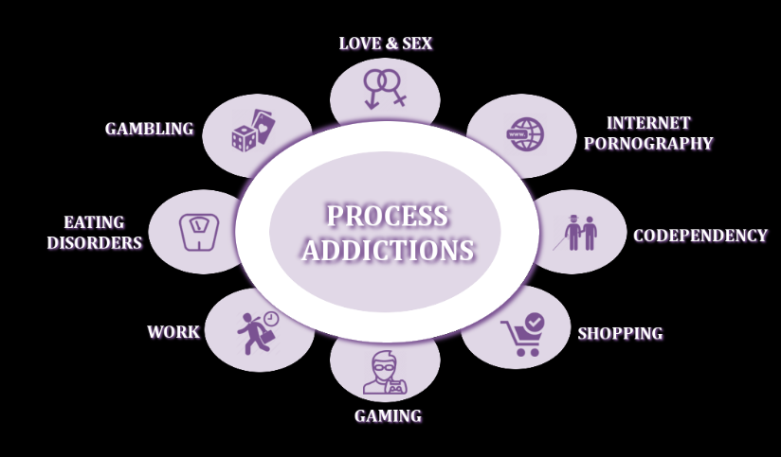
What is a Process Addiction ?
“[When a person experiences] The compulsion to continually engage in an activity or behavior despite the negative impact on the person’s ability to remain mentally and/or physically healthy and functional in the home and community.”
American Addiction Centers, 2019
Notes:
Gambling does not in itself include elements of digestion, inhalation, or injection the way that many more common and historically accepted addictions what. This is because gambling is understood as a process addiction. A process addiction is . . . “[When a person experiences] The compulsion to continually engage in an activity or behavior despite the negative impact on the person’s ability to remain mentally and/or physically healthy and functional in the home and community.”
Right now, gambling disorder stands as one of the first examples in the professional community of a process addiction being recognized as a psychiatric disorder. However, it is likely not the only process addiction. Many behaviors result in a rewarding experience in the brain chemistry of an individual that leads to ongoing and uncontrolled interaction with the behavior. These behaviors include things such as video games, shopping, pornography viewing, eating disorders, and sometimes work. This list is not complete. As society continues to change new behaviors will raise professional questions for addiction professionals across the fields of mental health.

Slide 25





The Continuum of Gambling Activity
No Gambling
Casual / Social Gambling
Serious Social Gambling
Problem Gambling
Compulsive / Pathological Gambling
Notes:
Gambling becomes a problem over time. Sometimes the problems arise quicker for some than others. The phases in which problems become apparent occurs on a continuum going from no gambling to compulsive gambling. The sequence goes as follows: no gambling – the person does not gamble and so they cannot have a problem with gambling; casual or social gambling – the person gambles with friends and social acquaintances at times when it is appropriate to have fun; serious social gambling – a person is beginning to take their bets more seriously and is putting more of their financial capital into their bets. They also seem more driven to win and begin gambling on their own instead of using gambling as a social occasion; problem gambling – this person is beginning to exhibit symptoms similar to the diagnostic criteria for gambling disorder. This could include preoccupation, plotting out the way their next bet is going to go, and connecting more with gambling as if it is a defining feature of their life. People may have no idea that gambling has grown to be this much of a fixation for the person, and because of these many things the gambling can result in consequences in their life; compulsive and pathological gambling – this person meets criteria for a DSM-V diagnosis for gambling disorder and will score higher values on various gambling addiction screens. Their process for gambling activity is reckless and results in numerous consequences.

Slide 26
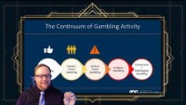
Lecture Video 1
Notes:
https://youtu.be/ssBDDgZ5gmM
Lecture on progression from Recreational Gambling to Problem Gambling **

Slide 27
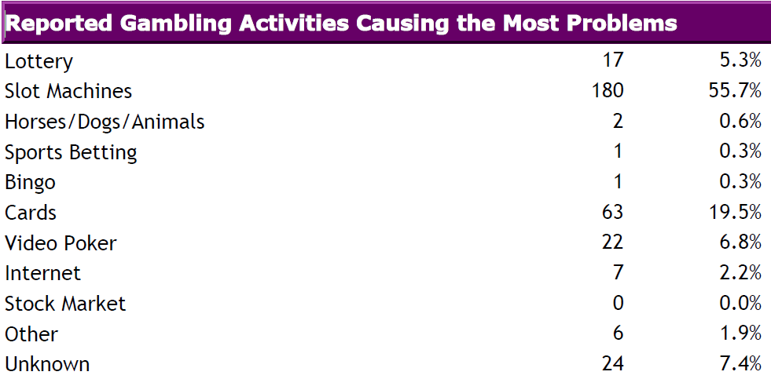
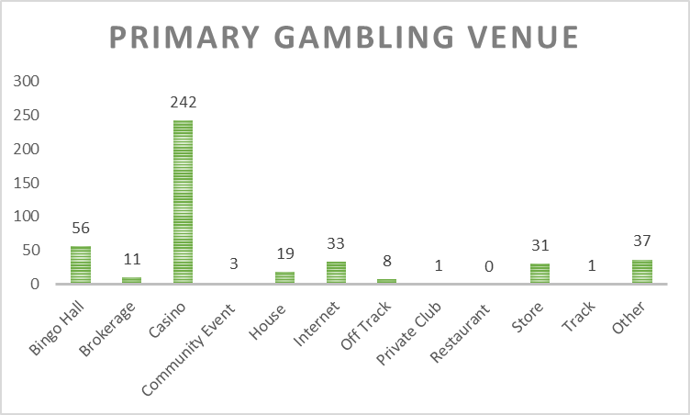
Primary Gambling Problems
(Arizona statistics)
Clients Served (FY 2020):
  N=774
Average Time-Course: 13 Sessions
Notes:
For fiscal year 2020 the primary gambling problems for residents of Arizona are listed in the chart on the left. The treatment program operated by the Arizona division of problem gambling had upwards of 750 clients participate in treatment during this fiscal year. The primary issue reported was slot machines, followed by cards, video poker, and then the lottery. The primary gambling venue were casinos by an overwhelming margin. The average time a person would participate in the treatment process was 13 sessions.

Slide 28
Problem Gambling (AZ Descriptive Stats)
(Gender)
Top 5 Activities (2018/19)
Slots (55%)
Lottery (9%)
Poker (7%)
Blackjack (19%)
Sporting Events (2%)
Notes:
In relation to descriptive statistics for treatment participants in Arizona during the 2018 and 19 fiscal year, 55% of treatment participants were female, with 45% being male. The top five activities for this group of participants was slot machines, blackjack, lottery, poker, and wagering on sporting events. Although you do not have to enjoy these activities or understand all of the details for participating in play, it can be helpful as a clinician to have a basic understanding of how these games work and how they appeal to your client who gambles. This helps in developing empathy which will be discussed during the clinical skills portions of this training.

Slide 29
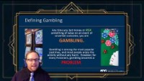
Lecture Video 2
Notes:
https://youtu.be/WuR7uV391b8
Lecture on the range of activities that fit into the definition of gambling **

Slide 30
Winning Phase
Gambles infrequently and socially
Losing Phase
Gambles alone
Desperation Phase
Reputation is affected
Hopelessness
Wins lead to more play and developing tolerance
Begins to fantasize about the opportunity of more gambling
Personality changes; (Irritable, restless, withdrawn)
Losing care about family and work
Losses are causing financial problems
Alienation from Friends/Family
Tolerance
Blame, Panic, and Relying on possibility of winning
The Progression
of
Gambling Problems
Suicidal Ideation
Arrests
Substance Abuse
Emotional Breakdown
(Robert L. Custer, MD & Harry Milt, 1985)
Notes:
***
Robert Custer and Harry Milt (1985) detailed the progression a problem gambling issue in the book “When Luck Runs Out). This book expands on the concept of a person going from a non-gambler to developing a severe gambling problem. These stages create a basic conceptualization used in the treatment of problem gambling in the form of stages.
The Winning Phase is the first stage, and it describes a person who is new to gambling. This type of gambler gambles in ways that appear infrequent and are also mostly social. If they win early, they may go on to expect a payoff more often when they perform this new recreational activity. Since their only experience includes winning, they will likely develop grandiose fantasies about what will happen if they gamble more and contribute more of their money. This leads to Tolerance in the form of the person increasing their bets, playing more often, and staying longer in search of the Big Win.
This leads to the second stage. This is known as the Losing Phase. In this phase, the gambler will gamble alone, and become increasingly preoccupied about gambling activities. They will begin to prioritize their play despite the risk of obvious consequences. Experiencing lengthy periods without winning will further serve to justify poor decision-making. These rash decisions can include losing time from work, missing the payments for bills, and making reckless financial choices. Essentially, gambling begins to affect the persons reputation, and brings negative changes to the forefront of their interactions with others unless their activities are conducted in secret.
By continuing to play without focusing on their psychological health in the process, the person can slip into the third stage, known as the Desperation Phase. In this phase, the gambler is focused on winning to overcome their problems. They will sacrifice their reputation in service of this goal. They have often alienated themselves from the people in their lives and are making dramatic decisions to avoid serious life altering problems. They begin to see gambling as the only solution to their problem. Even when they do win it is not enough. Since they are relying on “winning big” to get out of the financial hole, they begin to feel extreme levels of guilt and shame when they reflect on the damage they have caused and fear they cannot maintain the patterns of play they need to achieve this kind of win. When confronted by others, they often resort to lies, rationalizations, and blaming others, or agreeing to things as a ruse in order to receive a bailout or so they can continue playing by any means necessary.
The Hopelessness phase occurs when a gambler pushes their limits beyond the desperation stage and seems to have no resources left. This phase consists of what many in the addiction field call “hitting rock bottom.” This stage can lead the person to have suicidal ideation, getting arrested for activities related to their gambling, increases in consumption of alcohol and other substances, withdrawal symptoms forced on them by no longer having the means to gamble, and emotional breakdowns. The lack of trust from people in their social and family circles can often lead to severe alienation, lack of support, and even homelessness. This is where the deepest consequences occur and represents the lowest level of resources a gambler will have access to due to the desperation and internal hopelessness hitting at the same time.

Slide 31
Growth Phase
Rebuild Phase
Critical Phase
Hopelessness
New Way of Life
Insight & Awareness
Helpful to Others
Faces Problems
Self-Respect Returning
Improved Relationships
Repairing Financial Situation
New Interests and Life Goals
Problem Solving & Decision Making
Honest Desire for Help
Realistic Steps to Stop Gambling
The Progression
of
Gambling Recovery
Suicidal Ideation
Arrests
Substance Abuse
Emotional Breakdown
(Robert L. Custer, MD)
Notes:
***
The companion piece to the progression of problem gambling is the process of recovery. This is how a problem gambler moves out of the hopelessness in their problem and works to repair relationships and turn their life around.
Once the hopelessness of the problem becomes too much to manage, a person will identify ways to overcome their problem, accept support, and accept powerlessness related to gambling. The benefit of completing these steps is that the person learns to dedicate themselves to living a life without gambling. The Critical Phase includes the first steps in using this newfound resolve to grow and restore the value system that was lost in the heavier gambling stages. This critical phase is characterized by the person making solution-oriented decisions for each situation that suffered gambling consequences. They are working to have an honest desire for help others, and an understanding that steps taken to start recovery need to be realistic. They may begin to do things through a positive lens. Examples of this can include a rededication to work or family life, and this can lead to deeper understanding of their life away from gambling activity. The person becomes more familiar with healthy concepts like honesty, clarity, and concern for others, although it will take time to fully reflect some of these values as they develop over time.
After moving through the critical phase, the Rebuilding Phase allows the person to identify new interests, enhance their relationships with friends and family, and begin setting right the wrongs they created in their addiction. A defining feature of this stage is increases in awareness related to their own strengths and weaknesses with their addiction. The levels of success the problem gambler is having in recovery away from gambling leads to higher levels of self-respect, and richer interactions with others. They will attempt to repair gambling damages by paying bills, establishing a family budget, facing their legal problems, and experiencing less irritation and stress involved in the problems from the addiction.
The final stage of the recovery progression is known as the Growth Phase. In this phase, the person embraces a new way of life. They will aim to keep the insight and awareness they have built through this difficult process as a message for themselves and others. This person is also able to face problems promptly, and head-on, and is experiencing less pre-occupation related to their past gambling, and risk of relapse. The goal of this phase is to continue to grow as a person and stay strong in all efforts that support a gambling free lifestyle. They can live for themselves and others around them and can be willing to sacrifice or support others in many areas of life. Family relationships continue to grow, and the recovering person can show affection in ways that had been lost in the addiction.

Slide 32
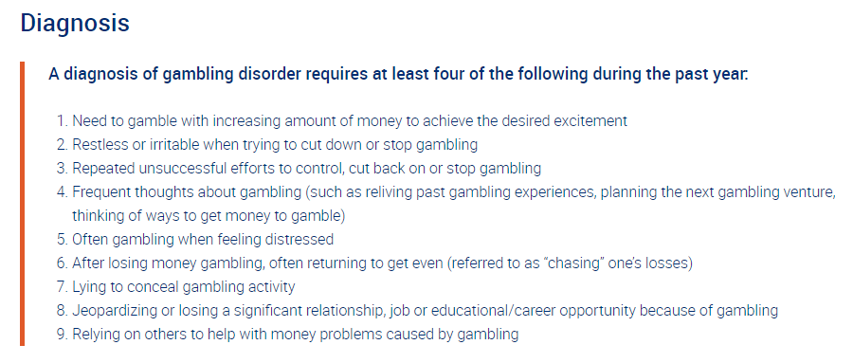
DSM-5: Defining Gambling Disorder
Notes:
The screenshot depicted in this slide is an overview of the diagnostic criteria we currently use to identify gambling disorder as defined in the DSM-V. This list of criteria includes tolerance, withdrawal, loss of control, preoccupation, escape, chasing, lying, risking significant relationships or opportunities, and bailout. This diagnostic listing no longer identifies illegal acts as a contributing factor to the diagnosis of gambling disorder. This is because illegal acts were often only admitted when a client was involved in legal consequences for their gambling which altered their frequency of correctly applying the criteria to many counseling cases.

Slide 33
Features Associated with Gambling Disorder
Distortions in Thinking
Personal Traits
Prone to Stress
Many individuals with Gambling Disorder believe that money is both the cause of and solution to all their problems.
They may be overly concerned with the approval of others and may be generous to the point of extravagance.
When not gambling, they may be workaholics or “binge” workers who wait until they are up against deadlines before really working hard.
Increased rates of Mood Disorders, Disorder, ADHD, Substance Abuse or Dependence, and Antisocial, Narcissistic, and Borderline Personality Disorders have been reported in individuals with Gambling Disorder.
Of individuals in treatment for Gambling Disorder, 20% are reported to have attempted suicide.
Highly competitive, energetic, restless, and easily bored.
(Rugle & Franklin, 2013)
Notes:
DSM-5 Associated Features: Distortions in thinking may be present in individuals with Gambling Disorder. Many individuals with Gambling Disorder believe that money is both the cause of and solution to all their problems.
Individuals with Gambling Disorder are frequently highly competitive, energetic, restless, and easily bored. They may be overly concerned with the approval of others and may be generous to the point of extravagance. When not gambling, they may be workaholics or “binge” workers who wait until they are up against deadlines before really working hard.
They may be prone to developing general medical conditions that are associated with Stress such as peptic ulcer disease, or migraines. Increased rates of Mood Disorders, Disorder, ADHD, Substance Abuse or Dependence, and Antisocial, Narcissistic, and Borderline Personality Disorders have been reported in individuals with Gambling Disorder. Of individuals in treatment for Gambling Disorder, 20% are reported to have attempted suicide.

Slide 34
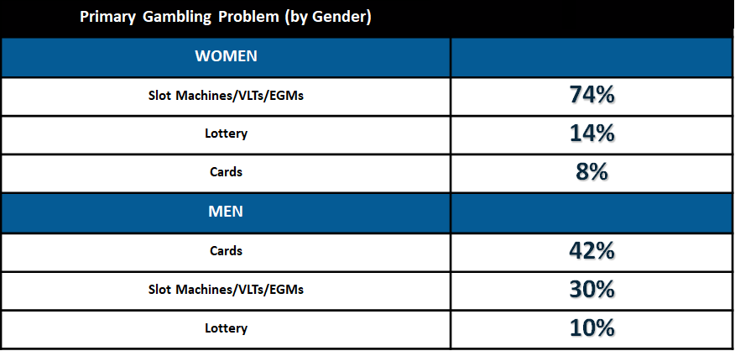
Primary Problem Gambling Issue (By Gender)
Florida Council on Compulsive Gambling (2013)
  Based upon 1,945 help calls regarding the caller’s primary gambling problem.
Notes:
The likelihood of certain gambling problems reaching a primary status in the mind of the individual often can relate to gender. For example, research conducted by the for the Council on compulsive gambling in 2013 surveyed helpline collars from their state and identified that women identified slot machines as their primary gambling problem 74% of the time which was met by men only at 30%. For men the highest primary gambling problem was attributed to cards. Likewise, cards only accounted for 8% of female helpline callers.

Slide 35
The Profile of Different Gambling Styles
More likely to wager on games of skill or the outcome of a sporting event
More likely to wager on games of chance
Action Gambling
Escape Gambling
Notes:
***
People who gamble may be broadly categorized as “action” or “escape” gamblers. Although this is a somewhat outdated approach to classification, it does highlight the importance of a helping professional understanding the motivation for of a gambler’s patterns of play and wagering decisions. Historically, action gamblers are more likely to be male, and will often wager on sports or games of skill such as poker, card games, and the outcomes of sporting events.
Females are more likely to participate in gambling as with the stance of an escape gambler. This style of play relies on using the game escape difficult or undesired emotions for a length of time. These games often consist of rapid engagement mixed with a component of chance. These games are found in the form of slot machines, but could be other activities such as the repetitive activity found in scratch-off lottery tickets.
These classifications are not evidence based and have been dropped from use in most current programming. Their only purpose is to help generate conversation and begin considering the motivation for playing a gambling game. An action gambler is interested in a progression and defeating the game or other players more so than an escape gambler would be. By contrast, the escape style of gambling is about mood modification and spending time in an activity to relieve tension or avoid the source of those tensions.

Slide 36

IN PROBLEM GAMBLING,
THE PERSON BELIEVES
THE PROBLEM IS THE
SOLUTION TO THEIR PROBLEM
Notes:
Finally, for gamblers, the solution to the problem is the problem. This means, in order to get out of the consequences of gambling, people often feel they need to gamble more, and win. This often leads to greater problems, but the person continues because this feels to them like the only logical solution.

Slide 37

Youth & Problem Gambling
Problem gambling for adolescents has several associated negative personal, familial, social, economic and health consequences
Prevalence rates in the U.S., Canada, Australia, New Zealand and the U.K. indicate about 80% of underage youth report gambling during the past year.
4-6% experience severe problems and 10-15% are at risk for the development of a severe gambling problem
Adolescent prevalence rates for problem gambling often appear greater than those of adults due to an unrealistic use of cut-off scores to categorize the gambling behavior across this population
Notes:
Youth gambling and problem gambling. Problem gambling for adolescents has several concomitant negative personal, familial, social, economic, and health consequences. Prevalence rates in the United States, Canada, Australia, New Zealand and the United Kingdom indicate about 80% of underage youth report gambling during the past year. 4 to 6% experienced severe problems and 10 to 15% are at risk for the development of a severe gambling problem. Adolescent prevalence rates for problem gambling often appear greater than those of adults due to an unrealistic use of cut-off scores to categorize the gambling behavior across this population.

Slide 38

Social Correlates for Youth Gambling
Adolescent problem gamblers report beginning gambling at earlier ages, about 10 years of age
Adolescent problem gamblers progress rapidly from social gamblers to problem gamblers, and report experiences of early gambling in the home and with family
Gambling is more popular among males, which leads to higher prevalence among male youth
Notes:
Adolescent problem gamblers report beginning gambling at earlier ages; about 10 years of age. They also progress rapidly from social gamblers to problem gamblers, and report experiences of early gambling in the home and with family. Gambling is more popular among males, which leads to higher prevalence among male youth.

Slide 39
Societal Influences on adolescent gambling
Video games
Advertisements
Gambling fund-raisers
Social acceptability
Increased venues
Internet gambling
Lack of Awareness
Parental modeling
Web TV
Attractive games
Notes:
Societal influences for youth that have shown to have some impact on the perception of gambling behaviors include: videogames, gambling fundraisers in schools and religious centers, social acceptability, increased venues, Internet gambling, powerful advertisements, lack of prevention and awareness, parental modeling, Web TV, and attractive games.

Slide 40
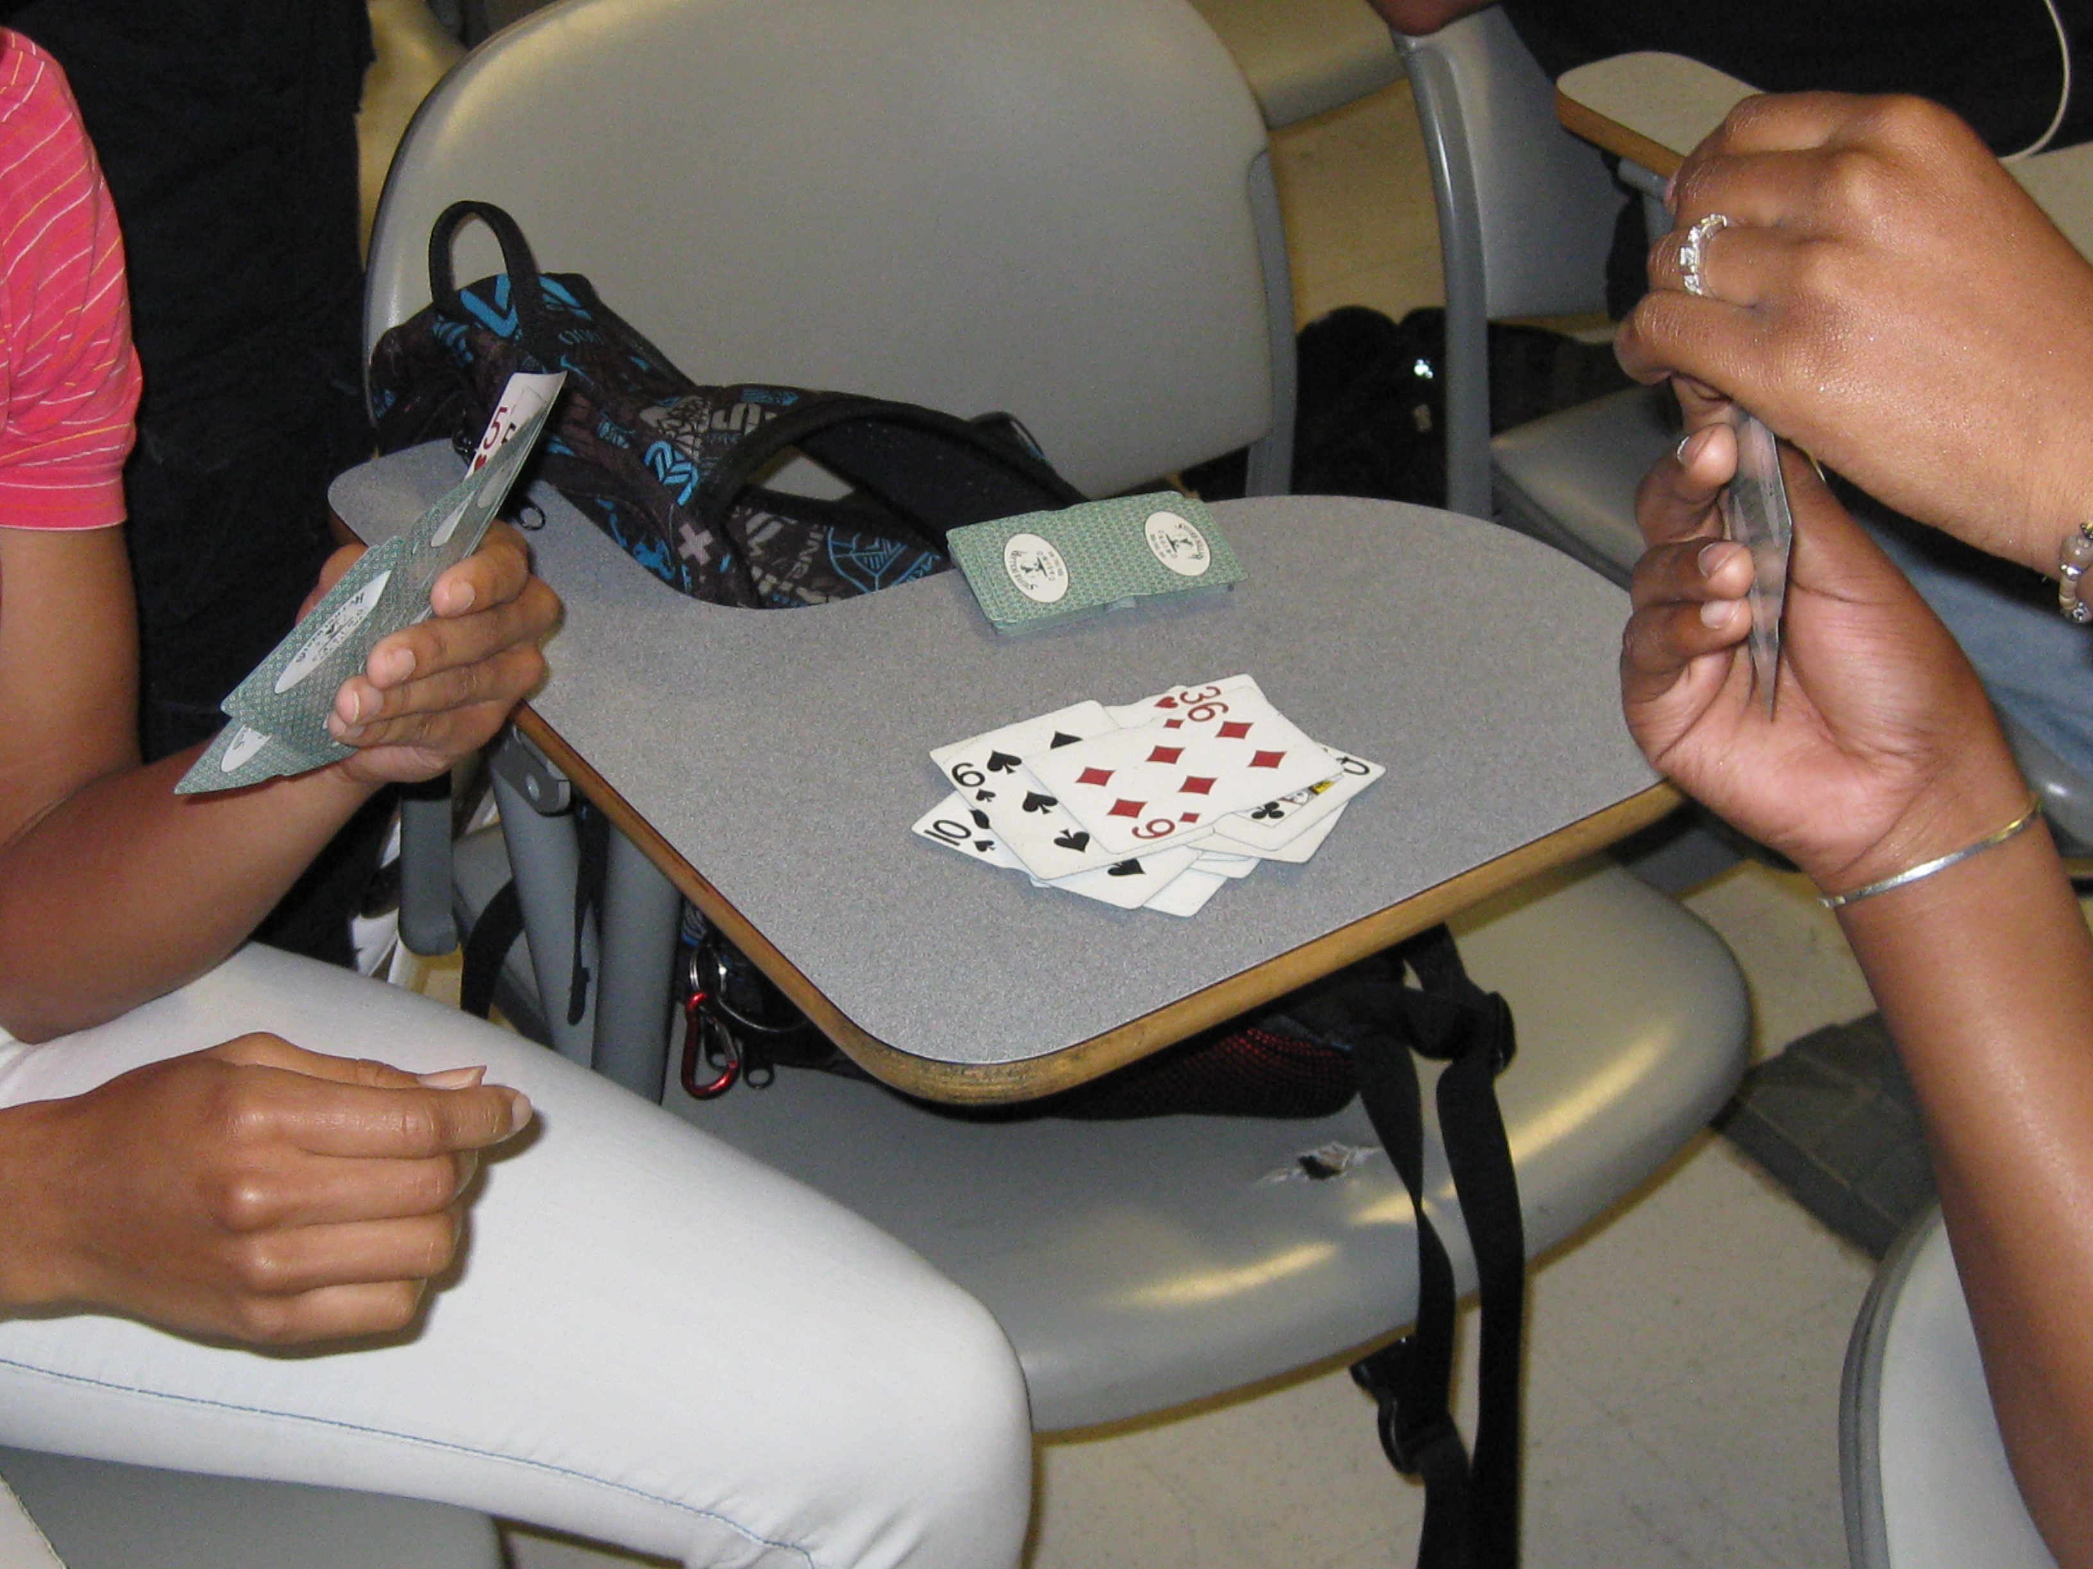
Youth Gambling Correlates
About 4.2% of 12-17 years old have an alcohol abuse problem
About 2.3% have an illicit drug abuse problem (NHS-DA 01)
Severe problem gambling rates are like or slightly less than those of alcohol and drug abuse rates among adolescent populations across current research
Notes:
About 4.2% of 12 to 17 years old report having an alcohol abuse problem. About 2.3% report having an illicit drug abuse problem. Severe problem gambling rates are like or slightly less than those of alcohol and drug abuse rates among adolescent populations across current research.

Slide 41

Problem Gambling Summary: Just the Facts
TERMS:
Problem Gambling: A descriptive term used to define those individuals with problems in their lives due to gambling.
Gambling Disorder (312.31): The clinical diagnosis for the problematic gambling behavior as defined by 9 diagnostic criteria listed in the DSM-5. This diagnosis is listed in the Non-Substance Related Addictive Disorder category.
Prevalence- estimates indicate that about 1-3% of the adult population in the U.S. has a serious gambling problem. This may be 3-5 million people. An additional 3% are at risk for developing a serious gambling problem.
Notes:
TERMS:
Problem Gambling is A descriptive term used to define those individuals with problems in their lives due to gambling.
Gambling Disorder (312.31) is The clinical diagnosis for the problematic gambling behavior as defined by 9 diagnostic criteria listed in the DSM-5. This diagnosis is listed in the Non-Substance Related Addictive Disorder category.
Current Prevalence estimates indicate that about 1-3% of the adult population in the U.S. has a serious gambling problem. This may be 3-5 million people. An additional 3% are at risk for developing a serious gambling problem.

Slide 42
Problem Gambling Summary: Just the Facts
Growing numbers of gambling problems among:
  Adolescents
  Older Adults
  Women
  People of Color
  Casino Employees
  Veterans
  Lower Income populations
  Those with lower educations (high school or less than high school) (Volberg 2000)
Notes:
There are a growing numbers of gambling problems found among: adolescents, older adults, women, multicultural populations, lower income populations, those with lower educations (high school or less than high school)

Slide 43

Suicide Attempt Rate: 15-27%
“Suicide attempts among pathological gamblers are higher than for any of the addictions and second only to suicide attempt rates among individuals with major affective disorders, schizophrenia and a few major hereditary disorders.”
Dr. Rachel A. Volberg
President of Gemini Research, Ltd.
Notes:
The suicide attempt rate for problem gamblers has been estimated to be at a rate of 15-27% depending on the study and categorization of terms and severity. Dr. Rachel Volberg, President of Gemini Research, Ltd.,
has stated “Suicide attempts among pathological gamblers are higher than for any of the addictions and second only to suicide attempt rates among individuals with major affective disorders, schizophrenia and a few major hereditary disorders.”

Slide 44
Problem Gambling 101
Thank you!
Public Awareness messages, Prevention messages and Program Evaluation are areas still being developed in the problem gambling field
Though recognized by the NFL, NCAA, MLB, the Gaming Industry, Several Unions and large Businesses - the U.S. has no coordinated or federally funded comprehensive leadership in addressing problem gambling
DPG is locally working to address these areas and mitigate the problem for individuals and families who are impacted by Problem Gambling through, Prevention Efforts, Community Outreach & Education, Treatment, & Self-Exclusion
For More information on Problem Gambling go to www.problemgambling.az.gov
Notes:
Public awareness messages, prevention messages and program evaluation are areas still being developed in the problem gambling field. Though recognized by the NFL, NCAA, MLB, the gaming industry, several unions and large businesses, the US has no coordinated or federally funded comprehensive leadership in addressing problem gambling.

