Slide 1
Module 8: Basic Gambling Training Wrap-Up
Dr. Daniel A Kaufmann
Ph.D., LPC, ICGC-II & BACC
Presentation Year 2020
Notes:
Welcome to session eight of problem and compulsive gambling training for mental health and addiction professionals: Basic Gambling Training Wrap-Up. The goal of this course is to increase clinicians' knowledge of problem and compulsive gambling, and to increase the number of professionals who are qualified to effectively treat gambling disorder. This course satisfies the training requirements for the international certification as a gambling addiction treatment professional.

Slide 2
Session 8 Topics
1. Ethical Codes & Professional Standards
2. Transference & Countertransference
3. Certification Processes
4. Course Wrap-Up
Notes:
By completing this module, participants should have increased knowledge in the following areas: Understanding counseling ethics and how these issues directly apply to problem gambling clients and families, Understanding potential transference or counter-transference issues in relation to working with problem gamblers, Developing a working knowledge of problem gambling resources, and understanding the requirements for international certification processes.

Slide 3
Supplemental Reading and Resources for this section includes:
Calado & Griffiths (2016) – Problem Gambling Worldwide:
Notes:
Supplemental Reading for this section includes:
Calado & Griffiths (2016) – Problem Gambling Worldwide: https://dpgtraining.az.gov/Portals/0/Resources/Calado%20&%20Griffiths%20(2016)%20-%20Problem%20Gambling%20W.pdf

Slide 4
Ethical Codes &
Professional Standards
Notes:
Ethical Codes & Professional Standards

Slide 5
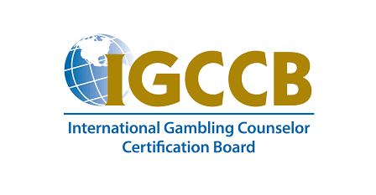
IGCCB Affirmations for Certified Counselors
THE CODE AND STANDARDS OF THE INTERNATIONAL GAMBLING COUNSELOR CERTIFICATION BOARD CONSISTS OF THE FOLLOWING
11 AFFIRMATIONS
Notes:
By participating in this training program, you are meeting all the continuing education requirements to pursue the International Certification requirements for Gambling Counselors. To complete your certification, you will be required to conduct your practice with clients according to the ethical standards of the International Gambling Counselor Certification Board. The code and standards of the International Gambling Counselor Certification Board consists of the following 11 affirmations:

Slide 6
IGCCB Affirmations for Certified Counselors
I
I SHALL SUPPORT ALL EFFORTS TOWARD A PRIMARY GOAL OF RECOVERY FOR CLIENTS AND FAMILIES.
Notes:
I shall support all efforts toward a primary goal of recovery for clients and families.

Slide 7
IGCCB Affirmations for Certified Counselors
II
I SHALL CONFORM TO ALL RULES AND REGULATIONS PERTAINING TO THE CONFIDENTIALITY OF ALL RECORDS, MATERIALS AND COMMUNICATIONS CONCERNING CLIENTS.
Notes:
I shall conform to all rules and regulations pertaining to the confidentiality of all records materials and communications concerning clients.

Slide 8
IGCCB Affirmations for Certified Counselors
III
I SHALL DEMONSTRATE RESPECT FOR CLIENTS BY MAINTAINING AN OBJECTIVE, NON-POSSESSIVE PROFESSIONAL RELATIONSHIP AT ALL TIMES.
Notes:
I shall demonstrate respect for clients by maintaining an objective, non-­‐possessive, professional relationship at all times.

Slide 9
IGCCB Affirmations for Certified Counselors
IV
I SHALL NOT DISCRIMINATE AMONG CLIENTS OR PROFESSIONALS ON THE BASIS OF RACE, COLOR, CREED, AGE, SEX, OR SEXUAL ORIENTATION.
Notes:
I shall not discriminate among clients or professionals on the basis of race, color, creed, age, sex, or sexual orientation.

Slide 10
IGCCB Affirmations for Certified Counselors
V
I SHALL RESPECT THE RIGHTS AND VIEWS OF OTHER GAMBLING COUNSELORS AND PROFESSIONALS.
Notes:
I shall respect the rights and views of other gambling counselors and professionals.

Slide 11
IGCCB Affirmations for Certified Counselors
VI
I SHALL RESPECT INSTITUTIONAL POLICIES AND WILL COOPERATE WITH MANAGEMENT FUNCTIONS.
Notes:
I shall respect institutional policies and will cooperate with management functions.

Slide 12
IGCCB Affirmations for Certified Counselors
VII
I SHALL MAINTAIN A GENUINE INTEREST IN HELPING PEOPLE WITH GAMBLING PROBLEMS AND WILL HELP THOSE AFFECTED TO HELP THEMSELVES.
Notes:
I shall maintain a genuine interest in helping people with gambling problems and will help those affected to help themselves.

Slide 13
IGCCB Affirmations for Certified Counselors
VIII
I SHALL ASSESS MY OWN PERSONAL AND VOCATIONAL STRENGTHS, LIMITATIONS AND BIASES. I WILL RECOGNIZE WHEN IT IS IN THE CLIENT’S BEST INTEREST TO REFER OR RELEASE HIM/HER TO ANOTHER COUNSELOR OR PROGRAM.
Notes:
I shall assess my own personal and vocational strengths, limitations, and biases. I will recognize when it is in the clients best interest to refer or release him or her to another counselor or program.

Slide 14
IGCCB Affirmations for Certified Counselors
IX
I SHALL TAKE RESPONSIBILITY FOR CONTINUED PROFESSIONAL GROWTH THROUGH FURTHER EDUCATION OR TRAINING.
Notes:
I shall take the responsibility for continued professional growth through further education or training.

Slide 15
IGCCB Affirmations for Certified Counselors
X
I COMMIT TO PROVIDING THE HIGHEST QUALITY OF CARE THROUGH BOTH PERSONAL EFFORT AND UTILIZATION OF ANY OTHER HEALTH PROFESSIONALS OR SERVICES WHICH MAY ASSIST THE CLIENT IN HIS/HER RECOVERY PLAN.
Notes:
I commit to providing the highest quality of care through both personal effort and utilization of any other health professionals or services which may assist the client in his or her recovery plan.

Slide 16
IGCCB Affirmations for Certified Counselors
XI
I DO NOT USE ALCOHOL, DRUGS, NOR GAMBLE IN A MANNER THAT WILL REFLECT ADVERSELY ON THE CREDIBILITY AND INTEGRITY OF THE PROFESSION.
Notes:
I do not use alcohol, drugs, nor gamble in a manner that will reflect adversely on the credibility and integrity of the profession.

Slide 17

Video Lecture 19: Professional Standards
Notes:
Provide a video review of ethical insights and the IGCCB affirmations
https://youtu.be/vwE9lCA4nis

Slide 18
Transference &
Counter-Transference
Notes:
Transference & Counter-Transference

Slide 19
Transference Issues
TRANSFERENCE IS THE EMOTIONAL REACTION A CLIENT MAY HAVE TOWARDS A THERAPIST
COUNTER-TRANSFERENCE IS THE CLINICIAN’S EMOTIONAL REACTION TO THE CLIENT
Client
Transference
Therapist
Counter-Transference
Rosenthal And Rugle
Notes:
Transference is the emotional reaction a client may have towards a therapist based on past experiences, memories, or even sub-conscious motives triggered by their interactions with them during treatment.
Counter-­transference is the clinician's emotional reaction to the client. It is always present, and if overlooked, leads to damaging interactions.

Slide 20
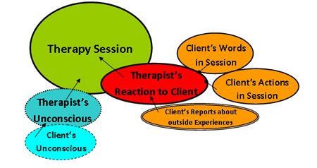
Transference & Countertransference
Transference
  The redirection of the client's feelings from a significant person in their life to their counselor and is mostly unconscious
Countertransference
  A counselor's feelings toward a client
  Depending on the counselor self-knowledge, experience may or may not be conscious
Notes:
As a working definition, Transference can also be considered The redirection of the client's feelings from a significant person in their life to their counselor and is mostly unconscious. Likewise, countertransference involves the counselor's feelings toward a client in a similar way. Depending on the counselor self-knowledge, experience may or may not be conscious.

Slide 21
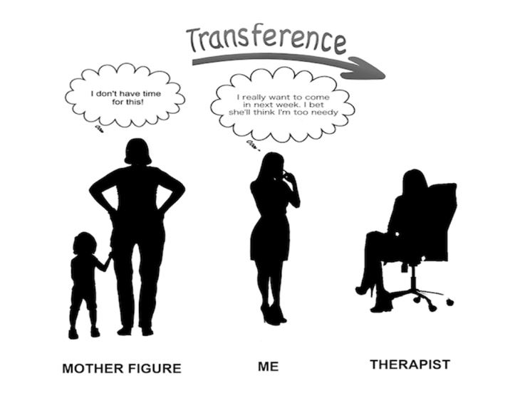
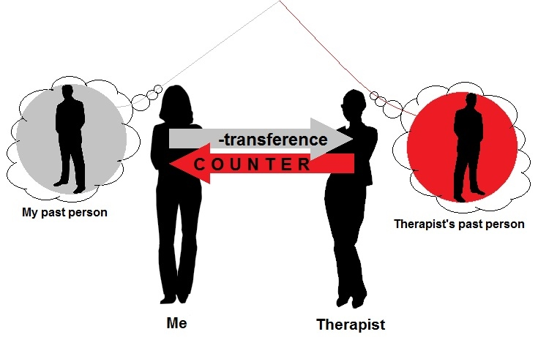
Examples of Transference Issues
Notes:
Transference occurs anytime a client interacts differently with their counselor in a way that does not match the way the relationship would be developing up to that point but is more of a reflection of the difficulties the client experiences in a different relationship. This could also reflect the client appreciating the counselor more than one would expect because of a separate positive relationship they have experienced.
Countertransference occurs when the feeling the counselor has towards their client is similarly unearned. This could be because of a past negative or positive interaction the client is making us re-experience that alters our interaction. It is important for counselors to notice these interactions early and remain aware of the ethical and decision-making implications this could lead to as treatment continues. Consultation and even referral could be warranted if the intensity of this counter-transference issue would result in a less than worthwhile counseling process.

Slide 22
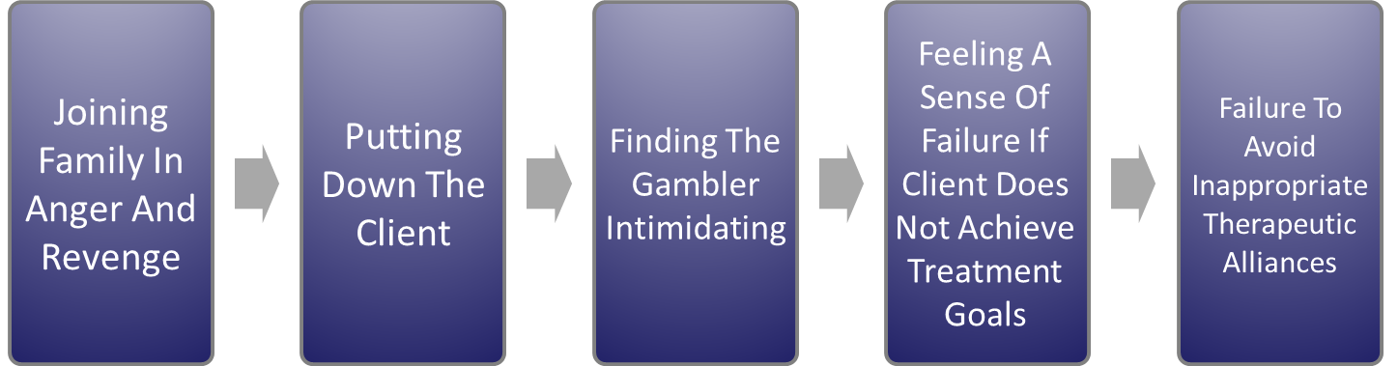
Counter-Transference Issues
COUNTER-TRANSFERENCE IS THE CLINICIAN’S EMOTIONAL REACTION TO THE CLIENT
Rosenthal And Rugle
Notes:
Counter-transference issues specific to problem gambling include:
Joining the family in anger or revenge, demonstrating superiority, or putting down the client, finding the gambler intimidating, feeling a sense of failure if the client does not achieve his or her treatment goals, and failure to avoid inappropriate therapeutic alliances

Slide 23

Counter-Transference with Gambling Disorder
COMMON POSITIVE COUNTER-TRANSFERENCE REACTIONS INCLUDE:
ENABLING AND THERAPEUTIC BAIL OUTS
  DOING TOO MUCH/REQUIRING TOO LITTLE
  NOT SETTING LIMITS
  PROTECTING GAMBLER FROM CONSEQUENCES/MAKING EXCUSES
COUNTER-TRANSFERENCE
TRANSFERENCE
Notes:
Common positive counter-transference reactions in work with gamblers can include enabling and therapeutic bailouts, doing too much/requiring too little, not setting limits, protecting gambler from consequences, or making excuses.

Slide 24
Counter-Transference with Gambling Disorder
COMMON POSITIVE COUNTER-TRANSFERENCE REACTIONS INCLUDE:
BEING IN ACTION WITH THE GAMBLER
VICARIOUS ACTING OUT, AMUSEMENT, OR SENSATION SEEKING
PLAYING THE “GURU” OR PORTRAYING THE SELF AS THE IDEAL
COUNTER-TRANSFERENCE
TRANSFERENCE
Notes:
Additional types of counter-transference behavior include being in action with the gambler, vicarious acting out, amusement or sensation seeking, playing the 'guru’ or PORTRAYING THE SELF AS THE IDEAL

Slide 25
Counter-Transference with Gambling Disorder
COMMON POSITIVE COUNTER-TRANSFERENCE REACTIONS INCLUDE:
HYPOMANIA AND POSITIVE COUNTER-TRANSFERENCE
  ENJOYING BEING ENTERTAINED
  RELIEF AT EASY SESSION
  SUPERFICIAL COMPLIANCE COVERING MORE SERIOUS PATHOLOGY/DISHONESTY
COUNTER-TRANSFERENCE
TRANSFERENCE
Notes:
There are a few more types to consider as well. Hypomania and the resulting behaviors can also trigger counter-transference from the clinician, as these behaviors will be projected from their outside behavior into their progress on treatment goals. The clinician enjoying the “entertaining” aspects of the gambler's situation raises questions into the purity of motivations in the direction of the session. If the therapist experiences relief after an “easy” session, or allows the appearance of superficial compliance when discussing more serious forms of pathology, or avoids processing the dishonesty of the client, these are all missed opportunities to be effective which originate in unchecked counter-transference attitudes in the clinician as they inform therapy

Slide 26
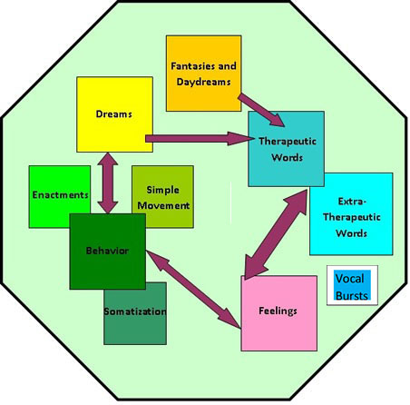
The Impact of Counter-Transference
Fear Of Emotional Indebtedness And Closeness
Dependency Issues
Maintaining Entitlement And Lack Of Responsibility
Maintaining Helplessness And Lack Of Efficacy
May Impair The Clinician’s Ability To Confront The Gambler With Discrepancies
Notes:
Positive counter-transference can have a range of unwanted ramifications on the efficacy of treatment. These consequences can commonly involve the client or the clinician experiencing the following: fear of emotional indebtedness and closeness, dependency issues, maintaining entitlement and lack of responsibility, maintaining helplessness and lack of efficacy, and it may impair the clinician’s ability to confront the gambler with discrepancies.

Slide 27

Common Negative Responses
COMMON NEGATIVE COUNTER-TRANSFERENCE REACTIONS INCLUDE:
FEARS OF BEING “CONNED” AND VULNERABILITY
FEARS OF GAMBLER’S DEPENDENCY
Notes:
Common negative counter-transference reactions in work with problem gamblers can include fear of being conned and vulnerability, and the clinician’s fear of the gambler’s dependency.

Slide 28
Common Negative Responses
COMMON NEGATIVE COUNTER-TRANSFERENCE REACTIONS INCLUDE:
REACTIONS TO SUPERIORITY, ENTITLEMENT, & AGGRESSION
  INTIMIDATION
  PUT DOWNS AND SPLITTING
  EFFECT ON TREATMENT TEAM
Notes:
Other forms of negative counter-transference can range from reactions to superiority, entitlement, and aggression, the use of intimidation, put downs and splitting, and negative effect on the treatment team.

Slide 29

Managing Counter-Transference
NORMAL PART OF THERAPEUTIC RELATIONSHIP
INSIGHT ISN’T ONLY FOR THE GAMBLER
ACKNOWLEDGE AND ACCEPT YOUR EMOTIONAL REACTIONS
DISCUSS WITH PEERS AND/OR SUPERVISOR
UTILIZE WITHIN THE THERAPY
IF SEVERE, REFER TO ANOTHER THERAPIST
MOTIVATIONAL ENHANCEMENT TECHNIQUES AND COUNTER-TRANSFERENCE
Notes:
It is important for counter-transference to be monitored and managed in order to provide effective treatment services as well as an opportunity for change and the desired progress in our clients’ lives. Counter-transference is a normal part of the therapeutic relationship. There are natural instances of the client and therapist holding a preconceived notion or belief that will affect their process of establishing a therapeutic rapport. These notions can allow us to build our level of insight to remain objective and effective as we would inform our clients to use their experiences as opportunity to grow. This insight is not only for the gambler or other forms of client. Throughout the therapeutic process, it is important to acknowledge and accept your emotional reactions, and discuss the reactions with peers, a supervisor, or other professional support to gain an objective perspective on where these feelings originate, and how to remain an effective mental health professional. These insights should be utilized throughout further work with this population to refine your ability to be a positive contributor to the direction of therapy. If the Counter-transference proves too severe for treatment to be effective, it is critical to refer the client to another therapist who may be better suited for the specific details in that client’s case. During the use of motivational enhancement techniques, it is also important to ensure that you are using your role as a counselor to objectively access the client’s level of motivation and interact without coercion or manipulation. This is a line every clinician working with gamblers will need to learn to identify and set appropriate limits.

Slide 30
Certification Processes
Notes:
Certification Processes

Slide 31
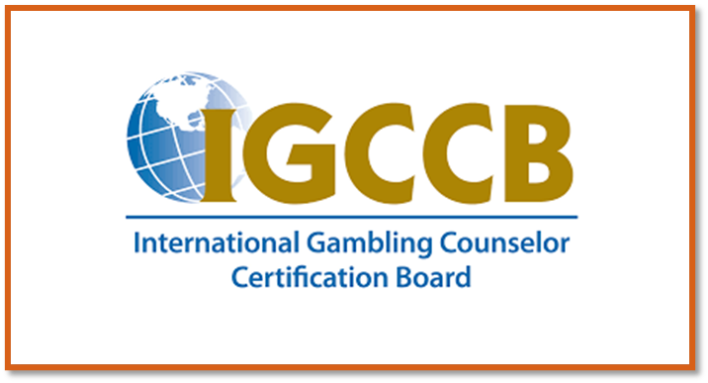
International Certification
PROCESS GOVERNED BY THE INTERNATIONAL GAMBLING COUNSELOR CERTIFICATION BOARD
The credentials are the
International Certified Gambling Counselor I or II
Two Levels of Certification (ICGC-I or ICGC-II)
Contact the IGCCB at www.IGCCB.org
Notes:
The processes for becoming certified are governed by the international gambling counselor certification board. The IGCCB has established the criteria for certification as an international certified gambling counselor level one or level two. Applications for certifications may be obtained online or by contacting the IGCCB at igccb.org.

Slide 32

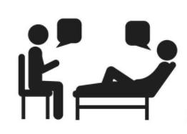
Educational Processes
Education/Training Hours
Bachelors Degree, or Equivalent, and/or license/certification in behavior health Field
Level I—30 hours- gambling specific
Level II—30 additional hours (total 60) -gambling specific
Supervision
Level I-100 Practice hours with minimum of 4 hours with BACC
Level II- 2000 Practice hours with 24 hours with BACC
Not limited to face-to-face contact
Notes:
The education and training requirements for certification are as follows: bachelors degree or equivalent and license or certification in behavior health field; 30 hours of gambling specific education and training are required for certification level I. Level II requires 30 additional hours for a total of 60 gambling specific education and training hours. The supervision requirements are 100 practice hours with a minimum of four hours with a board approved clinical consultant for level one. For level II 2000 practice hours with 24 hours with a board approved clinical consultant. Clinical consultation: board approved clinical consultant is not limited to face-­to-­face contact. Applications for certification may be obtained by contacting the International Gambling Counselor Certification Board.

Slide 33


Educational Processes
Continuing Education Requirements
  60 hours every 3 years
  30 hours (50%) - gambling specific
  30 hours (50%) – other continuing education
  MUST BE NON-REPETITIVE approved hours
Required Documentation
  2 letters from co-workers
  On-site clinical supervision verification
  Board approved clinical consultant (BACC) supervision
  Basic information Forms
Notes:
Applicants must also submit two reference letters from coworkers, verification of clinical supervision, and basic personal information. Once certified, continuing education requirements must be met in order to maintain proficiency and keep the credential.

Slide 34

The National Exam
Competency Requirements Include:
Basic Knowledge Of Problem Gambling And Gambling Disorder
Gambling Counseling Practice
Special Issues In Gambling Treatment
Professional Issues
Notes:
The content of the national exam includes the topics covered during the eight sessions of this training for mental health and addiction professionals. Basic knowledge of problem gambling and gambling disorder, gambling counseling practice, special issues in gambling treatment, and professional issues are all important areas covered in the national exam. Successful completion of this course is a significant step towards certification and succeeding on the national exam.

Slide 35


National Certification Testing
Exam Administered By Professional Testing Corporation
Contact www.ptcny.com For Additional Information
Application deadlines and testing dates can also be viewed online at https://ptcny.com/pdf/IGCCB.pdf
Notes:
The examination is administered by Professional Testing Corporation on behalf of the international gambling counselor certification board. Additional information on the national exam including content, online testing sites near you, fees, and testing schedule may be obtained by contacting the professional testing Corporation at www.PTCNY.com. Application deadlines and testing dates can also be viewed online at their website.
https://ptcny.com/pdf/IGCCB.pdf

Slide 36
Gambling Training
Course Wrap-Up
Notes:
Gambling Training Course Wrap-Up

Slide 37
Conceptualizing Gambling Behavior
Gambling is conceptualized on a continuum ranging from non-gambling, healthy gambling, and then problem gambling.
Healthy Gambling
Problem Gambling
Notes:
Remember, gambling occurs on a continuum, and it is your job as the counselor to work with your client to correctly define what the problems are in the client’s circumstances with their patterns of gambling behavior.

Slide 38
Defining Addiction
Addiction
Salience
Withdrawal
Tolerance
Conflict
Relapse
Mood Modification
“Historically, addiction has been understood in various ways—a sin, a disease, a bad habit—each a reflection of a variety of social, cultural, and scientific conceptions.”
(Hammer et al., 2012, p. 713)
Notes:
Addiction can be defined in many ways, but regardless of the addictive activity, there are certain factors which counselors can come to recognize in their clients as potentially risky or concerning. Components of addiction affect the reward pathways and coping behaviors in the client in much the same way in gambling as with other addictions.

Slide 39
Defining Gambling
Any time you bet money or RISK something of value on an event of uncertain outcome, you are
GAMBLING.
Gambling is among the most popular pastimes, and most people enjoy the activity without any harm. However, for many Arizonans, gambling becomes a
PROBLEM.
Notes:
Any time you bet money or RISK something of value on an event of uncertain outcome, you are
GAMBLING.
Gambling is among the most popular pastimes, and most people enjoy the activity without any harm. However, for many Arizonans, gambling becomes a
PROBLEM.

Slide 40





The Continuum of Gambling Activity
No Gambling
Casual / Social Gambling
Serious Social Gambling
Problem Gambling
Compulsive / Pathological Gambling
Notes:
The more people turn to gambling, and the more isolating the behavior becomes, the higher risk they are exposing themselves to in their patterns of activity. This goes all the way from a healthy, mostly social gambling pattern to being a diagnosable concern as indicated in clinical instruments such as those described in the DSM-5.

Slide 41




Notes:
There are many types of gambling, and as gaming technologies continue to develop, the way it looks to gamble will continue to transform as well. As a gambling counselor, it is our duty to keep up with the times and understand the problems we are specialized to treat in our clients.

Slide 42
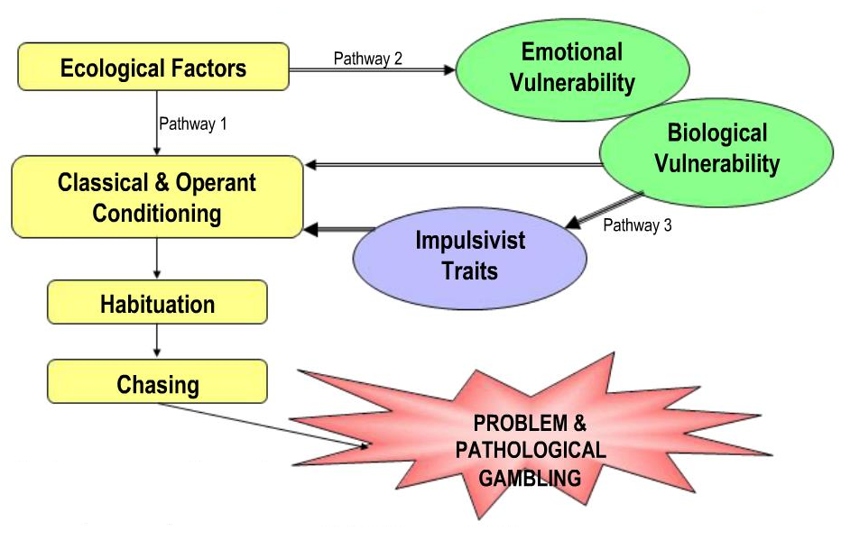
The Pathway Model of Problem Gambling
Resource:
“Overcoming Compulsive Gambling: A Self-help Guide Using Cognitive Behavioral Techniques.”
Alex Blaszczynski 1998
Notes:
Understanding how our clients arrived at the point where they require treatment services can be the first step on the path to a successful treatment process. Not every client experiences their gambling in the same way, and gambling does not meet everyone’s needs in the same way either. Understanding why they started and then continued for their time of involvement leading up to the treatment decision can be a great asset to building rapport and effectively understanding the client’s perception of their own story.

Slide 43
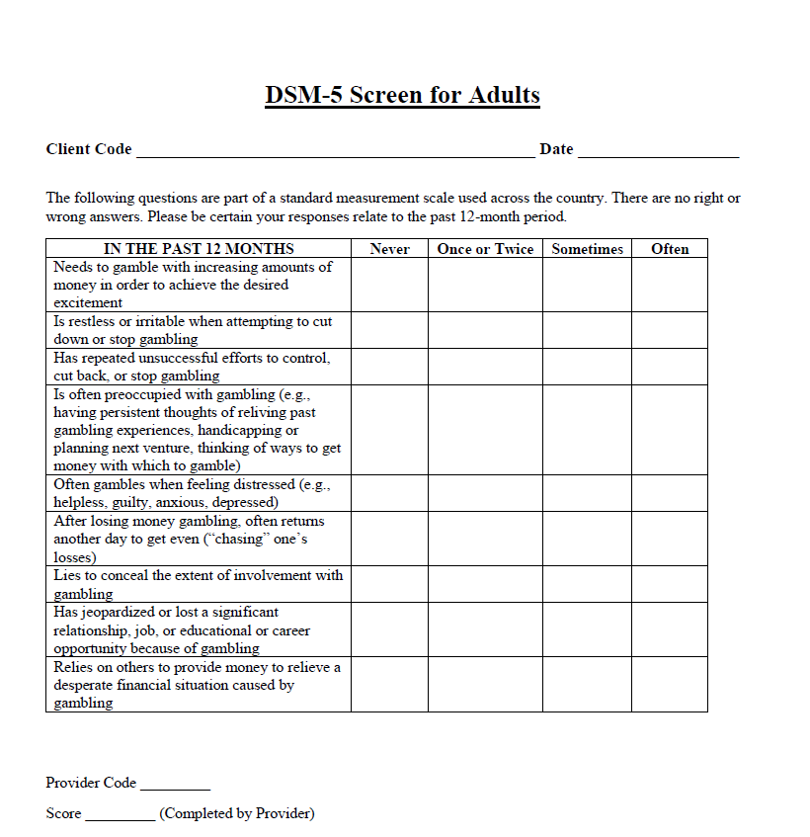
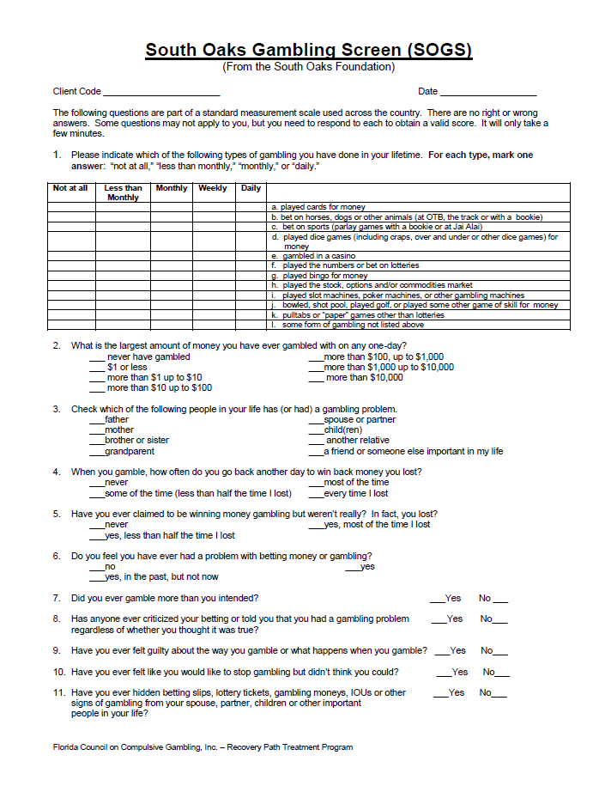
Common Screening Instruments
South Oaks Gambling Screen
South Oaks Gambling Screen – Revised Adolescents
NORC Diagnostic Screen
Notes:
Be familiar with the screening and assessment tools you choose to utilize as a clinician. Know what information they give you, and then develop a style for adding the conversations you need to fully understand your client and their gambling severity.

Slide 44
Psychiatric Comorbidity with Diagnosed Gambling Disorder
Affect
Disorders
~33-76%
~9-40%
Anxiety
Disorders
~5-30%
Trauma
Gambling
Disorder
Attention Deficit
Disorder
Substance Use
Disorders
~25-63%
Personality
Disorders
~20-40%
40-93%
Notes:
Remember, gambling disorder shares comorbidity considerations with many other psychological disorders. It is important not to develop clinical tunnel vision and over-respond to the gambling behavior. The choice to gamble may be a symptom of many other multifaceted experiences within the lives of your clients. Make sure you are taking the time to see your client as a holistic being and not just a gambler who needs to stop.

Slide 45




Comorbidity as a Risk or Consequence?
Psychiatric disorders may be
Risk Factors
for the development of a
gambling problem
But could also be the
Consequence
of a gambling problem.
Notes:
Gambling is not just a problematic behavior. There are risk factors involved that lead to developing a gambling problem over time. Knowing what problems are symptoms and which problems have a causal role in the client’s difficulties can be the difference between a stagnant treatment process and productive treatment process.

Slide 46

Major Couples Treatment Issues
Couples Work
Multiple addictions
Finances
Power and Control
Anger
Sexuality
Emotional Intimacy
Notes:
Couples work can be complicated with gambling. On the one hand, the gambling treatment goals do require a shift in the dynamic from the gambling partner to the non-gambling (or non-problem-gambling) partner. On the other hand, gambling could a be a coping mechanism for some difficult systemic realities. It is often important to address both during treatment to help the gambling partner to stay safe from relapse tendencies. This is often a surprise to the other partner, but the best strategy is to empower both sides of the relationship to have goals related to the recovery of the family from the pervasiveness of this problem.

Slide 47
Suicide Risk
Anxiety
Mood Disorders
Trauma
Family History
Substance Abuse
Personality Disorders
Prior Attempts
Severity of Consequences
Notes:
Suicide risk is high when treating problem gamblers. Without financial security and losing freedom that comes from a functioning bank account, it can be easy to slip into despair with a gambling problem. Be aware of your strategies for assessing clients for suicidal or homicidal ideation. All the factors for making a suicide attempt are similar as with other comorbid issues across the treatment spectrum. Do not hesitate to have these important conversations with your gambling clients. It can save lives to make every one of these risk factors safe topics in the therapy room.

Slide 48
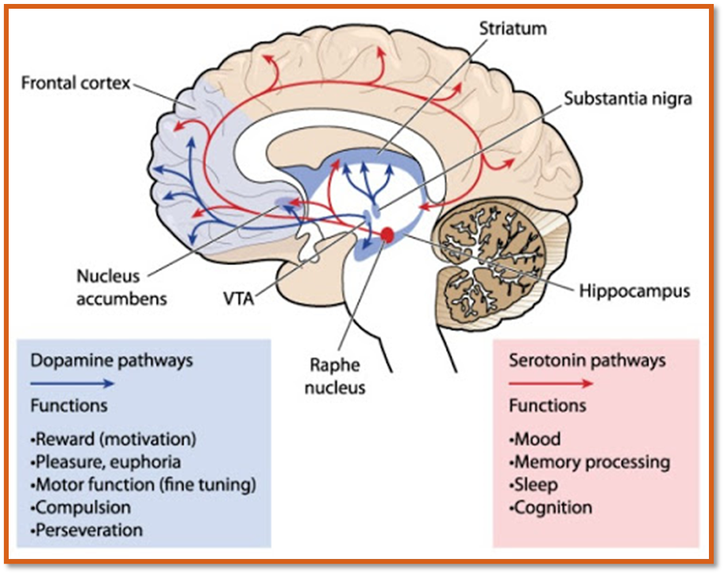
Notes:
It can also be helpful to talk with your clients at appropriate times about the role of the brain in their experience of reward, temptation, and other sensations related to their gambling experience. Many gamblers may see themselves as defective because they cannot get away from their gambling behavior when their brain is seeking a reward which is what it was programmed to do. This can be a turning point for the gambler to be able to understand themselves and make better decisions over time. You will want to share this information at a level that the client is able to understand, but this helps the gambler to see this is a medical issue and that the counseling sessions are similar to going to the doctor for an illness.

Slide 49

Integrating with Self-Help
You should be able as a gambling counselor to . . .
Describe Gamblers Anonymous (GA) and its’ program
List three (3) differences between Alcoholics Anonymous (AA) and GA
Explain the thought processes of problem gamblers
Notes:
Encourage your client to use support group meetings. These are free resources and connect the client with other people who have similar goals like not gambling and making amends with family and friends that may have been wrong during the patterns of gambling activity. Is important for the client to experience changes in a positive way to the people places and things they surround themselves with. If the meeting is being run correctly, gamblers anonymous is a great supplement to the treatment process. Many clients will continue going to meetings long after their counseling processes ended which makes this a positive lifelong change. Some clients may be able to achieve many of their goals simply by attending gamblers anonymous without the need of paying for counseling services. Resources such as this can be invaluable for the client be empowered to turn their life around.

Slide 50
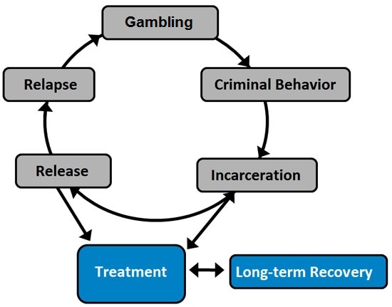
Therapeutic Justice System
Notre Dame Law Review (1999)
Court as a proactive agent of change
Intervene in cycle of criminal behavior
Rehabilitation and reduction of recidivism as a judicial goal
Notes:
Your clients may often be coming to counseling as a requirement for their probation and other legal requirements for atoning from their gambling behavior. Is important for the counselor to understand what kinds of scheduled client requires for different kinds of supportive services. This can include support groups, group therapy appointments, individual sessions, and sometimes family counseling. Understanding what the charges were and what kind of behaviors the client was engaging in can help to form an effective treatment plan. Make sure is a clinician that you request the proper things from this kind of client because this is a way for treatment to help the client to make amends, improve their lives, and avoid incarceration while acquiring the skills to put together a long-term recovery process.

Slide 51

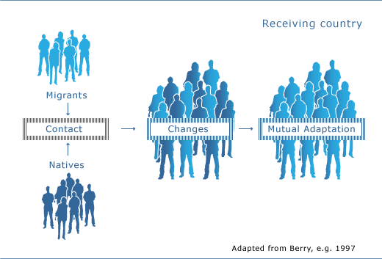
Understanding Client Demographics
Notes:
Knowing which demographics are affected by gambling and how can be a helpful tool in getting to understand your client better. Not all cultures are likely to gamble in the same way, and this is true about age groups and genders as well. Again, remember the purpose of the gambling behavior from the perspective of your client. If you see your client as a holistic being and take the time to let them tell you the ins and outs of their gambling behavior is more possible to achieve cultural humility and make a strong connection with your gambling client.

Slide 52



Spirituality and Treatment Integration
Spiritual and religious paths to well-being can be beneficial
Notes:
Spirituality and religion are not the same thing. In terms of using these as a treatment concept, client struggling with addiction issues often find effective uses for the concept of the higher power or God. From a conceptual perspective, these beliefs give a person purpose and can be the turning point between deciding to gamble and deciding that there are better things a person is called to then gambling. Several counseling theories such as acceptance commitment therapy and mindfulness techniques share similarities with support group elements like the serenity prayer and being able to accept the things in our life we cannot change. These simple concepts can be effective tools for a client to work on implementing as they go weekend and week out to their counseling sessions.

Slide 53
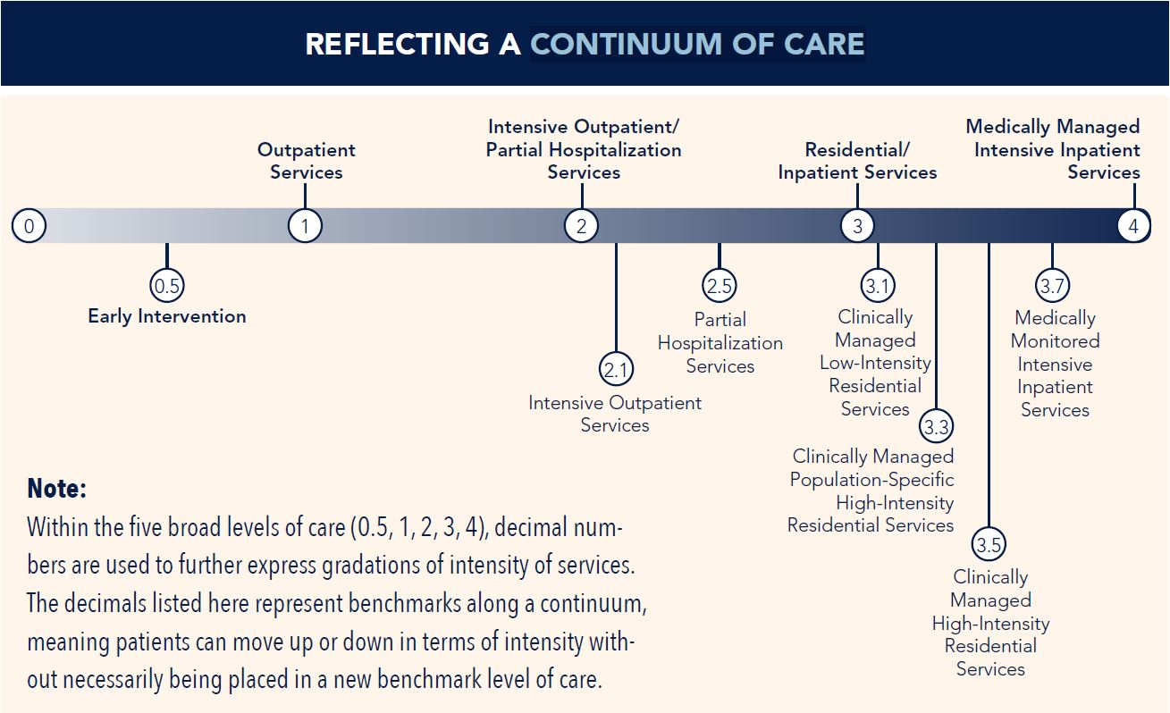
American Society of Addiction Medicine
Notes:
Although traditionally when counseling is discussed many people may think of the outpatient treatment model ( or they may default to their place of work such as a residential treatment facility ) gambling can affect the person in deep ways and required different approaches to counseling based on the individual. The ASAM continuum of care is one way of understanding the different levels a person can attend treatment. Make sure you understand your level of care that you are offering people, whether it would be outpatient, intensive outpatient, residential, or otherwise. Make sure you understand how to identify the client’s goodness of fit with that current modality, and then what a gambling issue would look like that requires a higher level and a lower level of treatment involvement. Is important for our clients to utilize the correct level of care.

Slide 54
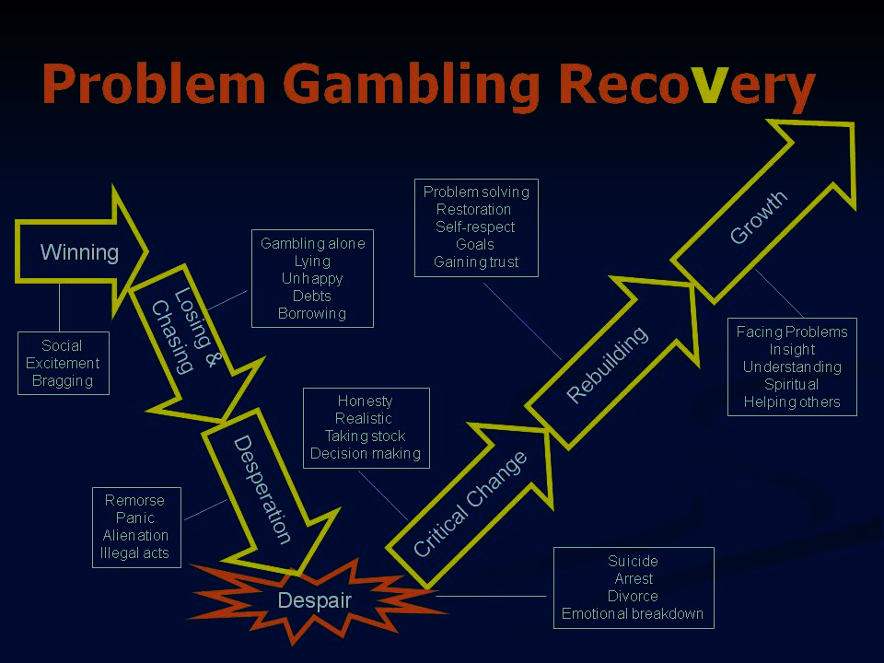
Listing the Relapse Triggers
Events
Advertising
Financial pressure
Availability
Friends gambling
Large jackpot
Hearing of a win
Near miss
Gambling and winning
Having money
Too much debt
Accused of gambling
Thoughts
Picturing winning
“My only chance”
“This time I’ll do it right.”
“If I win, I’ll be happy.”
Magical thinking
“It’s my destiny.”
“I’ll only bet a little.”
“I deserve some fun.”
“There’s no other way I can pay what I owe.”
“I’ll put the money back when I win.”
Feelings
Anger
Irritation
Boredom
Desperation
Hopelessness
Happiness
Envy
Disappointment
Fatigue
Depression
Intoxication
Loneliness
Spitefulness
Feeling “on top of the world”
Notes:
The discussion about relapse is an expected part of the treatment process with problem gamblers. It Is likely that every client will experience a slipper of full relapse at some point in their treatment process. Educating the client to understand himself in high-risk situations and to effectively identify their seemingly irrelevant decisions can be a positive turning point over time in the life of the problem gambler seeking recovery. These risky situations occur in the form of events thoughts and feelings, in the treatment process can be instrumental in encouraging the client to be accountable for what they put into these facets of their day-to-day experience. Sometimes things happen but other times we can encourage a person to work with the things that are under their locus of control for a more positive effect. Avoiding clear risk for relapse is part of learning what will be successful in the treatment process.

Slide 55
International Certification
PROCESS GOVERNED BY THE INTERNATIONAL GAMBLING COUNSELOR CERTIFICATION BOARD
The credentials are the
International Certified Gambling Counselor I or II
Two Levels of Certification (ICGC-I or ICGC-II)
Contact the IGCCB at www.IGCCB.org
Testing info can be found at www.ptcny.com
Notes:
By completing this training, you’re well on your way to becoming an internationally certified gambling counselor. Congratulations on making it to the end of this training. Information for testing and identifying your BACC for the clinical consultation hours can be found on the IGCCB website. Is important to lend our expertise to our clients in areas that we have a passion for treating.
Applications for certifications may be obtained online or by contacting the IGCCB at igccb.org. information related to the national exam can be found at www.ptcny.com .

Slide 56

Video Lecture 20: Gambling Counselor Test Review
Notes:
Review the overarching topics from each module and give the viewers a send-off.
https://youtu.be/sESdX_ufgYo

Slide 57

For Your Participation
From the Arizona Division of Problem Gambling
Notes:
On behalf of the Arizona division of problem gambling, thank you for your participation in this training. Congratulations on completing all eight modules. We wish you a pleasant experience with the rest of your certification process.

