Slide 1
Module 7: Application of Treatment Concepts
Dr. Daniel A Kaufmann
Ph.D., LPC, ICGC-II & BACC
Presentation Year 2020
Notes:
Welcome to session seven of problem and compulsive gambling training for mental health and addiction professionals: Treatment Skills and Design. The goal of this course is to increase clinicians' knowledge of problem and compulsive gambling, and to increase the number of professionals who are qualified to effectively treat gambling disorder. This course satisfies the training requirements for national and state certification as a gambling addiction treatment professional.

Slide 2
Session 7 Topics
1. Levels of Care
2. Beliefs About Gambling
3. Workplace Gambling Issues
4. Relapse Prevention
Notes:
The topics for this module will explore a range of unique topics influencing the course and design of treatment interventions. These will include levels of care in problem gambling, irrational beliefs a gambler may hold at the point of entering treatment, signs of gambling in the workplace, and relapse prevention strategies and interventions.

Slide 3
Levels of Care
Notes:
The following section will review Levels of Care in problem gambling

Slide 4
American Society of Addiction Medicine
Notes:
Levels of Care can be used to create a conceptualization of how gambling issues affect the problem gambling client in different ways requiring suitable treatment approaches for the uniqueness of the addiction severity. Within these broad levels of service is a range of specific levels of care. In addition, the functional deficits of the gambler must be considered in making determinations regarding appropriate levels of care. In general, decisions regarding levels of care should focus on what clients need, not what a specific program offers. It is also recommended that the counselor review state definitions of uniform placement criteria to ensure compliance with licensing and or reimbursement requirements.

Slide 5
Levels of Care in Gambling Treatment
Early Intervention
NO PRIOR TREATMENT
Outpatient Services
LOW LETHALITY
Intensive Outpatient
LOW TO MODERATE LETHALITY
LOW GAMBLING SEVERITY
MINIMAL CO-OCCURRING DISORDERS
GOOD ENVIRONMENTAL SUPPORTS
LOW/MODERATE RELAPSE RISK
VARIED STAGE OF CHANGE
SHORT TREATMENT HX
MINIMAL CO-OCCURRING DISORDERS
ADEQUATE RECOVERY ENVIRONMENT/SUPPORTS
MODERATE RELAPSE RISK
HIGHER MOTIVATION
INCLUDES TREATMENT HX
MODERATE GAMBLING SEVERITY
MODERATE CO-OCCURRING DISORDERS
LOWER RECOVERY SUPPORTS
INCREASED RELAPSE RISK
DEVELOPING MOTIVATION
From the work of L. Rugle PhD.
Notes:
Once it has been determined that a client is appropriate for participation in a gambling treatment program, it is important to determine the intensity of intervention and level of care that is necessary. Click each marker to review a description of the corresponding level of care. You can also view all slide information by clicking the next slide button at the top of the screen.
Early intervention might include no more than feedback on the results of the initial gambling screening and assessment and recommendations for attendance of self-­help groups such as Gamblers Anonymous.
Psycho-education may also include information on the differences between low and high-risk gambling, strategies for reducing the harmful consequences of gambling, and identifying the warning signs of gambling addiction. This type of intervention can be useful for individuals who have been pre-contemplative about their gambling behaviors and if they have a connection with their current life stressors and are not currently motivated for more intense levels of care.
Outpatient treatment is considered less than nine hours of treatment per week. Generally, this involves one to two individual, family, or group sessions per week. This form of treatment is recommended for people who have low to moderate gambling severity and will benefit from a form of treatment that can coincide with their current routine in the form of weekly or semi-weekly therapy sessions.
Intensive outpatient programs, or IOP’s, are considered to include nine or more hours of treatment programming per week, are generally offered in a group context, and may or may not include individual and/or family sessions. This level of care is indicated for persons with a history of treatment failure at lower levels, moderate to high severity to their gambling behavior, and a high risk of repetitive relapse if their current routine is not modified with an array of useful, relapse preventative events.

Slide 6
Levels of Care in Gambling Treatment
Residential Treatment
HIGH LETHALITY
MODERATE LETHALITY
Inpatient Treatment
PRIOR TREATMENT HX
SEVERE GAMBLING PROBLEMS
SIGNIFICANT COMORBIDITY
POOR RECOVERY SUPPORTS
VARIED MOTIVATION
FAILURE AT LOWER LEVELS
UNSTABLE / COMORBIDITY
HIGH RELAPSE RISK
NEED FOR SECURE RECOVERY ENVIRONMENT
VARIABLE MOTIVATION
From the work of L. Rugle PhD.
Notes:
Consider residential treatment for clients with moderate to severe gambling problems, moderate to serious comorbidity, few recovery supports, histories of treatment failure at lower levels, and moderate to high risk of relapse. Though an expensive alternative, residential treatment may be the only option for clients who lack access to outpatient treatment. Some of the benefits to this level of care include supervision in a controlled environment, exposure to a structured, gambling-free routine, and the ability to initiate abstinence in an environment away from the stressors that have served to preserve the high level of gambling severity.
Inpatient treatment may be indicated for when acute intoxication or withdrawal potential exists, and in cases where biomedical conditions and obligations require medical management. Other factors to consider are emotional, behavioral, or cognitive conditions and complications, readiness to change, relapse risk, and the need for a secure recovery environment.

Slide 7
Video Lecture 17: Patient Placement Criteria
Notes:
Lecture on GPPC and Levels of Care
https://youtu.be/_vs7jDtLdRc

Slide 8
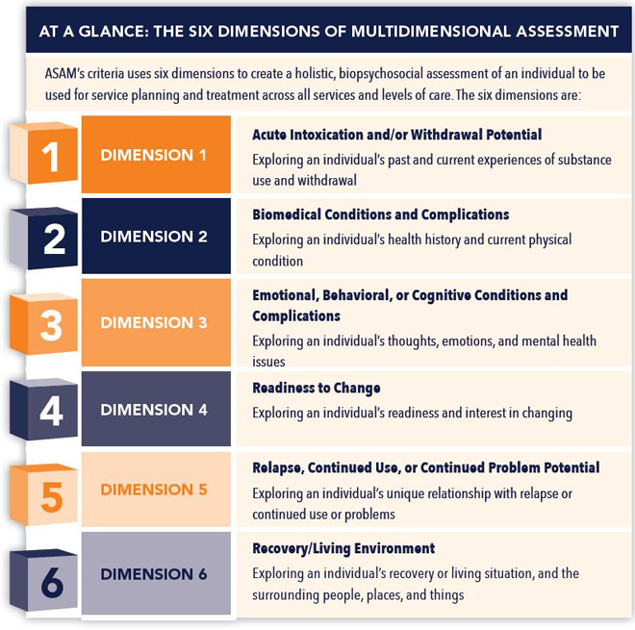
Therapeutic Decisions
Levels of care are intensities along a treatment continuum
Counselors need to consider the least restrictive and most appropriate level of care for each client. Therapeutic options along the continuum are summarized on the next slides…
American Society of Addiction Medicine
Notes:
Levels of care are intensities for the clients’ treatment experience along a treatment continuum. Counselors need to consider the least restrictive and most appropriate level of care for each client. Therapeutic options along the continuum occur in a range from low intrusiveness options like outpatient therapy to more severe options such as residential treatment. Clinicians can use the six ASAM dimensions in order to understand the conceptualization of this appropriate style of treatment for each individual client.
Dimension one relates to the withdrawal potential of the client. This dimension is often used in relation to substance use disorders and is critical not overlook because it relates to client safety. In gambling withdrawal functions in quite a different way. This dimension has a different degree of importance as a result. It is important to consider withdrawal potential and preoccupations with your gambling client, but not for the same reasons.
Dimension 2 is similarly different for gamblers as dimension one is. This relates to biomedical conditions and complications found in the individual’s health history and their current physical condition. Gambling does result in increased reactions in the reward mechanisms of the brain, and so has a different style of impact on an individual than other medical concerns which would be reviewed in a different way for substance use issues.
Dimension three is largely similar between substance use clients and gambling clients. This dimension relates to the individual’s thoughts emotions and mental health issues.
Dimension four relates to the individual’s readiness for change. This connects with the stages of change model found in motivational interviewing as first described by Prochaska and DiClemente.
Dimension five relates to relapse and continued use of the problem activity. This explores the individual’s unique relationship with relapse or continued use or problems related to their continued gambling activity.
Dimension 6 refers to the gamblers surrounding environment in the way that it affects their living situation, surrounding people, places, and things.
As you can see, it can be beneficial to understand the similarities and differences between substance use issues and gambling in order to utilize language already familiar in the treatment of other addiction issues with your problem gambling clients.

Slide 9
Levels and Interventions
Levels
Outpatient
Intensive Outpatient
Residential
Inpatient
Modalities
Individual
Family/couples
Group psychotherapy
Gender specific groups
Peer counseling
Interventions
Brief Feedback & Education
Psychoeducation
Cognitive Behavioral Therapies
12 Step Facilitation
Addressing Financial Issues
Motivational Enhancement
Family Education & Counseling
Workbooks/Journaling
Psychodynamic Therapy
Notes:
Any form of therapy can incorporate appropriate modalities, which are the types of sessions used to coordinate and facilitate treatment goals and objectives. These types of sessions can be individual, group, family, and other demographic specific types as deemed necessary by the clinician and their client base. Appropriate interventions rely on the clinicians’ theoretical orientation, their ability to apply effective counseling methods to the specific competencies in the treatment of gambling disorder, and the levels of comfort and motivation in the client to faithfully utilize recommended materials and referrals over the course of treatment.

Slide 10
Key Elements to Treatment Decisions
ASSESS FOR PSYCHIATRIC COMORBIDITY AS WELL AS CLIENT STRENGTHS AND LIMITATIONS
Notes:
The first key element in establishing a treatment process for a gambling client is to assess for psychiatric comorbidity, as well as client strengths and limitations which can impact and be utilized throughout therapy.

Slide 11
Key Elements to Treatment Decisions
EDUCATE THE GAMBLER ABOUT THE DISORDER
Notes:
The next key element is to educate the gambler about the disorder. This allows the client to build an objective awareness of how their behavior has become part of an addictive cycle, and will greatly enhance their ability to change their behavior and begin noticing their own internal processes which have played into their reliance on gambling to meet certain psychological or emotional needs.

Slide 12
Key Elements to Treatment Decisions
INCLUDE FINANCIAL RESTRUCTURING AND DEBT REPAYMENT
Notes:
An essential aspect of treatment for gambling disorder is to include financial restructuring and debt repayment as often in the process as possible. Finances are a uniquely prominent feature of treatment for gambling, and the use of and beliefs about money are an essential concept to visit if treatment is to be successful.

Slide 13
CONSIDER MOST HELPFUL APPROACHES
ABSTINENCE VS HARM REDUCTION
(Subramaniam et al. 2017)
Notes:
Consider what type of approach will be most helpful for the client, whether it will be abstinence or a harm reduction model. Factors to consider include the severity of consequences, client financial and other resources, and the way gambling is affecting their functioning at present severity, versus lower severities the client may not have the education, coping ability, or financial skills to utilize.

Slide 14
Key Elements to Treatment Decisions
IF APPROPRIATE…
EMPHASIZE SOCIALIZATION TO GAMBLERS ANONYMOUS OR OTHER SUPPORT GROUPS
Notes:
If appropriate, emphasize socialization to Gamblers Anonymous or other support groups. This may not be an effective referral for every client but can significantly increase the sense of support some people find essential in maintaining change over an addictive process. As a free resource, with many other offerings covered in previous modules such as sponsorship and financial groups, this can be a long-term support option for clients willing to integrate support group participation into their treatment approach.

Slide 15
Key Elements to Treatment Decisions
ELICIT GAMBLER’S MOTIVATION TO CHANGE
ANTICIPATE BARRIERS TO RECOVERY
Notes:
Another key element in clinical work with addiction is to elicit the client’s motivation for change. The client will present certain demeanor and willingness to implement strategies discussed during counseling sessions. It is important to accurately read the level of openness your client is showing to certain topics and behaviors and anticipate barriers to their recovery so they can be addressed at critical points in your sessions with them.

Slide 16
Key Elements to Treatment Decisions
ANTICIPATE AND RESPOND APPROPRIATELY TO GAMBLER’S IRRATIONAL THINKING AND COGNITIVE DISTORTIONS
Notes:
To preserve rapport, it is vital to anticipate and make appropriate responses to the gambler’s irrational thinking and cognitive distortions. Just as with assessing the client’s motivation, the addictive thought process should evolve throughout your work with the client and may begin at in a state of wild untruth, mystical thinking, rationalizations, or denial. These are all common errors of thought which will need to be consistently accessed, discussed, and processed as you work to modify the frequency of gambling and other harmful behaviors.

Slide 17
Key Elements to Treatment Decisions
EXAMINE AFFECT DISORDERS AND CONSIDER USE OF APPROPRIATE MEDICATION
Notes:
Comorbid psychiatric conditions are commonly identified during work with gamblers. It is important to make a comprehensive assessment for any additional conditions which could be affecting work on the gambling behaviors. In some cases, stabilizing concomitant disorders must be done before work on gambling behaviors is effective. Appropriate referrals for psychiatric assessment and medication management may be necessary to enable clients to effectively process their addiction and behavioral decision making.

Slide 18
Key Elements to Treatment Decisions
INVOLVE THE FAMILY/SIGNIFICANT OTHER IN ASSESSMENT, TREATMENT, AND THE RECOVERY PROCESS WHEN POSSIBLE
Notes:
Involving family members, significant others, and integral portions of the clients’ support system throughout the assessment, treatment interventions, and recovery process when possible, can often be an effective strategy, and should be utilized when possible. This allows for heightened levels of accountability, honesty, and follow-through on changes to routine discussed throughout sessions.

Slide 19
Key Elements to Treatment Decisions
UNDERSTANDING THE REWARD THE GAMBLER RECEIVES FROM GAMBLING WILL HELP IN IDENTIFYING AND RECOMMENDING ALTERNATIVE MEANS OF GOAL ATTAINMENT
Helén and Toivio (2015)
Notes:
Knowing the form of reward the gambler receives from gambling will help in identifying and recommending alternative means of goal attainment. Since every gambler is unique, it is important to create dialog over their process of what happens when they gamble. This can be used to create an individualized strategy for finding ways to attain these psychological, emotional, social, or financial rewards through paths with reduced adverse affects to the lives of gamblers and their families.

Slide 20
ENCOURAGE THE DEVELOPMENT OF ALTERNATIVE LEISURE ACTIVITIES
Notes:
It is important to use the course of treatment to identify alternate leisure activities with your clients. For many clients, gambling has been filling some form of need, whether it be psychological, emotional, or other, for some time. Once these activities are off the table, it will be mandatory to go over other forms of leisure or coping activities for your clients which will bring less risk of negative consequences as they initiate their recovery lifestyle. Clients should be encouraged to determine their personal strengths and find activities that are congruent with their sense of self outside of the addiction.

Slide 21
Key Elements to Treatment Decisions
Develop Coping Skills and Self-Regulation in Anticipation of Relapse
Notes:
Another key element of gambling treatment is to educate your client on the use of coping skills and self-regulation. In their past, gambling has likely served some regulatory function. When stressors from their daily life occur, clients may feel internal pressure to relapse. By using the discussion of reward mechanisms, alternate leisure activities, and an array of new coping skills or activities, the client can learn new ways to handle adversity, which over time can be used to decrease the frequency, intensity, and occurrence of relapse.

Slide 22
Video Lecture 18: Mood Cycle
Notes:
Review the key elements of treatment with a gambling treatment focus
https://youtu.be/vjQAxegC7jE

Slide 23
Designing a Treatment Program: Admission Criteria
I
WHAT ARE YOUR ADMISSION CRITERIA?
Will you admit a person with a Primary Gambling Disorder?
Will you admit family members/concerned others whether the person with the gambling disorder is in treatment?
Will you admit those with co-occurring disorders? If so which ones?
Notes:
There are many issues to consider when deciding to begin offering a treatment program for problem gambling. Please consider the following 18 elements of the treatment program…
What are your admission criteria? Will you admit a person with a primary gambling disorder? Will you admit family members or concerned others whether the person with the gambling disorder is in treatment? Will you admit those with co-­occurring disorders? If so which ones?

Slide 24
Designing a Treatment Program: Screening Tools
II
WHICH GAMBLING SCREENS WILL YOU USE?
DSM-5 Criteria
SOGS
NODS
SOGS-RA
NODS PERC
Brief Biosocial Gambling Screen
Notes:
Which gambling screens will you use? Will you use the DSM-5 criteria during the assessment process? Will you couple the criteria with other screening instruments to enhance the accuracy of the picture surrounding the clients’ potential gambling behavior? If so, which screens?

Slide 25
Designing a Treatment Program: Client Placement
III
WHAT IS YOUR PROTOCOL FOR DETERMINING APPROPRIATE LEVELS OF CARE?
Review the Gambling Disorder explanation of the ASAM criteria from earlier in this session
Notes:
What is your protocol for determining appropriate levels of care? For guidance, please review the Gambling Disorder explanation of the ASAM criteria from earlier in this session.

Slide 26
Designing a Treatment Program: Client Motivation
IV
HOW WILL YOU ENHANCE YOUR CLIENT’S MOTIVATION FOR RECOVERY?
Notes:
How will you enhance your client's motivation for recovery?

Slide 27
Designing a Treatment Program: Treatment Gaps
V
HOW WILL YOU MANAGE ANY GAPS BETWEEN A CLIENT'S FIRST CONTACT FOR HELP AND THE INITIATION OF TREATMENT?
Notes:
How will you manage any gaps between a client's first contact for help and the initiation of treatment?

Slide 28
Designing a Treatment Program: Payment for Services
VI
HOW WILL YOU HANDLE PAYMENT FOR TREATMENT SERVICES?
Notes:
How will you handle payment for treatment services? How will you set your costs and structure the flow of each service between individual, family, group, and otherwise?

Slide 29
Designing a Treatment Program: Treatment Activities
VII
WHAT ARE THE COMPONENTS OF YOUR TREATMENT ACTIVITIES?
Notes:
What are the components of your treatment activities?

Slide 30
Designing a Treatment Program: Assessing Client Progress
VIII
WHAT ARE YOUR CRITERIA FOR ASSESSING CLIENT PROGRESS?
Notes:
What are your criteria for assessing client progress?

Slide 31
Designing a Treatment Program: Stages of Treatment
IX
WHAT ARE YOUR PROGRAM’S CRITERIA FOR STAGES OF TREATMENT?
Notes:
What are your program’s criteria for stages of treatment?

Slide 32
Designing a Treatment Program: Coordinated Services
X
What are your plans for coordinated services and referrals:
Overall medical services?
Pharmacology?
Financial services?
Social services?
Notes:
What are your plans for coordinated services and referrals, such as: overall medical services, pharmacology, financial services, social services, and others?

Slide 33
Designing a Treatment Program: Family Program
XI
WHAT ARE YOUR PLANS FOR A FAMILY PROGRAM?
Notes:
What are your plans for a family program?

Slide 34
Designing a Treatment Program: Co-Occurring Disorders
XII
HOW WILL YOU INCORPORATE TREATMENT FOR CO-OCCURRING AND COMORBID DISORDERS?
Notes:
How will you incorporate treatment for co-occurring and comorbid disorders?

Slide 35
Designing a Treatment Program: Client Confidentiality
XIII
WHAT IS YOUR POLICY FOR PROTECTING CLIENT CONFIDENTIALITY?
Notes:
What is your policy for protecting client confidentiality?

Slide 36
Designing a Treatment Program: Media Decisions
XIV
WILL CLIENTS BE ALLOWED TO PARTICIPATE IN INTERVIEWS TO SHARE THEIR EXPERIENCES IN ORDER TO HELP OTHERS?
Notes:
What is your policy for dealing with the media? WILL CLIENTS BE ALLOWED TO PARTICIPATE IN INTERVIEWS TO SHARE THEIR EXPERIENCES IN ORDER TO HELP OTHERS?

Slide 37
Designing a Treatment Program: Outreach
XV
OUTREACH STRATEGIES?
HOW WILL YOU BUILD AWARENESS IN THE COMMUNITY ABOUT YOUR PROGRAM AND SERVICES?
Notes:
What are your plans for outreach strategies? How will you build awareness in the community about your program and services?

Slide 38
Designing a Treatment Program: Relapse Prevention
XVI
WHAT ARE THE COMPONENTS OF YOUR RELAPSE PREVENTION PROGRAM?
Notes:
What are the components of your relapse prevention program?

Slide 39
Designing a Treatment Program: Program Evaluation
XVII
HOW WILL YOU EVALUATE THE EFFECTIVENESS OF YOUR SERVICES?
WHAT OUTCOMES MEASURES ARE IMPORTANT TO MONITOR AND HOW WILL YOU MONITOR THEM?
WILL YOU HAVE A CLIENT SATISFACTION SURVEY?
Notes:
How will you evaluate the effectiveness of your services? What outcomes and measures are important to monitor and how will you monitor them? Will you have a client satisfaction survey?

Slide 40
Designing a Treatment Program: Resources
XVIII
DO YOU HAVE RESOURCES ON HAND?
WEBSITE ADDRESS
PAMPHLETS
BOOKS
VIDEOS
Notes:
Do you have resources on hand such as: website address, pamphlets, books, and videos?

Slide 41
Beliefs About Gambling
Notes:
The following section will review beliefs about gambling

Slide 42
Understanding the Gambler’s Beliefs
Gambler’s maintain strong beliefs about their choices in their betting lifestyle
Requires close examination in order to increase awareness of how the process of gambling is causing real ramifications in the different areas of their life.
Often lacks insight
Preserved through a series of cognitive distortions that allow gambling to be separate from the negative circumstances
Gambling is only noticed as a positive contributor to their experience regardless of mounting problems.
Notes:
Gamblers exhibit beliefs about their behavior that require close examination in order to increase awareness of how the process of gambling is causing real ramifications in the different areas of their life. This lack of insight is often preserved through a series of irrational beliefs and cognitive distortions that allow gambling to be separate from the negative circumstances and remain a positive contributor to their experience regardless of mounting problems.

Slide 43
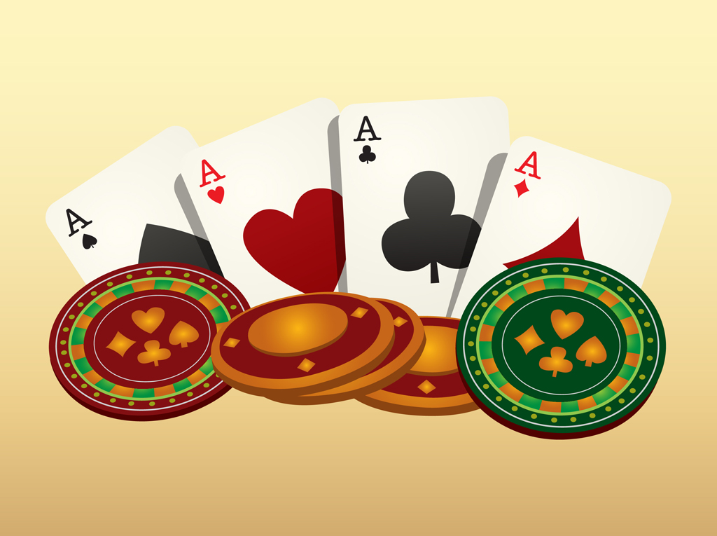
Julian Taber: 51 Beliefs About Gambling
“In the Shadow of Chance” by Julian Taber
GAMBLING IS AN IMPORTANT ACTIVITY.
GAMBLING IS AN EASY WAY TO MAKE MONEY.
THOSE WHO DON’T GAMBLE ARE STUPID, SLOW OR SCARED.
DEDICATED GAMBLERS ARE USUALLY BRIGHT AND CREATIVE.
GAMBLING IS A HEALTHY ACTIVITY.
MY GAMBLING IS UNDER CONTROL.
I DON’T HAVE TO QUIT; I CAN JUST CUT DOWN AND RATION MY GAMBLING.
Notes:
Tabor has identified 51 beliefs commonly held by gamblers at different phases of their progression through addiction. Listening for these beliefs can provide valuable insight into the severity of the gambling problem, the gambler's motivation and current stage of change, and the existence of comorbid disorders. The problem gamblers beliefs about gambling may include any or all of these:
Gambling is an important activity
Gambling is an easy way to make money
Those who don't gamble or stupid slow or scared
Dedicated gamblers are usually bright and creative
Gambling is a healthy activity
My gambling is under control
I don't have to quit I could just cut down and ration my gambling

Slide 44
Julian Taber: 51 Beliefs About Gambling
“In the Shadow of Chance” by Julian Taber
I can win it back
I'm smart I have a system to beat the odds
People respect a heavy better
Someday I'll score a big win and quit with honor
Gambling will be the solution to my problems
Expensive presents will make up for past disappointments
Gambling makes me feel better
Notes:
I can win it back
I'm smart I have a system to beat the odds
People respect a heavy better
Someday I'll score a big win and quit with honor
Gambling will be the solution to my problems
Expensive presents will make up for past disappointments
Gambling makes me feel better

Slide 45
Julian Taber: 51 Beliefs About Gambling
“In the Shadow of Chance” by Julian Taber
Money is my problem
I will pay it back
Borrowing to gamble is okay
Stealing to gamble isn't really stealing
The more money I must gamble with, the better my chances of winning
Notes:
Money is my problem
I will pay it back
Borrowing to gamble is okay
Stealing to gamble isn't really stealing
The more money I must gamble with, the better my chances of winning

Slide 46
Julian Taber: 51 Beliefs About Gambling
“In the Shadow of Chance” by Julian Taber
Even if I only have a few bucks, I'm better off taking a shot
Somebody will be there to bail me out if things go wrong
If only I knew why I gamble I could stop
Will power is the answer
I always win
Notes:
Even if I only have a few bucks, I'm better off taking a shot
Somebody will be there to bail me out if things go wrong
If only I knew why I gamble I could stop
Will power is the answer
I always win

Slide 47
Julian Taber: 51 Beliefs About Gambling
“In the Shadow of Chance” by Julian Taber
I am a lucky person
I can't stop
Sometimes I think I am really two personalities
Suicide will solve my problems
I can't afford to pay for treatment, or take time off from work to get help
I must make as much money as I can, as quickly as I can
Notes:
I am a lucky person
I can't stop
Sometimes I think I am really two personalities
Suicide will solve my problems
I can't afford to pay for treatment, or take time off from work to get help
I must make as much money as I can, as quickly as I can

Slide 48
The Gambler Mood Cycle
ANTICIPATION
ACTION
AFTERMATH
Notes:
The problem gamblers mood cycles continue from anticipation, to action, to aftermath, and back again. Each phase of the cycle is distinguished by distinct cognitive, affective, and physical elements that occur simultaneously.

Slide 49
Cognitive | Affective | Physical
ANTICIPATION: Money Raising Gambling System Development Preoccupation With Planning Developing Hidden Agendas | AFFECTIVE ANTICIPATION: Excitement Impatience IRRITABILITY ACTION: Expansiveness Grandiosity Intoxication Depersonalization Dissociation AFTERMATH: Narcissistic Wound Self-hatred Anger Shame/Guilt | ANTICIPATORY MOOD: May Involve… Increased Alertness Hyperactivity Increased Muscle Tone Mobilization Of Resources
Notes:
For example, at the cognitive level, anticipation is characterized by money raising, gambling system development, preoccupation with planning, and developing a hidden agenda. These cognitive processes manifest at the affective level as excitement, impatience, and irritability. Physical evidence of the anticipatory mood may involve increased alertness, hyperactivity, increased muscle tone, and mobilization of resources.

Slide 50
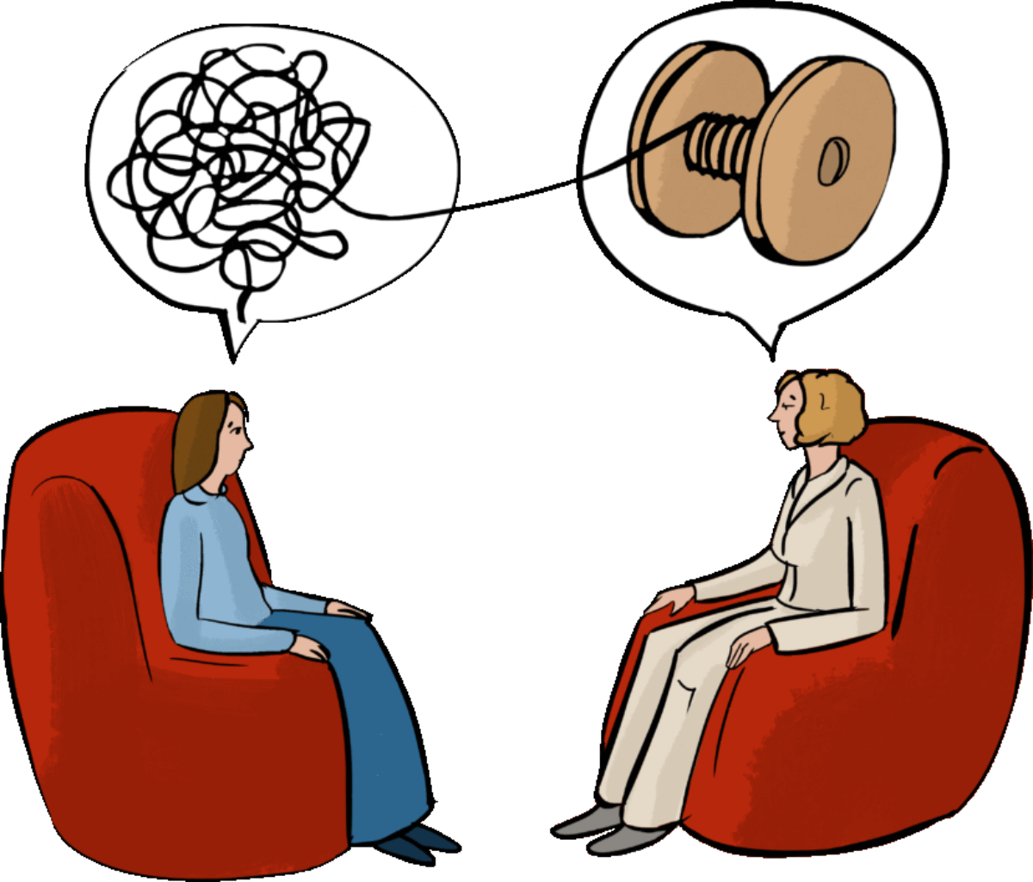
Education Through Intervention
INTERVENTIONS FOR USE WITH THE GAMBLER
Beliefs About Gambling (Taber)
Cost/Benefit Analysis
Elements of Gambler’s Mood Cycle
Defense Mechanisms
Notes:
The interventions listed here can provide a foundation for problem gambling treatment. Handouts for clients can serve as a brief example they can review during their week to assist them with applying clinical tools to their environment and expected situations.

Slide 51
Workplace Gambling Issues
Notes:
The next segment of our training will cover the signs of gambling in the workplace.

Slide 52
Henry Lesieur: Signs of Gambling in the Workplace
Late For Work
Leaves Work Early
Frequent Or Unexplained Disappearance From Work (Often After Lunch)
Excessive Sick Time
Excessive And/or Secretive Phone Use
Vacations Centered Primarily Around Gambling Activities
Gambling On Break
Displays Gambling Related Souvenirs On Person Or In Office
Decreased Productivity
Decreased Grooming And Appearing Ill Or Tired
Moody
Loan Seeking From Various Sources At Work
Arguments With Other Employees Related To Money
Signs Of Excessive Debt Or Financial Irresponsibility
Theft From Co-workers Or Employer
Notes:
No clear strategy has been developed for supervisors or coworkers to use to identify problem gambling in the workplace. However, a list of activities associated with gambling related problems at work has been compiled. Many of these behaviors could be associated with substance abuse, second jobs, illness or other problems. If the person is late for work, leaves work early, has frequent or unexplained disappearance from work (often after lunch), excessive sick time, excessive and/or secretive phone use, vacations centered primarily around gambling activities, gambling on break, displays gambling related souvenirs on person or in office, decreased productivity, decreased grooming and appearing ill or tired, moody, loan seeking from various sources at work, arguments with other employees related to money, signs of excessive debt or financial irresponsibility, or commits theft from coworkers or their employer, these could be signs that gambling has invaded the workplace. Since each of these alone does not pinpoint the presence of inappropriate gambling behavior, it is important that any intervention around job performance problems include screening and assessment for the existence of and extent of a gambling problem.

Slide 53
Henry Lesieur: Case Study Results
Low rates of detection among EAPs and providers
Rates should be higher due to comorbidity of gambling disorder and substance abuse
Hidden nature of problem gambling
Tendency to view problem as financial
Lack of training about the problem
Notes:
In spite of efforts to educate the public and EAPs, recent research has found low rates of detection of gambling problems among EAP's and service providers. The rates found were comparable to the rate in the general population; however, one would expect that EAPs would uncover larger numbers of questionable gambling activity than the rate in the general population, particularly since those who abuse alcohol and other drugs have rates of co-occurring gambling disorder that are at least 10 times higher than that of the adult population. Reasons for the low rate of case finding include the hidden nature of the problem, the tendency of gamblers to view their problem as financial, and a lack of training about the problem and identification methods among EAP and administrative personnel.

Slide 54
Proactive Strategy
EAPs are implementing proactive strategies to improve identification of problem gambling
Notes:
EAP counselors who have been educated about gambling addiction have higher case finding rates than those who lack training on this issue. EAPs are implementing proactive strategies to improve identification of problem gambling.

Slide 55
Workplace Assistance Strategies
Supervisor Awareness Training
Articles On Problem Gambling In Company And Union Newsletters
Posting Of Gambling Hotline Numbers
Inclusion Of Gambling In Announcements Of EAP Services, Along With Guarantees Of Confidentiality
Distribution Of Brochures And Pamphlets To Spread Awareness Of Gambling Addiction
Notes:
These strategies include supervisor awareness training by local counselors with competence and training in the area of gambling addiction, articles on problem gambling in company and union newsletters, posting of gambling hotline numbers, inclusion of gambling and announcements of EAP services along with guarantees of confidentiality, and finally the distribution of brochures and pamphlets to spread awareness concerning gambling addiction.

Slide 56
Relapse Prevention
Notes:
The final segment of this module covers relapse prevention for problem gambling.

Slide 57
Overview of Relapse Prevention
Precipitants
Warning Signs
Conflicts
Prevention
Identify Triggers
Monitor Finances
Intervention
Life Balance
Develop Coping Skills
Finances
Consequences
Low Supports
Salience
Comorbidity
Risk Factors
Enhance Supports
Relapse Prevention Plan
Notes:
Preparation involves the gambler learning his or her relapse triggers, implementing strategies for avoiding those triggers, and building a support system limiting the duration of the relapse episode. Precipitants can include many things such as emotional stress, lifestyle and personality factors, and a lack of coping skills for a given situation. Prevention strategies can be identified throughout treatment sessions to apply to specific circumstances, such as alternative gambling free coping strategies, processes for consistent monitoring of the gambler’s finances, and identifying comorbid psychiatric conditions and making appropriate referrals to supportive interventions such as psychiatric evaluation and medication management. All interventions used during treatment sessions should have a purposeful goal, some which can help the client and their family restore life balance, enhance the support system for all parties involved, develop asset protection and accountability plans, and more.

Slide 58
Gambling Relapse Symptoms (From the Michigan Council on Problem and Compulsive Gambling)
Notes:
The Michigan Council on problem and compulsive gambling has developed a 51-item checklist of gambling relapse symptoms. Let’s take a moment to read through the list to familiarize ourselves with the signs of potential relapse concerns.
I start to doubt my ability to stay abstinent,
I deny my fears,
I adamantly convince myself that I'll never gamble again,
I decide being abstinent is all I need,
I try to force abstinence upon others,
I become overconfident about my recovery,
I avoid talking about my problems and my recovery,
I behave compulsively, over or under work, over talk, withdraw etc.
I overreact to stressful situations,
I start isolating myself,
I become preoccupied with one area of my life,
I start having minor depressions

Slide 59
Gambling Relapse Symptoms (From the Michigan Council on Problem and Compulsive Gambling)
Notes:
I start unrealistic or haphazard planning,
I live in the 'there' and the 'then',
I find my life plans beginning to fail,
I start idle daydreaming and wishful thinking,
I view my problems as unsolvable,
I long for happiness but don't know what it is,
I avoid having fun,
I overanalyze myself,
I become irritated with friends and family,
I experience periods of confusion,
I am easily angered

Slide 60
Gambling Relapse Symptoms (From the Michigan Council on Problem and Compulsive Gambling)
Notes:
I begin blaming people places things and conditions,
I begin doubting my disease,
I eat irregularly over or under eating snacking etc.,
I have listless periods,
I sleep irregularly over or under sleeping,
I progressively lose my daily routine,
I experience periods of deep depression,
I sporadically attend GA meetings,
I develop an I don't care attitude,
I hoard money sex or power

Slide 61
Gambling Relapse Symptoms (From the Michigan Council on Problem and Compulsive Gambling)
Notes:
I develop unreasonable resentments,
I stop attending GA,
I'm overwhelmed with loneliness frustration anger and tension,
I begin visiting gambling friends and places,
I convince myself that I'm cured,
I make or experience a major life change,
I start playing with some other form of gambling,
I practice controlled gambling, I lose control

Slide 62
Gambling Relapse Symptoms (From the Michigan Council on Problem and Compulsive Gambling)
Notes:
I openly reject help,
I develop aches and pains,
I rationalize that gambling can't make my life worse than it is now,
I feel powerless and helpless,
I feel sorry for myself,
I have fantasies about gambling,
I begin to lie consciously,
I increase my use of alcohol,
I completely lose confidence in myself

Slide 63
What Symptoms Of Relapse Have You Experienced In The Past?
What Symptoms Of Relapse Do You Think You’d Experience If You Did Relapse?
What Actions Can You Take To Intervene In Your Relapse Process?
How Can Your Recovery Plan And Meetings Assist You In Preventing The Relapse Process From Beginning?
If Relapse Does Occur, What Action Do You Need To Take?
How Can GA Involvement Reduce The Probability Of Relapse?
How Do You Feel About People Who Relapse?
Florida Council on Compulsive Gambling
Notes:
In addition to this checklist, the Florida Council has developed questions to aid the treatment planning process in incorporating methods for relapse prevention.
What symptoms of relapse have you experienced in the past?
If relapse does occur what action do you need to take?
How do you feel about people who relapse?
What symptoms of relapse do you think you'd experience if you did relapse?
How can GA involvement reduce the probability of relapse?
What actions can you take to intervene in your relapse process?
How can your recovery plan and meetings assist you in preventing the relapse process from beginning?

Slide 64
Listing the Relapse Triggers
Events
Advertising
Financial pressure
Availability
Friends gambling
Large jackpot
Hearing of a win
Near miss
Gambling and winning
Having money
Too much debt
Accused of gambling
Thoughts
Picturing winning
“My only chance”
“This time I’ll do it right.”
“If I win, I’ll be happy.”
Magical thinking
“It’s my destiny.”
“I’ll only bet a little.”
“I deserve some fun.”
“There’s no other way I can pay what I owe.”
“I’ll put the money back when I win.”
Feelings
Anger
Irritation
Boredom
Desperation
Hopelessness
Happiness
Envy
Disappointment
Fatigue
Depression
Intoxication
Loneliness
Spitefulness
Feeling “on top of the world”
Notes:
Relapse triggers can occur at any time and are often unexpected. These events provide the client with stress over avoiding relapse, but also provide the opportunity to utilize new coping strategies and behaviors being developed during treatment sessions. Triggers can include an event the person experiences during their day, a thought they may have, or a feeling prompted by something completely unrelated to gambling. However, since the addiction has been so prominent in the gambler’s mind over time, these normal range of daily stimuli have psychological connections to their personal history of gambling. Hopefully, these triggers can be processed and turned into effective learning opportunities, and chances to strengthen the individualized nature of the treatment goals and objectives. Clients should also be supported when they report experiencing these trigger events, and appropriately commended when they are able to find a non-gambling path through the situation. Over time, the gambler can develop a resilience to these daily triggers and can find ways to manage them more and more effectively by finding supports that work well specifically for them.

Slide 65
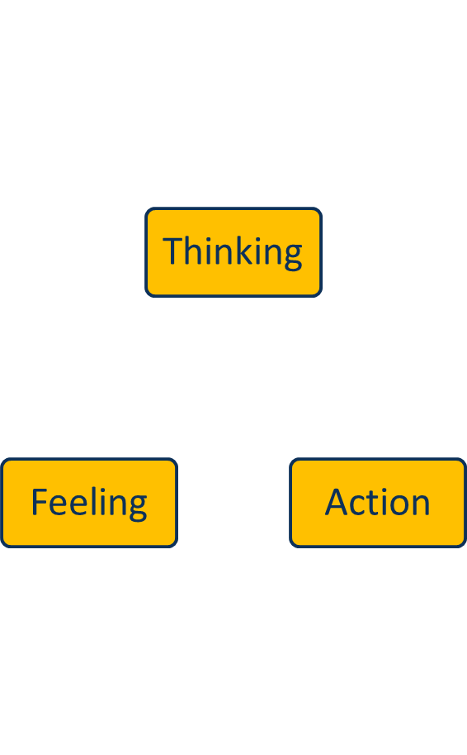
Thinking
Catch Gambling Thoughts As They Occur
Planning Ahead (E.G. Activities, Meetings, Counseling, Etc.)
Recognize Alcohol Or Drug Use Thoughts
Consider Consequences Of Gambling
Event
Feeling
Recognize Feelings When They Occur
Maintain And Express Feelings In A Journal
Acknowledge When Feeling Okay
Talk About Feelings
Action
Join A Gym Or Practice A Physical/Exercise Regimen
Establish And Adhere To A Budget
Develop Relationships With Non-gambling Friends
Identify And Engage In Relaxing Activities or Hobbies
Outcome
Notes:
Coping strategies occur in three stages that can occur simultaneously in the individual; thinking, feeling, and action. Thinking will consist of when the client is able to catch gambling thoughts as they occur, plan ahead to have supportive activities such as activities meetings, counseling, and so on, recognize alcohol or drug use thoughts, and consider the consequences of gambling.
For feeling, the client will learn to recognize feelings when they occur, maintain and express feelings in a journal or other forms of expression, acknowledge when feeling okay, talk about feelings, and know the difference between thoughts and emotions.
For action based coping skills, the client should avoid gambling venues, join a gym or practice a physical exercise regimen, cut up credit cards, establish and adhere to a budget, develop relationships with non-­gambling friends, identify and engage in relaxing activities or hobbies.

Slide 66
Session 7 Topics
1. Levels of Care
2. Beliefs About Gambling
3. Workplace Gambling Issues
4. Relapse Prevention
Notes:
This is the end of session 7.

