Slide 1
Module 5: Special Populations and Gambling
Presentation Year 2020
Notes:
Welcome to module five of the Arizona Department of problem gambling training on mental health treatment for gambling issues. This module is titled Special Populations & Gambling

Slide 2
Session 5 Topics
1. Adolescents & Problem Gambling
2. Culture & Problem Gambling
3. Hispanic Culture and Gambling
4. African-American Views on Gambling
Notes:
Your topics for this module include Adolescents & Problem Gambling, Culture & Problem Gambling, Hispanic Culture and Gambling, and African-American Views on Gambling

Slide 3
Supplemental Reading and Resources for this section includes:
Floros (2013) – Adolescent Online Gambling
Fortune & Goodie (2010) – Diagnosis and Screening College Students
Susana et al. (2014) – VGA and Gambling Disorder
Goldstein et al. (2014) – Mood and Young Adults
Notes:
Supplemental Reading for this section includes:
Floros (2013) – Adolescent Online Gambling: https://dpgtraining.az.gov/Portals/0/Resources/Floros%20-%20Adolescent%20Gambling.pdf
Fortune & Goodie (2010) – Diagnosis and Screening College Students: https://dpgtraining.az.gov/Portals/0/Resources/Fortune%20&%20Goodie%20(2010)%20-%20SOGS%20and%20DIGS%20in%20Col.pdf
Susana et al. (2014) – VGA and Gambling Disorder: https://dpgtraining.az.gov/Portals/0/Resources/Jimenez-Murcia%20et%20al%20(2014)%20-%20VGA%20in%20Gambling.pdf
Goldstein et al. (2014) – Mood and Young Adults: https://dpgtraining.az.gov/Portals/0/Resources/Goldstein%20et%20al.%20(2014)%20Mood%20Motives%20Gambling.pdf

Slide 4
Adolescents & Problem Gambling
Notes:
Adolescents & Problem Gambling

Slide 5
Video Lecture 13: How Youth Gamble
Notes:
Provide an anecdotal review of the client who came to session without his Kanye shoes he was so proud of.
https://youtu.be/QPoMUHboDHk

Slide 6
Research Overview on Youth Gambling
Jacobs (2000); Gupta (2000)
Harshbarger (1996)
Volberg et al. (2010)
Shaffer & Hall (1998)
2 out of 3 underage youth ages 12 to 17 have gambled within the past year; Gupta places the figure at 80%
Harsbarger’s Massachusetts study noted that underage youth were able to place Keno bets 66% of the times they had tried
A recent review of youth gambling studies concluded that most studies indicate rates of youth gambling are either stable or declining.
The top four adolescent gambling prevalence rates were: 40% Non-casino card games; 32% Games of Skill, 31%, Sports Gambling, and 30% Lottery
Notes:
It should come as no surprise that youths gamble. Adolescents have a tendency to try and emulate whatever adults do that looks to be fun or exciting. Jacobs estimates that as many as two out of three underage youth ages 12 to 17 have gambled within the past year. Gupta places this figure at 80%. Harshbarger's Massachusetts study noted that underage youth were able to place keno bets 66% of the times they tried. In a study by Volberg et al., they reviewed the results of gambling frequency among recent youth gambling studies, and found these rates in most cases be stable or declining. Shafer and Hall noted that the top four adolescent gambling prevalence rates were 40% Non-casino card games; 32% Games of Skill, 31%, Sports Gambling, and 30% Lottery.

Slide 7
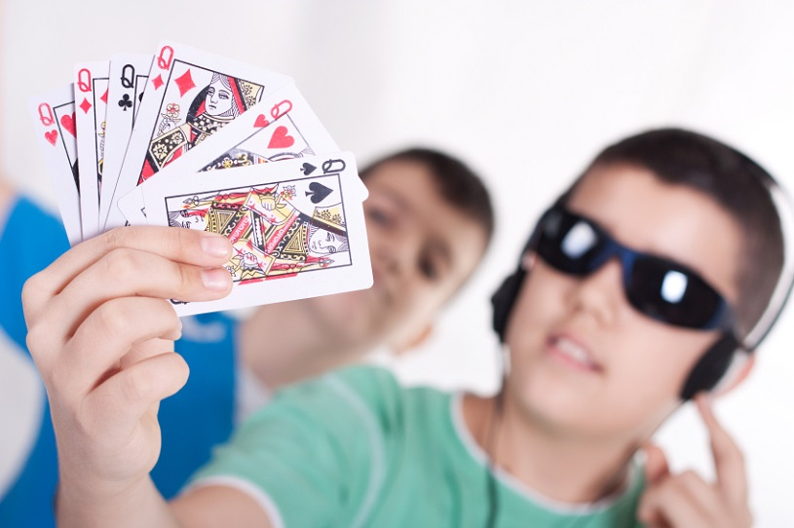
Findings from Derevensky & Gupta
Gambling behavior can best be understood and measured along a continuum of risk.
The continuum ranges from no gambling to social gambling to problem and compulsive gambling
While most of us gamble responsibly, some of us fail to control our level of playing, or are unable to stop and fail to set and maintain reasonable limits
Problem gambling is a growing concern among children and youth
Notes:
Gambling behavior can best be understood and measured along a continuum of risk. The continuum ranges from no gambling to social gambling to problem and compulsive gambling. While most of us gamble responsibly some of us fail to control our level of playing or are unable to stop and fail to set and maintain reasonable limits. Problem gambling is a growing concern among children and youth.

Slide 8
Youth & Problem Gambling
Problem gambling for adolescents has several concomitant negative personal, familial, social, economic and health consequences
Prevalence rates in the U.S., Canada, Australia, New Zealand and the U.K. indicate about 80% of underage youth report gambling during the past year.
4-6% experience severe problems and 10-15% are at risk for the development of a severe gambling problem
Adolescent prevalence rates for problem gambling often appear greater than those of adults due to an unrealistic use of cut-off scores to categorize the gambling behavior across this population
Notes:
Youth gambling and problem gambling. Problem gambling for adolescents has several concomitant negative personal, familial, social, economic, and health consequences. Prevalence rates in the United States, Canada, Australia, New Zealand and the United Kingdom indicate about 80% of underage youth report gambling during the past year. 4 to 6% experienced severe problems and 10 to 15% are at risk for the development of a severe gambling problem. Adolescent prevalence rates for problem gambling often appear greater than those of adults due to an unrealistic use of cut-off scores to categorize the gambling behavior across this population.

Slide 9
Social Correlates for Youth Gambling
Adolescent problem gamblers report beginning gambling at earlier ages, about 10 years of age
Adolescent problem gamblers progress rapidly from social gamblers to problem gamblers, and report experiences of early gambling in the home and with family
Gambling is more popular among males, which leads to higher prevalence among male youth
Notes:
Adolescent problem gamblers report beginning gambling at earlier ages; about 10 years of age. They also progress rapidly from social gamblers to problem gamblers, and report experiences of early gambling in the home and with family. Gambling is more popular among males, which leads to higher prevalence among male youth.

Slide 10
The 1999 Prevalence Estimate
National Research Council (1999)
73% median value – youth gambled recently
1.2-11.2% more narrow definition of problem gambling 5.0% median value
The methods youth can gamble with have transformed multiple times since this data was collected, so it is largely outdated
Notes:
National Research Council: 1999 conclusions. The National Research Council explored the correlation between youth problem gambling on health and social factors. Among their findings, they found a 73% median value in which youth reported recent gambling. Also, 1.2% to 11.2% under a narrower definition of problem gambling, reported similar events, yielding a 5% median value for the narrower inquiry.
It should be noted that the methods youth can gamble with have transformed multiple times since this data was collected, so it is largely outdated

Slide 11
Societal Influences
Video games
Advertisements
Gambling fund-raisers
Social acceptability
Increased venues
Internet gambling
Lack of Awareness
Parental modeling
Web TV
Attractive games
Notes:
Societal influences for youth that have shown to have some impact on the perception of gambling behaviors include: videogames, gambling fundraisers in schools and religious centers, social acceptability, increased venues, Internet gambling, powerful advertisements, lack of prevention and awareness, parental modeling, Web TV, and attractive games.

Slide 12
Inside the Adolescent Brain
Adolescence is a period of profound brain maturation
Previous belief held that brain development was complete during childhood
The maturation process is not complete until after age 24
Notes:
Adolescence is a period of profound brain maturation. Previous belief held that brain development was complete during childhood. Today, we understand that the brain maturation process is not complete until after age 24.

Slide 13
Gupta & Derevensky (1998)
Notes:
There are more adolescents engaged in gambling than other potentially addictive behaviors. This first chart is past year use by percentage. Take a look at grades 7, 9 and 11.
For alcohol use: grade seven was found to have a 36.8% use rate over the past year; grade nine was found to use at a rate of 62.2%, and grade eleven at 79.8%.
Regarding the past year use of illegal drugs, grade seven was found to use at 3.5%, grade nine at 13.4%, and grade eleven at 26.5%.
Now for cigarettes, the rate of past year use by grade was as follows: for grade seven - 18.2%, grade nine - 34.5%, and grade eleven - 48.4%.
Finally, for gambling past year usage rates by grade: for grade seven participants - 79.1%, grade nine - 78.9%, and grade eleven - 83.4%.
Now lets take a look at reported weekly use.

Slide 14
Gupta & Derevensky (1998)
Notes:
As you can see, the weekly rates of use are dramatically different due to the lower course of behavior being investigated. However, gambling is still a leading category for risky behavior among the various academic levels.
For alcohol: grade seven comes in at 7.4% grade nine 14%, and grade eleven 20.2% admitted to weekly use.
Regarding weekly use of drugs: 2.7% in grade seven, 2.1% in grade nine, and 9% in grade eleven.
For weekly use of cigarettes grade seven reported 7% use, grade nine reported 16.1% use, and grade eleven reported 31.4%.
By comparison, weekly participation in gambling behaviors ranged from 30.4% in grade seven, 37.4% in grade nine, and 37.1% in grade eleven.

Slide 15
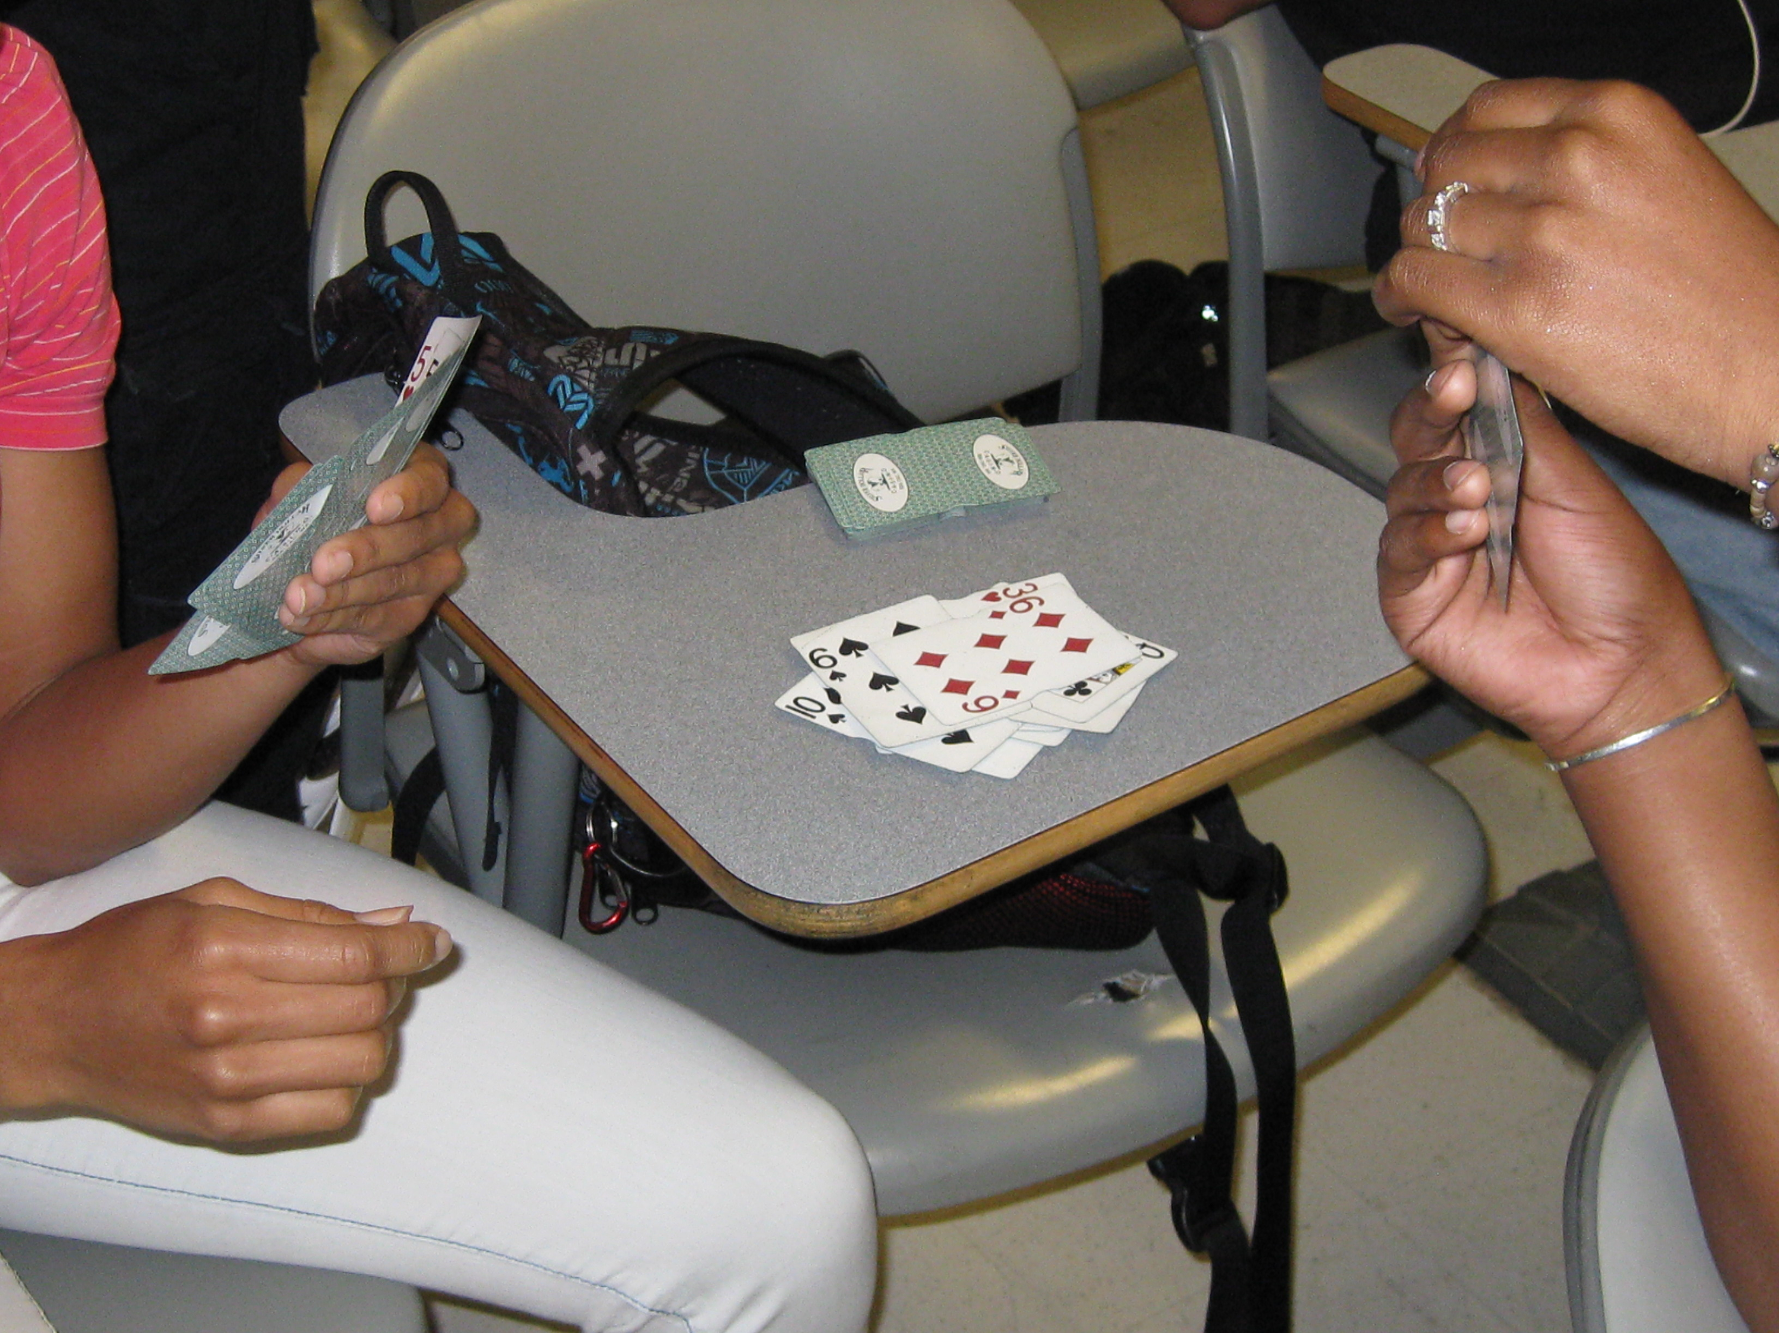
Youth Gambling Correlates
About 4.2% of 12-17 years old have an alcohol abuse problem
About 2.3% have an illicit drug abuse problem (NHS-DA 01)
Severe problem gambling rates are like or slightly less than those of alcohol and drug abuse rates among adolescent populations across current research
Notes:
About 4.2% of 12 to 17 years old report having an alcohol abuse problem. About 2.3% report having an illicit drug abuse problem. Severe problem gambling rates are like or slightly less than those of alcohol and drug abuse rates among adolescent populations across current research.

Slide 16
Youth Gambling Correlates
Problem gambling among youth often coincides with:
Increased delinquency and crime
Disruption of familial relationships
Decreased academic performance, higher truancy, poor grades
Higher rates of depression
Higher rates of suicidal ideation and suicide attempts
Notes:
Problem gambling among youth often coincides with increased delinquency and crime, disruption of familial relationships, decreased academic performance, higher truancy, poor grades, higher rates of depression, higher rates of suicidal ideation and suicide attempts.

Slide 17
Youth Gambling Correlates
Lower self-esteem
Co-occurring addictive behaviors
Greater need for sensation seeking
Salience
Dissociation when Gambling
Notes:
Adolescent gamblers have lower self-­esteem compared with other adolescents. They are often prone to engaging in co-­occurring addictive behaviors such as smoking, drinking, and other forms of drug abuse. They have been found to have greater need for sensation seeking, which often leads to escalation of riskier behavior. They feel higher levels of arousal and excitement from gambling than from other enjoyable activities. Adolescent problem gamblers dissociate more frequently when gambling.

Slide 18
Youth Gambling Correlates
Poor coping skills
Low self-discipline
Difficulty measuring risk
Notes:
Additionally, youth problem gamblers often have poorer levels of general coping skills, have difficulty conforming to social norms and hence, experience difficulties with self-­discipline.
Adolescents often fail to understand the risks or odds associated with gambling, which can lead to dire consequences being felt before they can notice and decide to stop the behavior.

Slide 19
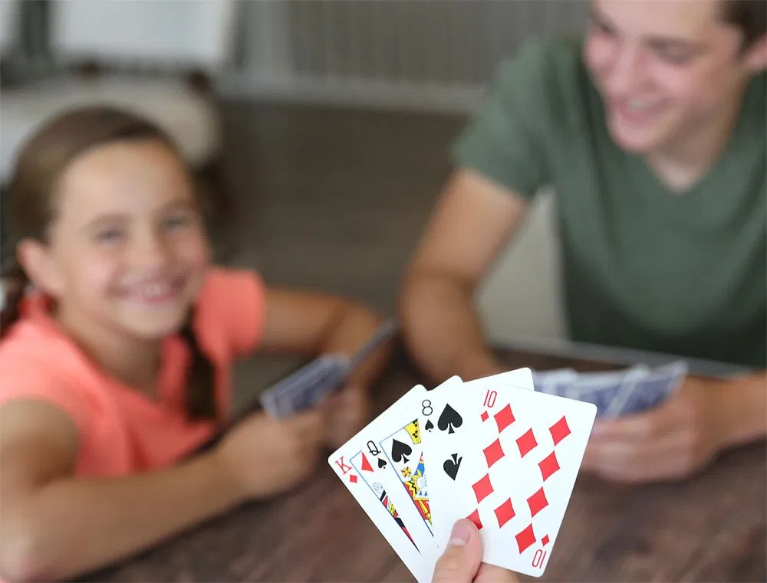
Youth Gambling Preferences
Popular gambling among “regular” young gamblers is dependent on Developmental Level, Gambling Opportunities, Accessibility, Legal Restrictions, And Cultural Factors
Males: Gamble On Cards, Sports Pools, Sporting Events, Games Of Skill
Females: Gamble On Cards, Lottery Tickets, And Bingo
Lottery or informal games such as Cards remain the most preferred gambling activities, dependent on age, gender, and developmental stage.
Notes:
Popular gambling among regular young gamblers is dependent on developmental level, gambling opportunities, accessibility, legal restrictions, and cultural factors. Males generally gamble on cards, sports pools, sporting events and games of skill. Females typically gamble on cards, lottery tickets, and bingo. Research differs in findings, but Lottery or informal games such as Cards remain the most preferred gambling activities among young gamblers, dependent on age, gender, and developmental stage.

Slide 20
Percentage of Game Participation
N=817 from grades 7, 9, 11
Notes:
Lottery or informal games such as Cards remain the most preferred gambling activities, dependent on age, gender, and developmental stage. You can also note the preferred game type by the severity of the gambling behavior across samples of adolescents in grades, seven, nine, and eleven.

Slide 21
Regular Gambling by Adolescents (by game)
Noted by
“At Least Once Per Week”
Gambling Activity
Grades 7, 9, 11
Notes:
This chart shows the percentage of adolescents by gambler type engaging in various gambling activities at a rate of once per week or higher. Notice that among the more severe levels of gambling problem, the Lottery is found to be a primary for of gambling among youths in this study’s sample population.

Slide 22
Reports of Requiring Additional Mental Health Support (percentages)
Grades 7, 9, 11
Notes:
This chart shows the percentage of respondents reporting additional problems concurrent with their gambling issues. Problems included seeking treatment for gambling or co-occurring addictions, suicidal ideation, and suicide attempts. This sample included 817 adolescents in grades seven, nine, and eleven.

Slide 23
Pending Legal Difficulties (by percentage)
Grades 7, 9, 11
Notes:
This chart shows the percentage of respondents who have legal actions pending against them. As you will see, the likelihood of an adolescent facing legal action increases significantly once the gambling activity crosses into some levels of problematic consequences.

Slide 24
Internet Gambling Among Youth
Internet Gambling
High Acceptance Of Internet Gambling
Misleading And Provocative Advertisements
Large Number Of Sports/Fantasy Sports Sites
Capitalize On Use Of Celebrities
Advertised On Television, Magazines
Notes:
Internet gambling among youth. Internet gambling is a form of gambling that can easily appeal to the adolescent demographic. There is a high societal acceptance of Internet gambling, often with games that many have not identified as a gambling behavior. These games are often promoted to youths online through misleading and provocative advertisements in online locations with high adolescent traffic. Large number of sports and fantasy sports sites glamorize the ability to place bets and win money based on effectively predicting game outcomes. Other subliminal forms of gambling will appeal through the use of celebrities, being advertised on television, and demographic specific magazines.

Slide 25
Participation in Gambling (Past 12 Months)
Notes:
This chart presents the participation in gambling by type of game across the past 12 months male and female. Notice that in specific categories, card games and sports betting, there is a gender difference of greater than 15%, while other categories, such as the Lottery and slot machines present a much more even percentage of players across gender.

Slide 26
14
12
Social Gambler
At-Risk Gambler
Types of Online Gambling
10
Probable Disorder
8
Frequency %
6
4
2
0
Roulette
Blackjack
Sports
Slot
Cards
Mah Jong
Stock
Betting
Machines
Market
Notes:
Types of Internet gambling grouped by behavioral severity. The social gambler, the at-­risk gambler, and the probable diagnosed adolescent gambler are all prone to different styles of gambling activity according to their types and preferences. Notice in the chart the difference in frequency of play for the different types of internet gaming activities, along with which gambling population is utilizing the activity.

Slide 27
Internet Gambling With Money (by Gambling Severity)
Notes:
Internet gambling with money by gambling group. This chart presents the frequency of gamblers utilizing the internet as part of their gambling behavior by severity. The Non-­gambler does not gamble, and thus utilizes the internet only for other purposes. The social gambler, at-risk gambler, and probable player diagnosed for Gambling Disorder all turn to the internet at increasing frequencies.

Slide 28
Internet Gambling at Early Ages
Provides a form of entertainment
Enhances levels of excitement and arousal
Provides an opportunity to win money
Younger generation of teens very attracted to Internet gambling websites
Practice sites are popular amongst future problem gamblers
Age of onset is before 13
Approximately 10% of adolescents are gambling on the Internet in some form
Over 10% of problem gamblers spent over $500 on Internet gambling
Notes:
Internet gambling provides a form of entertainment, enhances levels of excitement and arousal, provides an opportunity to win money while playing a game. Younger generations of teens are found to be attracted to Internet gambling websites. Practice websites utilize online games that prep the adolescent or non-gambler to get hooked to the cycle of playing through a series of winning based positive reinforcements followed by a requirement to pay in order to continue playing. These games are exceedingly popular amongst young problem gamblers, with ages often younger than 13. Approximately 10% of adolescents are known to be gambling on the Internet in some form. In many studies, over 10% of problem gamblers acknowledge their having spent over $500 on Internet gambling as they describe the financial impact of their gambling habits.

Slide 29
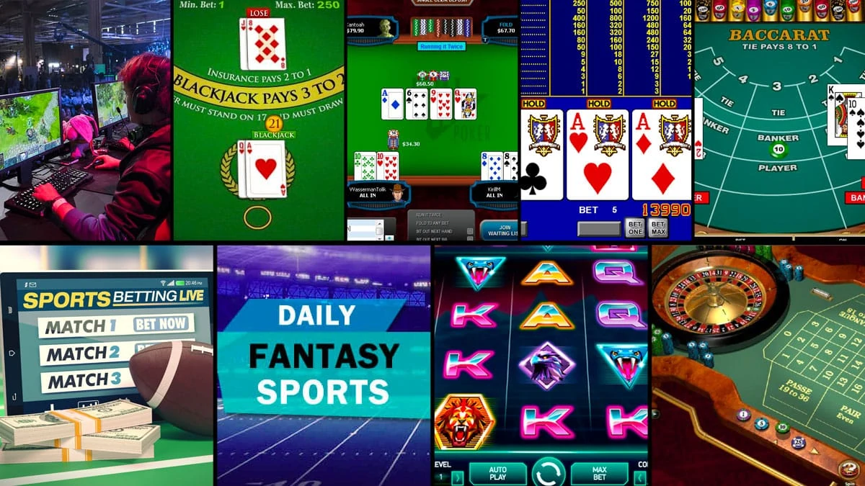
Gambling as a Public Health Issue
Problem Gambling among adolescents may be a “gateway” to substance abuse, depression, anxiety and other significant mental health disorders.
In the US and Canada about 15.3 million children 12-17 years old have gambled for money.
Nearly 2.2 million are reported to be experiencing serious gambling related problems.
Notes:
Gambling as a public health issue. Problem Gambling among adolescents may be a gateway to substance abuse, depression, anxiety and other significant mental health disorders. In the US and Canada, about 15.3 million 12 to 17 year-­olds have gambled for money, while 2.2 million are reported to be experiencing serious gambling related problems.

Slide 30
Healthy Teens Survey (Jeff Marotta, 2006)
Methodology
Districts within counties and schools within districts were randomly selected
Surveys were administered to nearly one-half of Oregon’s 8th and 11th graders
Information was collected from about 30,000 students
Participating students came from 248 schools in 34 counties
Notes:
The Healthy Teens Survey was a study on Youth Gambling in Oregon. Data was collected and analyzed by Jeff Marotta, PhD. Problem Gambling Solutions Inc.
Method: districts within counties, and schools within districts were randomly selected. Surveys were administered to nearly 1/2 of Oregon's eighth and 11th graders. information was collected from about 30,000 students. participating students came from 248 schools in 34 counties.

Slide 31
Questionnaires
Notes:
The questions included in this questionnaire were as follows: During the past 12 months how many times have you gambled, ergo bought lottery tickets or tabs, bet money on sports teams or card games, etc. have you carried a handgun? Have you sold illegal drugs? Have you stolen or tried to steal a motor vehicle such as a car or motorcycle? Were you in a physical fight?

Slide 32
Impacts of Gambling on . . .
Notes:
Have you carried a handgun during the past 12 months? Non-­gamblers for grade eight, 7.1% reported they had. Among Gamblers in grade eight, 23.2% reported they had.
Non-­gamblers for grade eleven, 5.2% reported they had. Gamblers in grade eleven, 16.8 reported they had.

Slide 33
Impacts of Gambling on . . .
Notes:
Were you in a physical fight during the past 12 months? Among Non-­gamblers in grade eight, 1.8% reported yes. Among Gamblers in eighth grade, 6.2% reported yes. For Non-gamblers in grade eleven, 12.1% reported yes. Gamblers in grade eleven, 30.4% reported yes.

Slide 34
Impacts of Gambling on . . .
Notes:
Have you attacked someone with the idea of seriously hurting them during the past 12 months? Among non-­gamblers in the 8th grade sample, 8.3% responded yes. Among gamblers in the same grade, 22.7% reported yes. For grade eleven, non-gamblers responded at a rate of 5.7% that they had, with gamblers reporting yes at a rate of 15%.

Slide 35
Impacts of Gambling on . . .
Notes:
Have you consumed beer, wine, or hard liquor in the past 30 days? Among non-­gamblers in the sample of eighth graders, 26% responded they had, while gamblers responded a much higher rate of 48.7%. In grade eleven, 41.3% of non-gamblers reported yes, with gamblers reporting yes at a rate of 60.3%.

Slide 36
Impacts of Gambling on . . .
Notes:
Have you ever had sexual intercourse? Non-­gamblers in grade 8, reported yes across 11% of the students sampled, while gamblers reported yes at 21%. In grade 11, 41% of the non-gambling sample reported yes, with gamblers reporting yes 51% of the time.

Slide 37
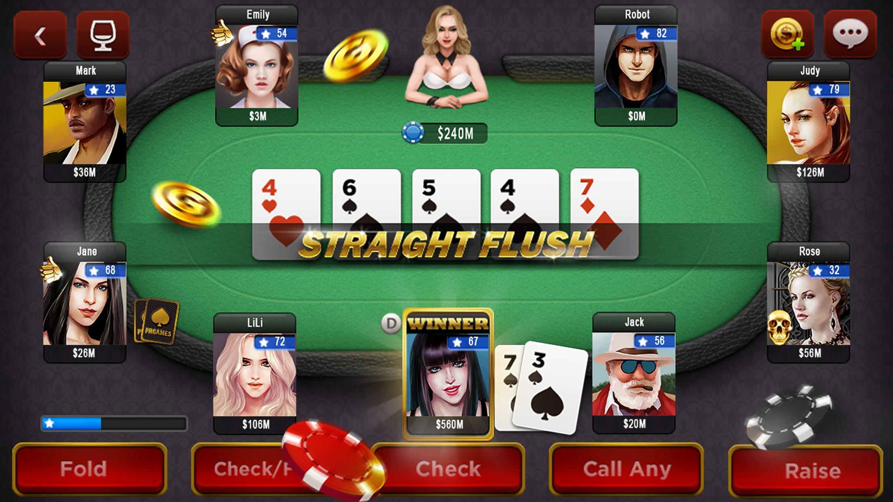
Possible Suggestions from Analysis
Students who gamble are significantly more likely to participate in other risky behaviors
We know that high risk behaviors tend to lead into each other, and gambling appears to fit within our risk behavior matrix
Notes:
What does this data mean? One possible interpretation of these findings would hold that students who gamble are significantly more likely to participate in other risky behaviors. We know that high risk behaviors tend to lead into each other, and gambling appears to fit within our risk behavior matrix.

Slide 38
Possible Suggestions from Analysis
Gambling is one of many activities that carry risk and should be addressed as such in school and community prevention efforts
Gambling should be a signal to parents that they ought to be talking to teens about risky behaviors including gambling
Notes:
In conclusion, gambling is one of many activities that carry risk and should be addressed as such in school and community prevention efforts. This should also be a signal to parents that they ought to be talking to teens about risky behaviors, including gambling.

Slide 39
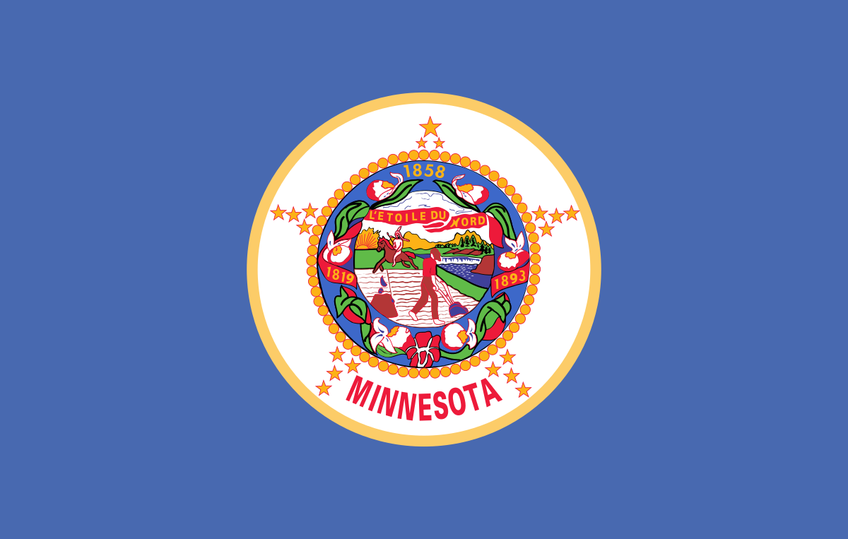
Minnesota Schools Survey (Stinchfield, 2010)
In Minnesota, the 2010 graduating class was born a couple years after the legalization of the state lottery and development of tribal casino gambling (1990), so they have been exposed to gambling their entire lives
Underage gambling is a particular concern since it is illegal and may put youth at risk for problem gambling
Concerns about time and money spent gambling and of the risk of addiction
Public health officials, policy makers, teachers, and parents want to know the extent of youth gambling and problem gambling and what can be done to prevent it
Notes:
Another influential study in our understanding of youth gambling was completed in Minnesota in 2010 by Randy Stinchfield, Department of Psychiatry, University of Minnesota Medical School.
The purpose of this student survey was to explore the impact of gambling on adolescent behaviors during select years beginning with 1992 through 2010. For Minnesota, 2010 high school graduates were born a couple of years after the legalization of the state lottery and development of tribal casino gambling (1990), so they have been exposed to gambling their entire lives. Due to this change in state environment, underage gambling is a specific concern since it is illegal and may put youth at a higher risk for developing problems related to gambling. As in many states, there is a concern over time an individual dedicates to gambling activity, as well as financial costs and the risk of the state developing a gambling epidemic as more people develop an addiction. For these reasons, public health officials, policy makers, teachers, and parents want to know the extent of youth gambling and problem gambling and what can be done to prevent it.

Slide 40
Questionnaire
Sample: 79,323 students participated in 2010
DURING THE LAST 12 MONTHS, HOW OFTEN HAVE YOU…
Played Cards for Money
Bet Money on Games of Personal Skill Like Pool, Golf, or Bowling
Bet Money on Sports Teams
Bought Lottery Tickets or Scratch Offs
Gambled in a Casino
Gambled for Money Online
Notes:
The 2010 sample of students who completed the Student Survey for gambling behaviors included 79,323 male and female students in the 9th and 12th grades. They were asked a series of six questions in terms of frequency of gambling behavior in specific categories over the past 12 months. These categories were:
Played cards for money
Bet money on games of personal skill like pool, golf, or bowling
Bet money on sports teams
Bought lottery tickets or scratch offs
Gambled in a casino….and
Gambled for money online

Slide 41
Results of the Study (Stinchfield, 2010)
Gambling At Any Level
(by gender and grade level)
Notes:
By organizing the results by grade and gender, there are a few trends that can be identified by comparing the more recent 2010 results with the initial sample from 1992. This chart is designed to show any type of gambling, and any intensity of the behavior covering the 12 months explored by the survey. First, it appears that adolescent males consistently gamble at higher rates than adolescent females. Next, older adolescent students, the 12th graders, have consistently gambled at a higher percentage than their 9th grade counterpart, regardless of gender. Finally, all four groups currently gamble at a lower percentage than they did in previous samples.

Slide 42
Results of the Study (Stinchfield, 2010)
9th Grade Gambling Among Males
(by game)
Notes:
By further exploring the issues involved in this survey, we can separate results in each category to view specific grades by gender, and then observe the types of gambling most prevalent for the demographic type. Among 9th grade adolescent males, skill games and cards were a chosen form of gambling behavior for around 33% each. Betting on sport events was another high selection activity for this group. Lottery is significantly less popular among this category than it was in the early 90’s. Online forms of gambling, a relatively new type first included in the survey in 2007, remained consistent at around 5%. This could be higher with further education of what constitutes online gambling among survey participants, which would aid in reducing completer error throughout self-report investigations such as this one. Even more troubling, 4.3% of survey responders in this demographic reported they have gambled at a casino in the past 12 months, which calls into question the responsibility of casino security to responsibly follow through on their age verification protocol for all persons appearing potentially underage.

Slide 43
Results of the Study (Stinchfield, 2010)
12th Grade Gambling Among Males (by game)
Notes:
Now we will look at the changes in gambling among adolescent males progressing to the 12th grade demographic. You will notice that almost every category sees a significant increase in past year gambling occurrence. Card gambling is a significant leader in this group. Likely due to the legal age for Lottery ticket purchases, there is a dramatic increase from earlier ages to the 12th grade group for Lottery participation. Also, certain forms of gambling at the casino are likely legal for the over 18 year old portion of the 12th grade participant base, which causes this type of gambling behavior to have a near 30% increase. Online gambling is still utilized by under 10% of this sample.

Slide 44
Results of the Study (Stinchfield, 2010)
9th Grade Gambling Among Females (by game)
Notes:
The next two charts explore the responses by female participants. Among 9th grade girls, Lottery, cards, skill games, and sports betting are all clustered between 5-10 percent. This seems to indicate a much lower occurrence than their male counterparts. Casino and online gambling are both lower than 3% Now, let’s compare these results to the 12th grade female sample.

Slide 45
Results of the Study (Stinchfield, 2010)
12th Grade Gambling Among Females
(by game)
Notes:
Within this group, Lottery is the most used form of gambling in this sample at around 25%. The next most used form is casino gambling. There is a slight increase in participation in card gambling, but for the most part, all other categories closely resemble those of the 9th grade results. Also, all forms are utilized at lower percentages than they were for the same group in the 1992 sample.

Slide 46
Implications of the Study (Stinchfield, 2010)
Are More Youths Gambling?
No, there were fewer youth gambling in 2010 than in 1992
Volberg, Gupta, Griffiths, Olason, and Delfabbro (2010)
Concluded that the literature is mixed, but most studies indicate either stability or decreases
Unpublished reports of the National Annenberg Survey of Youth have also found declines in gambling starting in 2006
Notes:
So the question is, are more youths gambling? This study and others like it seem to indicate that fewer adolescents gamble now than in previous periods of time. There has been a significant decline in the percentage of youth who have gambled in the past year, and the lottery showed the largest decline. In a recent review of youth gambling studies, Volberg, Gupta, Griffiths, Olason, and Delfabbro (2010), concluded that the literature is mixed, but most studies indicate either stability or decreases.

Slide 47
What Does Youth Gambling Look Like?
WE HAVE TO ASK…
How do youth spend their free time now?
Smart Phones
Internet
Social Networking
Notes:
Based on these findings, we have to ask, how do youth spend their free time now as compared to 1990’s. Other activities may have triggered a shift in how gambling behavior is classified. Adolescents seem presently to be drawn to technology driven interactions with others, namely through the massive cultural penetration of smart phones, Apple and Android devices, social networking, and other quick-fire communication mediums.

Slide 48
Impact of Technology
Obliterates traditional gambling definitions, regulations and practices.
Drives gambling and funding is is driven by gambling.
Allows manipulation of every aspect of any game.
Notes:
The interaction between advancing technology and video game gambling significantly changes the definitions of what gambling is, how it is regulated, and how companies can structure their business around the addiction phenomena people experience during their gameplay experiences. Much of the knowledge being utilized to propel people to play more and longer comes from gambling addiction. One aspect that is different than a slot machine or other traditional gambling games is the ability of the programmer to manipulate every aspect of the gambling simulation experience.

Slide 49
Online Social Gaming & Gambling
Gambling-like games online that are free to play involve elements of chance, but no monetary prizes.
Games can manufacture early success, increased desire to pursue victory, or even a psychological need to continue playing because wins are just one try away.
Players can pay for currency and extra game features.
Prizes range from the ability to continue play, social recognition, non-monetary rewards, to Facebook credits or even real money.
Notes:
Online social gaming is a category of games normally found on high traffic internet sites which are normally free to play, involves an element of chance, but does not give the player the potential to win back monetary prizes in most usual situations. Games can manufacture early success, increased desire to pursue victory, or even a psychological need to continue playing because wins are just one try away.
The ability to play for free is often limited. However, once free play is exhausted, there are parameters by which the player can pay a fee of complete other tasks to earn the ability to continue. Additionally, greater abilities, in-game items, or aesthetic changes can be purchased to give the player an easier difficulty curve, and perhaps a better chance at achieving success at their current level of the game. Prizes in this type of game often range from the ability to continue play, social recognition, non-monetary rewards, to Facebook credits or, in rare circumstances, even real money.

Slide 50
Online Lifestyles
20% OF FACEBOOK USERS ARE 13-17 YEARS OF AGE
Internet gambling has the lowest participation rates of any form of gambling
Internet gamblers are likely to also gamble in multiple “traditional” forms, so internet gambling may mainly be peripheral activity for existing gamblers
RISK-FACTORS
Problem gamblers may be attracted to internet gambling
Non-problem gamblers may develop problems online due to high speed of play, social isolation, use of credit/non-cash payment methods, and 24-hour availability
Notes:
The online communication based lifestyle adopted by the population at wide in no way should be viewed by mental health professionals as an adolescent specific issue. In fact, only 20% of Facebook users are within the ages of 13-17 years old. Internet gambling has been found through research to be the lowest participated form of gambling. This is likely because internet gamblers are probably a portion of gamblers in other categories of more traditional gambling activity that use the internet as a peripheral form of gambling, or a stop-gap in between days when they get to play their game of choice. However, people who do gamble online are found to be at higher risk for developing problems related to their gambling.
Problem gamblers may be attracted to internet based forms of gambling for many reasons. Non-problem gamblers may develop problems online due to high speed of play, social isolation, use of credit/non-cash payment methods, and 24-hour availability. As counseling and mental health professionals, it is important to educate clients who may be at risk on what online gambling looks like, the difference in how we define the activity, and make sure that any activity being done online is within healthy boundaries that carry minimum levels of consequence.

Slide 51
Adolescent Gambling and Prevention
The goal is to integrate problem gambling prevention into existing risky behavior prevention in school curricula
They have been aimed primarily at elementary and high school students
These programs are generally lectures, printed curricula, videos and/or multimedia
They vary from “scared straight tactics” to “show and tell” to early intervention with a few true primary prevention efforts
Notes:
Prevention initiatives: few programs exist today. They've been aimed primarily at elementary and high school students. These programs are generally lectures, printed curricula, videos, and other multimedia. They vary from scared straight tactics, to show and tell, and to early intervention, with a few true primary prevention efforts.

Slide 52
Treatment for Youth
Current treatment paradigms for adolescent and young adults have in general been based upon a number of theoretical approaches and parallel those used for adults:
Currently there is no consensus on what constitutes best practice standards for treating adolescents with gambling problems.
Psychoanalytic
Cognitive
Cognitive-behavioral
Psychopharmacological
Biological/Genetic
Self-Help
Notes:
Treatment for youth with gambling problems. Current treatment paradigms for adolescent and young adults have in general been based upon a number of theoretical approaches and parallel those used for adults. These theoretical orientations should be selected by you as the treating clinician, and integrated into your learning from this and other educational opportunities, to integrate the chosen theory into the unique qualities of the gambling addiction process. Some of the approaches that have shown effective potential for application with the issue of gambling include: Psychoanalytic or psychodynamic, behavioral, cognitive, cognitive behavioral, psychopharmacological, biological, genetic, addiction based and self-­help. Currently there is no consensus on what constitutes best practice standards for treating adolescents with gambling problems.

Slide 53
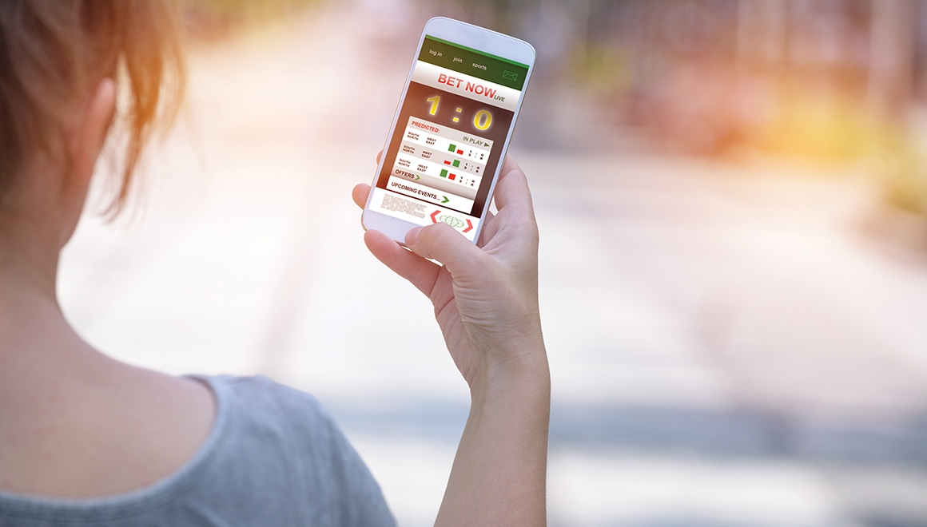
Adolescent Betting
Average age: 12 years old
Cards or dice with family or friends
Games of Skill
Sports Betting
Raffle Tickets
Arcade Games
Informal Wagering and Lotteries
Notes:
There are many other types of gambling adolescents engage in that are not regulated. These include cards or dice with family or friends, games of skill, sports betting, raffle tickets, arcade games, and informal wagering and lotteries. It is quite clear that there are numerous opportunities for youth to gamble. However, what are the rates of problematic gambling among youth, and do youth problem gamblers progress to become adult problem gamblers? Most current research concludes that around 1% of adolescent gamblers do progress into being problem gamblers in adulthood. However, it is important to consider the learned messages on responsibility, money management, and social interaction which could be altered during adolescent experiences of gambling. Based on the developmental implications, early age gambling research, such as was done by Shaffer and Hall, suggests that problematic gambling could create more of an ongoing problem in adolescence than adulthood. Jacobs noted that the mean age of onset is around 12 years old with some children beginning as early as 10 years old. He also noted a trend that the earlier the age of onset the higher the likelihood of problematic gambling.

Slide 54
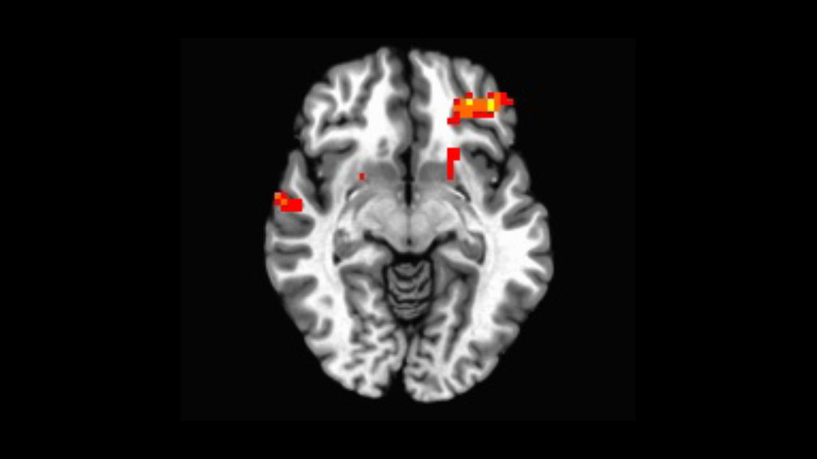
Factors Contributing to Youth Gambling
Chambers and Potenza argue that adolescents are particularly vulnerable to developing a gambling problem due to significantly higher levels of impulsivity characteristic of this age group
Egocentrism
Identity Formation
Impulsivity
Notes:
Factors contributing to youth gambling are the egocentrism characteristic of adolescence and the recent glamorization of gambling through televised poker and blackjack tournaments. Adolescence is also the time for identity formation; a sense of who one is and how one is alike, and yet different, from others. Many early onset gamblers have formed a crystallized identity of being the gambler or being a player. Finally, Chambers and Potenza argue in their 2003 study that adolescents are particularly vulnerable to developing a gambling problem due to significantly higher levels of impulsivity characteristics of this age group. The profound neurodevelopment changes occurring during adolescence are characterized by heightened novelty seeking and impaired impulse control; relative to adults the results can be poor risk/benefit decision-­‐making or bad judgment.

Slide 55
Understanding Prevalence
Youth consistently show similar of slightly lower rates of problem gambling compared to adults in the general population
Comparison
Youth with gambling problems have family, academic, peer, and legal problems
Is associated with alcohol and drug use, truancy, low grades, problematic gambling in parents
Twice the rate of legal involvement and twice the attempted suicide rate as their classmates
Notes:
Youth consistently show similar or slightly lower rates of problem gambling compared to adults in the general population. Studies further illustrated that youth with gambling problems have family, academic, peer, and legal problems. Adolescent problem gambling is associated with alcohol and drug use, truancy, low grades, and having parents who gamble. Youth whose parents gambled excessively had twice the rate of legal involvement and twice the attempted suicide rate as their classmates.

Slide 56
Warning Signs
Weekly or daily card games
Intense interest in watching or listening to sporting events
Preoccupation with internet gambling
Frequent conversations involving gambling
Boasting about winnings
Notes:
Here is a list of basic warning signs for youth problem gambling: Noticing weekly or daily card games, intense or bizarre levels of interest in watching or listening to sporting events, preoccupation with Internet gambling, frequent conversations involving gambling, boasting about winnings, …

Slide 57
Warning Signs
Unexplained need for money
Missing money or valuables
New items in their possession that are unaccounted for
Time away from home unaccounted for
Skipping school or classes to gamble or because of gambling
Notes:
… unexplained need for money, missing money or valuables, new items in their possession that are unaccounted for, time away from home unaccounted for, and skipping school or classes to gamble or because of gambling.

Slide 58
Entering Treatment
Teens requiring treatment for gambling . . .
Notes:
The treatment options for adolescent problem gambling are in their infancy. A variety of characteristics among adolescent problem gamblers have emerged. Children requiring some level of treatment have often been left to fend for themselves, received mixed messages about their value in the family, have not learned effective coping skills, are intellectually immature, faced challenging periods through typical lifecycles, often exacerbated by circumstances; experienced difficulty differentiating from their dysfunctional family, impacted by the burden of family secrets, feel it is their responsibility to keep the family together, attempt to attain stability, attention, respect, and affection; attempt to escape from problems at home and school through gambling.

Slide 59
Video Lecture 14: Loot Boxes & Random Number Generation (RNG)
Notes:
Provide a mini-lecture on loot boxes and RNG appealing to adolescent and adult gamblers
https://youtu.be/Vd6rxFOtBdw

Slide 60
Honoring Cultural Values & Belief Systems
Notes:
Honoring Cultural Values & Belief Systems

Slide 61
Considering Gender & Ethnicity
Problem gambling prevalence rates are
2 OR MORE TIMES HIGHER
among minority men and women
than in the majority population internationally
Notes:
Problem gambling prevalence rates are two or more times higher among minority men and women than in the majority population internationally. In 2009, Alegria and colleagues conducted analyses based on the National Epidemiologic Survey on Alcohol and Related Conditions (NESARC), a large nationally representative survey of adults residing in households during 2001-2002, which had43,093 participants. Prevalence rates of the disordered gambling among Blacks (2.2%) and Native Americans (2.3%) were higher than that of Whites.
Demographic characteristics and psychiatric comorbidity differed among Black, Hispanic, and White disordered gamblers. However, all racial and ethnic groups demonstrated similarities with symptom patterns, time course, and treatment seeking for pathological gambling. The authors stated that targeted prevention strategies for high-risk racial and ethnic groups is needed.
Because many racially and ethnically diverse communities do not subscribe to traditional Western methods of healing, problem gambling professionals will need to expand beyond traditional models to provide wellness opportunities to many of these individuals, families, and communities.

Slide 62
Multicultural Variables
Gambling Beliefs
Gender Perspectives
Magical Thinking
Immigration Issues
Minority Recognition
Religious Belonging
Education
Beliefs of Fate
Language Barriers
Beliefs About Treatment
Community Obstacles
Finances
Socioeconomic Status
Family Structure
Notes:
As you work with clients, keep in mind some of the variables that are viewed in widely divergent ways between different cultures. Being able to do so not only increases your ability to engage clients and mobilize community resources; it also helps you to distinguish between values and beliefs regarding gambling and problem gambling. Cultural variables can include things such as
Gambling Beliefs
Gender Perspectives
Magical Thinking
Immigration Issues
Minority Recognition
Religious Belonging
Education
Beliefs of Fate
Language Barriers
Beliefs About Treatment
Community Obstacles
Finances
Socioeconomic Status and
Family Structure

Slide 63
Gambling Counseling Strategies for Ethnic Communities
Pay attention to help-seeking attitudes of each ethnic/racial group
Understand the socio-economic political history of each ethnic group:
This history may influence how a person negotiates the world and relationships
EXAMINE YOUR OWN POSITION
How does my cultural perspective impact my view of the world and others, including my clients?
Am I Eurocentric? Am I Ethnocentric? / Individualistic or Collectivistic? . . .
How does social identity influence gambling behavior?
Notes:
Pay attention to help-seeking attitudes of each ethnic or racial group. Professional helpers will enhance culturally competent problem gambling treatment by first exploring one's own cultural identity and content. Questions such as: How does my own cultural perspective impact how I view the world and others, including my clients? Am I Eurocentric (perceive the world primarily through the lens of European-Americans)?; Am I Ethnocentric (perceive the world through the lens of my own ethnic culture)?; How does social identity influence gambling behavior and what access individuals and how communities seek problem gambling treatment or wellness resources? It is important for counselors to understand the socio-economic and socio-political history of each racial or ethnic group, because this history may influence how a person negotiates the world and relationships. For example, slavery is a traumatic history that still impacts the psyche of many African-Americans and whether the African American client/community will trust professionals or seek treatment services from White or European-American professional helpers or institutions.

Slide 64
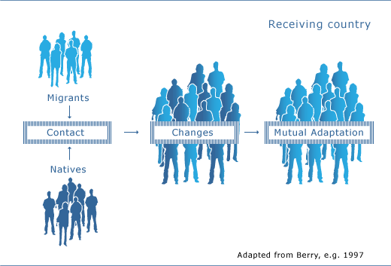
Implications of Acculturation
Understand Acculturation
Assess inter-generational reasons for migration, language, and occupational status
Conduct differential diagnosis
What need is being met by the gambling behavior?
Notes:
Understand acculturation. Build into your assessment process first, second, and third‐generation reasons for migration, language, and occupational status. Conduct differential diagnosis. Are presenting issues a symptom of the acculturation process? Are there multiple issues? Is gambling part of an acculturation process or struggle? For example, how is the immigrant family transitioning to the new culture? Are there multiple issues; finding employment, speaking the language, understanding the new culture, psychological/social/economic? Is gambling part of an acculturation process or struggle? Fong (2005) discussed the following cultural factors that may contribute to excessive gambling behavior: immigration (for further socialization and to make money. Many immigrants who gamble in the casinos may gamble more for socialization support if they experience isolation from acculturating and because there is no requirement to speak English while engaged in gambling for recreation. Petry (2005) screened 96 Southeast Asian refugees from Laos, Cambodia, & Vietnam community center participants and found a surprising prevalence rate of 59%; 42% had gambled more than $500 in the previous 2 months, and these were persons who did not have much income to support losing this amount of money.

Slide 65
Individualism vs. Collectivism
What do family members, church members, or friends think about your gambling? Or, if they knew, what would happen?
Does your pastor know? What would be your church’s response? Would your church be willing to host a GA program?
How does this impact your spiritual or religious experience?
How does your culture, family, or community usually resolve issues like this?
Notes:
Many cultures are individualistic versus collectivistic; individualistic cultures focus on the individual/self whereas collectivistic cultures value the group. Counselors must explore how will the client or community seek help? Are they likely to prefer using communal or community methods to gain support or problem solve. Consider how to engage the ethnic or racial group into the treatment process beginning with the assessment process, by exploring questions such as: What do family members, church members, or friends think about your gambling? If they knew, how would they respond and what would happen? Does your pastor know, or spiritual leader know? What would be your church's response? Would your church be willing to host a GA program? How does your gambling impact your spiritual or religious experience? How does your culture, family, or community usually resolve issues like problem gambling?

Slide 66
Hispanic/Latino Cultures & Problem Gambling
Notes:
Hispanic/Latino Cultures & Problem Gambling

Slide 67
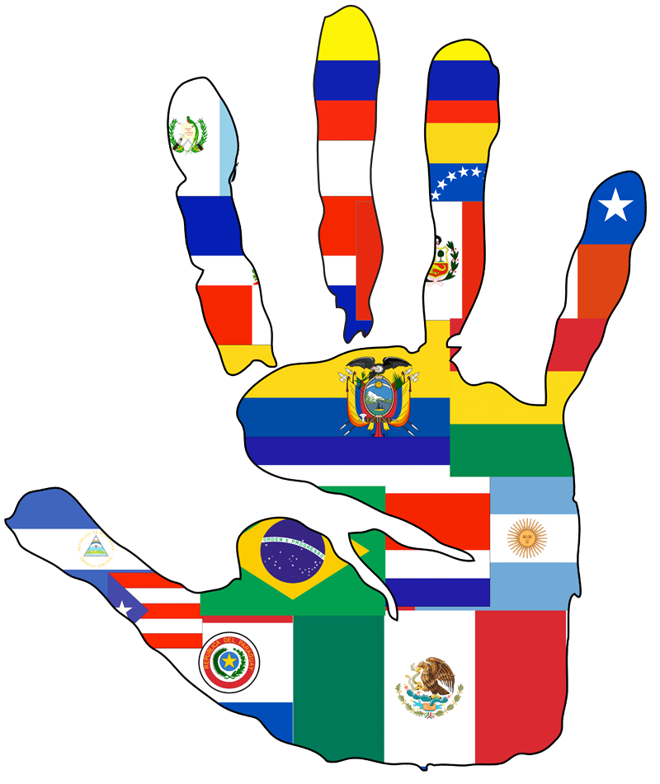
Lessened Assimilation Experiences
Lack of emphasis on cultural assimilation
Secure in cultural traditions
Would view giving up traditional culture as a community loss
Notes:
Unlike previous immigrant groups, Latinos did not need to sever ties with their native lands and cultures. Rather, they bring their cultures with them; many with roots in Mexico, Cuba, Puerto Rico, or the Dominican Republic. Many have the ability to return frequently to their native countries. Hispanic/Latino groups are rightly proud and secure in their cultural tradition and see giving up any part of traditional culture as a loss to their community.

Slide 68
Reaching and Treating the Older Latino Gambler
Differences extend further than language
Latinos/Latinas, think, act, and feel differently than other cultures
This is especially true regarding Hispanic/Latino elders
Notes:
An important consequence of this view of culture for the helping professions and to the gambling addiction therapist in particular is that in Latino/Latina culture, especially among older persons, they are not simply clients who may speak a different language. Hispanics or Latinos often think and act and feel differently about many things than other cultures presenting for gambling treatment. This is especially true regarding Hispanic elders. You will want to take the time to learn these beliefs from them instead of relying on faulty assumptions.

Slide 69
Strategies for Reaching Out
How can the Western-centric Psychology Social and Helping Professions reach out to the Hispanic/Latino older adults who may be focused on traditional cultural norms and who may not speak English?
Ethno-cultural identification between client and therapist
Adaptations to physical space
Language
Natural support systems
Spirituality
Notes:
How can the Western-centric psychology social and helping professions reach out to the Hispanic or Latino older adults who may be focused on traditional cultural norms and who may not speak English? Ethno-cultural identification between client and therapist, adaptations to physical space, language, natural support systems, spirituality. Techniques may include cultural identification between client and therapist to support client identification with the therapist and help to create a foundation for beginning the work. Be culturally sensitive to the physical and institutional space as well as the activities within the office or find a more suitable place in the Hispanic or Latino community to serve Hispanic and Latino clients. Use of language switching to allow clients to use whatever language is most comfortable for expression at the time. Use of dichos, proverbs and folk sayings to convey meaning beyond the words themselves; use of natural support systems such as extended family members and neighbors, friends, healers, local self-­help groups, community and religious leaders, as well as commercial establishments, bodegas, clothing stores, food establishments, and botanics not only for outreach but also to provide services. Use of espiritismo where appropriate, since many Hispanic groups see this as a legitimate healing and spiritual system.

Slide 70
Reaching and Treating the Older Latino Gambler
Key concepts or viewpoints
Familismo
Personalismo
Fatalismo
Respeto y verguenza (respect and shame)
Notes:
There are also a number of concepts or viewpoints that are extremely important to many Hispanics or Latinos and are often the emotional and value framework guiding and explaining day-­‐to-­‐day behavior and responses. The concepts or viewpoints are familismo, which represents the strong bonds of loyalty, identity, and responsibility given and expected member of a Latino or Hispanic family. Personalismo: a Hispanic or Latino notion of close, friendly, familiar relationships between individuals. This may be a challenge for the counselor trained to regard a personal relationship between counselor and client as a potential ethical conflict. However Personalismo does not mean that the personal relationship extends outside the therapy situation, but that the Hispanic or Latino client is most comfortable and trusting when the therapist treats them first as a whole person and not merely as a client. Fatalismo or the perception that there is no protection against adversity. Many Latinos believe that they are powerless to control their own future and that problems are to be expected because they are God's will or destiny. Respeto e Verguenza. Respect and shame. The notion of not showing respect to and for the entire family and bringing shame to them can be a powerful motivator and help Hispanics or Latinos change behavior. The therapist who is aware of these concepts can help break down barriers and improve treatment.

Slide 71
African-American Views & Problem Gambling
Notes:
African-American Views & Problem Gambling

Slide 72
Challenges for Treatment
Need of Developing Comprehensive & Varied Treatment Strategies
Lack of Complete Research Knowledge
Sociocultural Influences
Sociopolitical Considerations
Psychological Realities
Notes:
Devising effective services for African-Americans requires an understanding of socio-cultural influences, psychological realities, and the implications these have for gambling prevention and treatment. There is a lack of research on gambling behavior among African-­Americans. Due to these limitations, it is necessary to develop educational programs that train healthcare professionals in identifying gambling problems within this population

Slide 73
Sociocultural and Sociopolitical Influences
History of slavery and exploitation
Exclusion from traditional gender roles and family values
Suspicion and mistrust of mainstream institutions and practices
Notes:
The African-­American role in America was synonymous with labor outside of the home, with little of the benefit returning to the African-­American family unit. The history of slavery included exploitation and many years of discrimination and prejudice. Men and women were exempt from traditional gender roles that stress putting one's own family first; socio-­cultural and sociopolitical influences arising from this legacy of exploitation may contribute to suspicion and mistrust of the clinician's motivation or qualifications and many traditional treatment approaches such as the legal and financial systems used most often in gambling interventions.

Slide 74
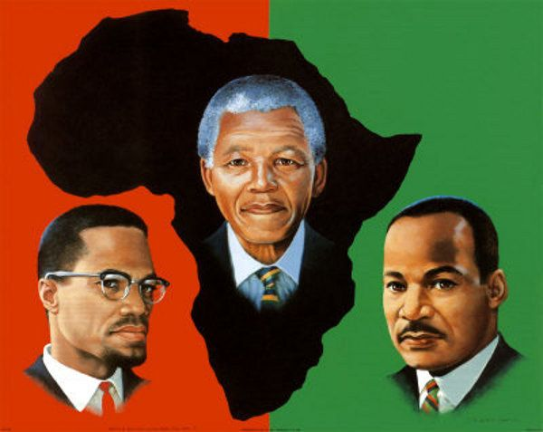
Psychological Realities
Cultural imperative to integrate
Struggle to internalize dominant culture’s devaluating of persons of African descent
Negative imagery affects perceptions of self-worth
Assess emotions regarding self-image and their role in problem gambling behavior
Notes:
African-­Americans experienced certain psychological realities that may influence the development and implementation of culturally competent services. These realities include a cultural imperative to integrate aspects of African cultures as part of addressing the typical stresses of American life, along with the additional stress of discrimination and racism. The influence of dominant culture often results in negative racial and ethnic identity for persons of African-descent and communities. These images may impact one's self worth; therefore, problem gambling treatment may offer opportunities for the African American client to explore one's self-identity, including internalized racism. Many may feel powerless, and gambling may provide an escape from these negative experiences. There is limited problem gambling research on African-Americans, and more research is needed to help counselors include evidence-based knowledge. Woods & Griffiths (2007) found that gambling to escape was identified as the core category. It is possible that African-Americans, and other cultural communities experiencing oppression in society, will gamble as an escape from stressful life experiences that are often not validated by society or in treatment. Counselors must be open to explore all emotional experiences, including race and culture as part of treatment.

Slide 75
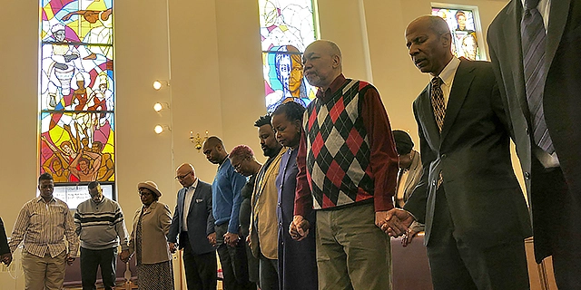
Prevention and Treatment
Incorporate natural resources into treatment planning and service delivery
Spirituality or religion
Family and kin networks
Individual resiliency
Additional resources needed
Culture-based educational materials
Research designs for sub-populations
BE CAREFUL NOT TO OVER-GENERALIZE
Many sub-populations have specific cultural identities, and do not identify with the African-American identity
Notes:
Implications for prevention and treatment indicate the desirability of incorporating natural resources into treatment planning and delivery. Resources might include spirituality or religion, family and kin networks and individual resiliency. What is needed is more research into problem gambling among African‐Americans. Culturally-based educational materials and research designs which acknowledge the diversity within African-descent cultures; such as West Indians, Haitians, or African persons from the homeland of Africa are a much needed resource. Counselors must be careful not to generalize that all African-Americans are the same (Kehe, Brooks, & Haskins, 2004). Many West Indian and African cultures do not identify with African-American as their cultural identity.

Slide 76
End of Session 5 Topics
1. Adolescents & Problem Gambling
2. Culture & Problem Gambling
3. Hispanic Culture and Gambling
4. African-American Views on Gambling
Notes:
This is the end of session five.

