Slide 1
Module 4: Theories & Treatment Concepts
Presentation Year 2020
Notes:
Welcome to module four of the Arizona Department of problem gambling training on mental health treatment for gambling issues. This module is titled Theories & Treatment Concepts

Slide 2
Session 4 Topics
1. Motivational Interviewing & Stages of Change
2. Abstinence & Natural Recovery
3. Harm Reduction
4.Financial Issues in Gambling
5. Legal Issues in Gambling
Notes:
Your topics for this module include Motivational Interviewing & Stages of Change, Abstinence & Natural Recovery, Harm Reduction, Financial Issues in Gambling, Legal Issues in Gambling.

Slide 3
Supplemental Reading and Resources for this section includes:
Soberay et al. (2014) – Stages of Change
Dixon et al. (2019) - Mindfulness
Hodgins (2011) – CBT Review
Notes:
Supplemental Reading for this section includes:
Soberay et al. (2014) – Stages of Change: https://dpgtraining.az.gov/Portals/0/Resources/Soberay,%20Grimsley%20et%20al.%20(2014)%20-%20SFBT%20&%20Gambl.pdf
Dixon et al. (2019) - Mindfulness: https://dpgtraining.az.gov/Portals/0/Resources/Dixon%20et%20al%20(2019)%20-%20Mindfulness%20Issues%20and%20Da.pdf
Hodgins (2011) – CBT Review: https://dpgtraining.az.gov/Portals/0/Resources/Hodgins%20(2010)%20Review%20CBT%20Gambling.pdf

Slide 4
Motivational Interviewing
&
Stages of Change
Notes:
Motivational Interviewing

Slide 5
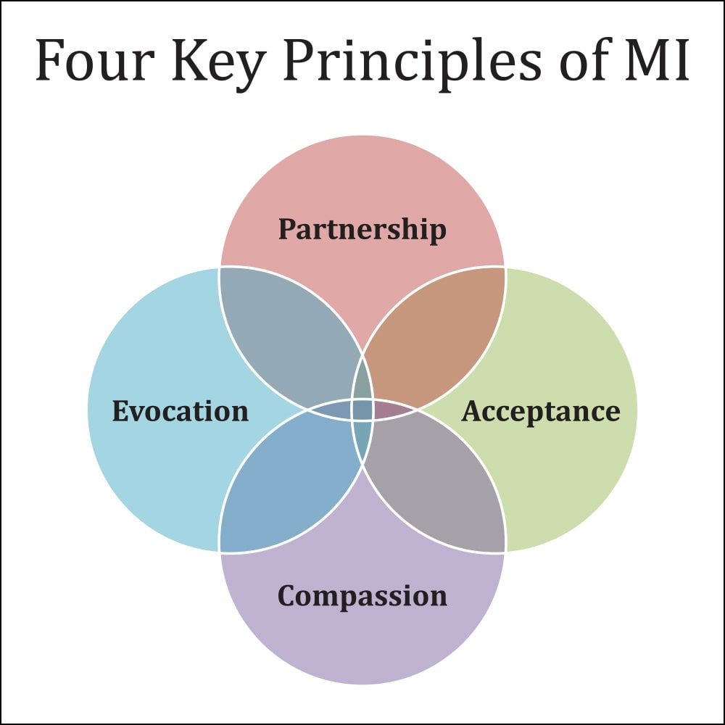
Motivational Interviewing
Motivational interviewing helps individuals assess their need for treatment and decide to commit to treatment if needed.
Effectiveness hinges on engagement.
Goals are a commitment to bridging gaps between current and desired life situations
Notes:
Motivational interviewing is a therapeutic intervention for helping individuals assess their need for treatment and commit to treatment if needed. In brief, the intervention’s effectiveness hinges on the interviewer’s ability to engage individuals in activities designed to bridge the gap between the life the individual has, and the life the individual wants.

Slide 6

Video Lecture 8: Stages of Change
Notes:
Lecture on CNL-501 Week 3 – Slides 2 through 9
https://youtu.be/RSDgHOMLX6g

Slide 7
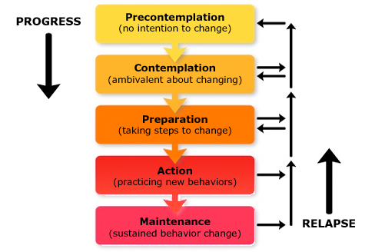
Basic Tenets of Motivational Interviewing
Change is the central feature of any therapeutic interaction.
Motivational interviewing is a relationship-centered, client-centered system of change.
Motivational interviewing is a trans-theoretical approach to the change process.
Notes:
Motivational interviewing works hand in hand with the stages of change model, first described by James Prochaska and Carlo DiClemente. The idea behind the model is that behavior change occurs as an individual progresses through six stages, beginning with pre-­contemplation and ending with termination. Relapse can occur anywhere along the continuum. When relapse occurs, the client’s challenge is to avoid regressing back all the way to the pre-­contemplation stage.

Slide 8
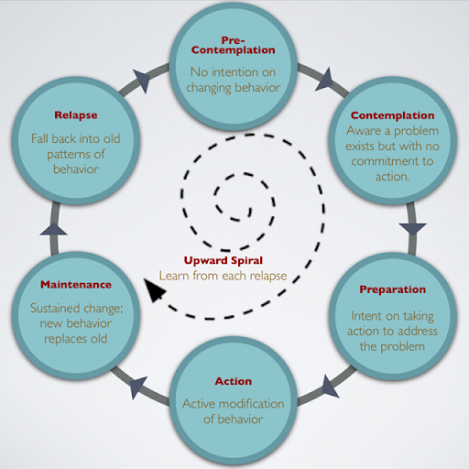
Stages of Change
Notes:
Each stage is marked by certain thought processes and behaviors. In the pre-­contemplative stage, the individual has not yet acknowledged that there is a behavior that needs to be changed. An individual who has progressed to the contemplation stage recognizes there is a problem but is not yet ready to make the change. In the preparation stage, the individual has decided to change, and is preparing. The action stage marks the individual’s actual behavior change. In the maintenance stage, the individual is sustaining the behavior change begun in the actions stage. The termination stage describes the conclusion of structured treatment, and transition into recovery. Relapse, or, recycling, includes the commonly occurring setbacks the individual may experience.

Slide 9


Precontemplation Stage
Client may be defensive and unconvinced his or her behavior is a problem
Help the client to realize there are choices:
The therapeutic goal is to help the client consider a change “just think about it.”
Notes:
In the pre-­contemplative stage, the client may be defensive and unconvinced his or her behavior is a problem. The therapist’s task is to raise doubt and increase the client’s perception of the risks and problems they are experiencing in connection with the current behavior. Specific activities might include sharing information or considering the fact that there are choices. You should also consider educating the client on terminology used to describe problem gambling or addiction. Describing some of the actions and feelings of problem gamblers can be useful in forming a basic awareness. Describing scenarios of other problem gamblers can serve to decrease resistance. Although there is likely an unwillingness to change now, the therapist is leading the client to eventually be open enough to “just think about it.“

Slide 10


Contemplation Stage
Client is aware of the consequences of gambling
Clinician’s task is to tip the balance, strengthen, and encourage
Notes:
Individuals who are contemplating change are more aware of the consequences of their problem behavior and are weighing the pros and cons of changing. The therapist’s task is to tip the balance, evoke reasons for change, educate the client about the risks of not changing, and strengthen the client’s willingness to make a change. Activities might include encouraging the client to imagine how stopping gambling might affect feelings about loved ones, thoughts about work, or the client’s general outlook on life.

Slide 11


Preparation Stage
Client is gathering information, stating intent to change problematic behavior
The clinician’s task is to strengthen client’s resolve and help client explain what they can expect from becoming active in treatment goals
Notes:
Progression to the preparation stage is characterized by information gathering and statements of intent to change the problem behavior. The therapist’s task is to help the client determine the best course of action to take in seeking change. The therapist’s activities should be guided by the importance of the client’s understanding that change is possible, there are options, and change is absolutely within the client’s reach. The therapist might also strengthen the client’s resolve by explaining what the client can expect to accomplish in treatment, learn about his or her problem, understand his or her ways of thinking, take specific steps to change that thinking, and practice those steps until they are a part of the client’s new life.

Slide 12


Action Stage
Client is actively engaged in behavior change
The clinician’s task is to help inventory client changes, their action steps, supportive factors, and provoke additional thinking to practice new behaviors
Notes:
The action stage occurs when the client is actively engaged in their behavioral change. During this stage the clinician’s task is to help inventory client changes, clarify and identify their action steps, encourage and reinforce supportive factors, and provoke additional thinking to practice new behaviors. This is the stage where things start to change in the client is developing behaviors to do things differently in their lives.

Slide 13

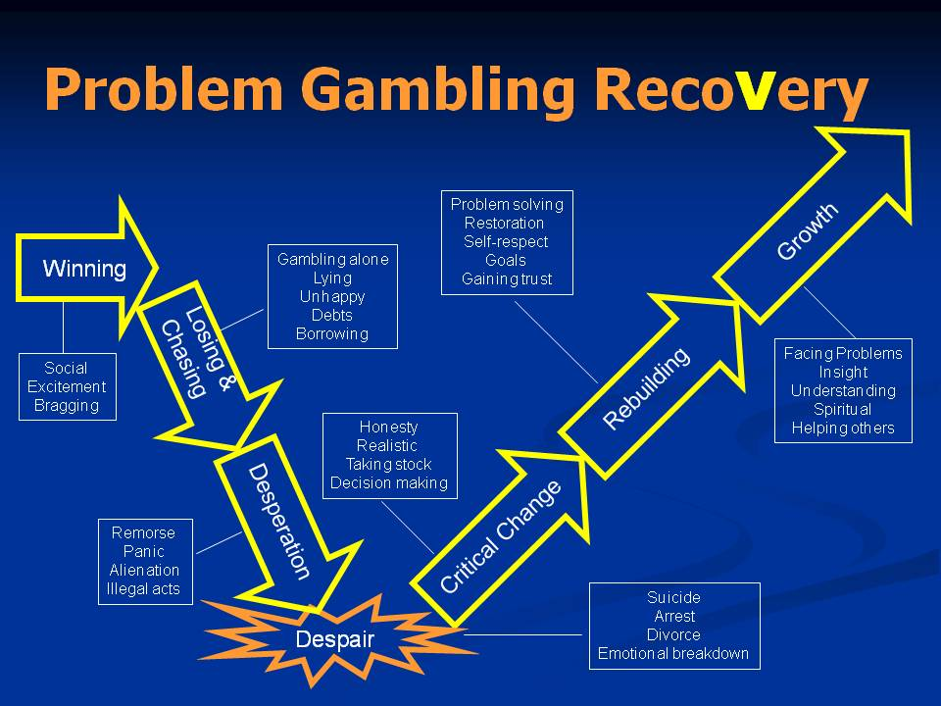
Maintenance Stage
Client is successfully avoiding temptation and continuing to embrace their new way of living
The clinician continues to help the client with strategies for relapse prevention, rehearses responses to triggers, reviews replacement activities, encourages making amends, and helps the client to understand relapse and recovery concepts
Notes:
The maintenance stage involves successfully avoiding temptations to engage in the problem behavior. The therapist’s task in this phase is to help the client identify and use strategies to prevent relapse. Activities would include rehearsing new responses to situations that previously led to gambling; developing replacement activities for gambling, and making amends. The therapist would also help the client understand that relapse is a common part of recovery and it need not be permanent.

Slide 14
Understanding Relapse
Client’s may Relapse
The clinician’s task is to help the client avoid becoming demoralized, renew the processes of contemplation through action, and remind client to utilize lessons from past success
The Upward Spiral encourages the client to learn from mistakes and move forward with hope and optimism
Notes:
It is common to have at least one relapse on the way to permanent cessation of a problematic behavior. The therapist’s task is to help the client renew the processes of contemplation, preparation, and action without becoming stuck or demoralized due to relapse. Motivational interviewing will be useful for assessing the client’s current place on the change continuum and reminding the client of his or her previously successful progression from that stage to the next.
The relapse simply taught the client and counselor a few things about how recovery does not work. It does not cancel out the hard work that has already helped the client to move forward. This idea is called the upward spiral, and it helps the client to look at these slips or relapses as “one we to not do things next time” instead of encouraging despair and other unhelpful thought processes that can create even worse problems when a disappointment occurs.

Slide 15
Six Ways to Increase Resistance
The following list of counselor actions should be avoided when discussing relapses with the client:
Arguing for change
Assuming role of expert
Criticizing, shaming or blaming the client
Labeling: What client is or has, not what to do
Being in a hurry
Claiming preeminence
Notes:
Adherence to motivational interviewing techniques will help the therapist avoid communication styles that impede client engagement, limit potential for compliance, and decrease client desire for treatment. The following six communication choices are common mistakes clinicians can make that prevent treatment from being successful. Arguing, or otherwise trying to persuade the client to change. Assuming the role of expert, implying the therapist has all the answers. Criticizing, blaming, or shaming the client; or trying to shock or jar the client. Labeling, thereby focusing on what the client is or has, not what to do. Being in a hurry and trying to rush the process. Claiming preeminence or otherwise suggesting the therapist knows what is best.

Slide 16
Abstinence-Based Recovery
Notes:
Abstinence-Based Recovery

Slide 17

Defining Abstinence-Based Treatment
Definition
  Endorses abstinence as primary therapeutic goal
  Often eclectic and multi-modal
  Not required for recovery
Tradition
  Draws primarily on philosophical orientation of Gamblers Anonymous/Gam-anon, and other self-help programs
  Encourages the use of meetings as support for recovery.
Notes:
Abstinence based treatment approaches are typically modeled after the treatment approaches used for alcohol and drug abuse, which endorse abstinence as the primary therapeutic goal. The approach is often eclectic and multi-­‐modal, but often draws on the philosophical orientation of self-help programs, such as Gambler’s Anonymous. Accordingly, treatment includes teaching a gambler can live one day at a time without gambling, and how support can be found in self-­help groups like GA or Gam-Anon. Clients are encouraged to establish support systems for themselves and their families. While abstinence is not a requirement for recovery, it is a common treatment option in areas where meetings are available for the compulsive gambler and the family.

Slide 18

Integrating with Self-Help
You should be able as a gambling counselor to . . .
Describe Gamblers Anonymous (GA) and its’ program
List three (3) differences between Alcoholics Anonymous (AA) and GA
Explain the thought processes of problem gamblers
Notes:
Encourage your client to use support group meetings. These are free resources and connect the client with other people who have similar goals like not gambling and making amends with family and friends that may have been wrong during the patterns of gambling activity. Is important for the client to experience changes in a positive way to the people places and things they surround themselves with. If the meeting is being run correctly, gamblers anonymous is a great supplement to the treatment process. Many clients will continue going to meetings long after their counseling processes ended which makes this a positive lifelong change. Some clients may be able to achieve many of their goals simply by attending gamblers anonymous without the need of paying for counseling services. Resources such as this can be invaluable for the client be empowered to turn their life around.

Slide 19
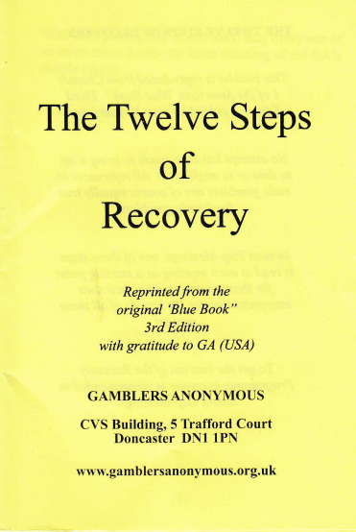
Introduction to the 12 Steps of GA
The Gamblers Anonymous steps are:
  Similar to the steps found in Alcoholics Anonymous
  Speak to a Higher Power in language compared to using the word God / god
  Feature similar concepts such as powerlessness, making amends, and connecting with the Serenity Prayer
Notes:
The gamblers anonymous steps are similar to the steps found in alcoholics anonymous. They choose to speak to a higher power and language compared to using the word God. This allows gamblers to attend gamblers anonymous meetings without having to have a comfort level as high which is concepts. A higher power can simply be the mechanisms that make life worth living. These could be children and family, a hobby, a life goal, basically anything a gambler would use as motivation to prevent themselves from future gambling behaviors. The steps for gamblers anonymous also feature similar concepts from step 1 to 12 including powerlessness, making amends, and connecting with the serenity prayer.

Slide 20

Notes:
The serenity prayer originated from Reinhold Niebuhr in the early 1900s. It reads as follows: God, grant me the serenity to accept the things I cannot change, the courage to change the things I can, and the wisdom to know the difference.
Many counseling issues besides gambling can benefit greatly from utilizing this philosophy. Please review the following video lecture for some of these insights.

Slide 21
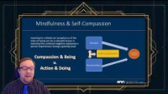
Video Lecture 9: Serenity Prayer & Mindfulness
Notes:
Lecture for 8-15 minutes on the use of the Serenity Prayer as a counselor
https://youtu.be/9sByn3Tli14

Slide 22

Gamblers Anonymous
PATTERNED AFTER ALCOHOLICS ANONYMOUS
  Founded 1957
  Emphasis often on Abstinence Vs. Recovery Program skills
  1,800 GA meetings vs. approximately 60,000 AA meetings in US
Notes:
Gamblers anonymous is a 12 step with her support program designed to help problem gamblers begin and maintain recovery from their gambling choices. It is originally patterned after Alcoholics Anonymous and was founded in 1957. It emphasizes abstinence over other philosophies of addiction recovery. There are approximately 1800 GA meetings in the United States which makes these meetings often more difficult to encourage than AA which provides almost 60,000 meetings across the US. If a gambler needs a meeting that specifically talks about their problem, and gambling is their problem, gamblers anonymous could be a good fit. Because of the scarcity of the meetings, it is often required that the counselor talk with alternative meeting types. Clinicians in this situation can always encourage the importance of having a home meeting that talks about the client’s main problem if it does happen to be gambling.

Slide 23

Meeting Types
  Meeting types
    Traditional (Closed)
    Combined
    Open
    Step
    * Cross-Comment
  Additional Supports
  Sponsorship
  Financial Pressure/Budget Relief
Notes:
Gamblers Anonymous meetings are conducted through the following meeting types.
traditional or closed meetings: These meetings are only attended by the Gambler,
Combined: These are a combination of Gamblers Anonymous and Gam-Anon but are not open to the public as with open meetings.
open meetings: Anyone can attend,
Step: These meetings are focused on working through the 12 steps as described earlier in this training,
Cross-­comment is a type of meeting that results in more interactive conversation than a traditional meeting format and can be used in any meeting type as a rule for interaction amongst attendees.
Sponsorship and financial pressure/budget relief are offered as needed by the person attending the meeting.

Slide 24

Benefits of GA Meetings
Benefits
  Improved Peer Support
  No dues or fees
  Structure for recovery
  Means for reducing shame and guilt
  Enhancing accountability
  Encourages active participation in own recovery
  Long term maintenance
Notes:
There are numerous benefits a participant can experience when they attend GA meetings. These include Improved Peer Support, No dues or fees for their recovery activity, a provided Structure for recovery, a Means for reducing shame and guilt, Enhancing accountability, and others. These meetings Encourage active participation in a person’s own recovery and if the program is used by the individual can lead to Long term maintenance of the gambling issue.

Slide 25

Limitations to Support Groups
Limitations
  Low retention rate
  Does not address family issues
  May be skeptical of professional help
  Difficult for some types of gamblers
  Some may resist treatment because they fear the implications of abstinence on their ability to enjoy life
Notes:
There are a series of known limitations related to the support group approach to initiating abstinence. First, GA meetings can have a low retention rate, which can impact the desire for certain types of gamblers to continue utilizing this form of support for a variety of reasons. Secondly, GA does not address family issues in the same way as counseling, family or couples therapy due to the nature of how sharing is done under the 12-Step format. As healthcare professionals, it is also important to understand that many people who have succeeded using only GA of other 12-Step philosophies may project skepticism towards traditional treatment methods. This type of sharing, if un-checked, can permeate the meeting environment, causing lack of motivation for either continuing therapy, or continuing the meetings. Finally, it may be difficult for certain types of gamblers to find the format of GA an effective way to meet their needs. If you encounter this, you can process with them what happened that resulted in this feeling, identify alternate meetings or support groups, and also educate your client on the useful qualities of doing both meetings and counseling, but with realistic expectations for what each experience can contribute to their recovery.
In terms of treatment or abstinence through counseling, some may resist treatment because they fear the implications of abstinence on their ability to enjoy life. How often this occurs is uncertain, but is an important question for counselors to consider when they are forming their approach to gambling specific treatment.

Slide 26

Comparison to AA Meetings
Comparison to AA
  GA meetings longer and smaller
  GA everyone expected to speak
  Often GA and Gam-Anon held at same place and same time
  Few step meetings, topic, beginner, or lead meetings
Notes:
There are a series of notable differences between Gamblers and Alcoholics Anonymous meetings. GA meetings are often longer and smaller. In GA meetings everyone is expected, and offered the opportunity to speak; Often GA and Gam-Anon are held at the same place and same time, which opens up increased opportunity for family members to become part of the support system, and receive support themselves from other spouses and loved ones. Due to lesser availability, GA offers fewer alternative styled meetings than AA, which includes step meetings, as well as topic, beginner, or lead meetings.

Slide 27
Comparison to AA Meetings
Comparison to AA
  Less emphasis on Sponsorship in GA
  GA de-emphasizes God as ultimate authority
  Higher power
  Spirituality less emphasized
  Step 4 includes financial inventory
  pressure relief group
    www.gamblersanonymous.org
    www.Gam-anon.org
Notes:
There is less emphasis on sponsorship in GA. GA de-­emphasizes God as the ultimate authority; instead focusing on a higher power of the individuals’ understanding in an effort to decrease the concern of forcing religious systems on participants. Additionally, spirituality is less emphasized in the overall structure of GA. Step 4 includes a fearless moral AND FINANCIAL inventory due to the fact that gambling carries with it the need to be completely honest about the handling and management of money. In an effort to aid the gambler, GA also offers pressure relief groups. These involve senior members meeting with a member who is struggling with financial pressures - debt, making restitution, paying bills etc. This process generally includes help with making a budget, developing a plan for debt repayment, and a plans to protect the gambler and their families money from further gambling. Further information can be found at www.gamblersanonymous.org; and at www.gam-­anon.org .

Slide 28
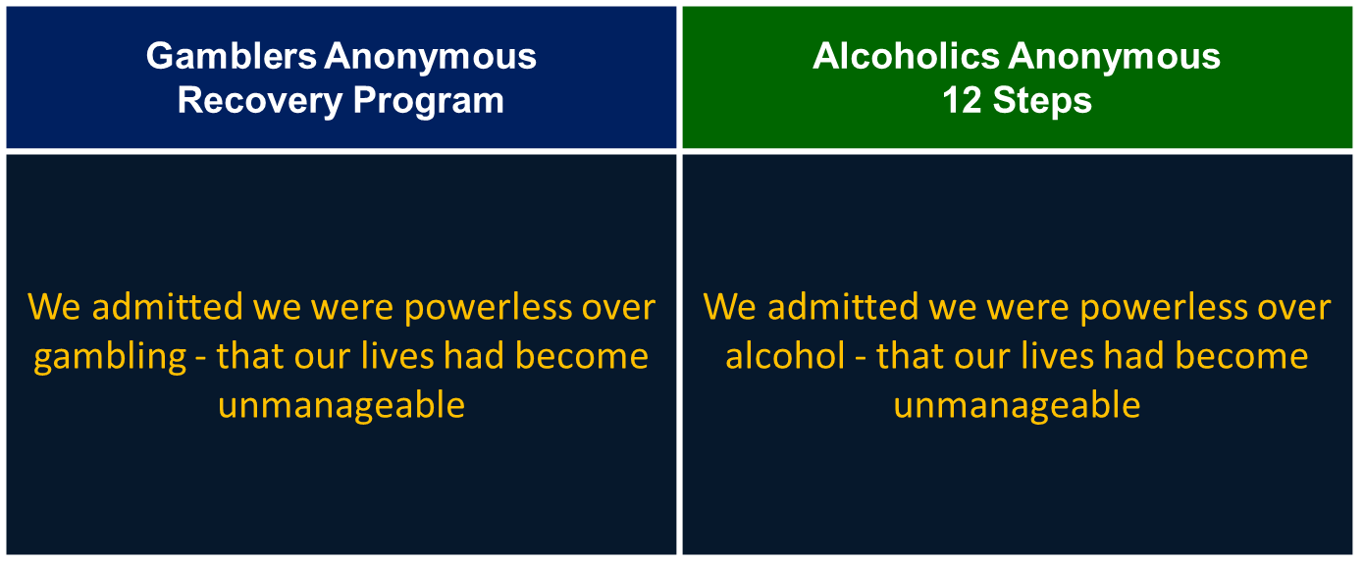
GA and AA: A 12-Step Comparison
Step 1:
Notes:
Twelve step comparison. As you view the following series of slides, take note of the similarities and differences in the phrasing between Gamblers Anonymous and Alcoholics Anonymous. Keep in mind, both are consistent resources for support relating to addiction, and have common approaches to the philosophy of abstinence as a method for recovery.
Step 1. Gambler’s Anonymous: We admitted we were powerless over gambling – that our lives had become unmanageable.
Alcoholics Anonymous: we admitted we were powerless over alcohol – that our lives had become unmanageable.

Slide 29
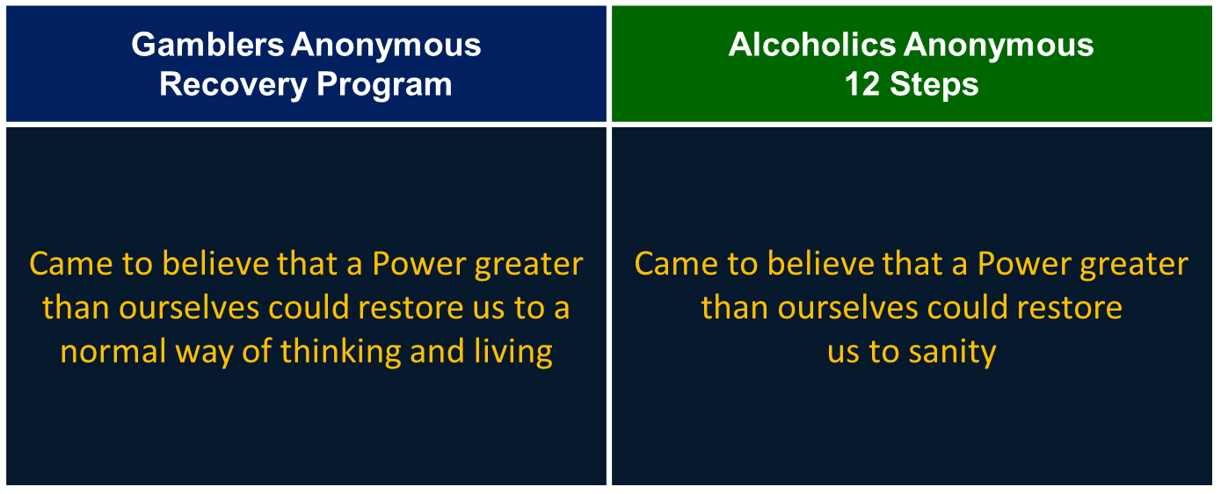
GA and AA: A 12-Step Comparison
Step 2:
Notes:
Step 2. Gambler’s Anonymous: came to believe that a power greater than ourselves could restore us to a normal way of thinking and living.
Alcoholic’s Anonymous: came to believe that a power greater than ourselves could restore us to sanity.

Slide 30
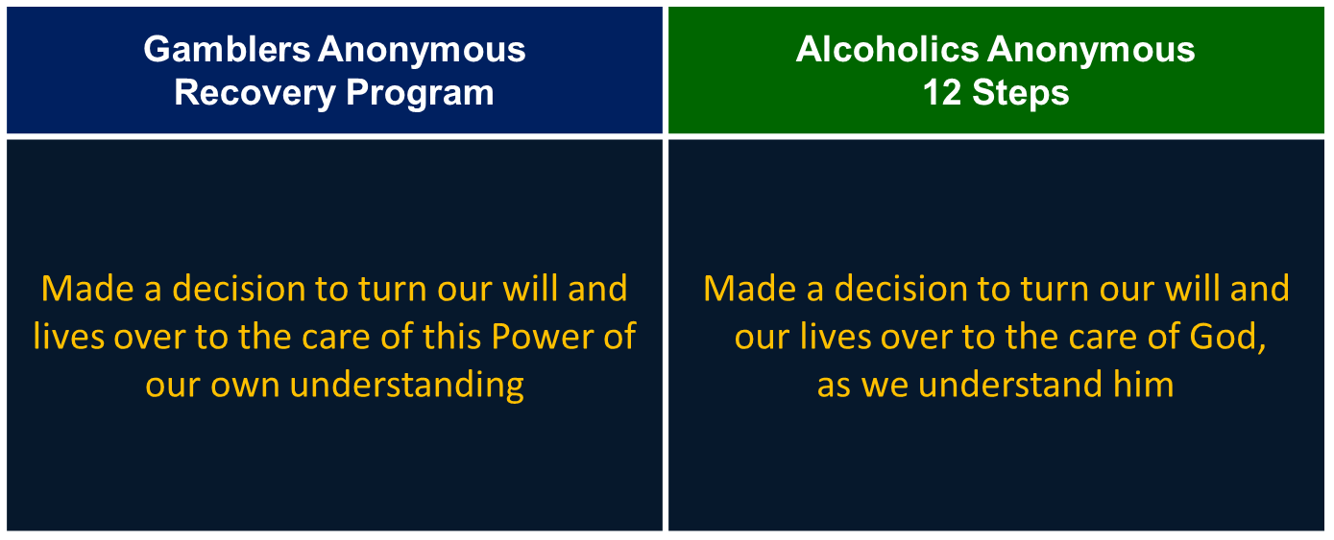
GA and AA: A 12-Step Comparison
Step 3:
Notes:
Step 3. Gambler’s Anonymous: made a decision to turn our will and lives over to the care of this Power of our own understanding.
Alcoholic’s Anonymous: made a decision to turn our will and our lives over to the care of God, as we understand Him.

Slide 31
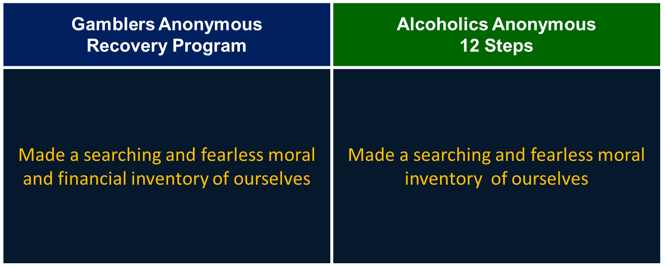
GA and AA: A 12-Step Comparison
Step 4:
Notes:
Step 4. Gambler’s Anonymous: made a searching and fearless moral and financial inventory of ourselves.
Alcoholic’s Anonymous: made a searching and fearless moral inventory of ourselves.

Slide 32
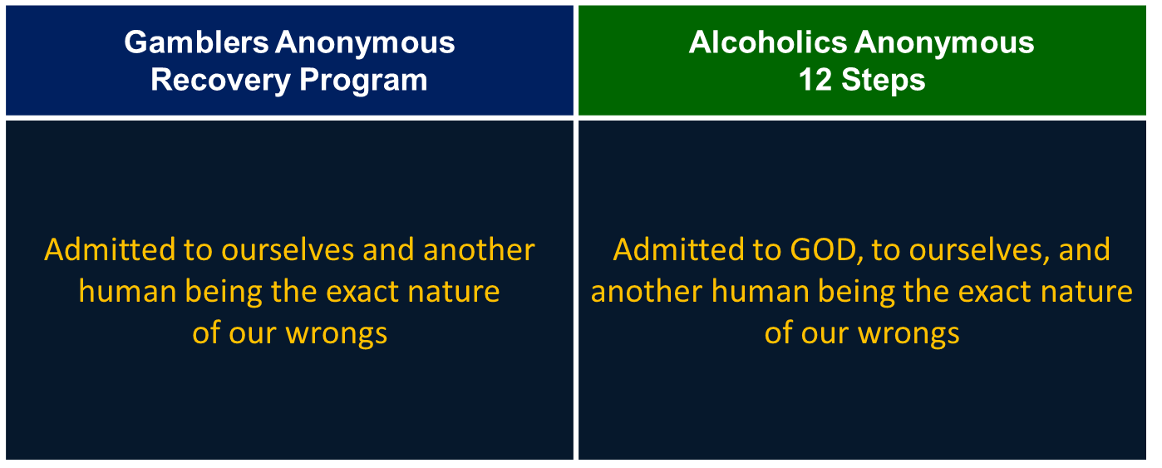
GA and AA: A 12-Step Comparison
Step 5:
Notes:
Step 5. Gambler’s Anonymous: admitted to ourselves and another human being the exact nature of our wrongs.
Alcoholics Anonymous: Admitted to God, to ourselves, and another human being the exact nature of our wrongs.

Slide 33
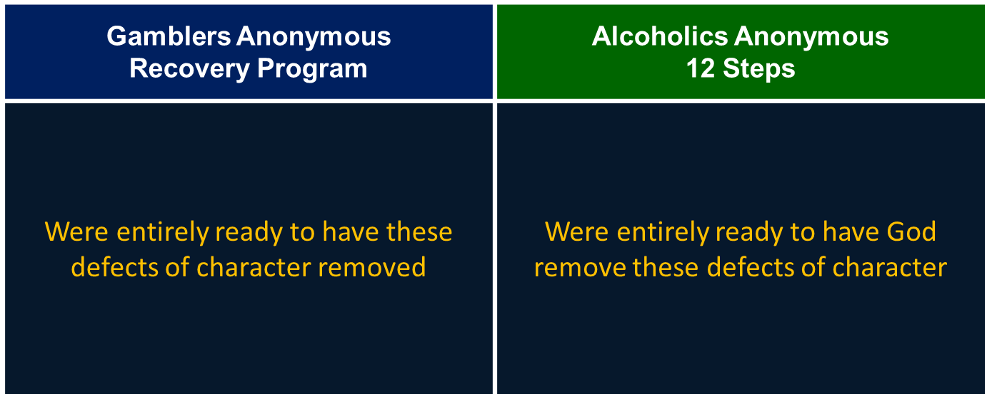
GA and AA: A 12-Step Comparison
Step 6:
Notes:
Step 6. Gamblers Anonymous: were entirely ready to have these defects of character removed.
Alcoholics Anonymous: were entirely ready to have God remove these defects of character.

Slide 34
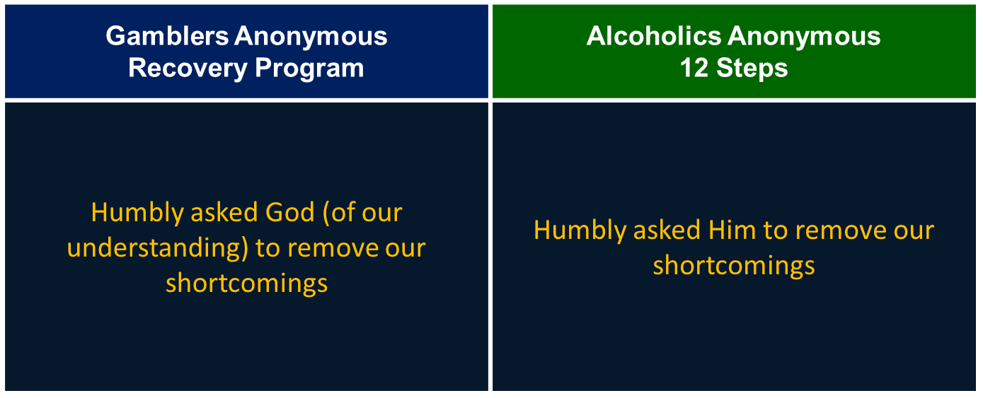
GA and AA: A 12-Step Comparison
Step 7:
Notes:
Step 7. Gamblers Anonymous: humbly asked God (of our understanding) to remove our shortcomings.
Alcoholics Anonymous: humbly asked Him to remove our shortcomings.

Slide 35
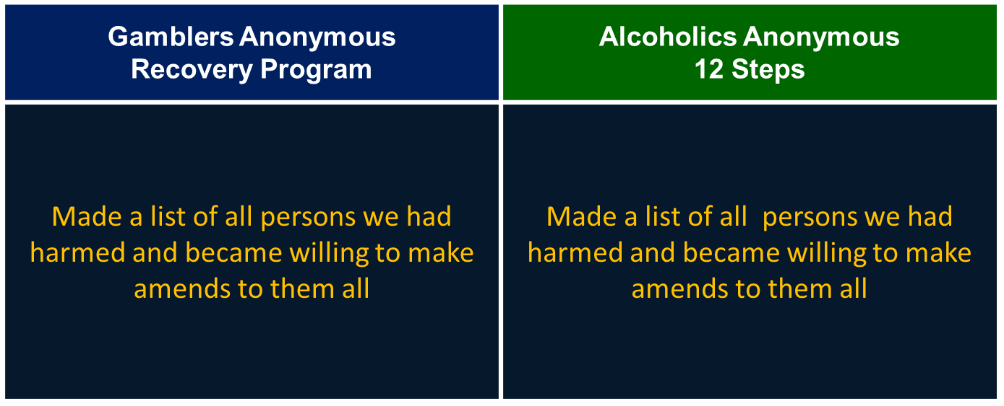
GA and AA: A 12-Step Comparison
Step 8:
Notes:
Step 8. Gamblers Anonymous: made a list of all persons we had harmed and became willing to make amends to them all.
Alcoholics Anonymous: made a list of all persons we had harmed and became willing to make amends to them all.

Slide 36
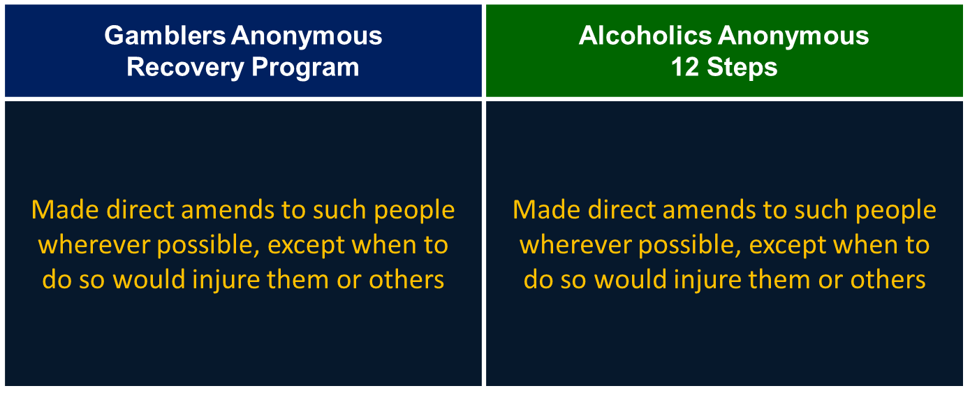
GA and AA: A 12-Step Comparison
Step 9:
Notes:
Step 9. Gamblers Anonymous: made direct amends to such people wherever possible, except when to do so would injure them or others.
Alcoholics Anonymous: made direct amends to such people wherever possible, except when to do so would injure them or others.

Slide 37
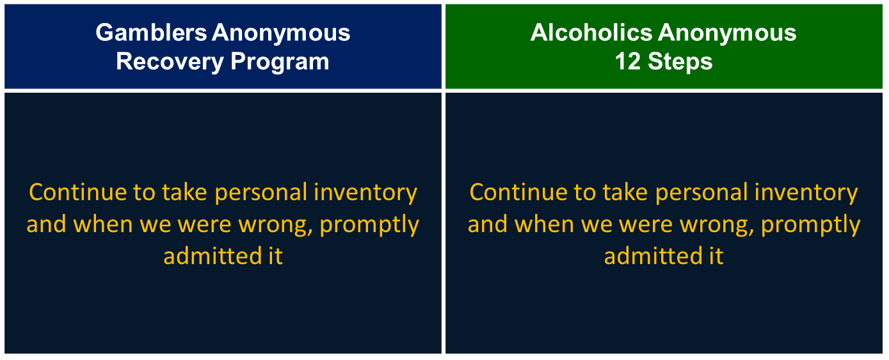
GA and AA: A 12-Step Comparison
Step 10:
Notes:
Step 10. Gamblers Anonymous: continue to take personal inventory and when we were wrong, promptly admitted it.
Alcoholics Anonymous: continue to take personal inventory, and when we were wrong, promptly admitted it.

Slide 38
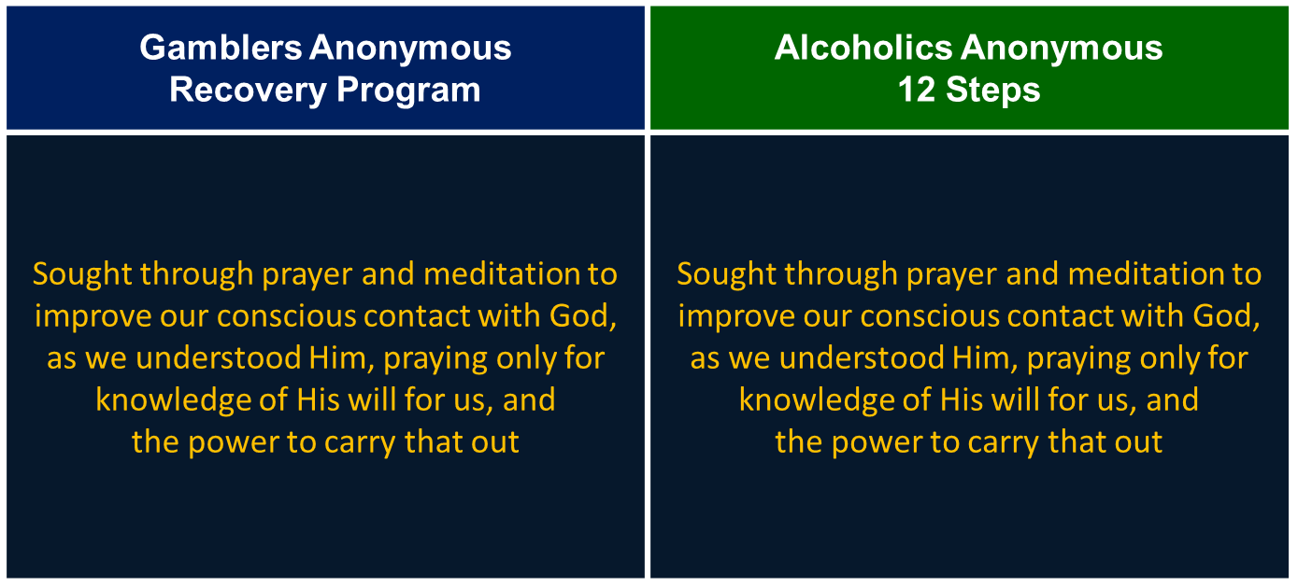
GA and AA: A 12-Step Comparison
Step 11:
Notes:
Step 11. Gamblers Anonymous: sought through prayer and meditation to improve our conscious contact with God, as we understood Him, praying only for knowledge of His will for us, and the power to carry that out.
Alcoholics Anonymous: sought through prayer and meditation to improve our conscious contact with God, as we understood Him, praying only for knowledge of His will for us, and the power to carry that out.

Slide 39
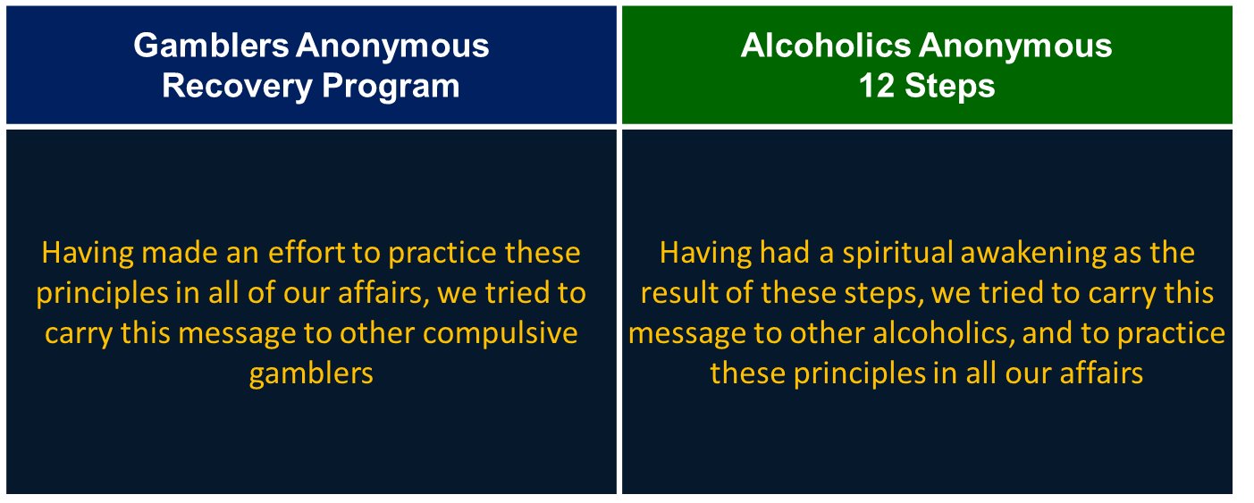
GA and AA: A 12-Step Comparison
Step 12:
Notes:
Step 12. Gamblers Anonymous: having made an effort to practice these principles in all of our affairs, we tried to carry this message to other compulsive gamblers.
Alcoholics Anonymous: having had a spiritual awakening as the result of these steps, we tried to carry this message to other alcoholics, and to practice these principles in all our affairs.

Slide 40
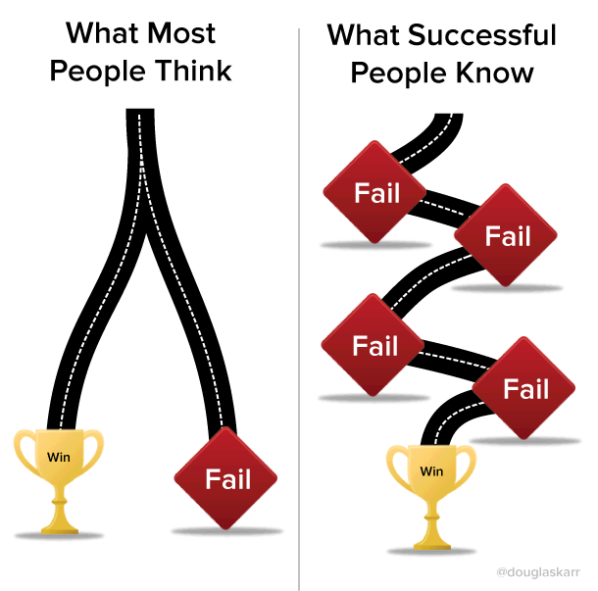
Abstinence-Based Treatment
Process starts with understanding its meaning, potential, and implementation
Substituting new routines is difficult, but important
Therapist’s task:
  Help client focus on enjoying life in new ways
  May require client’s understanding of underlying feelings, fears, and needs
Notes:
Abstinence is a process that starts with helping the client understand how to abstain and cope with their urges without turning to gambling. Client’s are encouraged to think about how abstinence could influence their life. One of the most difficult and important aspects of abstinence is for gamblers to substitute the gambling behavior with new routines. Gambling has probably become a huge part of their life, and to stop it abruptly can leave them with the perception that they have no enjoyable comparable activity, and no other way to get the feeling they feel when gambling. The therapist’s task is to help the gambler focus on learning to enjoy life and cope in new ways. This might mean coming to understand feelings, fears and needs, so the client no longer feels he or she must hide or escape by gambling.

Slide 41

Video Lecture 10: Resilience
Notes:
Lecture 5-20 minutes on resilience + trial and error in achieving success with counseling goals
https://youtu.be/k-AuckD8Hto

Slide 42

Research on Abstinence-Based Treatment
Cleveland Veterans Affairs Medical Center
40-year history of gambling treatment
Outcomes reported in two studies
Notes:
A small number of gambling treatment outcome studies have focused on the abstinence-­‐based treatment approach. The Brecksville unit of the Cleveland Veteran’s Affairs Medical Center has offered inpatient, highly structured gambling treatment for nearly forty years, and the center has reported on treatment outcomes in two studies.

Slide 43

Russo et al. (1984)
60 Clients: 48% follow-up response rate
33 (55%) reported complete abstinence
13 (22%) reported significant reduction
Notes:
In one study conducted in the 1980’s, 60 clients were contacted post-­‐treatment and slightly more than one half reported complete abstinence from gambling for the year following treatment. 22% reported significant reductions in gambling activity.

Slide 44
Taber et al. (1987)
66 Clients: 86% follow-up response rate
32 (48%) reported complete abstinence
Notes:
In a second study three years later, researchers contacted 66 former clients at six months post treatment. 32 clients, slightly fewer than one half, reported complete abstinence.

Slide 45
Volberg (1988) & Blackman et al. (1989)
Evaluations of abstinence-based treatment conducted in NY state in the mid to late 1980s:
  Most clients reduced their gambling between admission and discharge
  Many clients failed to complete treatment
Few clients achieved complete abstinence
Notes:
In separate studies involving 5 different treatment programs, researchers found most clients significantly reduced their gambling activity by the end of treatment; however, dropout was high, and few clients had achieved complete abstinence, regardless of discharge status.

Slide 46


Oregon & Minnesota Statewide Evaluations
Two large-scale gambling treatment evaluations have been conducted in statewide treatment program systems
Notes:
Two large-­scale gambling treatment evaluations have been conducted in statewide treatment program systems.

Slide 47

Minnesota (Stinchfield and Winters, 1996)
Study included 6 state-funded treatment programs
Most clients showed significant reductions in gambling problem severity and improvements in social functioning and vocational responsibilities
31% of sample did not complete full course of treatment but still exhibited improvement at follow-up
Notes:
In Minnesota’s first statewide study of state funded treatment programs, most clients were found to have achieved significant reductions in gambling frequency and problem severity. Social functioning and vocational responsibilities were also improved. Nearly one third of the sample left treatment against staff advice, but, as a whole, still exhibited improvement at six and twelve month follow up.

Slide 48
Minnesota (Abt et al. 1997)
Findings at follow-up were comparable to the 1996 study
Additional evaluation of outcomes by type of therapy conducted at each setting found treatment orientation had no effect on treatment outcome
Notes:
Abt’s study in 1997 further validated the previous study’s findings. In addition, Abt and colleagues also evaluated and compared the primary type of therapy conducted in each treatment setting. Most of the six programs were multimodal, four programs were more strongly cognitive-behavioral, and two had a stronger family systems orientation. The differences in treatment orientation were not found to have had any effect on treatment outcome.

Slide 49
Natural
Recovery
Notes:
Natural Recovery

Slide 50
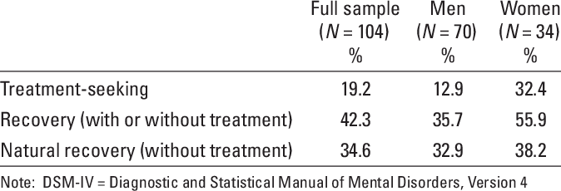
Defining Natural Recovery
NATURAL RECOVERY: RECOVERY WITHOUT PROFESSIONAL TREATMENT
  Often referred to as “going cold-turkey”
  Epidemiological studies disclose widespread existence
  Self-reports suggest recovery from gambling is common
Notes:
As is true with other addictions, many gambling addicted individuals recover without professional treatment. This phenomenon is known as natural recovery. Even in recovery for gambling people will refer to this as “going cold turkey.” Epidemiological studies of gambling prevalence typically disclose the existence of many individuals who report lifetime, but no current, gambling problems, indicating a natural recovery from past gambling problems. Though based on un-validated self-­report measures, the results suggest that recovery from gambling is common, and it is likely that many of those who recover do so without treatment.

Slide 51

The Tradition of Natural Recovery
Common phenomenon among addiction problems:
    1996 Canadian Study - Natural recovery was typical from alcohol problems
    1982 DiClemente and Prochaska - Similar findings for smoking
High probability of similar occurrence with problem gambling
Notes:
In general, recovery from addiction problems without formal treatment is a common phenomenon. A 1996 study among Canada’s general population revealed that natural recovery from alcohol problems was the most typical path to recovery. Similarly, a 1982 study by DiClemente and Prochaska found that most smokers quit on their own, thus it is possible that most gamblers also resolve their problems without treatment, particularly since, compared to other addictions, treatment and self-help groups for gamblers are not as widely available.

Slide 52
Natural Recovery: Epidemiological Studies
2 Epidemiological Surveys (Slutske, 2006)
Majority of people who stopped problem gambling did so without seeking treatment or G.A. Only 7-12% sought treatment.
Australian Community Based National Twin Survey (Slutske et al, 2009)
Most individuals with lifetime history of PG likely to recovery without treatment (82%)
Men (92%) more likely to recover without treatment than women (57%)
Notes:
To date, there have been two major epidemiological studies focusing on the use of natural recovery among people who have at one time experienced problem gambling. In 2006, Slutske found that the majority of people who stop gambling do so without seeking professional help in the form of treatment or participating in GA. Among those who do stop, only 7-12% sought treatment.
Then in 2009, Slutske and colleagues explored the incidence of natural recovery through the process of a National Australian Twin Study. This study found that most individuals, 82%, will recover without treatment. Included in this study was a measure for gender differences in recovery, which indicated men are more likely to succeed through natural recovery than women.

Slide 53
Natural Recovery: Epidemiological Studies
Study: Hodgins & El-Guebaly, 2000
Assessment of resolved and active gamblers using Structured Clinical Interview
    Lifetime gambling and related problems
    Comorbid depression and substance abuse
    Life events in previous two years, and following one year
    Circumstances of resolution where appropriate
Notes:
In a study in 2000 comparing resolved, or former, and active gamblers, researchers used the structured clinical interview for the DSM-­IV criteria to assess lifetime gambling and related problems. Comorbid depression, substance abuse, life events in the two years prior to, and one year following where applicable , as well as the resolution circumstance for the gambling problem were all topics explored in this study.

Slide 54
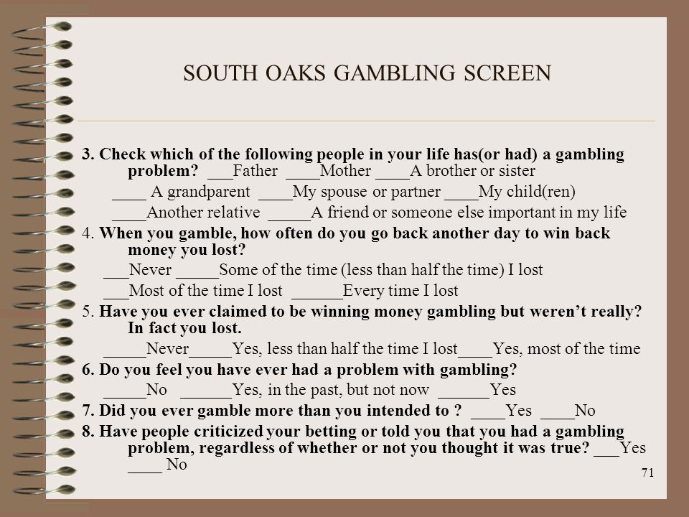
Natural Recovery: Research Qualities
106 Adults (43 resolved and 63 non-resolved)
50/50 male and female
Mean age - 42
Mean SOGS score - 12
94% met DSM-IV criteria for pathological gambling; remaining 6% averaged 3.3 criteria of the minimum 5 criteria required for diagnosis
Approximately 50% of sample reported lifetime experience of mood or substance abuse disorders
Notes:
The study population of 106 adults represented a credible cross section of the gambling population based on previous studies of gamblers who seek treatment. 43 were resolved, or former, gamblers. 63 were non‐resolved. The study population was evenly divided between men and women. The mean age of study participants was 42 years. The mean score on the South Oaks Gambling Screen was twelve. 94% also met DSM-­IV criteria for pathological gambling. The remaining 6% averaged 3.3 of the 5 criteria required for diagnosis. Approximately 50% of the sample reported lifetime experience of mood or substance abuse disorders.

Slide 55

Findings on Natural Recovery
Resolution most often resulted from financial concerns, negative emotions, and intrinsic concerns
Emotional reactions to life events was pivotal
New activities, anticipating negative consequences, and social support helped maintain change
Severity of gambling problem was a predictor of participation in treatment
Embarrassment or pride were barriers to treatment for active gamblers
Notes:
Resolved gamblers reported a variety of reasons for quitting gambling, mostly related to emotional and financial factors. In addition to life events, recovered gamblers reported intrinsic motivational factors such as "will power," self-respect, goal commitment, pride/sense of accomplishment as key factors for maintaining change.
The resolved gamblers did not experience a greater number of precipitating life events compared with active gamblers but did report an increase in positive and a decrease in negative life events in the year after resolution. Both resolved and active gamblers who had relatively more severe problems were more likely to have had treatment or self-­help involvement. Ignorance of treatment and stigma were the most common reasons for not seeking treatment.

Slide 56

Applying Natural Recovery Concepts
Problem gamblers don’t necessarily “hit bottom” before deciding to make a change
Routine clinical screening for co-morbid disorders
Cross training of service providers
Importance of public health approaches that reinforce natural recovery pathways and provide easy access to recovery support information
Notes:
The study’s findings highlighted important differences between the recovery process for gambling as compared to alcohol or other drug addictions. Negative life events were equally prevalent among resolved and active gamblers, suggesting gamblers did not necessarily hit rock bottom before deciding to quit. At any given time, a significant number of individuals are experiencing gambling problems, and it is possible that more problem gamblers would access treatment if services were a more routine element of the behavioral healthcare continuum. Cross training of service providers is important to enable gambling treatment services to be integrated into general mental health and addictions services. As more programs incorporate gambling specific programs, it is important to place a higher emphasis on reinforcing natural recovery pathways and simplifying patient access to recovery support information

Slide 57
Harm Reduction
&
Early Intervention
Notes:
Harm Reduction & Early Intervention

Slide 58

Video Lecture 11: Abstinence vs. Harm Reduction
Notes:
Lecture for 5-20 minutes on Abstinence in gambling treatment versus harm reduction
https://youtu.be/MfSISHqdax8

Slide 59

Defining Harm Reduction
Definition:
Interventions with goals of controlling or setting limits on gambling
Tradition:
Controversial with tendency to elicit emotional responses
Notes:
Harm reduction approaches to gambling addiction treatment includes interventions with the goal of controlling or setting limits on one’s gambling as well as reduce the harm of any gambling to an individual or their family.
The issue of harm reduction or controlled gambling has tended to elicit emotional responses, which have been highly critical. Some consider a treatment goal of controlled gambling as heretical, an approach that undermines the foundation of traditional addictions recovery and treatment.

Slide 60

Harm Reduction in Research
Traditionally, U.S. programs favor abstinence-based approaches
Canadian program achieving success using harm-reduction approaches
Notes:
Harm Reduction: Research. Many gambling treatment programs in the United States employ abstinence-based approaches; however, many programs in Canada are doing preliminary work using harm-­reduction approaches and appear to have achieved some success with gamblers who may be at risk for progression to severe levels of addiction.

Slide 61
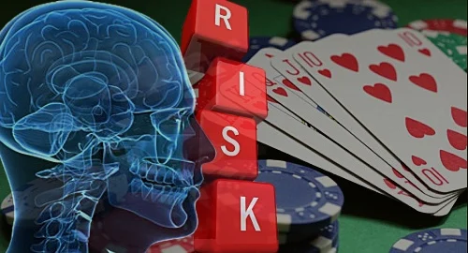
Harm Reduction in Research
Gambling Decisions Program
From T. Toneatto of CAMH
  117 clients over the course of 1 year
  DSM-IV Pathological Gambling diagnoses : 0
  Goals were to control gambling and reduce negative consequences
Notes:
One example of harm reduction research is the Gambling Decisions Program. This program enrolled 117 clients over the course of a year. None met the DSM-IV criteria for pathological gambling, and the program’s goal was to assist the gambler in controlling their gambling behaviors and reducing the negative consequences of their gambling.

Slide 62
Harm Reduction in Research
Amount of money lost gambling declined from $600 to $110
At 12-month follow-up, the average amount of money lost gambling was $140
Hours spent gambling declined from an average of 24 hours per week to 11 hours per week
Notes:
Results found significant reductions in time spent gambling and money lost gambling, and reductions were sustained through twelve-­month follow up. The amount of money lost gambling was reduced on average from $600 pre­‐treatment to $110 at the end of treatment. Hours spent gambling dropped from 24 hours pre-treatment to eleven hours per week at one year follow up.

Slide 63
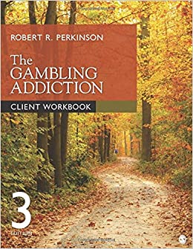
Harm Reduction in Research
Three treatment conditions
  Brief motivational enhancement plus self-help workbook
  Self-help workbook only
  Waiting list (control condition)
Subjects set own goals
84% reported significant reduction in gambling
25% indicated abstinence in the 6 months prior to 12-month follow-up
Notes:
In a separate Canadian study, participants were assigned to one of three treatment conditions, and set their own treatment goals: abstinence or controlled gambling. Overall, 84% of participants reported a significant reduction in their gambling, and 25% reported abstinence in the six months prior to twelve-­month follow up. Individuals in the waiting list group reported less involvement than subjects receiving motivational enhancement plus workbooks. The group receiving the workbook alone showed no significant differences from either the waiting list group or the workbook plus motivational enhancement group.

Slide 64
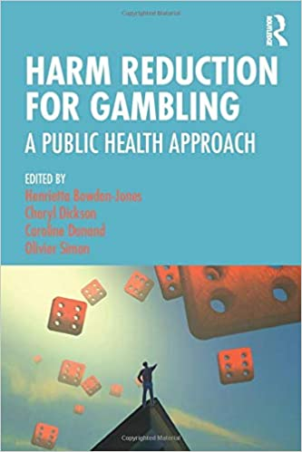
Support for Harm Reduction Models
ADDITIONAL SUPPORT FOR HARM REDUCTION MODELS
Subsequent studies report a range of interventions result in reduced gambling over 6 months to 2 years (Hodgins et al., 2009; Petry et al., 2006)
Banff Criteria (Walker et al, 2006) - A panel of most highly recognized problem gambling experts recommend that treatment effectiveness be evaluated based on reduced gambling measures rather than abstinence.
Notes:
At present, there is professional support growing through research and professional opinions among gambling treatment professionals for the merits of a harm reduction approach. Since 2006, multiple studies have found interventions oriented toward the gambler reducing the harmful effects of their approach to gambling have been effective for maintaining reduced gambling beyond termination of treatment at both 6 month and 2 year follow ups. Additionally, the Banff criteria, proposed by Walker and a panel of highly recognized problem gambling experts, is used to evaluate the effectiveness of treatment through measures of reduced gambling behavior since the beginning of treatment rather than abstinence since the end of treatment.

Slide 65
Application of Harm Reduction Models
HARM REDUCTION MAY HAVE A PLACE ON THE TREATMENT CONTINUUM
  Useful for early intervention
  Engage gamblers who view abstinence as unrealistic
  Provides option for revising treatment goals as success is achieved
  Assist gamblers who view abstinence as impossible, but need help establishing control
  Provides option of minimizing harm of gambling while gambler is not yet willing or able to stop gambling
Notes:
Harm reduction: application. The results of the Canadian studies suggest that harm reduction has a place in the treatment continuum for problem gambling, particularly as an early intervention. The approach may be appropriate for gamblers who might otherwise be deterred from seeking treatment for fear abstinence is an unrealistic goal. Harm reduction approaches also leave open the option of revising treatment goals to include abstinence once interim success has been achieved. Other merits include the fact that this approach may appeal to a different client base; the type who feel abstinence is impossible but need help establishing control. Finally, harm reduction may be a useful concept at the beginning of treatment, when motivation to stop is lower, but would still allow the gambler to begin receiving professional help for their problem in a less threatening way.

Slide 66
Financial Issues in Gambling
Notes:
Financial Issues in Gambling

Slide 67

Video Lecture 12: The Meaning of Money
Notes:
Lecture on the Meaning of Money in counseling for problem gamblers
https://youtu.be/kCYjEd8swjs

Slide 68



The Value of Money
Real Money consists of cash, checks, electronic transfers, and similar instruments
Gambling Money consists of the gambler’s claim to personal wealth with which to gamble
Notes:
The meaning of money is an important concept in the treatment of gambling. There are 2 basic types: Real money & Gambling Money. Real money consists of cash, checks, electronic transfers, and similar forms of wealth used to purchase goods or services. Gambling money consists of the gambler’s claim to personal wealth with which to gamble

Slide 69


Taber (2001): The Meaning of Money
Problem gamblers have two kinds of money- “Real Money” and “Gambling Money”
Gambling money cannot be used for anything but gambling
Once money undergoes a cognitive conversion into gambling money, it is never converted back to “real” money
Gambling money is never really “LOST”
Instead, the gambler convinces themselves their money is being held for them at the casino or track, and the next time they return to gamble they will win it back
Notes:
Problem gamblers have two kinds of money: “real money” and “gambling money.” Gambling money cannot be used for anything but gambling. Once money undergoes a cognitive conversion into gambling money, it is never converted back to “real” money. That conversion only ever goes one direction. However, gambling money is never really “lost.” Instead, the gambler convinces themselves their money is being held for them at the casino or track, and the next time they return to gamble they will win it back.

Slide 70

Taber (2001): The Meaning of Money
All accidental or unexpected money, and any windfall, is automatically converted into gambling money
A gift from “Lady Luck” needs to be spent in her worship
In casinos, money is always converted to chips or credits
Real money received as loans from others, even for the repayment of gambling debts, is immediately converted to gambling money
Notes:
All accidental or unexpected money, and any windfall, is automatically converted into gambling money. A gift from “Lady Luck” needs to be spent in her worship. In casinos, money is always converted to chips or credits, which also helps the gambler from feeling pressured to convert it back into “real money.”. Real money received as loans from others, even for the repayment of gambling debts, is immediately converted to gambling money.

Slide 71
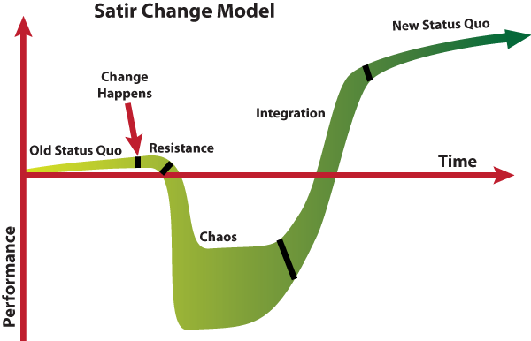

Chaos and Consequences with Money
Gambling addiction creates financial chaos
Problems are far-reaching
Client likely to be cycling through range of emotions
Therapist’s task is to help client recognize possibility of change
Notes:
Gambling addiction can create chaos in all aspects of life, including finances. The problems relating to a problem gambler’s finances may also be affecting loved ones, friends, or business partners. At this point, the gambler may be cycling through a range of emotions, including frustration, resentment, fear, anger, confusion, stress, and anxiety, as well as feeling hopeless and incompetent when it comes to dealing with financial problems. The client may feel there is no hope; that financial ruin is unavoidable. The therapist’s task is to assist the client to recognize that change is always possible.

Slide 72
Chaos and Consequences with Money
Financial issues are among the most difficult
Money and love may be intermingled
Gambler may feel threatened by attempts to change status quo
Gambler may be angered by spouse’s attempts to pull away financially or limit access to funds
Notes:
Taking an honest look at their financial situation is one of the most difficult aspects of recovery for gamblers and their loved ones. Within the family, money and love can be so intermingled that any attempt to change the financial status quo can be threatening to the gambler. If the spouse starts to pull away financially, the gambler may become extremely angry; they may become angry as their access to funds becomes limited; emotional buttons may be pushed, and arguments may ensue.

Slide 73

Enabling the Gambler: Financial Mistakes
Definition:
Loved ones’ behavior that consciously or unconsciously contributes to allowing gambling to continue.
Examples:
Covering up, lying, lending money, making gambling easier, encouraging gambling
Prognosis:
Understand the amount given will never be enough
Notes:
“Enabling” describes behavior loved ones of a gambler make that consciously or unconsciously contributes to allowing gambling to continue. If loved ones cover up for a gambler, lend them money, lie for them, make it easier for them to continue to gamble, or even encourage them to gamble, they are enabling. Loved ones must be helped to understand that in financial matters, no matter how much is given to a gambler, it will never be enough.

Slide 74
Adding “No” to the Family Vocabulary
FIRST ASSURE FAMILY SAFETY
Saying “no” can be difficult
Loved ones must be reminded that bailouts provide breathing room
Gambler must experience personal consequences of his behavior
Saying “No”
Accepting New
Boundaries
Notes:
Saying no can be difficult and at times put family members safety at risk. Before discussing attempts for family members or concerned others to withhold money or refuse a gambler's request for money, be sure to do a safety assessment. Current research has confirmed high potential for domestic violence in relationships where problem gambling is involved.
It can be challenging to say “no” to a gambler’s plea for monetary assistance, particularly when a loved one knows the consequences of the decision. If saying “no” involves others, such as children, or a mother or father, it can be incredibly hard to stand firm. The therapist’s task is to remind loved ones that bailing out the gambler provides the breathing room necessary for them to start the cycle all over again. It is when the consequences begin to affect them personally, and often in devastating ways, that gamblers may begin to face reality.

Slide 75




Limiting Gambler’s Access to Money
ONLY AFTER SAFETY OF FAMILY MEMBERS
OR CONCERNED OTHERS IS ASSURED
Step one:
Limit gambler’s access to funds
  Gambler may perceive as demeaning
  Or, limited access can provide peace of mind from temptation
Limiting access is affected by breadwinner roles
Notes:
The process of limiting the gamblers’ access to family funds should be done only after the safety of family members or concerned others is assured. Once you have made that assessment, action can begin to preserve the remaining financial resources for the family. For the gambler this may feel demeaning; however, it can be perceived as liberating and provide the gambler with peace of mind from temptation as they move through their program of change. If the spouse is the primary breadwinner, limiting the gambler’s access to funds may proceed from a position of strength. If the gambler is the primary breadwinner, the spouse may need to strengthen their position by beginning to build a separate financial history.

Slide 76
Financial Protection Plans
Close all joint accounts; open new accounts in the name of the non-gambling spouse, partner, friend, or other trusted individual
Eliminate access to any accounts opened in children’s names
Do not keep excess cash on hand
Arrange to have paychecks given to the non-gambling spouse, partner, or other trusted individual
Remove all items of value from the home to a secure place
Have the gambler surrender all interest in real property
Notes:
When talking with a gambler and their loved ones, it is important to discuss creating a financial protection plan. This is a plan that both the gambler and loved ones develop jointly to protect their money from gambling. This approach emphasizes that they are working together as a team against gambling. This is a positive way of describing this intervention and can be more effective than implying that the loved one is taking financial control away from the gambler.
Making this plan begins with a series of steps and can include closing all joint accounts and re-­opening them in the name of the non-­gambling spouse, partner, friend, or other trusted individual. Eliminating access to any accounts opened in children’s names. Deciding not to keep excess cash on hand. Arranging to have paychecks given to the non-­gambling spouse, partner, or other trusted individual. Making plans to remove all checks, credit or debit cards, insurance policies, deeds, titles to property, jewelry or other items of value from the home to a secure place where the gambler cannot gain access. And, Having the gambler sign a quit claim deed, which relinquishes the gambler’s right, title, and interest to all real property, and is done to prevent liens from being placed on properties due to the gambler’s debt.
This is the basic menu of money protection options that should be discussed and considered. More creative and situation specific options may present themselves over the course of working with gamblers and their families. Remember that along with motivation to stop gambling, there may be a very separate and different stage of motivation that the gambler experiences when it comes to dealing with money. Both the gambler and loved ones may not yet be ready to act on all these recommendations. Support where they are willing to begin and enhance motivation to develop a comprehensive money protection plan from there.

Slide 77
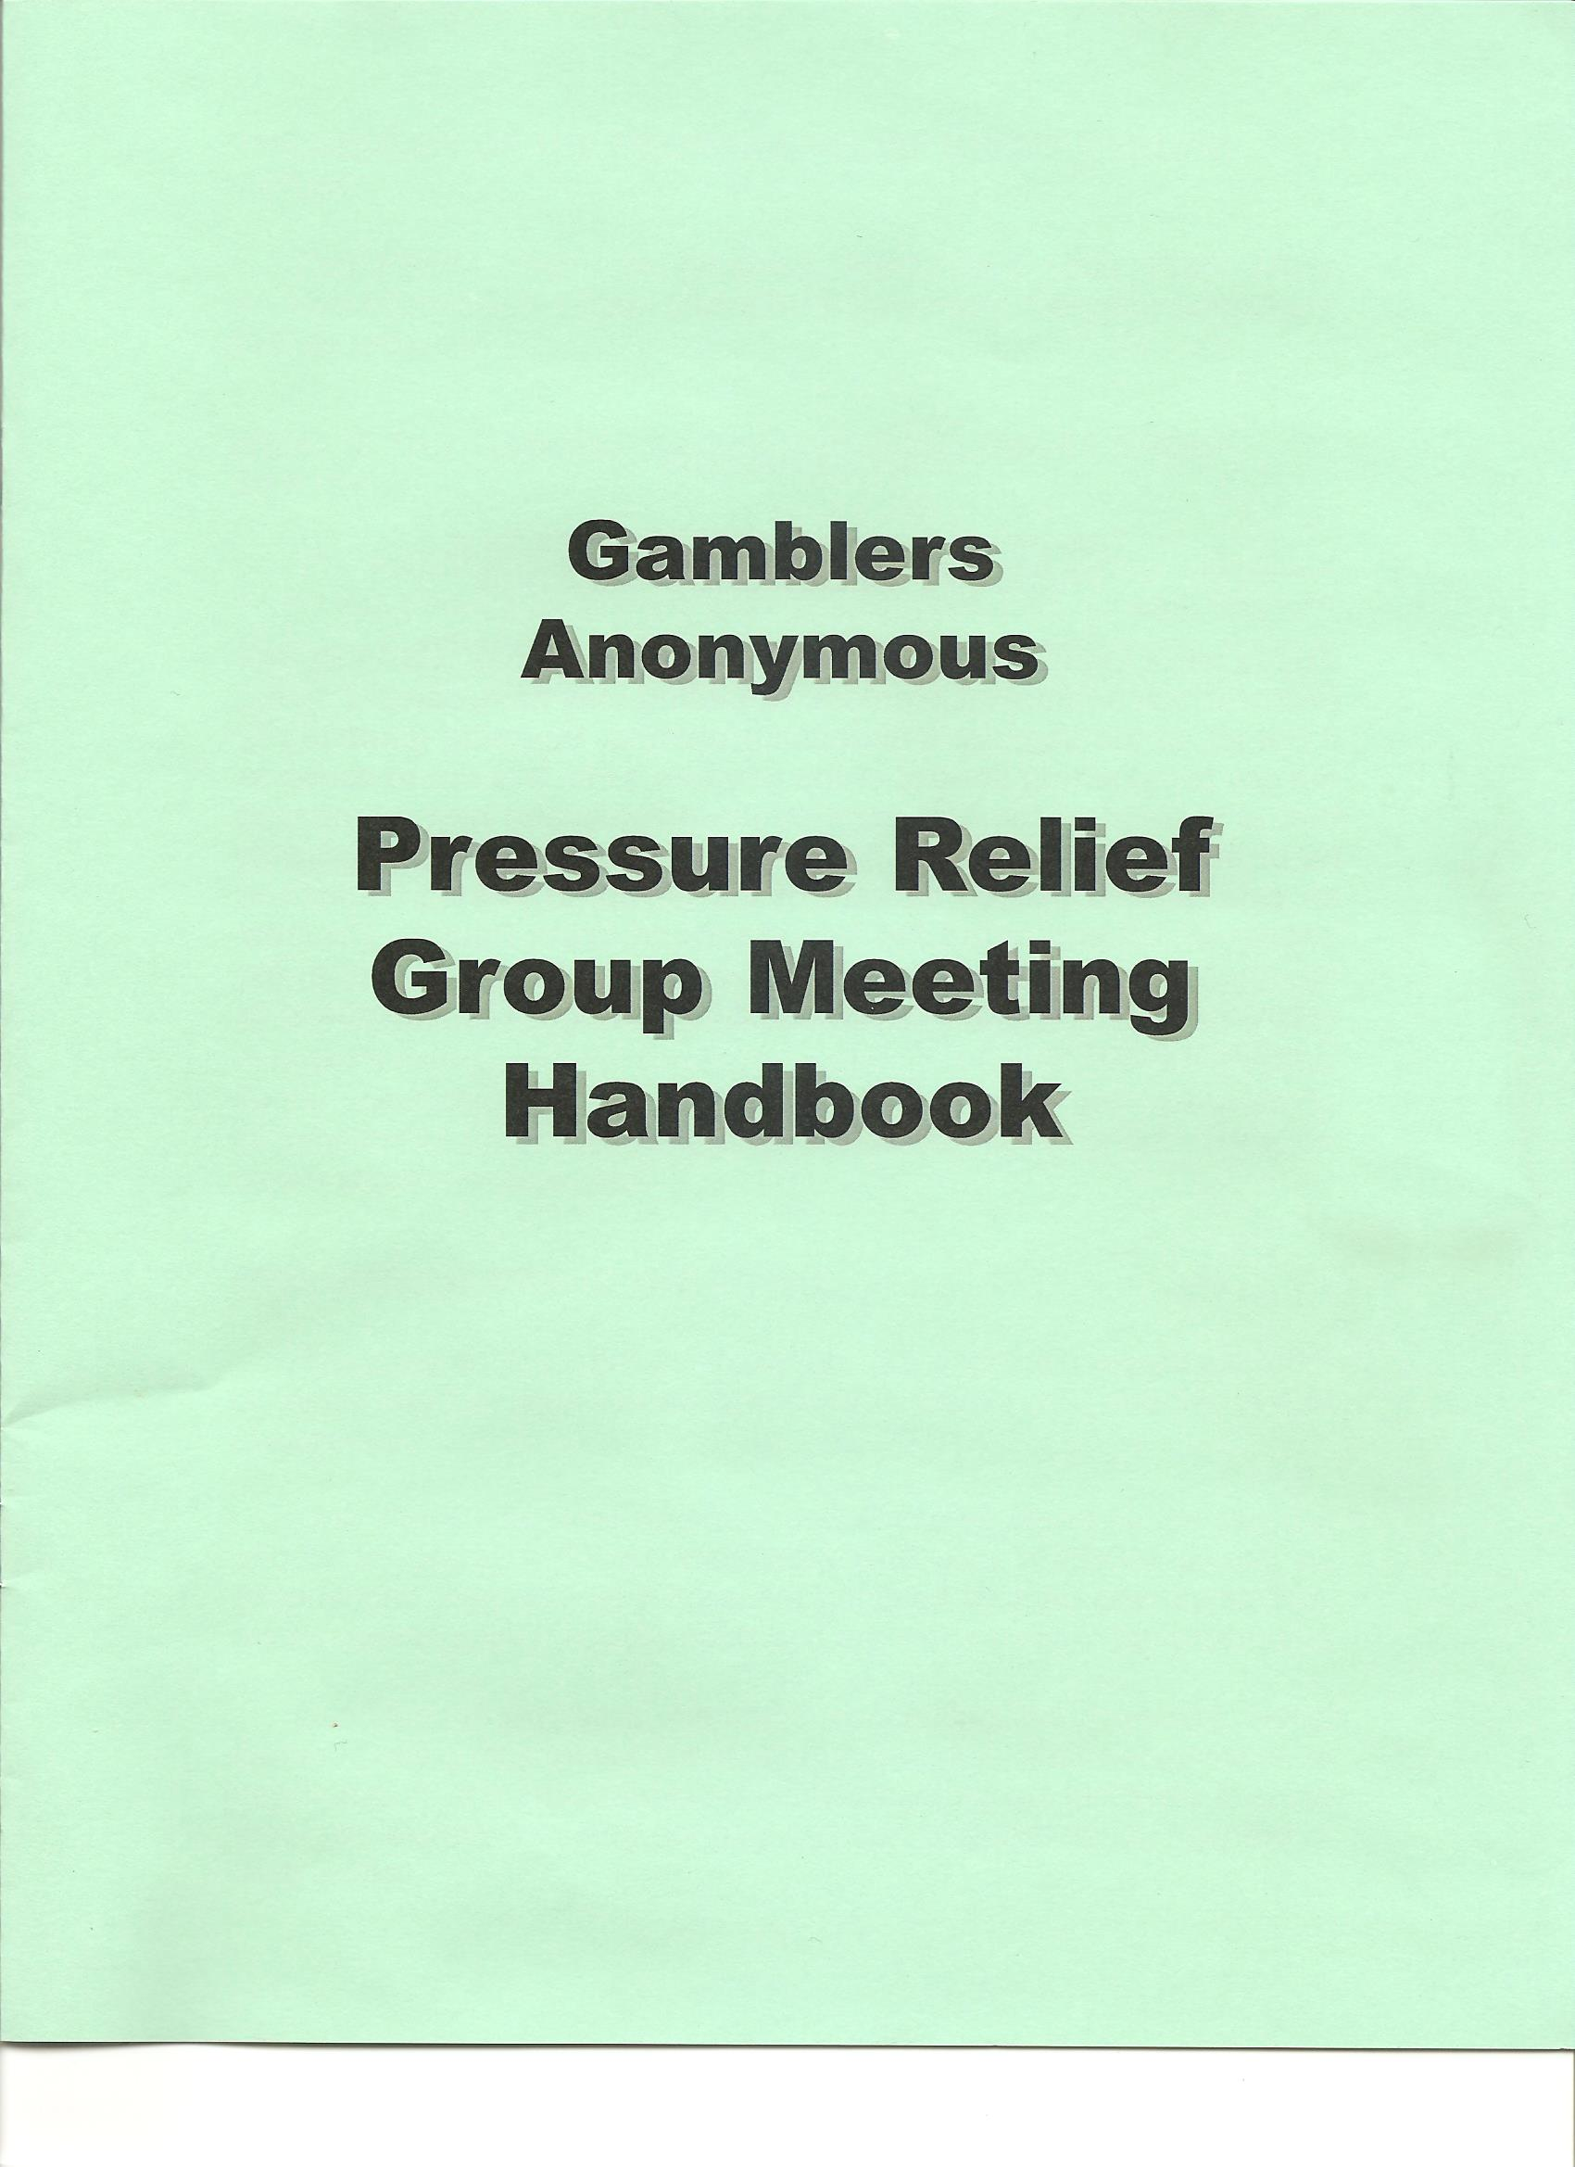
Pressure Relief: Getting the Full Picture
Complete an accurate account of present financial condition
Pressure Relief Meetings can be useful to accomplish the collection of these details if the client attends Gamblers Anonymous
Honesty is essential to overcoming financial problems
Notes:
The first step in getting to the truth is a complete and accurate account of the gambler’s present financial circumstances. This will require asking the gambler and locating documentation for all accounts, obtaining credit reports, examining balances on all charge accounts, listing any money owed to family, friends, and others, and, if applicable, examining the financial records of any businesses owned by the gambler, or the gambler and his family. The gambler being honest with themselves and others is essential to overcoming financial problems. Nothing will change until the gambler takes charge of their life, and the gambler needs to be a fully active participant in any financial recovery, even if someone else is taking over the gambler’s access to funds.
If you are not versed in all the proper questioning as a clinician, Gamblers Anonymous offers a type of meeting called Pressure Relief where meeting leaders use an in-depth packet to collect this degree of information. It can be a useful clinical activity to replicate this meeting if the client has not participated in this already as a recovery activity.

Slide 78


Special Concerns for Finances
Taxes or Quit Claim deeds may require legal assistance
Spouse and others must be alert to fraud
Debt management plans should consider impact on family
Notes:
Special concerns, such as taxes or filing a quitclaim deed may require professional legal assistance. Also, gamblers may, in desperation, falsely and fraudulently sign a spouse, partner, parent, or friend’s name to loan guarantees, credit cards, checks, or other financial documents. Any plan for management of debt should be sensitive to the impact on other family members, including careful consideration of the family’s safety.

Slide 79
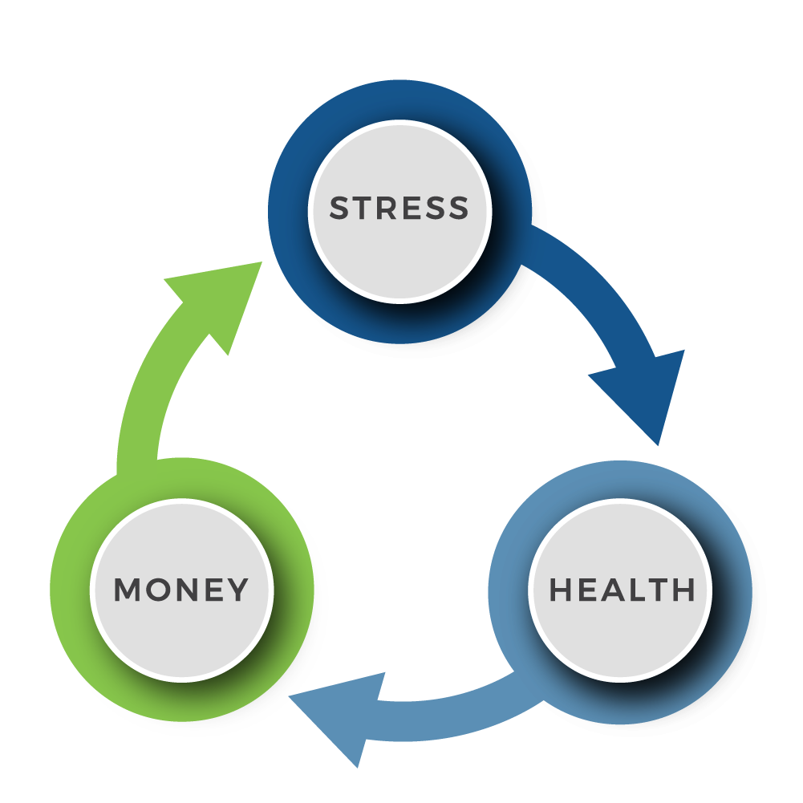
Assessing Financial Health
Gathering Documents
Analyzing Debts And Assets
Known Debt
Known Assets
Estimated Assets Used
Balance Sheet
Notes:
It is essential for the gambler to take inventory of where things stand. This includes gathering all financial documents, analyzing debts and assets, beginning with documenting all known debts and assets, estimating assets used in gambling, and constructing a balance sheet illustrating all remaining assets and liabilities. The balance sheet should detail assets, income, expenses, and debt.

Slide 80

Devising a Budget Plan
A MONTHLY BUDGET SHOULD BE MANDATORY TO HELP FAMILY BALANCE FINANCES
Budget elements
  Monthly sources of income
  Compiling a list of all expenses
  Monthly expenses
Notes:
With problem gamblers, spending habits have been skewed to prioritize gambling over other necessary expenses, often overlooking monthly bills such as rent or mortgage, utilities, and other services. Since money is the fuel for a gambling addiction, it should be mandatory as part of treatment to incorporate the construction of a financial plan into the therapeutic approach. To restore balance to family finances, the gambler needs to create a structured spending plan. This is called a budget. While the debt and assets summary produces a balance sheet, or snapshot, a budget is a spending plan, typically based on monthly expenses. The budget consists of a list of current sources of income and a list of all expenses. Cash flow equals total monthly income minus total monthly expenses. Negative cash flow means the gambler must examine spending habits and create new money management goals.

Slide 81
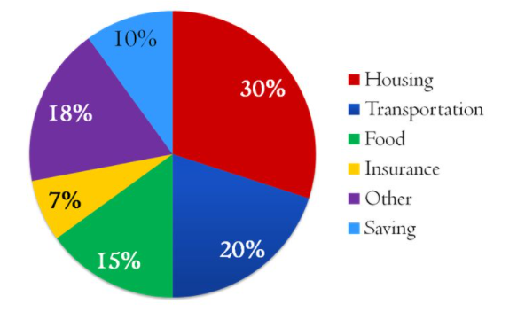
Adhering to the Spending Plan
Monthly allowance for each budget item
Include savings
Include emergency fund
Notes:
The monthly expense budget takes into account how much money will be allowed for each budget item every month. Ideally, it will also help the gambler include saving as part of the overall plan. One way to help ensure this plan will succeed is to include in the budget an emergency fund for potential expenses. Be mindful of establishing exact parameters for how this emergency fund will work, who has access, and appropriate scenarios for utilizing these funds. Especially early on, it will be tempting for the gambler to convert this emergency fund into “gambling money” so appropriate precautions should be made for any money not being utilized specifically in the planned budget.

Slide 82

Financial Counseling
Helpful for gambler and family to get back on track
Pressure Relief program is available through some GA chapters
Notes:
Financial counseling may be helpful for the gambler and family to get back on track. “Pressure relief,” a service provided by some Gamblers Anonymous fellowships, can also assist the gambler and family members in addressing financial, emotional, legal, and other problems.

Slide 83

Financial Counseling
Debt consolidation and consumer credit services
Self-help plan for debt
Reduction/repayment
Bankruptcy
Special concerns about taxes
Notes:
Debt consolidation and consumer credit services negotiate with creditors and re-­organize payment schedules and payment amounts. They also negotiate whether debt consolidation appears on a consumer credit report. In choosing a service, it is important to select one that has experience working with gamblers. Alternatively, some gamblers and their families can successfully set up their own plan for debt reduction and repayment. Often, bankruptcy may be the only option; however, this can be a form of bailout and should only be viewed as a last resort. Taxes pose special concerns as well, and professional assistance may be required to resolve issues relating to the liability for back taxes and innocent spouse relief.

Slide 84
Legal Issues in
Gambling
Notes:
Legal Issues in Gambling

Slide 85
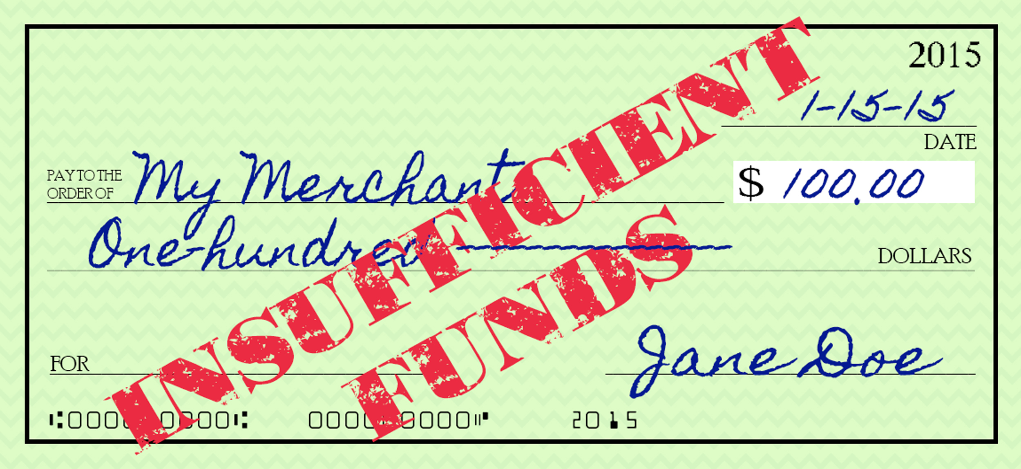

Legal Problems in Gambling Treatment
50% to 67% of diagnosed gamblers in Gamblers Anonymous have committed a crime related to their gambling
In a Florida helpline study of problem gamblers, 20% admitted crime, and 11.5% were arrested
    The Florida Council on Compulsive Gambling found adult problem and pathological gamblers were four times more likely to have been arrested than non-problem gamblers
    Adolescent problem gamblers were more likely to have stolen money and goods and bought or sold stolen property to pay gambling debts
Notes:
Studies conducted within Gamblers Anonymous and treatment settings show that 50‐67% of diagnosed gamblers have committed a crime related to their gambling. In a HelpLine study of problem gamblers, 20% admitted crime, and 11.5% were arrested. The Florida Council on Compulsive Gambling’s 2002 study found that adult problem and pathological gamblers were four times more likely to have been arrested than non-­problem gamblers, and adolescent problem gamblers were more likely to have stolen, bought or sold stolen property, and taken money from family or friends to pay gambling debts.

Slide 86
Contributing Factors to Illegal Acts
Social attachments
Personality
Addiction pressures
Multiple areas of the gambler’s life can contribute to the decision to break the law for a gambling act
Antisocial Personality Disorder (ASPD)
  15% of gamblers studied met criteria
  ASPG associated with other risk factors
Notes:
Researchers have identified three related factors that contribute to criminal behaviors in problem gamblers: social attachments, personality, and addiction pressures. Similarly, 15% of gamblers studied in treatment and GA programs meet the criteria for antisocial personality disorder. The antisocial problem gambler is associated with having held a large number of jobs, substance abuse, and early onset of gambling and non-­gambling related criminal activity.

Slide 87

Gambling & The Law
Gambling has been considered a vice in the legal system for many years
Police departments still place gambling crimes in the “vice” squad with drug and prostitution crimes
Is the client insane and not responsible, morally weak, or deserving of punishment
Notes:
Gambling has been considered a vice in the legal system for many years. Currently, police departments still place gambling crimes in the “vice” squad with drug and prostitution crimes. The primary questions related to how the legal and justice systems handle these cases focus on the culpability of the gambler. Is the client insane and not responsible, morally weak, or deserving of punishment?

Slide 88
Gambling & The Law
Is the gambler to blame, are they “ill?”
The legal system does not punish the “ill”
Persons are relieved of responsibility if they are deemed mentally challenged or psychotic – “Legally Insane”
United States v. Hinckley
  One case did find the gambler innocent because the expert testimony stated the man was a pathological gambler and that was why he stole over $100,000 from a widows and orphans fund (Conn. 1981) but…
Notes:
Furthermore, these questions often present the courts with additional concerns related to the nature of gambling as an addiction. Is the gambler to blame, or are they “ill?” This distinction must be made because the legal system does not punish the “ill.” Persons deemed ill to the point of being “legally insane” are relieved of responsibility for their actions due to being viewed as mentally challenged or psychotic. One case, the United States versus Hinckley, did find the gambler innocent because the expert testimony stated the man was a pathological gambler and that was why he stole over $100,000 from a widows and orphans fund, but…

Slide 89
Gambling & The Law
Since he was innocent by reason of insanity, he was committed to the State Hospital for care and “treatment”
Since Hinckley, the insanity defense has been abandoned at the recommendation of gambling treatment experts
Mitigating Circumstances are the focus of defense for an addicted gambler
Notes:
Since he was innocent by reason of insanity, he was committed to the state hospital for care and quote “treatment.” Since Hinckley, the insanity defense has been abandoned at the recommendation of gambling treatment experts. Mitigating circumstances are the focus of defense for an addicted gambler.

Slide 90
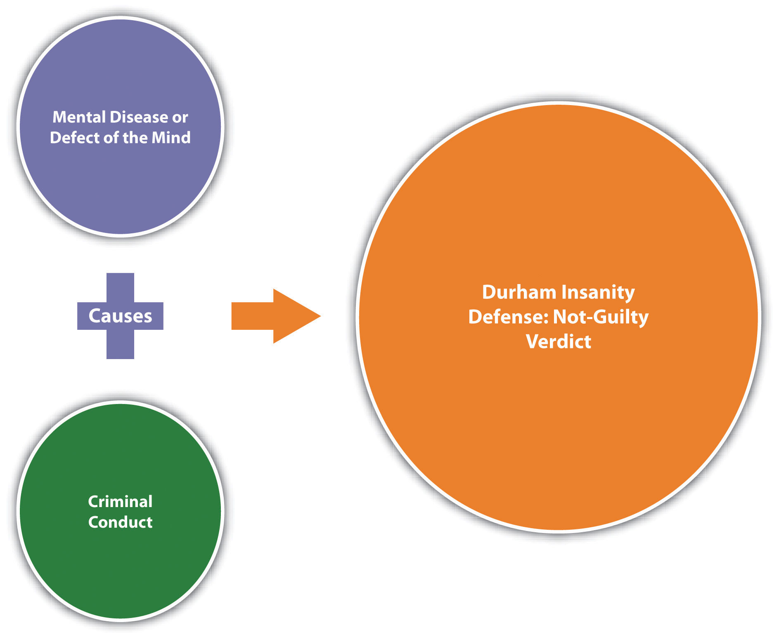
McNaughten Rule
1843 – McNaughten
  Cognitive test used across jurisdictions
  States the client does know right from wrong
Does the client know the nature and quality of the act committed?
Individual is responsible for behavior unless exceptions apply
Notes:
Several factors influence the court experience for problem gamblers. A key factor is the McNaughten rule, which governs the cognitive testing of clients. Do they know right from wrong? Minors, the psychotic, and the mentally challenged are not held at the same letter of the law as they are found to be incapable of telling right from wrong.

Slide 91
McNaughten Rule
Governs Volition test and power to choose right over wrong
Individual is responsible for behavior unless exceptions apply
Notes:
Under the McNaughten rule, an individual is responsible for his behavior, or it must be clearly proved that at the time of committing the act, the party accused was laboring under such a defect of reason from disease of the mind, as not to know the nature and quality of the act he was doing; or, if he did know, that he did not know that what he was doing was wrong.

Slide 92
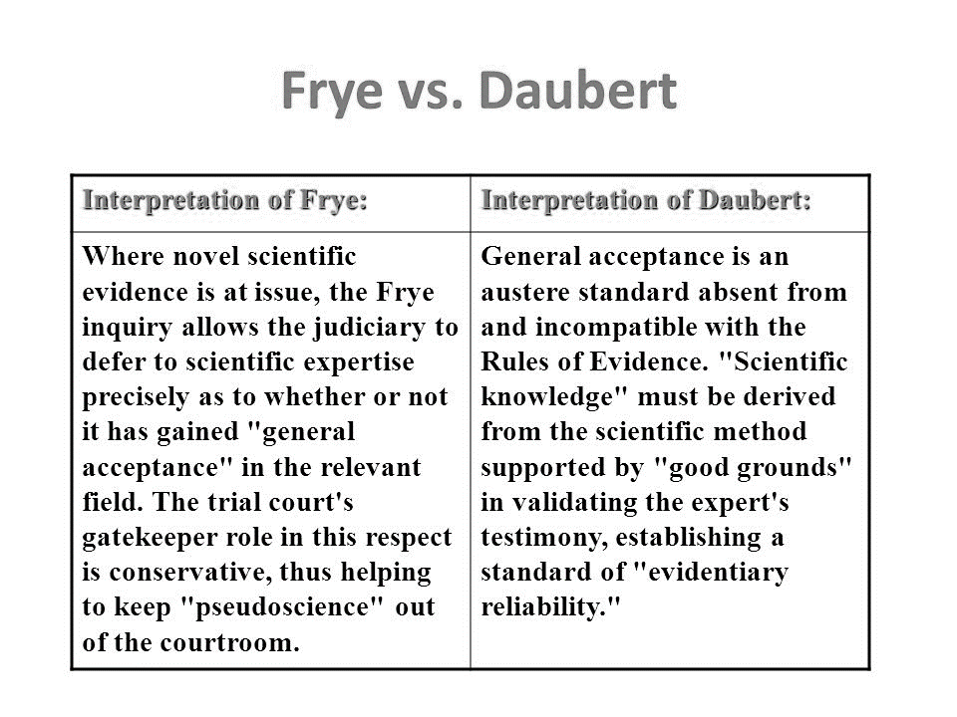
The Frye and Daubert Standards
Governs the admissibility of scientific evidence in legal proceedings
Disease vs. Defect
Courts must interpret evidence as “generally accepted” by a meaningful segment of the associated scientific community
Notes:
Closely related to the McNaughten rule are the Frye and Daubert standards, which governs the admissibility of scientific evidence in legal proceedings. To meet these standards, scientific evidence presented to the court by expert witnesses must be interpreted by the court as “generally accepted by a meaningful segment of the associated scientific community.”
Considerations for the legitimacy of the findings are introduced in the Daubert standard, which provides a check and balance for judges and juries not to be swayed by an untoward defense manipulation pretending to be scientific.

Slide 93

Counselors & Legal Standards
Knowing the McNaughten Rule and the Frye / Daubert Standards are important for clinicians who may be called upon to attest to their client’s diagnosis or state of mind in legal proceedings related to a client’s gambling behavior
Notes:
If you intend to be an expert or fact witness as part of your work with problem gamblers, knowing the related standards can be critical. For clinicians who may be called upon to attest to their client’s diagnosis or aspects of their presentation in therapy, it is useful to understand how the courts make determinations, and what questions they are seeking to be answered. Any testimony made for cases of current or past clients should be made ethically, and with the client's best interests in mind. If brought in under a court order, it is also necessary to clarify specifically what information is required and be certain to satisfy the intent of the court order while also being willing to advocate for the rights your client has to confidentiality in an appropriate manner. Any questions you have pertaining to providing testimony should be explored using your state or professional ethical codes. It is important to remember that these court proceedings require you as part of an effort to determine for the court the patients’ state of mind related to their gambling behaviors and related alleged crimes.

Slide 94
Rulings for Problem Gamblers
Mitigating circumstances have been used successfully in:
Disbarments
Tax Cases
Bankruptcies
Divorce
Civil Cases
Criminal Cases
Embezzlement
Personal Injury Claims
Bad Checks
Larceny
Forgery
Notes:
Mitigating circumstances have been used successfully in disbarments, tax cases, bankruptcies, divorce proceedings, civil cases, criminal cases, embezzlement, bad checks, larceny, forgery, and personal injury claims.

Slide 95

Alternative Sentencing
Expert testimony and alternative sentencing
  Court-ordered residential treatment
  Outpatient treatment
  Rehabilitation and Restitution
  Attendance at Gambler’s Anonymous or Gam-Anon meetings
Notes:
A clinician’s testimony can influence court decisions regarding sentencing for gambling-related crimes. Alternative sentences to jail time can include any or all of the following: court ordered treatment for the gambling disorder in a licensed treatment facility. Outpatient therapy by a licensed, certified therapist, specialized in gambling addiction; rehabilitation and restitution in which the gambler is ordered to perform community service or repay debts owed, and active participation in treatment and appropriate self-help groups.

Slide 96
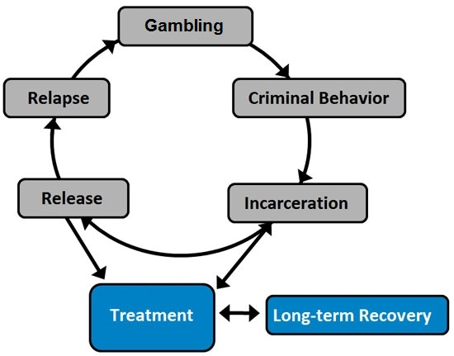
Therapeutic Justice System
Notre Dame Law Review (1999)
Court as a proactive agent of change
Intervene in cycle of criminal behavior
Rehabilitation and reduction of recidivism as a judicial goal
Notes:
Strides have been made in recent years for the justice system to acknowledge the role it can play in the recurrence and rehabilitation of addiction related crimes. Beginning with the Notre Dame Law Review in 1999, courts have begun to see themselves as proactive agents of change. When a person is charged with a crime coinciding with a psychological addiction, this establishes a cycle of behaviors, charges, incarceration, release, and then relapses propelling the sequence to re-occur. By using the criminal charges and incarceration as a process leading to the treatment of the problematic condition, courts are able to facilitate rehabilitation processes, thus decreasing the rate of recidivism among gamblers accruing criminal charges.

Slide 97

Keys to Care and Legal Issues
Primary Question:
Can Gambling Disorder be diagnosed?
  Assessment by trained and competent clinicians
  Use of valid and reliable instruments (e.g., SOGS)
  Meet DSM-5 criteria
  How is this condition affecting their behavior?
Are there any co-occurring or comorbid disorders?
Notes:
The keys to initiating the potential for therapeutic justice intervention relies on numerous considerations. Assessment – is Gambling Disorder a valid diagnostic impression for this client? Assessment should be conducted by trained and competent clinicians using valid and reliable instruments for screening the severity of gambling related issues, for example; the South Oaks Gambling Screen. The person must also meet DSM-5 criteria, both at the time of the event in question, and at the time of the court decision. Additional concerns, such as substance abuse, cross-addictions, and other psychological disorders should be screened for as well to ensure the appropriateness of court response.

Slide 98
Clinician’s Obligation to the Court
Clinician’s Obligation to the Court
  Provide Timely Reports of Client Evaluation
  Note Changes in Agency and Lengths of Care
  Provide Updates on Course of Treatment and Program Compliance
Notes:
Clinicians whose recommendations are factors in sentencing typically have obligations to the court, such as providing timely reports of client evaluation, and noting changes in agency and lengths of care. These factors focus on fully informing the court of the client’s planned course of treatment and subsequent compliance.

Slide 99
Clinician’s Obligation to the Court
Clinician’s Obligation to the Client
  Written permission to release information
  Be aware of ethical responsibilities: What “can” and “cannot” be subpoenaed
  Remember programs for impaired professionals
  Consider utilizing IRS “Innocent Spouse Provision”
Notes:
Fundamental to the clinician’s participation in judicial proceedings is securing the client’s consent to release treatment information. It is also useful for clinicians to review their ethical codes and discuss with legal counsel what can and cannot be required by a subpoena and subject to court review. In some instances, advocating for your client's privacy of information may be a more advisable, and ethical, choice depending on the specific court request. The clinician must also be knowledgeable of options that may be useful for protecting a client or loved one’s interests; for example, an impaired professionals' program that can help individuals retain professional licenses or certifications that might otherwise be jeopardized by criminal convictions. An additional option is the “innocent spouse” provision of the IRS tax code. Spouses who qualify under the provision are relieved of responsibility for outstanding tax liabilities, including interest and penalties.

Slide 100
Summary
The therapist’s first task is to engage the gambler in treatment so that recovery can begin
The clinician’s role expands to assist clients and their families with rebuilding their lives
To be most effective, the therapist must be well-versed in financial and legal issues that are unique to compulsive gambling
Notes:
When providing treatment to a gambler, a wide range of problems are possible. The therapist’s first task is to engage the gambler in treatment so that recovery can begin. As treatment progresses, the clinician’s role expands to assist clients and their families with rebuilding their lives. To be most effective, the therapist must be well­‐versed in financial and legal issues that are unique to compulsive gambling.

Slide 101
End of Session 4 Topics
1. Motivational Interviewing & Stages of Change
2. Abstinence & Natural Recovery
3. Harm Reduction
4.Financial Issues in Gambling
5. Legal Issues in Gambling
Notes:
This is the end of session four.

