Slide 1
Module 3: Research & Client Care
Presentation Year 2020
Notes:
Welcome to module three of the Arizona Department of problem gambling training on mental health treatment for gambling issues. This module is titled Research & Client Care

Slide 2
Session 3 Topics
1. Neurotransmitters & Communication in the Brain
2. Medication-Assisted Treatment
3. Case Management Issues
Notes:
Your topics for this module include Neurotransmitters & Communication in the Brain, Medication-Assisted Treatment, and Case Management Issues.

Slide 3
Supplemental Reading and Resources for this section includes:
Campbell-Meiklejohnet al. (2011) – Serotonin & Dopamine:
Dowling, Smith, & Thomas (2005) – EGM’s as a ‘crack cocaine’ concept
Alavi et al. (2012) – Behavior v. Substances in Addiction
Notes:
Supplemental Reading for this section includes:
Campbell-Meiklejohnet al. (2011) – Serotonin & Dopamine: https://dpgtraining.az.gov/Portals/0/Resources/Campbell-meiklejohn-2011-Serotonin-and-dopamin.pdf
Dowling, Smith, & Thomas (2005) – EGM’s as a ‘crack cocaine’ concept: https://dpgtraining.az.gov/Portals/0/Resources/Dowling%20et%20al%20(2005)%20-%20Electronic%20Gambling%20as.pdf
Alavi et al. (2012) – Behavior v. Substances in Addiction: https://dpgtraining.az.gov/Portals/0/Resources/Alavi%20(2012)%20-%20Behavior%20vs%20Susbstance%20Addictio.pdf

Slide 4
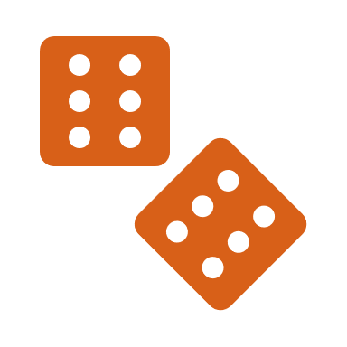
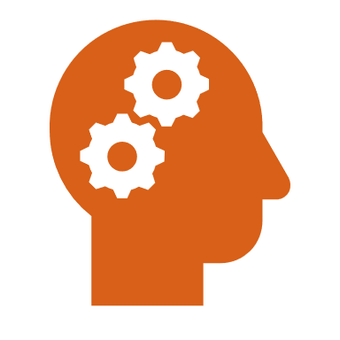
Learning Objective
To increase counselor understanding of
problem gamblers in the following areas:
Neurotransmitters
Medication Management
Interpersonal & Case Management Issues
Notes:
The learning objective for this session is to increase counselor understanding of
problem gamblers in the following areas: Neurotransmitters, Medication Management, and Interpersonal or Case Management Issues

Slide 5
Learning Objective
To increase counselor understanding of
problem gamblers in the following areas:
To be able to describe three neurotransmitter deficits and behavioral interventions that appropriately address these deficits.
To be able to effectively develop gambling specific treatment plan goals and objectives which take brain function and medication into account.
To be able to list medications currently being researched for use with problem gamblers and identify proper indications for each medication.
Notes:
The learning objectives for this module are To increase counselor understanding of
problem gamblers in the following areas:
To be able to describe three neurotransmitter deficits and behavioral interventions that appropriately address these deficits.
To be able to list medications currently being researched for use with problem gamblers and identify proper indications for each medication.
To be able to effectively develop gambling specific treatment plan goals and objectives which take brain function and medication into account.

Slide 6
Neurotransmitters & Communication in the Brain
Notes:
Neurotransmitters & Communication in the Brain

Slide 7
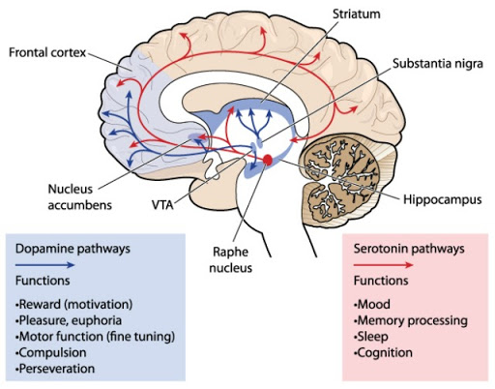
Neurotransmitter Circuits
Researchers have mapped many of the neurotransmitter circuits and regions of the brain for use with understanding the reward gamblers receive from their betting.
Notes:
Researchers have mapped some of the neurotransmitter circuits and regions of the brain. Click on the markers for descriptions of the brain functions that are illustrated in the diagram.

Slide 8
Neurotransmitter Circuits
Dopamine:
  The blue pathways indicate the dopamine system. Dopamine affects behavior and cognition, prolactin release, voluntary movement, motivation and reward, sleep, mood, attention, and learning.
Notes:
Dopamine: the blue pathways indicate the dopamine system. Dopamine affects behavior and cognition, prolactin release, voluntary movement, motivation and reward, sleep, mood, attention, and learning.

Slide 9
Neurotransmitter Circuits
Frontal cortex:
  The primary functions of this part of the brain are to govern behaviors such as risk assessment and decision-­making.
Notes:
Frontal cortex: the primary functions of this part of the brain are to govern behaviors such as risk assessment and decision-­making.

Slide 10
Neurotransmitter Circuits
Serotonin:
  The serotonin system is indicated by the red pathways. Serotonin is instrumental in the modulation of aggression, anger, body temperature, mood, sleep, appetite, metabolism, and human sexuality. Serotonin has also been associated with learning, anxiety, migraine and vasoconstriction. Selective Serotonin Reuptake Inhibitors, or SSRI’s, have proven effective in the treatment of many types of depression, anxiety, and some personality disorders.
Notes:
Serotonin. The serotonin system is indicated by the red pathways. Serotonin is instrumental in the modulation of aggression, anger, body temperature, mood, sleep, appetite, metabolism, and human sexuality. Serotonin has also been associated with learning, anxiety, migraine and vasoconstriction. Selective Serotonin Reuptake Inhibitors, or SSRI’s, have proven effective in the treatment of many types of depression, anxiety, and some personality disorders.

Slide 11
Neurotransmitter Circuits
Basal Forebrain & the Nucleus Accumbens:
  Neurotransmitters active in the cholinergic system are produced largely in the basal forebrain and transmitted widely throughout the brain. The cholinergic system activates muscles and is a major neurotransmitter in the peripheral and central nervous systems. The cholinergic system is also required for forming new neural connections that enable learning and short-­term memory, which are important processes in understanding the connection between brain chemistry and the desire to gamble.
Notes:
Basal forebrain & the Nucleus Accumbens: Neurotransmitters active in the cholinergic system are produced largely in the basal forebrain and transmitted widely throughout the brain. The cholinergic system activates muscles and is a major neurotransmitter in the peripheral and central nervous systems. The cholinergic system is also required for forming new neural connections that enable learning and short-­term memory, which are important processes in understanding the connection between brain chemistry and the desire to gamble.

Slide 12
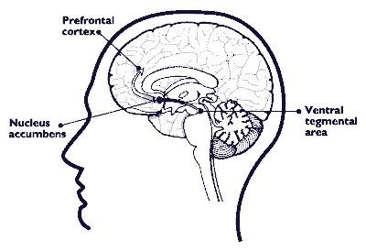
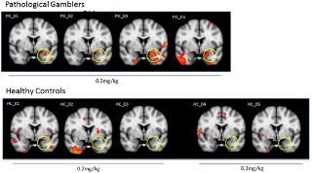
Reward Pathway: Brain Regions
Areas of brain key to addictive cycle
  Ventral tegmental area (VTA)
    Origin Location for Dopaminergic Cell Bodies
    Natural Reward Circuitry of Brain
  Nucleus accumbens
    Preoptic area of Hypothalamus, which controls Homeostatic Systems (Sleep, Temperature, Thirst, Hunger, etc.)
    Motivation, Aversion, Reward
  Pre-frontal cortex
    Planning complex Behavior, Cognition, Personality, Social / Decision Making
Notes:
There are several key areas in the brain that make up the reward pathway. In order to engage in a simple description of the reward mechanism the next several slides will be presenting the basic brain regions and their overall contributions to the experience of a psychological reward in an individual. The first is the ventral tegmental area, or VTA. This area is an originated location for many dopaminergic cell bodies and forms a natural reward circuitry of the brain. The nucleus accumbens is located in the pre-optic area of the hypothalamus and is related to the experiences of motivation, aversion, and reward. The prefrontal cortex is located in the front portion of the brain and is involved in planning complex behavior and maintaining the decision-making processes found in our cognitions, personality, and models of social decision-making.

Slide 13
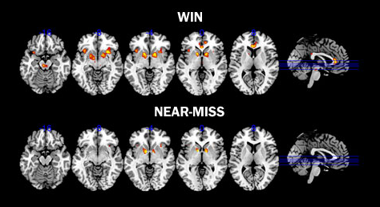
The “Near Miss” Experience
Wins vs. A “Near-Miss”
  The gambler will continue to play (and pay) because they were “close” to winning
The Gambler’s Fallacy
  Understanding of odds does not result in ceasing the behavior
  Media and Advertising has an impact on the belief in Win-Probability which contributes to the “almost” and “destined” win feeling of the player.
(Stange et al., 2016)
Notes:
The near miss experiences important to understand when providing treatment to problem gamblers. When a person experiences a near miss they often experience many of the same psychological responses as they would during the win. The turn of their emotions at the end results in the same thrill but often connects with their motivation to keep playing through their disappointment and desire to end with the victory. The gambler will continue to play and pay to play because they were close to winning.
The gambler’s fallacy connects to the near miss experience in important ways. This fallacy relies on the gamblers understanding of odds that prompts them to continue playing instead of ceasing the behavior. Media and advertising has an impact on the belief of win probability which contributes to the almost winning and destined to win feeling of the player. All these mechanisms form rules in our mind that encourage us to keep playing when logically it is not a good idea.

Slide 14
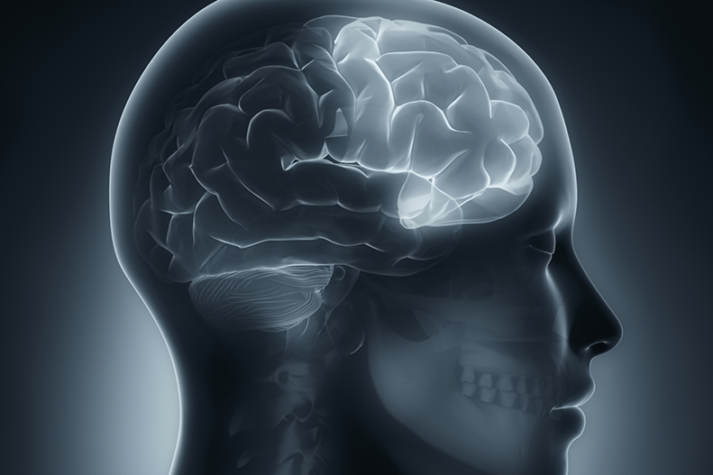
The Inhibitory Pathway
The Inhibitory System
  Located in Frontal Lobe
    Anterior Cingulated Cortex (ACC):
      Attention, Reward Anticipation, Decision Making, Morality
    Orbitofrontal Cortex (OFC)
      Emotion / Emotional Rewards & Decision Making
  Involved in Self-Regulation
  Errors in these systems could result in decision making with compulsive tendencies and overlooking adverse consequences
  Seen commonly in Addiction
ACC
OFC
Notes:
The inhibitory system in the brain is designed to help us regulate our emotions and make decisions that serve us in a positive way. The anterior cingulated cortex, or ACC, is involved in attention, reward anticipation, decision-making and our concepts of morality. The orbitofrontal cortex, or OFC, is involved in our emotion and emotional rewards in our decision-making. Errors in these systems could result in decision-making with compulsive tendencies and overlooking our adverse consequences experienced. These errors are commonly seen across many addictions including problem gambling.

Slide 15
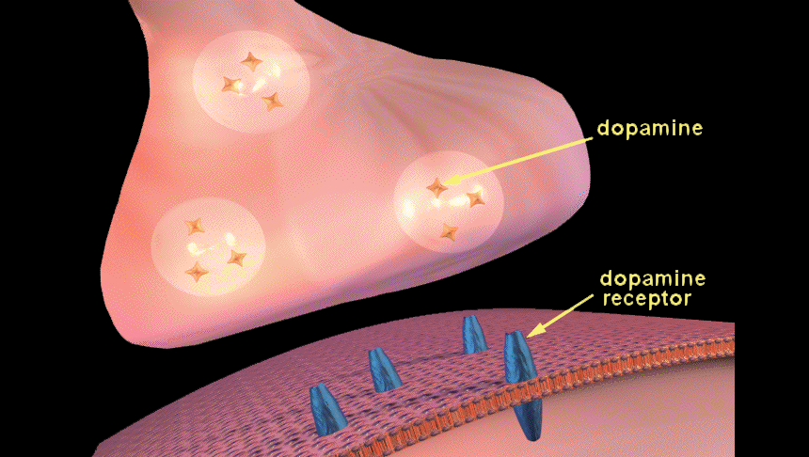
Neurotransmitters & Gambling
Neurotransmitters such as DOPAMINE
relays signals between neurons
Pre-Synaptic
Neuron
Synaptic Gap
Post-Synaptic Neuron
Notes:
Neurotransmitters, such as dopamine, are chemicals that relay, amplify, and modulate signals between one neuron and another. Communication between neurons begins when an electrical impulse (called an action potential) travels along the axon of a pre-­synaptic neuron toward the axon terminal. The action potential cannot cross the synaptic gap. When it reaches the axon terminal, it causes membranous sacs, called vesicles, to move toward the membrane of the axon terminal. The membrane of the vesicle fuses with the membrane of the axon terminal, enabling the vesicle to release its neurotransmitters into the synaptic gap. They drift across the synaptic gap and bind to special proteins called receptors on the post-synaptic neuron. The binding of a neurotransmitter to it's receptor can either trigger or inhibit a nerve in the post-­‐synaptic neuron. Brain research has found connections between gambling behavior and the levels of certain neurotransmitters in the synaptic gap. Though preliminary, the links disclosed through these findings are significant indicators of the biological basis among many individuals who have been diagnosed with gambling disorder.

Slide 16
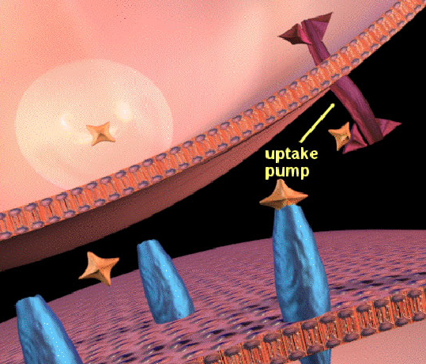
Neurotransmitters & Gambling
Once the neurotransmitter has relayed its message, it releases from the receptor back into the synaptic gap
Notes:
Once the neurotransmitter has relayed its message, it releases from the receptor back into the synaptic gap. Some of the neurotransmitter is degraded by enzymes in the synaptic gap, and some of the neurotransmitter is carried back to the pre-­synaptic neuron through transporter proteins. The neurotransmitter that is taken back into the pre-­synaptic neuron is repackaged into vesicles that can be released the next time an action potential reaches the axon terminal. The entire process repeats each time an action potential reaches the axon terminal of the pre-­synaptic neuron.

Slide 17
Neurotransmitter Depletion / Imbalance
Addictive behaviors are linked to neurotransmitter depletion
It is unclear which comes first:
Neurotransmitter deficiencies can be caused by:
IMBALANCE or ADDICTION?
Genetics, trauma, environment
Or due to a co-occurring disorder
Notes:
Prolonged exposure to addictive substances or activities is related to depletion of dopamine and other neurotransmitters. However, it is not clear which comes first; the imbalance, or the addictive behavior. The deficiency could be genetic, the result of early trauma, other environmental conditions, or the consequence of other disorders such as depression.

Slide 18
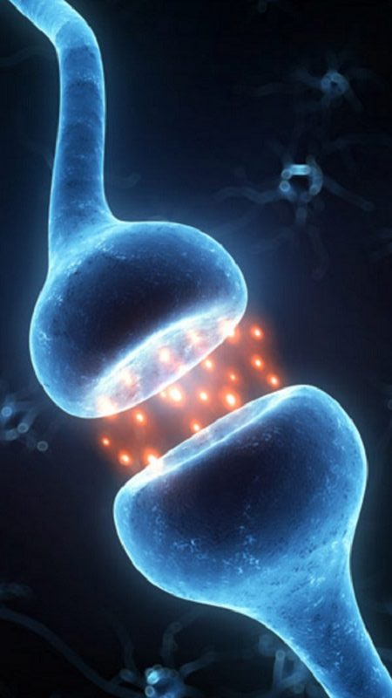
Major Neurotransmitter Systems
Dopamine System
Serotonin System
GABA
Norepinephrine
Acetylcholine
Glutamate
Notes:
Major Neurotransmitter Systems. The brain's six neurotransmitter systems have been associated with addiction. These include Dopamine, Serotonin, Norepinephrine. Acetylcholine, GABA and Glutamate. Research on gambling addiction has found evidence among the neurotransmitters, such as the dopamine and serotonin systems, as well as GABA, may have an affect on gambling behaviors.

Slide 19
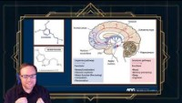
Video Lecture 6: Neurotransmitters and Brain Pathways
Notes:
https://youtu.be/ZZDfEkQqr3A
Lecture 6: Neurotransmitters and Brain Pathways **

Slide 20
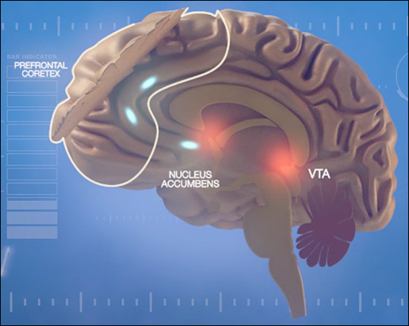
Dopamine: Learning & Memory
Dopamine’s role in the brain:
  Pleasure Center of the Brain
  Learning and Memory
  Survival Enhancing Choices
  Hijacking of the Natural System of Reinforcement
  What is Different about Gambling Addicts?
Notes:
Dopamine: Learning and Memory. Dopamine's role in the brain. Pleasure center of the brain. Learning and memory. Survival enhancing choices. Hijacking of the natural system of reinforcement. What is different about gambling addicts?

Slide 21
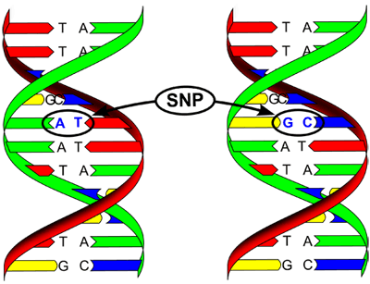
Gambling & the Brain
Summary: Gamblers with a dopamine receptor site deficit have:
D2A1 Allele
  Person has 1/3 Fewer D2 receptors, which creates…
  Negative feedback by means of reuptake process, that…
  Triggers Noradrenergic neurons which…
  Increases the release of Norepinephrine to the amygdala, thereby…
  Producing increased levels of anxiety and depression.
Notes:
Gamblers with a dopamine receptor site deficit have D2A1 Allele. Here is the process for how this affects the gamblers state.
The person has one third fewer D2 receptors, which creates negative feedback by means of the reuptake process that triggers noradrenergic neurons, which increases release of norepinephrine to the amygdala; thereby producing increased levels of anxiety and depression.

Slide 22
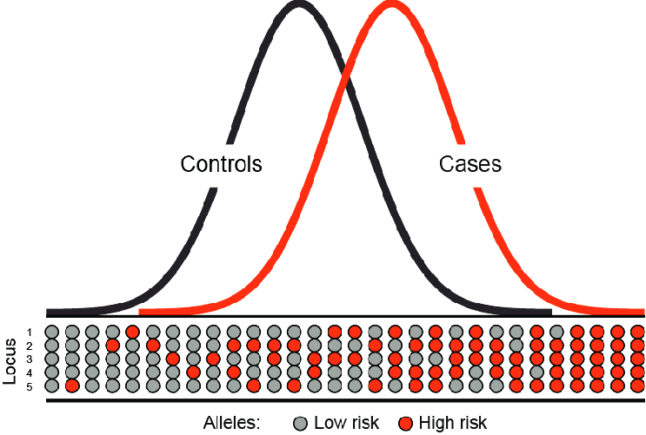
Polygenetic Model:
The Additive Effect of Neurotransmitter Genes
Gambling Disorder may be more likely to involve a broader range of genetic risk factors
Related to subtypes in Gambling Disorder, certain individuals may present genetic risk factors involving only one or two neurotransmitter systems
Subtypes of Gambling Disorder may respond to specific types of medication
Notes:
Polygenetic Model: Additive Effect of Neurotransmitter Genes. Gambling Disorder may be more likely to involve a broader range of genetic risk factors
Related to subtypes in Gambling Disorder, certain individuals may present genetic risk factors involving only one or two neurotransmitter systems
Subtypes of Gambling Disorder may respond to specific types of medication

Slide 23
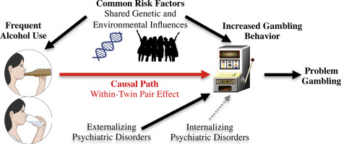
Genetic Risk Factors: Twin Studies
Slutske et al., 2000
  Problem Gambling and Gambling Disorder have many, if not all, risk factors in common.
  Relationship between problem gambling and full diagnosis is similar to that of substance abuse and dependence
  12 – 20% of genetic risk for Gambling Disorder in common with genetic risk for Alcohol dependence (less than nicotine and about the same as marijuana)
Notes:
In 2000, Slutske and colleagues explored the genetic risk factors of problem gambling and gambling disorder using a twin study. They found that Problem Gambling and Gambling Disorder have many, if not all, risk factors in common.
Problem gambling differs from Gambling Disorder in requiring fewer, not different, risk factors. The relationship between problem gambling and full diagnosis is similar to that of substance abuse and dependence. 12-­20% of genetic risk for problem gambling in common with genetic risk for alcohol dependence (less than nicotine and about the same as marijuana).

Slide 24
Medication-Assisted
Treatment
Notes:
Medication-Assisted Treatment

Slide 25
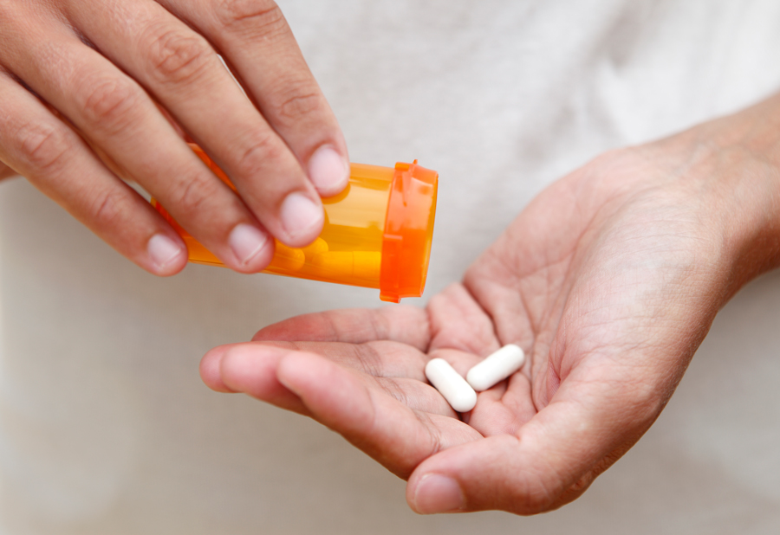
Physical Benefits of Medication-Assisted Treatment
Help achieve emotional balance
Allowing compliance to treatment structure and other supports
Maintain treatment efficacy
Failure to consider may precipitate relapse, premature termination, etc.
Notes:
Medication can help some gamblers improve emotional balance. In turn, this may help them better use structured recovery programs and support systems in a more compliant manner. Gamblers struggling to establish progress in the areas of their urge to gamble, depression, anxiety, attention problems and mood swings could potentially benefit from the helpful effects of integrating a medication assisted approach into their treatment. Completely ignoring this possibility could result in decreased effectiveness of treatment, which over time could risk precipitating relapse, hopelessness, suicidal ideation, criminal behavior, premature termination, or other activities that can disrupt or threaten treatment efficacy.

Slide 26
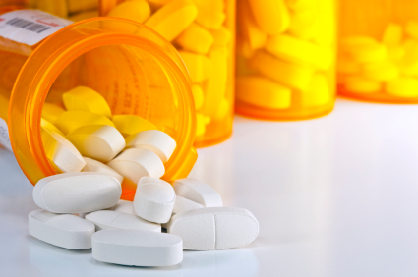
Classes of Medications
Serotonin Re-Uptake Inhibitors
Mood Stabilizers
Opioid Antagonists
Notes:
Research on the use of medication in treatment of gambling disorder is still in the early stages. The studies to date have stemmed from the recognition of the similarities between gambling behaviors, alcohol, and other drug addictions, as well as obsessive-­compulsive disorder. Consequently, the studies have largely explored the three classes of medication used to treat other addictions and impulse disorders, namely, serotonin reuptake inhibitors, mood stabilizers, and opioid antagonists, such as naltrexone. New research by Dr. Jon Grant with glutamate may indicate the use of NAC (N-acetyl cysteine) as helpful to some gamblers as well.

Slide 27

Study Descriptions
Use of medication can be promising for many gamblers
Confounding factors
    Comorbid disorders
    Gender differences
    Gambling typology
    Sample sizes
    Attrition
    Placebo effects
Notes:
In general, the use of medication with gamblers has shown promise. However, interpretation of study results has been confounded by factors such as comorbid diagnoses, gender differences, gambling typology, sample sizes, attrition, and placebo effects.

Slide 28
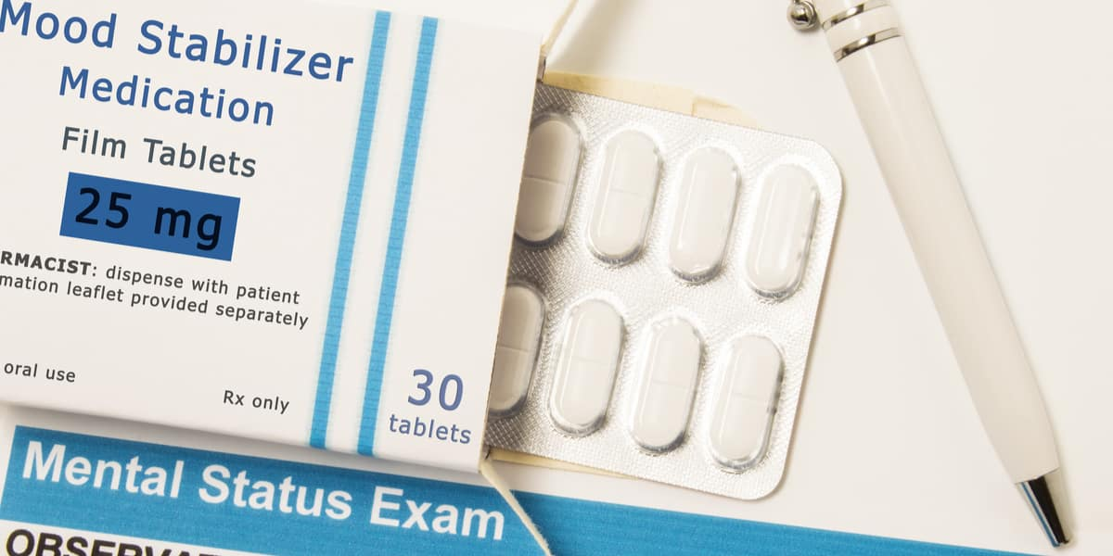
Goals: Abstinence or Harm-Reduction
How Do We Measure Treatment Outcomes?
Notes:
There is currently no consensus among researchers on how to measure treatment outcomes. Several studies have found statistically significant correlations between medications and reductions in time and money spent gambling, while other replication studies contradict these correlations, such as Carlo Blanco M.D. and colleagues as well as Eric Hollander M.D. in their examination of SSRI use.
It comes down to the dialog between the gambler, their clinician, and other requirements legally or relationally be placed upon them to decide what constitutes an effective treatment experience.

Slide 29
Selective Serotonin Reuptake Inhibitors
(Hollander, et. al, 1992, 1998, 2000)
Notes:
Selective Serotonin Reuptake Inhibitors. The earliest studies of medically assisted treatment sought to identify the utility of anti-depressants for Gambling Disorder. Selective Serotonin Reuptake Inhibitors, or SSRIs such as fluvoxamine were among the first medications in Hollander’s initial researcher into the effect of SSRI use in the treatment of compulsive gambling behavior. Subsequent researchers introduced other SSRIs, such as psyclopram, celexa, and paroxetine.

Slide 30
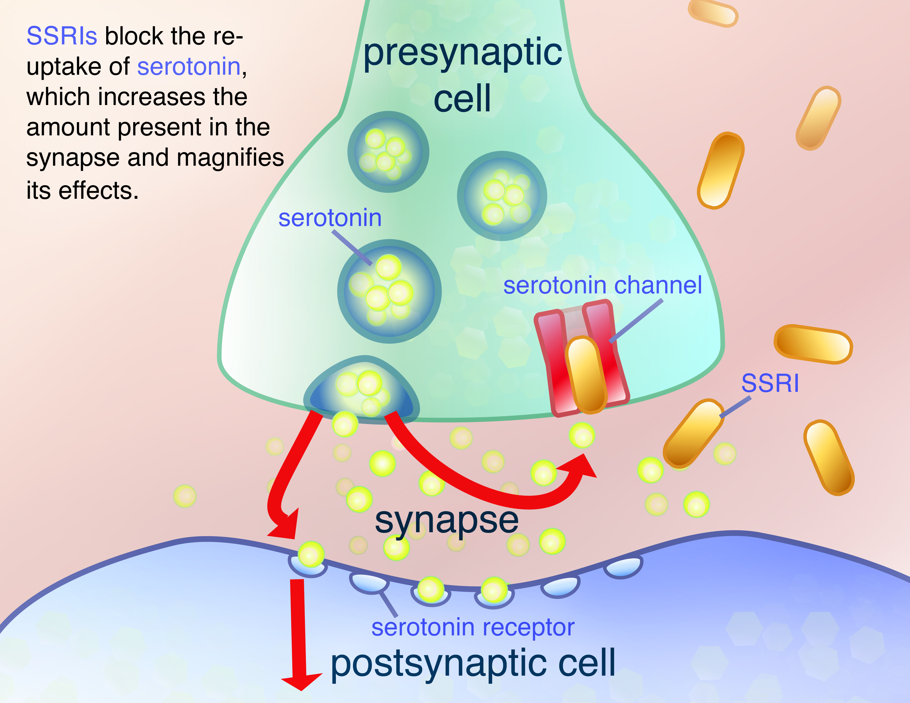
SSI Study Findings
Decreases in days gambling and amount of money lost in several studies, but not all
Decreases in subjects’ levels of depression
Improvement on the Clinical Global Impression (CGI) scale
Improvement in the Yale Brown Obsessive Compulsive Scale
Reduced urge to gamble
Significant placebo effects
Notes:
Findings from the studies of the effects of SSRIs on gambling behavior included decreases in days gambling and amount of money lost in several studies, but not all. Decreases in subjects' levels of depression, Improvement on the clinical global impression, or CGI, scale. improvement in the Yale Brown obsessive compulsive scale. Reduced urge to gamble. Significant placebo effects.
Interestingly, when the Hollander studies were replicated by Carlo Blanco, MD of Columbia, he found there to be no statistical significance relating to change in his subjects. Further research is needed to examine what type of medication may be the most helpful with which type of gambler.

Slide 31
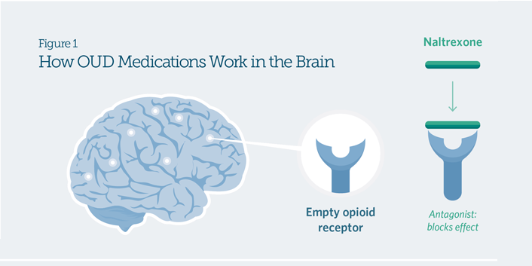
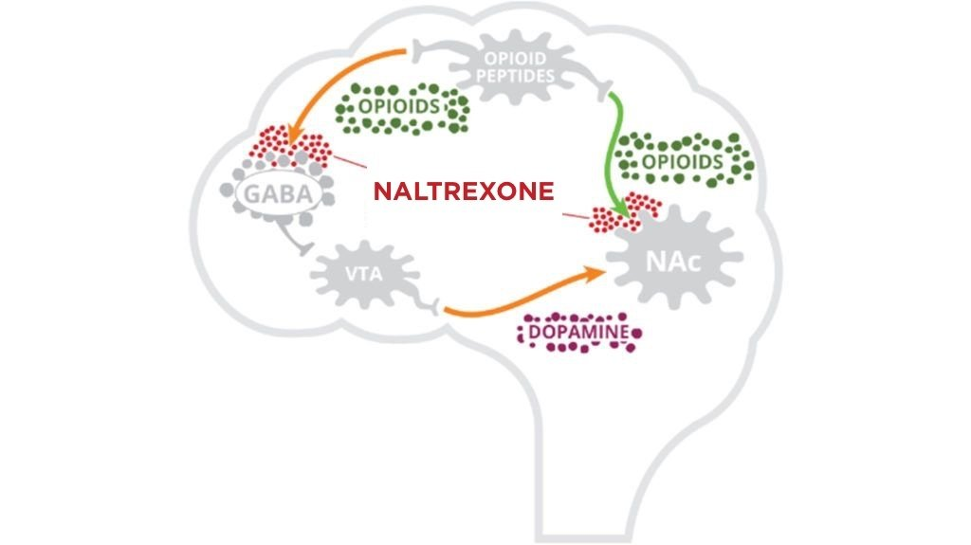
Opioid Antagonist
Naltrexone studied for its effects on impulsive behavior, including gambling
Study groups were adults meeting criteria for gambling diagnosis
Non-strategic gambling, such as slot machines, was the predominant game of choice among this study population
Results indicate the Naltrexone, coupled with basic exposure to counseling and education on risk-free alternative behaviors, may result in decreased impulsivity and depressive symptoms, and can increase perceived quality of life.
Notes:
The opioid antagonist, Naltrexone, has been studied for its effects on impulsive behavior, including gambling. Study groups consisted of men and women who met diagnostic criteria for gambling diagnosis. Predominant forms of gambling were non-strategic types, such as slot machines, bingo, and video lottery machines. Results indicate the Naltrexone, coupled with basic exposure to counseling and education on risk-free alternative behaviors, can result in decreased impulsivity and depressive symptoms, and can increase perceived quality of life.
It should be noted that this research, as well as other studies conducted prior to 2014 were based on prior DSM criteria.

Slide 32
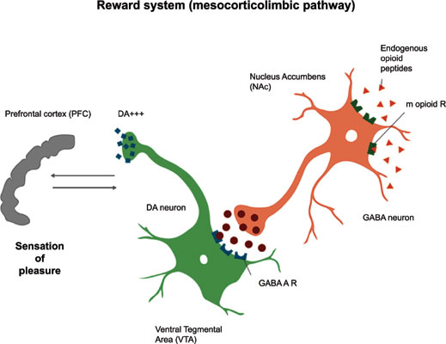
Opioid Antagonist Study Results
(Dr. S. Kim of Univ. of Minnesota)
75% of the gamblers who took naltrexone were improved or very much improved on post-treatment measures of efficacy as compared with 24% of those on placebo
Subjects who had moderate or higher levels of urge symptoms at baseline responded better to the medication
In addition to reducing urges to gamble, naltrexone reduced the subjective experience of pleasure when subjects did gamble
Long-acting versions of the medication, which may have fewer side effects, are a current focus of study.
Notes:
The controlled study, a double blind, eleven-­week trial, also excluded gamblers who had a current axis I diagnosis. Additional exclusions included any who had abused alcohol or drugs in the previous three months, or who presented with a severe personality disorder with anticipated behavioral concerns, such as antisocial or borderline personality disorders.
Opioid Antagonists Study Results. 75% of the gamblers who took naltrexone were improved or very much improved on post treatment measures of efficacy as compared with 24% of those on placebo. Subjects who had moderate or higher levels of urge symptoms at baseline responded better to the medication. In addition to reducing urges to gamble, naltrexone reduced the subjective experience of pleasure when subjects did gamble. Drug interactions between analgesics and naltrexone indicated a requirement for patient warnings and regular liver function tests. Long-acting versions of the medication, which may have fewer side effects, are a current focus of study.

Slide 33
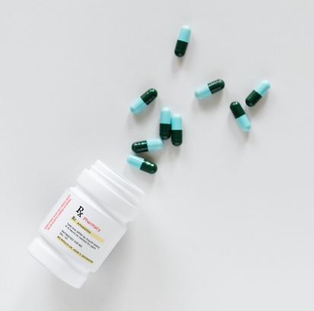
Mood Stabilizers
Discussion began with ‘Lithium and Lady Luck’, published in 1988
Article described treatment of 3 compulsive gamblers
  1800 mg/day of lithium carbonate
  All achieved abstinence that was maintained during long-term follow-up
Generalization of results limited by participation of comorbid bi-polar participants
Notes:
The discussion of mood stabilizers dates back to the 1980’s, when J.A. Mousekewitz published an article titled "Lithium and Lady Luck" in the New York State Journal of Medicine. The article described the treatment of 3 compulsive gamblers with 1800 mg/day of lithium carbonate. The three gamblers achieved abstinence and improvement and were further documented in long-­term follow up. Unfortunately, at least two of the subjects were bipolar; the observed results may have been due to the medications side effects on the underlying disorder.

Slide 34
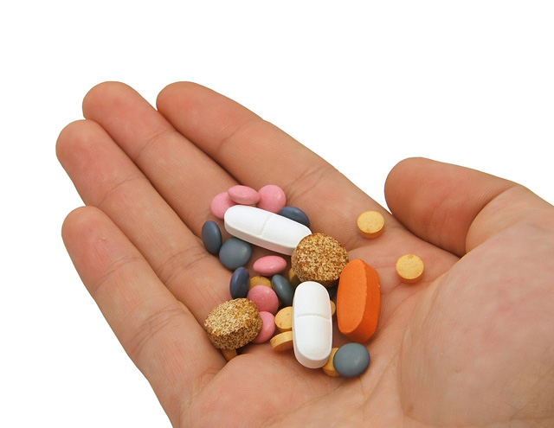
Additional Considerations
Long-term effects
Continuing efficacy
Patient non-compliance
Combining medications
Notes:
Additional research is needed to answer questions regarding the long-term effects of medication for the treatment of gambling disorder. There are also issues related to the continued efficacy of SSRIs over time, patient non-­compliance with medication regiments, particularly naltrexone, and the treatment of gambling disorder using combinations of medications.

Slide 35

Additional Considerations
Medication costs and dosage levels
FDA warnings of potential liver damage
Notes:
Medication costs and dosage levels are also areas of concern. For naltrexone, for example, the average monthly cost of treatment using the generic version of the drug is approximately six hundred and sixty-five dollars. The high cost is due in part to the high dosage required to effectively treat pathological gambling. 150 ­200 mg/day is the effective dosage. Serious life-threatening side effects, liver failure, and death must be considered, especially for those with liver related concerns due to alcohol abuse. Though the studies conducted to date have demonstrated the safety of this dosage level, some clinicians may be discouraged by FDA warnings of potential liver damage when naltrexone dosages exceed 50 mg/day.

Slide 36
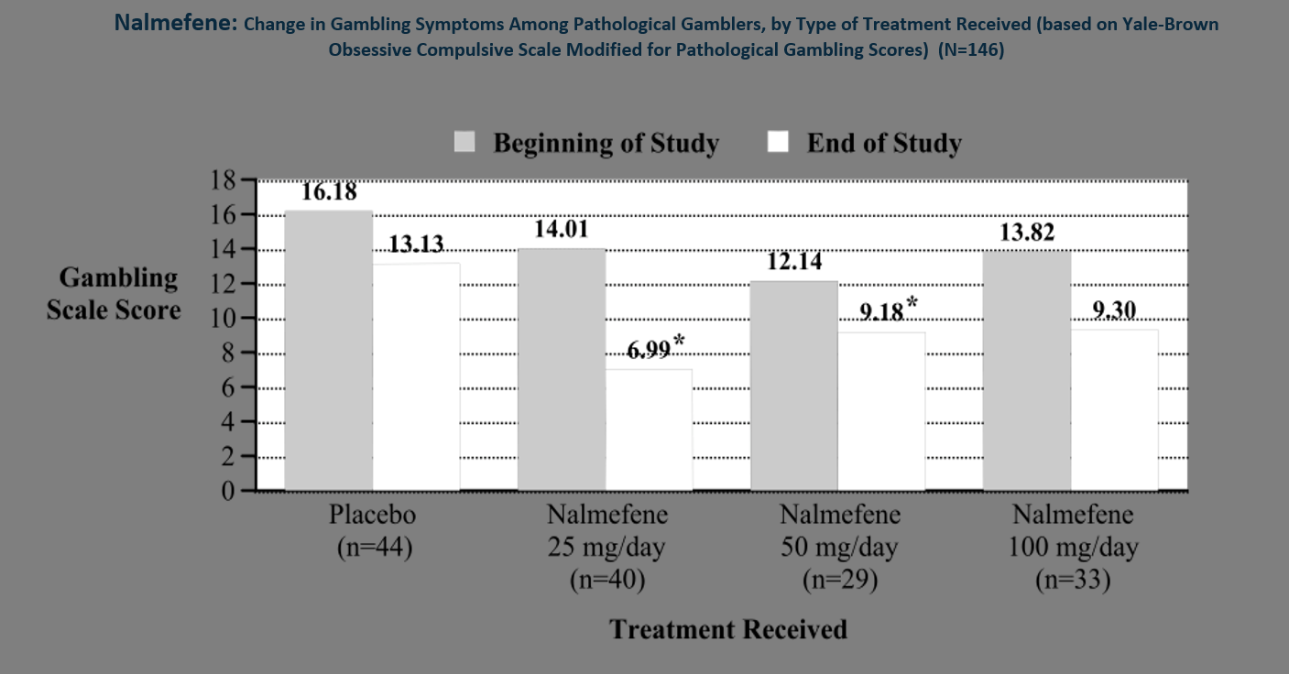
Nalmefene was approved for use in the United States in 1995 as a therapy of opioid overdose. Oral formulations, which have been used to treat alcohol dependence and other addictive behaviors, have not been approved for this use in the United States. (NCBI)
SOURCE: Adapted by CESAR from Grant, J.E.; Potenza, M.N.; Hollander, E. et al. “Multicenter Investigation of the Opioid Antagonist Nalmefene in the Treatment of Pathological Gambling,” American Journal of Psychiatry 163(2):303-312.
For more information, contact Dr. Grant at grant045@umn.edu.
Notes:
Let's look at a study where researchers looked at nalmefene and the change in gambling symptoms among sample participants based on the type of treatment received through using the Yale Brown obsessive compulsive scale (modified for pathological gambling scores). At the beginning of the study, those that were taking placebo had a gambling scale score of 16.18. By the end of the study, their score was 13.13. Those taking 25 mg of nalmefene per day scored 14.01 on the gambling score, and 6.99 at the end of the study. At the beginning for the study, those who were taking 50 mg/day of nalmefene , scored 12.14, and at the end of the study, 9.18. Those who were taking 100 mg/day of nalmefene scored a 13.82 at the beginning of the study, and 9.3 at the end.

Slide 37
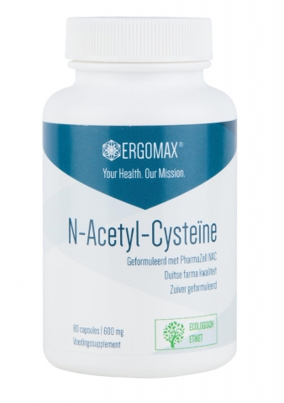
Pharmacotherapy Studies with Gambling Disorder
N-Acetyl Cysteine (NAC): Glutamatergic Supplement
  (Grant, Kim, and Odlaug 2007)
Studies have suggested levels of glutamate within the nucleus accumbens mediate reward seeking behavior.
NAC is an amino acid and cysteine pro-drug.
Reduces synaptic release of glutamate, restoring extracellular glutamate concentration in nucleus accumbens seems to block reinstitution of compulsive behaviors and decrease cravings.
N is equal to 23, decrease in PG-YBOCS 41.9%. 59.3% were treatment responders.
59.3% were very much, or much improved. Among completers, 62.5% reported abstinence.
Mean effective dose 1476.9 mg/day. None of those on psychotropic meds responded to NAC.
This is a simple amino acid available in health food stores, inexpensive and without serious side effects.
Notes:
Pharmacotherapy studies with gambling disorder. N-­Acetyl Cysteine. NAC is a glutamatergic. Studies have suggested levels of glutamate within the nucleus accumbens mediate reward seeking behavior. NAC is an amino acid and cysteine pro drug. Reduces synaptic release of glutamate, restoring extracellular glutamate concentration in nucleus accumbens seems to block reinstitution of compulsive behaviors and decrease cravings. N is equal to 23. Decrease in PG YBOCS 41.9%. 59.3% were treatment responders. 59.3% were very much or much improved. Among completers, 62.5% reported abstinence. Mean effective dose 1476.9 mg/day. None of those on psychotropic meds responded to NAC. This is a simple amino acid available in health food stores. It is inexpensive and has no report of serious side effects.

Slide 38
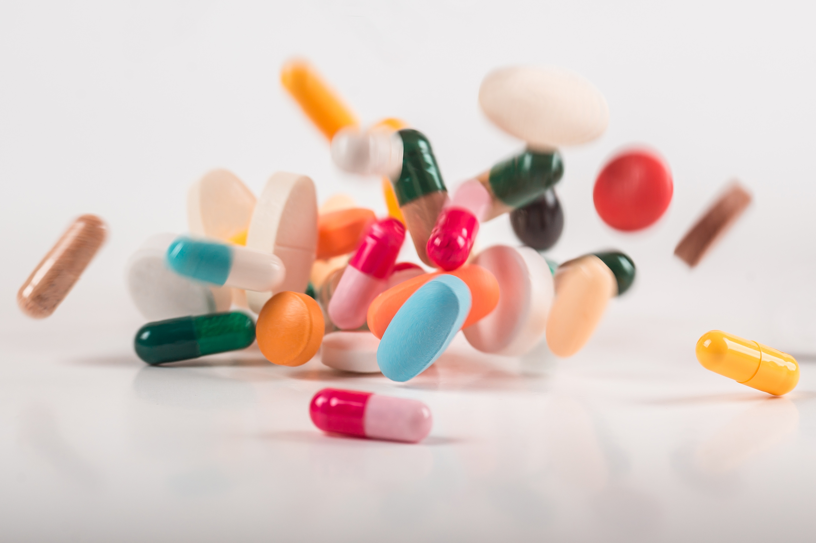
Implications
Studies are encouraging in indicating role of medication as part of total biopsychosocial treatment for gambling addiction
Need to further research to define which medications work best for which gambling subtype
Need for longer-term studies
Studies of combined effects of medication plus therapy in treatment of diagnosed gamblers
Interaction of medication, and subtype (as well as prescribing practices and gender etc.)
Notes:
Conclusions. Studies are encouraging in indication role of medication as part of total biopsychosocial treatment for gambling addiction. There is a professional need to further research to define which medications work best for which gambling subtype. Also, there is a need for longer-­term studies, and studies on combined effects of medication plus therapy in treatment of diagnosed gamblers. Additional concerns include interaction of medication and subtype, prescribing practices and gender, and others.

Slide 39
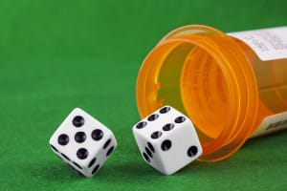
Models for Treatment with Medication
Gambling prevention medication is unlikely
Alternative treatment models should consider:
Neurotransmitter deficiencies
Kindling
Withdrawal
Cravings
Comorbidity and cross-addiction
Sub-typing
Notes:
The pervasiveness of uncertainty and risk in everyday life make it unlikely that there will ever be a medication to prevent gambling. Instead, it is helpful to consider treatment models that facilitate tailoring specific medications to individual gamblers. These models include treatment strategies that address gambling treatment concerns in terms of neurotransmitter deficiencies, kindling, withdrawal, cravings, comorbidity and cross-addiction, and sub-­typing.

Slide 40
Gambling Disorder and Norephinephrine
Opposite appears to be true for norephinephrine
  High levels found in the cerebrospinal fluid samples of diagnosed gamblers
  Gambling activity and cravings appear to be connected to levels of noradrenaline
Notes:
The opposite appears to be true for noradrenaline. 2 studies in 1989 and 1997 found high levels of the neurotransmitter in the cerebrospinal fluid in samples of diagnosed gamblers. Levels of gambling and cravings to gamble are associated with high levels of noradrenaline.

Slide 41
Gambling Disorder and Dopamine (Bergh, 1997)
Low Dopamine Levels
Higher
Byproducts Of Dopamine
Metabolism
Rapid Dopamine
Re-uptake
Notes:
Bergh's landmark 1997 study focused primarily on dopamine function and yielded intriguing results. Compared to a control group, the dopamine concentrations in the cerebrospinal fluid were lower in identified gamblers, but the byproducts of dopamine metabolism were higher. This points to rapid dopamine reuptake in persons experiencing gambling addiction. However, it is not clear if the resulting deficiency was the cause or the effect of the gambling addiction.

Slide 42
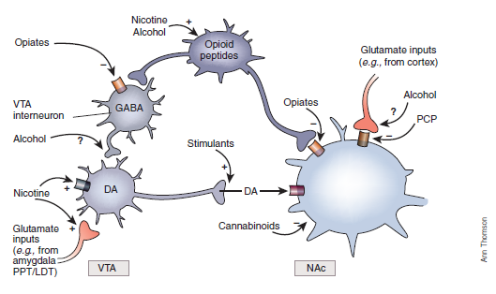
Gambling Addiction & Dopamine
Abnormality of the dopamine D2 receptor gene likely among addicted gamblers
Likelihood increases with gambling pathology
Notes:
Compared with control groups, addicted gamblers were significantly more likely to have an abnormality of the dopamine d2 receptor gene. The more severe the gambling pathology, the more likely the individual is to have the abnormality.

Slide 43
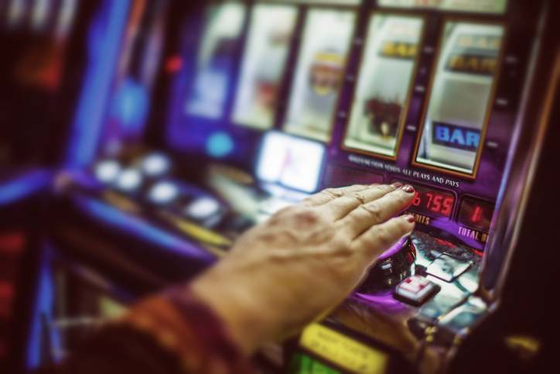
Gambling Addiction & Parkinson’s Disease
Side effect of overuse of Parkinson’s medications
Gambling subsides with reduced dosages
Notes:
Parkinson's patients who take medication to increase their dopamine levels provide further insight into the relationship between dopamine and gambling addiction. Gambling has been identified as a side effect of the overuse of medications for Parkinson’s. For those patients the gambling subsides when the dosages are reduced.

Slide 44
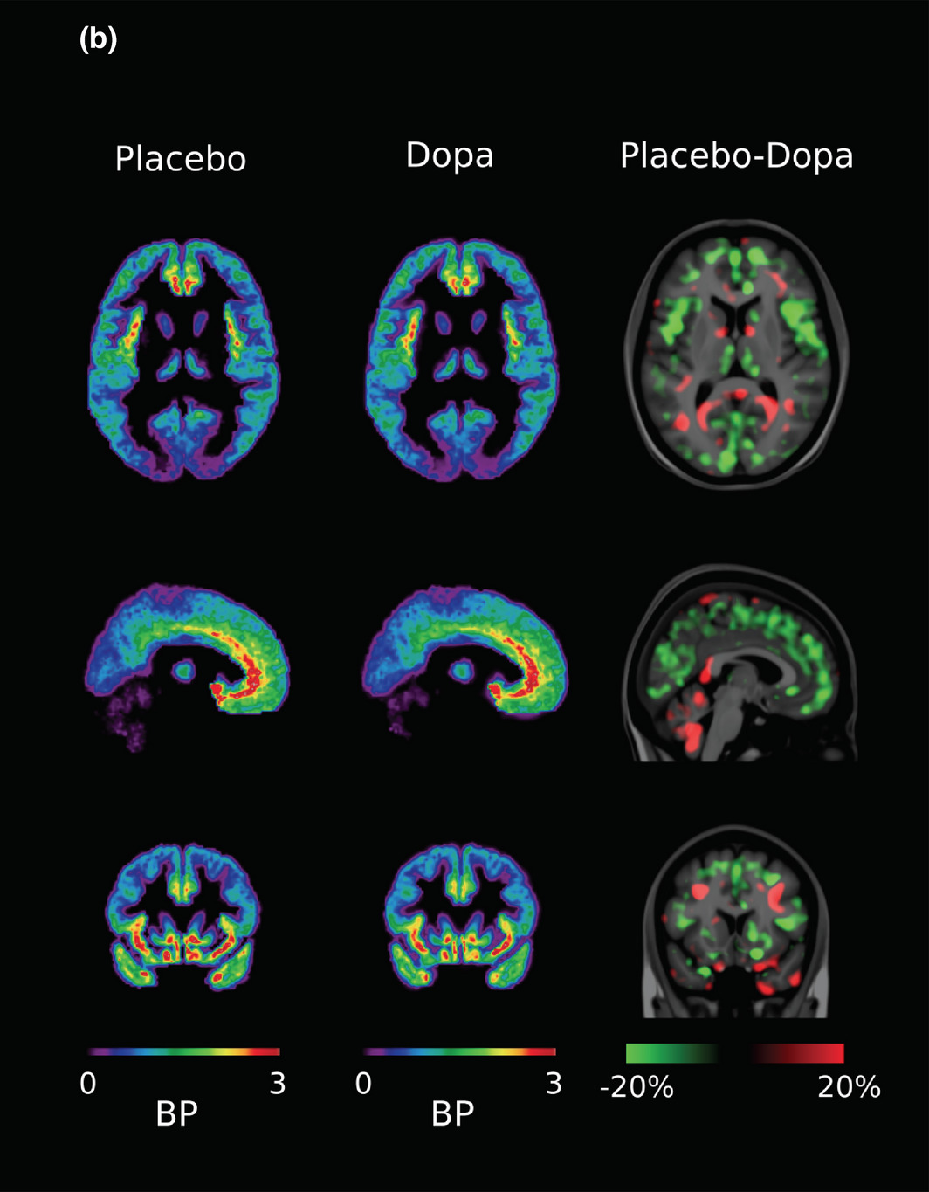
PET Scan Results
POSITRON EMISSION TOMOGRAPHY (PET)
  Scans of gambling addicted individuals’ brain activity have shown significantly lower activity in the frontal regions of the brain, which are responsible for executive function
Notes:
Pet Scan results. In one study, Positron Emission Tomography (or PET) Scans of gambling addicted individuals’ brain activity have shown significantly lower activity in the frontal regions of the brain, which are responsible for executive function. Executive function relates to abilities to delay gratification, determine good and bad, predict consequences, and suppress urges that could lead to negative outcomes.
https://onlinelibrary.wiley.com/doi/full/10.1002/brb3.1239

Slide 45
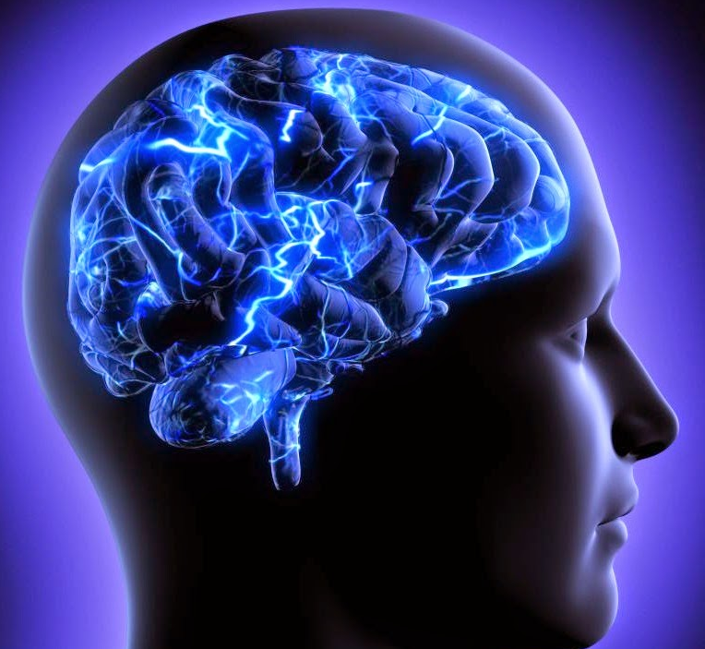
Kindling
Kindling refers to long-term changes in brain function that result from a recurrent, mild stimulus applied over time
Kindling may help to explain relapse
Notes:
Kindling refers to long-­term changes in brain function that result from a recurrent, mild stimulus applied over time. Research has shown that repeated application of stimuli can produce increasingly exaggerated responses. The response eventually begins to occur indecently, and can be evoked months or years later without any further stimulation. Kindling may help to explain the chronic relapse nature of addictive disorders, including gambling disorder.

Slide 46

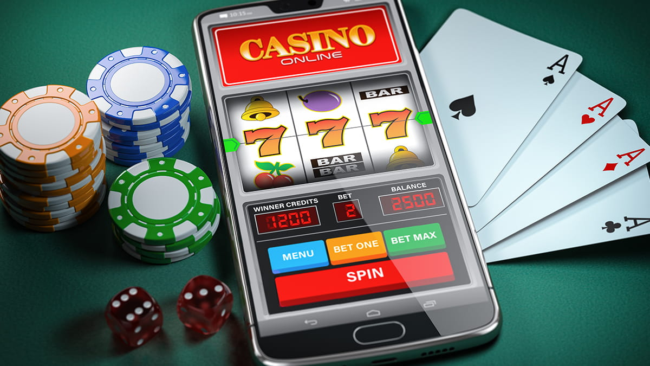
Withdrawal
Characterized by physical symptoms
Symptom severity is related to severity of gambling problem and presence of dissociation
Resolves without medical intervention
Notes:
Several studies have documented withdrawal symptoms in addicted gamblers. The more prominent symptoms are physical, and include insomnia, headache, upset stomach, physical weakness, heart palpitations, tremors, muscle aches or cramps, difficulty breathing, sweats, chills, or fever. The severity of the symptoms correlates with the number of hours spent gambling, severity of problem gambling as measured by DSM-5 criteria, and the presence of dissociation. Fortunately, withdrawal resolves itself with no need for medication to alleviate the symptoms.

Slide 47
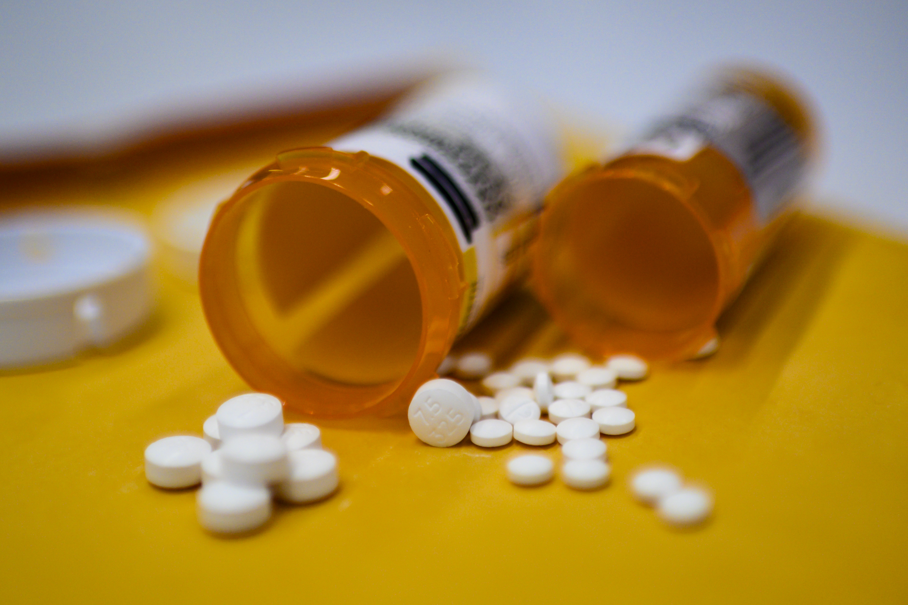
Substitute Agents
Potentially eliminate craving without encouraging the original behavior
  Example: Methadone treatment
  NO COMPARABLE CHEMICAL SUBSTITUTION AGENT EXISTS FOR GAMBLING ADDICTION
Notes:
Substitution agents take away from the craving by satisfying it in a way that does not encourage the bad behavior. For example: in the chemical dependency field, methadone is prescribed to mitigate withdrawal from heroin. Currently, no comparable chemical substitution agent exists for gambling addiction.

Slide 48
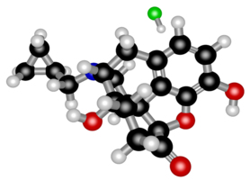
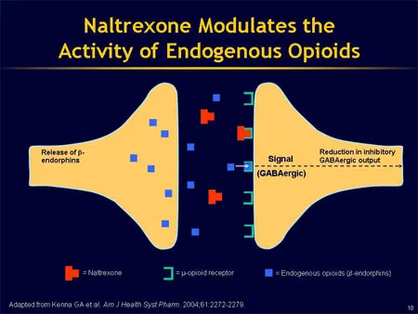
Blocking Agents
Drugs that block the excitement of gambling behavior
Naltrexone has shown promise for this purpose
Notes:
Drugs that block the excitement a person receives during their gambling would hold great promise. Early clinical trials have explored the use of naltrexone for this purpose. Two clinical trials reported the drug effectively blocked endorphin receptors, causing the gamblers to experience less pleasure from their gambling activities. Beta‐blockers may also prove helpful due to their action to block autonomic arousal.

Slide 49
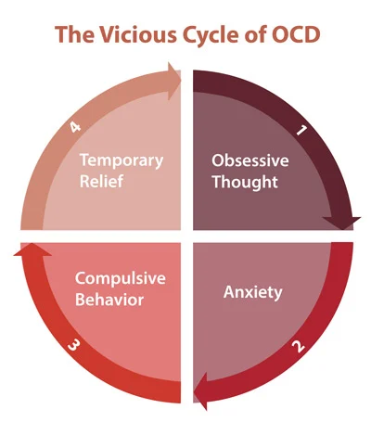
An Obsessive-Compulsive Model (OCD)
Similarities between gambling craving and
OCD suggest OCD medications would
be helpful to reduce cravings:
  Study samples have been insufficient to test the hypothesis
  OCD medications also contain anti-depressants, not all of which help control OCD
  Most promising anti-OCD medications are those containing anti-depressants that reduce serotonin uptake
Notes:
Based on the resemblances of craving in gambling addiction to obsessive-­compulsive disorder, it might seem like medications useful for treating OCD would be able to control cravings or urges for gambling. Unfortunately, this has not proven to be the case.

Slide 50

Reduction of Negative Affect
Address factors that trigger negative emotions
SSRIs and mood stabilizers have been found effective
Notes:
A fourth approach to craving is to address the factors that trigger feelings of hopelessness, shame, and guilt from which some individuals gamble to avoid. SSRIs and mood stabilizers have been shown to reduce the intensity of negative affect, interrupt the response sequence that might otherwise trigger the craving and reduce the likelihood of relapse.

Slide 51
Reasons for Gambling
Need for Spectacular Success
Rebelliousness & Anger
Freedom from Dependency
Social Acceptance
Escape from Difficult Emotions
Competitiveness
Notes:
Need for Spectacular Success:
Individuals who have a need for spectacular success may gamble to demonstrate personal worth or to get approval from others, particularly in families where gambling is valued, and being a winner confers a sense of success. These individuals may also pay inordinate attention to news concerning others who have won at gambling.
Rebelliousness and Anger:
For some gamblers, the behavior is a means of defying authority or societal norms. Anti-Authoritative attitudes may be a part of gambling's allure. These individuals may use gambling to punish others by engaging in what may be perceived as deviant behavior. Gambling may also be used to humiliate others, either through spectacular success or financial ruin.
Freedom from Dependency:
Gambling may be a substitute activity for those who feel overly dependent for approval. Individuals who feel overly dependent may gamble as an effort to be in "control" and free from the whims of others. Although the dependence is emotional, an individual may gamble in pursuit of money and financial independence.
Social Acceptance:
Some gamblers value being recognized by gaming staff and other gamblers. Gamblers in this category may boast of friendships with their bookie or gaming staff at gambling venues. For gamblers seeking social acceptance, kinship with other gamblers erases feelings of alienation. The absence of expectations or demands reduces incentives to change the gambling behavior. Also, receiving attention after a big win further reinforces the gambling behavior.
Escape from Difficult Emotions:
Unresolved grief, abandonment, or trauma may motivate some individuals to use gambling to relieve the resulting depression or anxiety. For theses gamblers intense concentration on gambling activity may blot out awareness of problems. Gambling can also have a temporary anti-­depressant effect, causing an increase in energy and a release of endorphins, which reinforces the gambling behavior.
Competitiveness:
Gambling behaviors can often be attributed to a strong need to excel against competition in certain types of gamblers. The gambler may be drawn to competitive situations because of parental neglect, social pressures, or addictive thought processes. Individuals who gamble from a spirit of competitiveness may also have family histories of a lack of bonding with their fathers, a family emphasis on achievement and material success, parents with overly critical, demanding, or passive styles of interaction, and family taboos against quitting short of completing a goal.

Slide 52
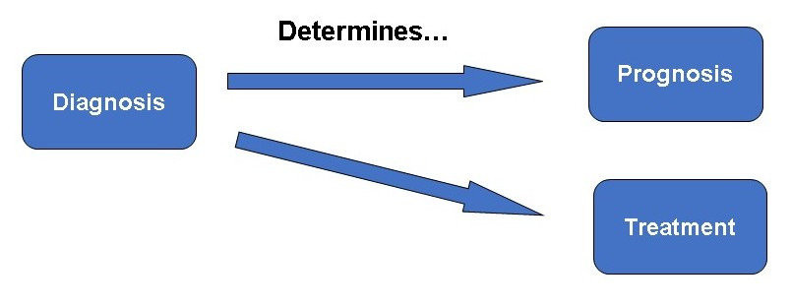
Sub-Typing
Treatment tailored to patient characteristics
Incorporates knowledge of different gambling
Motives, triggers, and progression are considered in assessing treatment needs and prognosis

Slide 53

Sub-Typing: 3 Type Theory
Further approach to sub-typing correlates clinical syndromes with neurotransmitter deficits
Three resulting sub-types are:
Multi-compulsive
Sensation Seeker
Apathetic gambler
Notes:
Another potentially useful approach would correlate specifically between clinical syndromes and neurotransmitter deficits. In this regard, clinicians may encounter three sub types: The multi-compulsive, which suggests low levels of serotonin that may respond to treatment with SSRI’s. The sensation-seeker, whose compulsory engagement in exciting activities may include a dopamine deficit, for which MAO inhibitors might be appropriate. For the third type, the apathetic gambler, whose motivational syndrome has been linked to low dopamine levels. This group would benefit from treatment with naproprian.

Slide 54
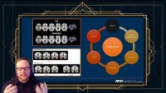
Video Lecture 7: Neuroscience & Addiction Similarity
Notes:
https://youtu.be/kFNpcSQ745A
Addiction and Brain Similarities **

Slide 55

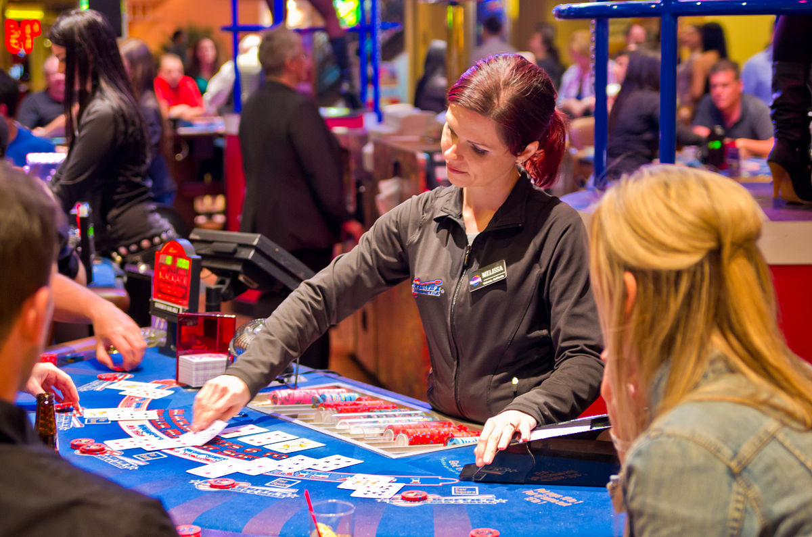
Summary
COMPARISONS BETWEEN PROBLEM
GAMBLING AND SUBSTANCE ABUSE
Other models
    Combined evidence suggests several disorders may be present
    Additional research is needed
    Comorbidity considerations are the clearest indication for using medication
    Genetic profiling in the future may prove promising
Notes:
Until now, researchers and clinicians have explored the utility of medications in cases of substance abuse and compulsive behavioral conditions. The goal of these efforts is to identify potentially effective medication regimens for gambling addiction. Today, gambling disorder is diagnosed as a Non-Substance Related Addictive Disorder through the implementation of the DSM-5, and has been determined by the American Psychiatric Association to be a behavioral addiction. Addiction to gambling is understood to be a neurochemical process approximating the same addictive reactions as found in other disorders from the "Substance-Related and Addictive Disorders” category. Several disorders may present in tandem with gambling addiction, and much remains to be discovered about the interrelationships between gambling addiction, bipolar disorder, depression, substance-abuse, and personality disorders. Comorbidity remains the clearest indication for incorporating medication into the treatment of gambling. Medications can be used to reduce specific symptoms which serve to preserve and reinforce behaviors from other conditions. Another indication is for making negative emotions, such as feelings of guilt, shame, helplessness, and decreased mood more tolerable. A final indication for the medication of gamblers would be to reduce urges or cravings to gamble. Problems with compliance are significant, but are reduced when medications are used in conjunction with more holistic approaches. In the future, it may be possible to utilize genetic profiling with clinical subtypes of gamblers, which would expand the concept of providing the best opportunity for recovery for gambling individuals.

Slide 56
End of Session 3 Topics
1. Neurotransmitters & Communication in the Brain
2. Medication-Assisted Treatment
3. Case Management Issues
Notes:
This is the end of session three.

