Slide 1
Module 2: Understanding Problem & Pathological Gambling
Presentation Year 2020
Notes:
Welcome to module two of the Arizona Department of problem gambling training on mental health treatment for gambling issues. This module is titled Understanding Problem & Pathological Gambling

Slide 2
Session 2 Topics
1. Typology Of Problem Gamblers
2. Comorbidity & Co-Occurring Disorders
3. Family Counseling
4. Crisis Intervention
Notes:
Your topics for this module include overview and basic knowledge, history and scope of gambling, national prevalence of gambling issues, describing gambling disorder, and screening and assessment.

Slide 3
Supplemental Reading and Resources for this section includes:
Tremblay et al. (2018) – Couples and Gambling Treatment
Ferland et al. (2008) – Gambler & Spouse:
Notes:
Supplemental Reading for this section include & links:
Tremblay et al. (2018) – Couples and Gambling Treatment: https://dpgtraining.az.gov/Portals/0/Resources/Tremblay-2018-The-experience-of-couples-in-the.pdf?ver=vVfpmOXIvTR6j6QGDCvyuQ%3d%3d
Ferland et al. (2008) – Gambler & Spouse: https://dpgtraining.az.gov/Portals/0/Resources/Ferland-2008-Consequences-of-pathological-gamb.pdf

Slide 4
Typology of
Problem Gamblers
Notes:
Typology of Problem Gamblers

Slide 5

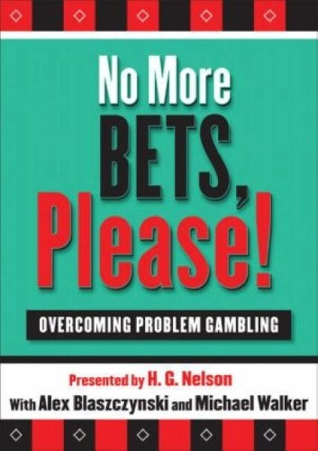
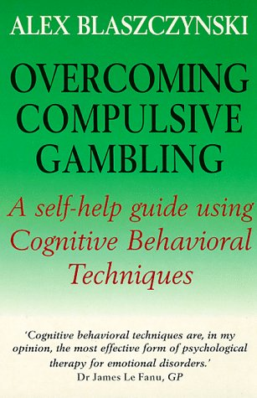
Understanding Gambler Types
Model based on causal factors
    Absence of pre-morbid psychopathology
    Predisposing psychological vulnerability
    Predisposing biological vulnerability centering on impulsivity and attention-deficits
Notes:
You’ve already learned about the pathways model in session 1 and the work of Alex Blazczynski. The method of identifying and understanding gambler type Blazczynski proposed is an alternate paradigm for conceptualizing problem and pathological gamblers. Blazczynski’s typology is based on etiological, or causal, factors rather than simply basing the type on gender or the type of game being played. Blaszcynski’s “pathways” model includes three pathways explaining different ways problem and pathological gambling may develop. The first is for those with an absence of premorbid psychopathology. The second, for those with predisposing psychological vulnerabilities. The third for those with predisposing biological vulnerabilities centering essentially on impulsivity and attention deficit factors.

Slide 6
Path 1: “Normal” Problem Gambling
GAMBLING
ABSENCE
OF
PRE-MORBID
PSYCHOPATHOLOGY
PRESENCE
OF
PSYCHOSOCIAL
PROBLEMS
Blaszczynski’s Pathways Model (2000)
Notes:
In Blasczynski’s first instance, the group is characterized as normal problem gamblers. This group is most likely to meet clinical criteria for Gambling Disorder at the peak of their excessive gambling. These gamblers are notable for the absence of any significant premorbid psychopathology. Problems arise as a result of bad judgment; any other features, such as substance abuse disorders or depression are usually seen as the result of the ongoing presence of gambling behaviors and the ensuing negative consequences rather than as a causal factor. These gamblers are often better motivated to seek help and comply with treatment recommendations. Brief interventions and short-­term counseling are thought to be beneficial for this group.

Slide 7
Path 2: “Emotionally Disturbed” Gambling
PROBLEMATIC AFFECTIVE STATES
MEETS NEEDS
THROUGH
GAMBLING
PREDISPOSED
PSYCHOLOGICAL
VULNERABILITY
Blaszczynski’s Pathways Model (2000)
Notes:
The second subtype of gamblers are the emotionally disturbed gamblers and are characterized by the presence of predisposed psychological vulnerability. According to Blasczynski, gambling for this group is thought to be motivated by a desire to modulate affective states or meet specific psychological needs. Negative childhood experiences and family histories of addiction are typical. This subgroup is more likely to present with heightened levels of pathology. Treatment should include stress management and problem-solving skills, empowerment techniques for enhancing self-­esteem, and possible medications to stabilize any comorbid psychiatric disorders. Long-­term treatment for family of origin issues should be considered.

Slide 8
Path 3: “Biologically Dysfunctional” Gambling
CONCENTRATION &
CONDUCT ISSUES
AFFINITY
FOR IMPULSIVE BEHAVIOR
NEUROLOGICAL
or
NEUROCHEMICAL
DYSFUNCTION
PERSONALITY
BASED
PATHOLOGY
PRESENCE of
GAMBLING
DISORDER
Blaszczynski’s Pathways Model (2000)
Notes:
Biologically dysfunctional gamblers are the final subgroup. They are defined by the presence of neurological or neurochemical dysfunction reflecting impulsivity and attention deficit features. Personality defects are likely, especially involving the dramatic emotional or erratic disorders of Cluster B in the DSM. With this type of gambler, antisocial traits are not uncommon. Their histories often involve traits of attention deficit hyperactivity disorder, or other conditions effecting concentration and momentary focus. These gamblers typically develop an early onset and are thought to be the most difficult to motivate for treatment while showing the least compliance. Gamblers in this group are also likely to have comorbid psychopathology and issues relating to dysfunctional families of origin.
Biologically Dysfunctional Gamblers often manifest high levels of impulsivity, reward deficiency, diminished response to punishment, inability to delay gratification, sensation-­seeking, and a low tolerance for boredom and frustration. Structure and organization in treatment are especially important for this group, and relevant medications should be considered.
This concludes typology of problem gamblers, the first module of session 2. Over the next few modules, you will build on your knowledge with an exploration of comorbid disorders and treatment interventions for problem gambling.

Slide 9
Comorbidity &
Co-Occurring Disorders
Notes:
Comorbidity and Co-Occurring Disorders

Slide 10
Psychiatric Comorbidity with Diagnosed Gambling Disorder
Affect
Disorders
~33-76%
~9-40%
Anxiety
Disorders
~5-30%
Trauma
Gambling
Disorder
Attention Deficit
Disorder
Substance Use
Disorders
~25-63%
Personality
Disorders
~20-40%
40-93%
Notes:
From the inclusion of gambling as a focus of treatment and research, clinicians and researchers have found significant rates of co-­occurring psychiatric disorders, such as depression, affect disorders, trauma, substance abuse, anxiety disorders, ADHD which is of specific concern if undiagnosed in childhood but manifests by gambling and other related behaviors in adulthood, and finally personality disorders.

Slide 11

Psychiatric Comorbidity
Prevalence of co-occurring and comorbid disorders
Impact of comorbid disorders on the presence of gambling behaviors
Progression of the disorder
Treatment strategies
Interactions between gambling and psychiatric disorders
Notes:
Our discussion will cover the prevalence of co-­occurring of comorbid disorders, the impact of comorbidity disorders on the presence of gambling behaviors, progression of the disorder, treatment strategies, and interactions between gambling and other mental disorders.

Slide 12

Comorbid Disorder Prevalence Estimates
Neurodevelopmental Disorders
20% to 35% of problem gamblers are affected by Attention-Deficit/Hyperactivity Disorder (ADHD)
With ADHD, gambling may be used to slow down thinking, improve concentration, and “feel normal.”
(Rosenthal, 2001; Rosenthal & Rugle, 2008)
Notes:
For neurodevelopmental disorders, especially attention-deficit/hyperactivity disorder, the overlap rates vary from 20-­35%. It is thought that a gambler with ADHD uses gambling to self-­medicate. Research indicates that gambling focuses their attention, allows them to slow down their thinking process, improve concentration, and “feel normal.”

Slide 13

Comorbid Disorder Prevalence Estimates
Suicidal Ideation and Suicide
  20% of survey respondents reported suicide attempts and 77% reported suicidal ideation.
  A 1994 study showed that 28.6% of compulsive gamblers attempted suicide versus 7.25% of a non-problem gambling control group.
  Persons diagnosed with Gambling Disorder are nearly 3x more likely to attempt suicide.
Notes:
Reported rates of suicide vary from 12% to over 27%. In a study of Gamblers Anonymous members, 20% reported suicide attempts, and 77% reported suicidal ideation. A 1994 study found that 28.6% of pathological gamblers had attempted suicide, compared to 7.25% in a non-­‐problem gambling control group. The National Research Council, in 1999, noted, however, that other possible factors, such as depression, have not been adequately understood in this respect. Nationally, according to the DSM 5, suicidal ideation is experienced by nearly 50% of diagnosed gamblers, with around 17% following through on suicide attempts.

Slide 14

Comorbid Disorder Prevalence Estimates
Mood Disorders
  50% to 80% of gamblers in treatment are affected by mood disorders
  Major Depression, Dysthymia, and Bipolar Disorder
Notes:
Prevalence of Mood disorders: 50-­80% of gamblers in treatment are affected by mood disorders, such as major depression, dysthymia, and bipolar disorder. Gambling was likely funded the beginning and provided an escape from difficult affective states. Once the gambling starts creating problems as well mood disorders can become intensified because the fun is gone it is replaced by problems which further complicate the client's mood experiences.

Slide 15

Comorbid Disorder Prevalence Estimates
Anxiety Disorders
  10% to 35% of Compulsive Gamblers are affected.
  Incidence is highest among female Problem Gamblers.
  Panic Disorder, General Anxiety Syndrome, PTSD, and some features of Obsessive-Compulsive Disorder
Notes:
Approximately 10-­30% of compulsive gamblers are affected by anxiety disorders. The incidence is highest among women problem gamblers. The most commonly occurring anxiety disorders include panic disorder, general anxiety syndrome, posttraumatic stress disorder, and some features of obsessive-­compulsive disorder.

Slide 16


Comorbid Disorder Prevalence Estimates
Substance Abuse Disorders
  Alcohol and drug addictions may affect 50% of problem gamblers
  Alcohol is the most frequent substance identified in co-occurring cases.
  Not uncommon for sobriety efforts to result in increased instance of gambling, or vice-versa.
Notes:
Alcohol and drug addictions occur among many compulsive gamblers at rates ranging from 26% to 63% among those who present for care. A fairly reliable figure is 50%. It is important to recognize that these rates, as with all co-occurring disorders, reflect both current and past, or lifetime occurrence. It should also be noted that problem gambling occurs in about 9-­30% of persons in treatment for a substance abuse disorder. It is not at all unusual to find many problem gamblers who are currently sober, but were at one time dependent on substances. In most cases, gambling has co-occurrence with alcohol, which when used in tandem with gambling behavior, leads to increasing severity to financial loss, time spent, and overall seriousness of the consequences of continued play. Often, a person will quit using a substance, but fall deeper into their gambling patterns. In short, they substituted one addiction for another.

Slide 17

Unique Aspects of Substance Abuse Co-Occurrence
30-50% of problem gamblers in treatment are also working to overcome issues related to substance use.
10-30% of people receiving substance use treatment are also dealing with some level of problem related to gambling.
Gambling-related treatment needs may be overlooked.
Due to these facts, it is important to screen for presence and severity of gambling when beginning work for substance-related issues.
Notes:
Unique aspects of substance abuse comorbidity: 30-50% of problem gamblers in treatment are also working to overcome issues related to substance use. 10-30% of people receiving substance use treatment are also dealing with some level of problem related to gambling.
The research suggests a significant percentage of patients in treatment for substance abuse disorders may not be receiving any treatment for their problems associated with gambling. Due to these facts, it is important to screen for presence and severity of gambling when beginning work for substance-related issues.

Slide 18


Personality Disorders:
Prevalence Study Characteristics
Blaszczynski:
  Utilized a self-report Personality Disorder questionnaire to diagnose what were previously known as Axis II disorders.
Kruedelbach and Specker:
  Utilized structured clinical interviews
Personality Disorder questionnaires are known to err in favor of false positive, while structured interviews are more conservative in this regard.
Notes:
Studies of comorbid disorders have diverged on both study population and methods for diagnosing psychiatric disorders involving personality. Blazczynski utilized a self-­report personality disorder questionnaire to diagnose what were previously known as axis II disorders. Since the inception of the DSM-5, diagnosis is now done in a nonaxial fashion rather than multi-axially. However, personality disorders and related traits still show to be a present issue in specific populations of problem gamblers. Similarly, Kruedelbach and Specker explored the prevalence of personality disorders through utilization of structured clinical interviews. The personality disorder questionnaires are known to err in favor of false positives, while the structured interviews are more conservative in this regard.

Slide 19



Axis II: Specker - 1996
Majority were machine players
Rapid progression to problem gambling
Self-selection may have impacted broader relevance of findings
25 Females
15 Males
Notes:
A 1996 Minnesota study was comprised of 25 females and 15 males. The majority of the group were machine players; video poker and slots, and had developed a gambling problem within two years prior to treatment. The study found that among Axis-II diagnosed patients, there is a rapid progression from normal to problem gambling. The sample utilized in this study consisted of 40 volunteers out of 60 total patients, so there may have been some issues relating to the self-selected nature of the sample.

Slide 20

Axis II: Veterans Administration Study
Kruedelbach V.A. Study:
162 Consecutive Admissions to a Residential VA Treatment facility
98% of participants were male, coming in from 40 different states.
Diverse ranges in gambling preference
Majority of participants were long-term problem gamblers, meaning gambling behaviors exceeded 10 continuous years.
Results indicated treatment can have a significant effect on the participants attitudes towards gambling
(Breen, Kruedelbach, Walker, 2001)
Notes:
In a study reported by Kruedelbach, the sample consisted of 162 consecutive admissions to a residential VA treatment facility. The study population was 98% male, came from 40 different states, and represented about every form of gambling imaginable. Furthermore, many of these patients had been gambling for well over a decade before seeking treatment. Results indicated treatment can have a significant effect on the participants attitudes towards gambling.

Slide 21
Personality Disorder Prevalence Estimates
Cluster B: Dramatic, Emotional, or Erratic
Cluster C: Anxious or Fearful
effects 20% to 90% of problem gambler
Male Gamblers: More often exhibit
Cluster B Disorders
Female Gamblers: More often exhibit Cluster C Disorders
Antisocial
Borderline
Histrionic
Narcissistic
Avoidant
Dependent
Obsessive-Compulsive
Notes:
Personality Disorders are defined in the DSM-5 as “an enduring pattern of thinking, feeling, and behaving that is relatively stable over time.” Additionally, a personality disorder should be diagnosed only when the defining characteristics appeared before early adulthood, are typical of the individual’s long-term functioning, and do not occur exclusively during an episode of another mental disorder. Clusters B and C are considered to effect from 20-­90% of problem gamblers. A more reliable figure to keep in mind is 40-­50%. Personality disorders among gamblers vary according to both gender and gambling preference. Male gamblers may more often exhibit cluster B disorders such as antisocial or narcissistic personality, while some female gamblers may seem to exhibit cluster C disorders, such as avoidant or dependent personalities. There is some question as to how our perceptual biases pertaining to gender stereotyping can result in the under-identification of Cluster B traits in females, and also cluster C traits in males.

Slide 22

Overview of Prevalence Rate Disparity
Mood, Anxiety, Personality, Substance-abuse Disorders, and Suicide overlap significantly.
  Substance-Abuse varies between 26% and 63%.
  Personality Disorders range from 5% to 90%.
Differences are attributed to differences among sample populations across research studies.
It is important to consider the effect of diverse screening tools and research protocols on the resulting estimates of co-occurring conditions.
Notes:
Disorders that coincide significantly with instances of problem gambling include mood, anxiety, personality and substance-abuse disorders, as well as suicide. It is noteworthy that rates within each disorder are very disparate. For instance, the percentages for substance-abuse disorders vary between 26% and 63%, while the rates for personality disorders are even more extreme, ranging from 5%-­90%. One reason for these varying estimates is that different studies have used different populations, screening tools, and protocols for work with problem gamblers.

Slide 23
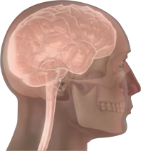
Psychiatric Comorbidity
Comorbid Disorders Make An Impact
Initial Engagement to Recovery & Support
Notes:
Comorbid disorders impact all aspects of treatment planning and service delivery, from initial engagement, to recovery and support. Due to the frequent omission of co-­occurring disorders from research studies investigating treatment efficacy for problem gamblers, our field continues to be limited in our ability to apply the study results to the larger population of problem gamblers with co-occurring concerns.

Slide 24


Impact and Implications of Diagnosing Comorbid Disorders
PSYCHIATRIC COMORBIDITY APPEARS TO BE THE RULE, NOT THE EXCEPTION.
INITIAL SCREENING AND ONGOING ASSESSMENT ARE AN IMPORTANT CLINICAL PRACTICE
    Implications for treatment:
      Client’s greater understanding of disorder
      Improved client engagement and retention
      Strengthened recovery & support
      Improved treatment outcomes
Notes:
Psychiatric comorbidity would appear to be the rule rather than the exception when considering gamblers who receive treatment due to the negative impact of their addiction. A good clinical guideline would be to screen and assess for comorbid disorders and continue to monitor potential for additional developments of clinical concern as treatment progresses. Gamblers with comorbid disorders need to understand how these disorders may affect their gambling, as well as their recovery. The phenomenon of recovering substance abusers or gamblers developing another addiction is all too common.

Slide 25

Interactions Between Gambling and Co-Occurring Disorders
Co-occurring disorders interact with a gambling problem in several ways . . .
Notes:
Co-­occurring disorders interact with a gambling problem in several ways.

Slide 26



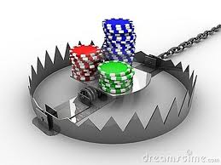
Comorbidity as a Risk or Consequence?
Psychiatric disorders may be
Risk Factors
for the development of a
gambling problem
But could also be the
Consequence
of a gambling problem.
Notes:
Psychiatric disorders may be risk factors for the development of a gambling problem. However, it is important to note that a comorbid disorder could also be the consequence of a gambling problem. For example, envision a person who is addicted to gambling and has sustained several exorbitant losses. They may present with feelings of hopelessness, isolation, report of decreased ability to maintain sleep, poor appetite, and thinks he or she would be better off dead. This patient is describing a multitude of issues like clients presenting with a depressive episode or worse. On the other hand, a person could have been experiencing a depressive state for several months, has a day where they go to a casino, win large sums of money in an instance, and then learn that gambling is a way to avoid the feelings of depression that seem present every moment of their life. Unfortunately, their winning will normally progress to losing, and may increase feelings of desperation and hopelessness, further entrenching the original depressive symptoms, but with greater intensity. As clinicians, it is our task to understand that both gambling and comorbid diagnostic situations can have complex interactions to prove critical to our efforts to provide effective treatment.

Slide 27

Co-Occurring Disorders and
Reward Deficiency Syndrome
Reward Deficiency Syndrome
  Co-occurring disorder and gambling may share same underlying causes.
  Genetic deficiencies have been linked to addictive behaviors such as gambling.
  Substance-abuse clients may downplay the significance of gambling as a clinical issue.
  Make efforts to educate them on the significance any addictive process can have on their standing prognosis and ability to benefit from treatment.
Notes:
Additionally, co-­occurring disorders may share the same underlying causes and common risk factors as are suggested by Reward Deficiency Syndrome. Through this theory, the gambler will continue to place bets due to the inability of their brain to provide a rewarding “pleasure response.” Over time, the gambler learns that only behaviors which result in an addiction-based reward can overcome their biochemical deficiency. This phenomena extends to any co-occurring substance abuse issues as well. Studies have worked to clearly establish connections between genetic deficiencies and addictive behaviors that stimulate the brain’s reward system through gambling in comparison to substance-abuse and other risk-taking behaviors. Finally, Be aware of the tendency of substance-abuse clients to downplay the significance of gambling as a clinical issue and educate them on the significance any addictive process can have on their standing prognosis and ability to benefit from treatment.

Slide 28

Gambling & Bipolar Disorder Interaction
Interactions may be cyclical.
Destabilization of bipolar disorder facilitates gambling.
Resulting changes in brain chemistry reinforce gambling activity.
    In order to diagnose Gambling Disorder (312.31), the presence of four or more gambling criteria occur in a manner not solely related to a manic episode.
Notes:
The interaction between problem gambling bipolar disorder may occur in a cyclical fashion due to the nature of the client’s affective fluctuations. For example, the affective mood cycle between mania and depression destabilizes the disorder, which facilitates further gambling activity. The resulting changes in brain chemistry reinforce the gambling activity as the gambler strives to relieve depression or sustain the high. It should be noted that a diagnosis of Gambling Disorder should only be included when the presence of four or more gambling criteria occur in a manner not solely related to a manic episode.

Slide 29
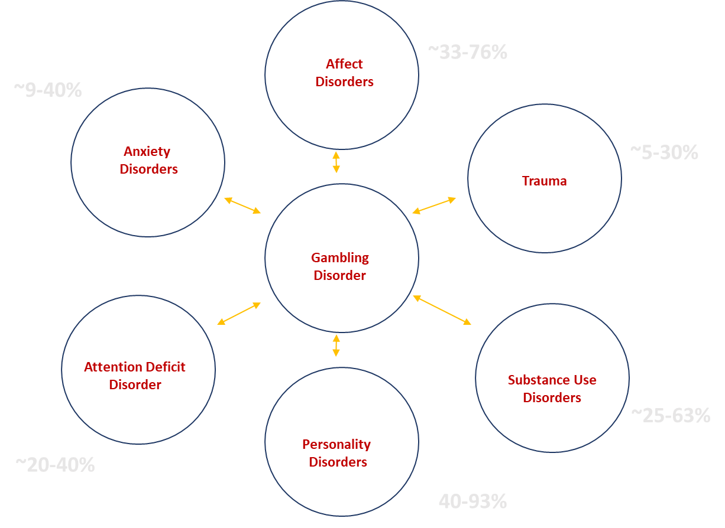

Focus for Clinical Practice
CLINICAL PRUDENCE IS KEY
  Over-diagnosing is as bad as under-diagnosing
  Disorders may emerge over time
Notes:
Making accurate diagnoses for comorbid psychiatric disorders among clients presenting with gambling addiction is complicated by the emotional effects of gambling. Longitudinal studies would be helpful to discriminate between reactive forms of depression, anxiety, and personality entrenched behaviors and the occurrence of predisposed disorders having a genetic base. Therefore, it is necessary for mental health professionals working with the gambling population to be clinically prudent when diagnosing comorbid psychiatric disorders as well as identifying co-occurring substance abuse in our clients. Over-diagnosing is just as bad as under-­diagnosing, and it may take time to recognize the disorders that did not present overtly during the initiation of treatment.

Slide 30
Session 2 Topics
1. Typology Of Problem Gamblers
2. Comorbidity & Co-Occurring Disorders
3. Family Counseling
4. Crisis Intervention
Notes:
We are now ready to move over to our next session 2 topic.

Slide 31
Family Impacts from
Problem Gambling
Notes:
Family Impacts from Problem Gambling

Slide 32


Gambling’s Effects on the Child
1989 - First controlled study of children’s health and social risks
Students with parental histories of problem gambling were compared with their classmates
Notes:
The first controlled study to assess the health and social risks of children of problem gamblers was conducted in four California high schools by Jacobs in 1989. In the study, students who described one or both parents as having a problem with compulsive gambling were compared with their classmates who stated their parents had no such problem.

Slide 33
Youth Health Survey Results
Higher levels of eating disorders and use of alcohol, tobacco, or other drugs
Early onset of gambling experience, typically before age 11
Almost twice the incidence of homes broken by separation, divorce, or death of a parent
Suicide attempts at twice the rate —12% versus 6% of their classmates
Higher incidence of rating themselves insecure, emotionally down, unhappy with life, and performing poorly in school

Slide 34

Family Roles According to Franklin & Thoms (1989)
Scapegoat, peacemaker, or the child who is over-responsible
Responsible for family conflict and turmoil
Alignment with non-gambling parent combined with a need to protect
Poor interpersonal skills Fear of abandonment
Notes:
In their 1989 publication, Franklin and Thoms note: the children of compulsive gamblers often experience severe role conflict, such as being the family scapegoat, the peacemaker, or the child who is over‐responsible. Such children may feel responsible for the emotional conflict and turmoil experienced within the family. They may align with the non-­gambling parent and feel the need to protect them. They may also have poor interpersonal skills and fear abandonment.

Slide 35
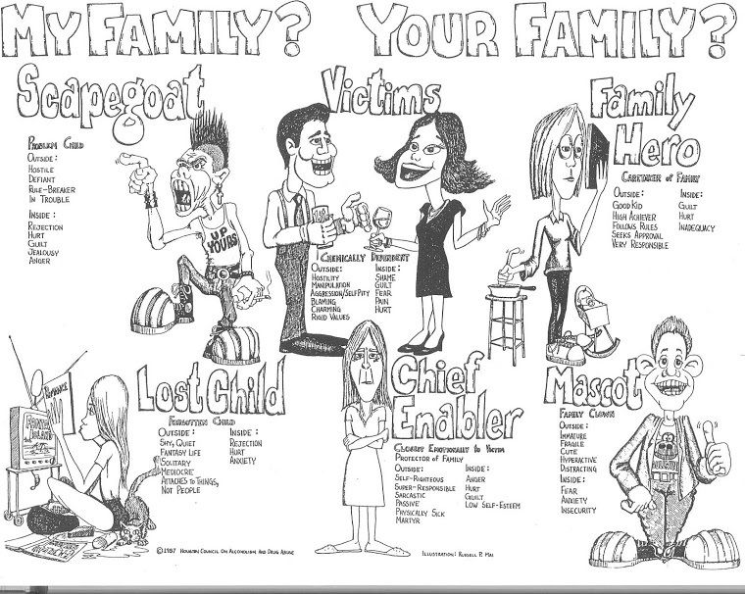
Notes:
Family roles can be an important consideration for providing systemic treatment to families with a gambler in their midst. Children are at heightened risk for being the scapegoat, the lost child, or being expected to enable the gambler because of a manipulation of parent-child interactions related to respect and deserving of support from each other often in a one direction only style of expectation. Manipulation of family roles also allows the gambler to place blame on other family members and create an expectation that “ of course they need to gamble” as a rationalization because of how tough life is or interacting with the family is at the present time. The spouse of the gambler also could fall victim to this kind of manipulation, victimize themself, or fulfill the role of chief enabler. All these family role manifestations can happen under the surface with the people playing the roles not realizing the part they play in the gambling behavior continuing across the family system.

Slide 36



Implications and Potential for Neglect
Gambling may divert money from children’s physical and material needs.
Deprivation of needs may cause children to feel resentful, confused, rejected, and unimportant.
Parents may provide inadequate supervision due to a fixation of gambling opportunity.
Notes:
Financial problems due to gambling may put the family in financial crisis, with little money available to meet the child’s physical and material needs. Such deprivation may lead to the child feeling resentment and confusion, as well as rejection and a sense of being unimportant. Additionally, children may be poorly supervised; sometimes being put into precarious positions, such as being home alone, alone in a hotel room, or left alone in a car while the parent gambles.

Slide 37

Children and Loss - Australian Study (2001)
Losses felt by children of problem gamblers
    Physical and existential loss of parent
    Tangible losses
    Trust, reliability, security, and emotional validation
Notes:
In their 1989 publication, Franklin and Thoms note: the children of compulsive gamblers often experience severe role conflict, such as being the family scapegoat, the peacemaker, or the child who is over‐responsible. Such children may feel responsible for the emotional conflict and turmoil experienced within the family. They may align with the non-­gambling parent and feel the need to protect them. They may also have poor interpersonal skills and fear abandonment.

Slide 38

Parental Effects on Children’s Gambling
Children of gamblers are significantly more likely to develop gambling problems of their own . . .
Notes:
There is some evidence that children of gamblers are significantly more likely to develop gambling problems of their own, and they suffer higher rates of abuse from both the gambling and the non-gambling parent.

Slide 39





Family Counseling and Crisis Intervention
FAMILY THERAPY IS INDICATED FOR TREATING COMPULSIVE GAMBLING…
Notes:
Family therapy is indicated for treating compulsive gambling due to the effects of problem gambling behavior on the entire family. Family therapy usually means more rapid and broader change, and effects are longer lasting. Many systemic effects provoked by having a gambler in the family unit can only be accessed in a therapeutic way through approaching the issues from the lens of family therapy.

Slide 40
Strategies for Family Therapy
Advantages of including significant others, extended family members, and community as appropriate:
  Orientation and preparation of family members
  Counselor gains better perspective on the gambling problem
  Improved outlook for gambler’s treatment and recovery
  Stronger engagement of significant others in the healing process
Notes:
Prepare for family work with individual sessions to build trust and identify individual issues faster. Significant others and extended members of the family and community, as appropriate, should be included as early as possible. This strategy orients family members to the therapeutic process and prepares them for potential involvement. The counselor gains the perspectives of others and a more accurate picture of the gambling problem. Family dynamics, personal strengths, and challenges may become clearer when the probability of honesty, accountability, and early recognitions of signs of relapse are increased. Early involvement also increases the likelihood that significant others will enter or remain engaged in the healing process, even if the gambler drops out.

Slide 41


Specific Strategies for Engaging Family Members
STRATEGIES FOR COUPLES SESSIONS
  Negotiate goals
  Personal change
  Accountability
STRATEGIES FOR INDIVIDUAL SESSIONS
  Coping skills
  Existing support system
WHEN TO INCLUDE CHILDREN
  Couple relationship is stabilized
  Separation or divorce is imminent
  They request inclusion
  They are highly symptomatic
Notes:
Couples sessions may be used for negotiating goals, as well as intended change, and establishing areas of accountability for each partner. Individual sessions with the significant other can provide an opportunity to assess coping skills and the extent of the existing support system. Consider including children when the couple’s relationship is stabilized, separation or divorce is imminent, they request inclusion, or they are highly symptomatic.

Slide 42

Family Systems Perspective
Major Couples Issues:
  Enmeshment
  Shifting relationship from Functional to Intimate
    Addictions
    Finances
    Power and Control
    Anger
    Sex
INITIAL FOCUS IS ON THE GAMBLER
Notes:
The initial focus of family counseling begins with changing the gambler. From a psycho-educational perspective, couples are often enmeshed, though the clinician’s relationship is with the client. Major issues for couples involve moving from merely functioning as a couple to achieving or regaining intimacy. Issues of addiction, sometimes beyond the gambling, finances, power and control, anger, and sex are also present.

Slide 43

The Effects of Compulsive Gambling on the Spouse (Wexler)
Denial
Stress
Exhaustion
Hopelessness
Occasional worries, keeps concerns to self, makes excuses, considers gambling temporary, easily reassured, questions unpaid bills, accepts remorse of gambler, unexplained financial crisis
Spouse spends less time with family, arguments, spouse feels rejected, makes demands upon gambler, attempts to control gambling, provides bailouts, avoids children, family and friends, intense resentment, isolation
Confusion, thinking impaired, physical symptoms, immobilization, rage, doubts sanity, anxiety-panic
Divorce, emotional breakdown, legal charges, suicidal ideation and attempts, substance abuse
COMMON EFFECTS OBSERVED AMONG WIVES OF GAMBLERS INCLUDE:
Notes:
In a study conducted by Wexler, the effect of being in a relationship with a gambler was explored, identifying a series of shared experiences amongst the wives who participated. The spouse of a compulsive gambler is subject to a progression of hopelessness that is like the phases experienced by the gambler. The typical progression is from denial to stress, then exhaustion and finally hopelessness. Each phase is characterized by behaviors ranging from occasional worries in the denial phase, to suicidal ideation and attempts as the situation begins to feel more and more hopeless. It should be noted that all relationships and gambling behaviors are not identical and can create unique scenarios that can alter or rearrange the sequence of experiences identified in this and other studies.

Slide 44
The Effects of Compulsive Gambling on the Spouse (Wexler)
Critical
Rebuilding
Growing
Sharing, more affectionate and trusting, sacrificing for others, relaxed, sense of achievement
Increased self-esteem, self-confidence returns, realistic planning, closeness within family, problem solving, making decisions, communications improved, recognizes self needs, helping others, understanding others, meets own needs
Hope, honest desire to help, accepts compulsive gambling as illness, accepts friends again, realistic personal inventory, stops giving bailouts, deals with resentment, guilt diminishes
COMMON EFFECTS OBSERVED AMONG WIVES OF GAMBLERS INCLUDE:
Notes:
Whether or not the gambler seeks help, the spouse may enter treatment to begin the progression from hopelessness to growth. The process will usually include a critical phase of hope, acceptance, and self‐assessment. The critical phase is followed by a rebuilding phase of increased self-­‐esteem, self-­‐confidence, understanding others, and meeting the spouse’s own needs. In the final growing phase, there is more sharing, affection and trust, as well as a sense of achievement. Per observations made by Sheila Wexler, this pattern is not true of all spouses, in that husbands and male partners of female gamblers will generally react differently than wives or companions of male gamblers will.

Slide 45

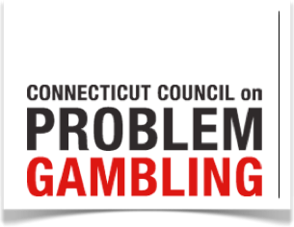
Couples Treatment Issues for Recovering Male Compulsive Gamblers and Their Partners
Notes:
Dr. Marvin Steinberg, previously the director of the Connecticut Council on Problem Gambling, is a clinical psychologist with extensive experience in the treatment of individuals and families who are impacted by gambling problems. His findings, as presented here, are based on clinical experience rather than statistical analysis of case material.

Slide 46
Gambling from a Systems Perspective
Historical focus on independent assessment and treatment
Traditions changing with influx of family therapists
Family systems perspective is emerging
Notes:
The approach of the mental health field has historically focused on independent assessment and treatment of the gambler and the spouse. Couples and family interventions have been perceived as ancillary to individual and group treatment. As clinicians trained in family therapy increasingly enter the gambling field, a family systems perspective of assessment and treatment is beginning to come to the forefront.

Slide 47

Family Assessment Issues
Partner or spouse often initiates contact
Interview each to form therapeutic bond
Include children as appropriate
Notes:
As is typical of other addictions, it is the partner of the compulsive gambler who most often initiates the therapeutic contact. It is helpful to interview each partner alone to facilitate the process of forming therapeutic bonds with each. Include children as appropriate, generally after the couples’ relationship has stabilized. The assessment process for each family determines the most favorable composition of family members for future treatment sessions.

Slide 48

Couples Focus
Couples work necessary from outset
View partners as having interconnecting dynamics
Combine interventions as required
Couples focus shifts view of treatment
Notes:
Couples work is necessary from the outset of therapy in order to manage and negotiate crisis response and to halt further deterioration of the relationship. Viewing couples as having interconnecting dynamics is a useful working premise. Different combinations of couple and individual interventions may be required. Couples’ treatment helps the couple adjust from the individual focus of GA and Gam-Anon to a more relational perspective.

Slide 49

Major Couples Treatment Issues
Couples Work
Multiple addictions
Finances
Power and Control
Anger
Sexuality
Emotional Intimacy
Notes:
To be effective, treatment must address the major issues of multiple addictions, finances, power and control, anger, sexuality, and emotional intimacy.

Slide 50

Multiple Addictions
Expect co-occurring addictions.
Addictions for either partner are additional barriers to intimacy.
The addictions within and between each partner will interact.
Notes:
Clinical practice leads to the expectation that partners of gamblers have an over-­representation of substance addictions, eating disorders, and relationship addictions. However, it is commonplace for other addictions from either side of the relationship to be topics of therapy at one time or another. Addictions for either partner are additional barriers to intimacy. One difficulty that must be managed in work with couples is maneuvering the interactions between the multiple addictions identified over the course of treatment.

Slide 51


Finances
Key treatment components
  Financial accountability
  Therapist’s knowledge of gambling-related financial issues
  Referral to a consumer credit counseling
Finances As Focal Point In The Partner’s Power Struggle
Notes:
Treatment planning should include holding the gambler accountable for the financial consequences of his behavior. Therapists may need to provide direction regarding realistic budgeting and financial restitution. The therapist also needs knowledge on the impact of loan consolidation, bankruptcy, gifts (which may effectively be bailouts), and other issues in dealing with gambling related debts. Referral to a consumer credit counseling service is often helpful. Finances often become major focal points in the partners’ struggle for power and control in the relationship.

Slide 52

Power and Control
Issues affect both partners
Gam-Anon information may heighten control issues
Therapist’s role is to defuse power struggles
Notes:
Both partners have control and power issues, often stemming from their families of origin. The partners typically have difficulty negotiating role changes in recovery. Control issues may be heightened by advice and feedback the spouse receives in Gam-Anon. The therapist’s role includes defusing power struggles through restatement and interpretation.

Slide 53
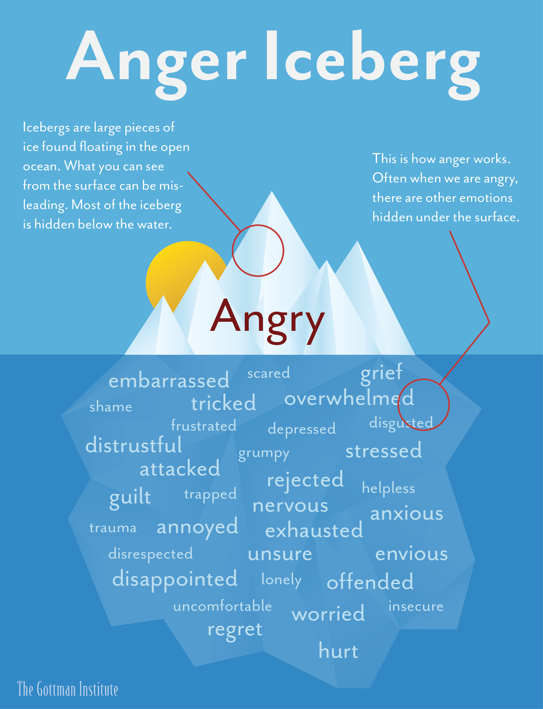
Anger
Unhealthy expressions of anger
Destructive rage used as an excuse
Anger often displaced
Identify triggers and practice new responses
Notes:
Both partners tend to express anger in unhealthy ways. Destructive rage, as an excuse to leave the conflict, creates an opportunity for gambling. Anger may be expressed through passive aggressiveness, covering anger with other addictions, or displacing anger toward the children. The therapist’s role includes assisting the couple to identify triggers and to identify and respond positively to vulnerable emotions that are often behind the anger. Spending time in couple sessions working on understanding defense mechanisms, ways of expressing emotional reactivity, or understanding concepts such as the anger iceberg can often lead to the generation of useful insights with both members of the couple.

Slide 54

Sexuality
Sexual interest replaced with absorption in gambling
Dysfunction takes different forms
Reasonable to infer low sexual desire among either partner
Lack of interest may mask fear of intimacy or unconscious rage
Notes:
Gamblers may replace sexual interest with an absorption in gambling. Dysfunction may range from low desire to acting out sexually in a compulsive way. It is reasonable to infer low sexual desire by either partner due to observed intimacy difficulties. Lack of interest may also mask fear of intimacy or unconscious rage.

Slide 55

Emotional Intimacy
Trust and intimacy shattered by partners’ gambling
Deeper roots of problems may be found in families of origin
Therapeutic sessions must include:
  Reinforcing processes for appropriately expressing hurt and anger
  Initiating and maintaining positive new behaviors
Notes:
Trust, mutual vulnerability, and sharing of feelings is usually shattered by partners’ gambling. Deeper roots of prolonged marital problems may often be found in families of origin. A genogram may be used to highlight intergenerational issues such as addictive patterns, and ways in which each partner symbolically assumes a role played by a member of the other partner’s family of origin. Therapeutic sessions must include reinforcing processes for appropriately expressing hurt and anger and initiating and maintaining positive new behaviors.

Slide 56

Video Lecture 5: Couples Counseling
Notes:
https://youtu.be/D6pS6tqYR1U
This video lecture will review couples counseling issues with problem gamblers. **

Slide 57

Working with Couples and Family
FROM THE WORK OF
JOANNA FRANKLIN, M.S. NCGC-II LCAC-II
Notes:
Another study, conducted by Joanna Franklin, sought to determine how many of the state’s adults gamble? Other key issues included: How prevalent is problem and compulsive gambling, what types of gambling cause the most problems, how does Arizona compare to the nation as a whole, and what is the state’s capacity for identifying and treating problem gambling?

Slide 58

The Relationship is With the Couple
WHICH AND HOW FAMILY MEMBERS ARE INVOLVED?
WHO HAS THE POWER?
CAN THE THERAPIST ALLY WITH THE POWER BASE IN THE FAMILY?
Think Family First
  Family often represents gambler’s motivation
  Couples work can improve attendance and outcomes
  Doing too much too soon can become a “bailout” for family
Notes:
The therapist’s relationship is with the couple, and the therapist must know which and how different family members are involved. Who has the power? Can the therapist ally with the power base in the family? The therapist must think “family first” because family often represents the gambler’s motivation. Also, couples work can improve treatment attendance and outcomes, though the therapist doing too much too soon can become a “bailout” for the family.

Slide 59



Three Common Family Responses (Ciarrocchi 2001)
THE FAMILY ACCEPTS THE GAMBLER WITH LITTLE LOSS OF INTIMACY
THE FAMILY DEVELOPS A PARALLEL RELATIONSHIP WITH THE GAMBLER EXEMPLIFIED BY EMOTIONAL COLDNESS
OR, THE FAMILY REMAINS TOGETHER, BUT WITH INTENSE CONFLICT AND CHRONIC ANGER
Notes:
Families typically respond to the problem gambler in one of three ways. The family accepts the gambler with little loss of intimacy. The family develops a parallel relationship with the gambler exemplified by emotional coldness. Or, the family remains together, but with intense conflict and chronic anger.

Slide 60

Treatment Considerations
THE FOCUS CHANGES AS TREATMENT PROGRESSES TOWARD STABLE RECOVERY
Gambler’s sense of entitlement may be linked to domestic violence
Treatment must also address trauma concerns;
A trauma-recovery model may help to explain the lengthy recovery process
Reinforce seeing the gambling—not the gambler—as the problem, the “it” being worked on.
Notes:
The focus changes as treatment progresses toward stable recovery. Considerations include how is the gambler’s sense of entitlement be linked to potential for domestic violence? Treatment must also address trauma concerns: indeed, a trauma recovery model helps to explain the lengthy recovery process. Counseling must reinforce seeing the gambling, not the gambler, as the problem; the “it.” being worked on.

Slide 61

Psychological & Behavioral Factors
DISSOCIATION AND INVOLVEMENT IN FANTASY
SUPERSTITIOUS OR MAGICAL THINKING
NARCISSISM
DEPRESSION
Notes:
The therapist must also be knowledgeable of psychological and behavioral factors, commonly exhibited by problem gamblers. These factors include: dissociation and involvement in fantasy, using gambling for purposes of ego-enhancement or trying to avoid their own personal oblivion. Problem gamblers also engage in ritualistic behaviors indicative of superstitious or magical thinking. Narcissism, characterized by egocentricity. Being under-stimulated and boredom prone is common, as is depression evidenced by feelings of hopelessness and a high incidence of trauma.

Slide 62
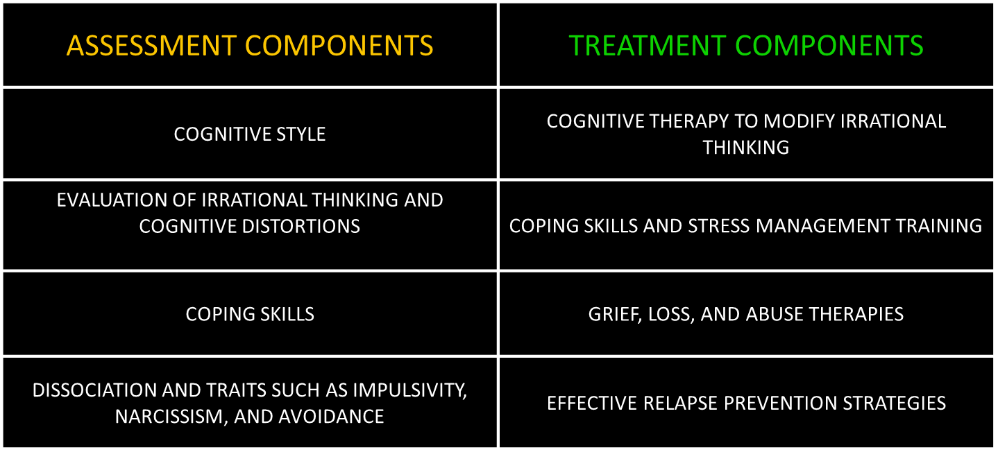
Psychological and Behavioral Factors
Notes:
To assess the problem gambler’s psychological and behavioral factors, assessment should include an evaluation of the gambler’s cognitive style. Irrational thinking, cognitive distortions, coping skills, and dissociation along with traits such as impulsivity, narcissism, and avoidance should be addressed throughout treatment. Interventions for problem gambling should include: cognitive therapy to modify irrational thinking, coping skills and stress management training, grief, loss, and abuse therapies, and effective relapse prevention strategies.

Slide 63
Crisis Intervention &
Problem Gambling
Notes:
Crisis Intervention & Problem Gambling

Slide 64

Many who complete this training have likely been trained to address suicidal tendencies in various mental health populations.
This segment of the training will offer some perspectives on what might be helpful if you’re working specifically with a problem gambler who is feeling suicidal and how to manage such individuals in clinical practice.
Notes:
Many who complete this training have likely been trained to address suicidal tendencies in various mental health populations.
This segment of the training will offer some perspectives on what might be helpful if you’re working specifically with a problem gambler who is feeling suicidal and how to manage such individuals in clinical practice.

Slide 65

How Can Gambling Disorder Lead to a Crisis Situation?
Notes:
It is important to understand how gambling disorder can lead to a crisis situation?

Slide 66
Overview
Approximately 70 to 90% of North American adults have participated in some form of gambling, yet only 1 to 3% of these individuals develop GD.
Most individuals who gamble don’t develop a gambling disorder.
For those who do, the impact can be devastating to themselves and their loved ones, leading to significant emotional distress.
Notes:
Approximately 70 to 90% of North American adults have participated in some form of gambling, yet only 1 to 3% of these individuals develop GD.
Most individuals who gamble don’t develop a gambling disorder.
For those who do, the impact can be devastating to themselves and their loved ones, leading to significant emotional distress.

Slide 67

Overview
As with other addictions, individuals with gambling problems often have a history of multiple unsuccessful efforts in attempting to reduce or stop their addictive behaviors.
Money lost gambling leads to financial difficulties that interfere with the ability to contribute to household living expenses such as paying bills, the rent, food, medical care, or transportation costs.
Notes:
As with other addictions, individuals with gambling problems often have a history of multiple unsuccessful efforts in attempting to reduce or stop their addictive behaviors.
Money lost gambling leads to financial difficulties that interfere with the ability to contribute to household living expenses such as paying bills, the rent, food, medical care, or transportation costs.

Slide 68
Gamble & Lose
Still Low on Funds
Win (Maybe) then Lose
Repeat
Low Funds
Gambling
Fantasy
Notes:
The gambling fantasy is a particular problem that can lead to crisis when resources become extinguished. Once a gambler begins losing, they will eventually reach points where they are low on funds. They will often continue to play despite this realization, and then become even more uncomfortable about the string of losses and the financial consequences they will soon experience. The fantasy makes them decide to continue playing with the idea that this is the most likely way to repair the gambling damage and avoid consequences. Often, this results in even lower funds, greater losses, and leads to a desire to believe even more in the fantasy of winning as the best choice for correcting the gambling mistakes. This cycle repeats itself endlessly, often pushing the problem gambler to points where financial resources or beyond the potential for reclaiming, and the person requiring clinical intervention to begin the repairs through recovery rather than hope of winning.

Slide 69

Overview
Before long, debt-collectors, late-notices, eviction threats, wage garnishment, service cancellation, and other threats to a person’s overall stability begin having a constant negative impact on the individual.
These experiences leave problem gamblers and their loved ones feeling discouraged and hopeless about the future.
Notes:
Before long, debt-collectors, late-notices, eviction threats, wage garnishment, service cancellation, and other threats to a person’s overall stability begin having a constant negative impact on the individual.
These experiences leave problem gamblers and their loved ones feeling discouraged and hopeless about the future.

Slide 70
Overview
Gambling Issue
Comfortable Life
Lose Money
Fall Behind
Lose More
Losses Threaten Lifestyle
Solve Problem by Winning Big
Continue Losing
Desperation & Loss
Suicide Risk
The constellation of factors encountered by problem gamblers increases their risk for suicide.
Gamblers seek some type of gain. When they feel they have lost everything, there’s nothing more to lose, and no possibility of any other attempts to gain, some may wonder:
Notes:
The constellation of factors encountered by problem gamblers increases their risk for suicide.
Gamblers seek some type of gain. When they feel they have lost everything, there’s nothing more to lose, and no possibility of any other attempts to gain, some may wonder:

Slide 71

Why continue living if there’s nothing to live for?
Notes:
Among the direst questions a gambler may begin ruminating on is “Why continue living if there’s nothing to live for? This is a reaction to losing financial security and access to numerous basic needs the gambler relied on for stability across multiple life areas.

Slide 72

Feeling Stuck
Regardless of the psychological and emotional reasons for the gambling activity, feeling financially stuck can lead some gamblers to struggle with the presence of hopelessness, and eventually, suicidal ideation.
Notes:
Regardless of the psychological and emotional reasons for the gambling activity, feeling financially stuck can lead some gamblers to struggle with the presence of hopelessness, and eventually, suicidal ideation.

Slide 73
What We Know
  Literature reports a strong relationship with Suicide and GD
  12-37% of GA sample had attempted suicide, and 40-92% had thoughts of committing suicide.
  One Canadian study found a 13% attempt rate for compulsive gamblers vs. 4% for the general population.
  Attempts may be more serious among Problem Gamblers, as one study reports 61% of those who did attempt required medical attention.
Notes:
Literature reports a strong relationship with Suicide and Gambling Disorder.
12-37% of GA sample had attempted suicide, and 40-92% had thoughts of committing suicide.
One Canadian study found a 13% attempt rate for compulsive gamblers vs. 4% for the general population.
Attempts may be more serious among Problem Gamblers, as one study reports 61% of those who did attempt required medical attention.

Slide 74
Severity & Risk
No Risk
Social Play
Normal Losses
High Risk
Psychiatric Comorbidity
Lies / Damaged Relationships
Homelessness
Legal Problems
Suicidal Ideation & Attempts seem to positively correlate with gambling severity
Those with greater consequences are at a higher risk.
Notes:
Suicidal Ideation & Attempts seem to positively correlate with gambling severity
Those with greater consequences are at a higher risk. These risk factors include Homelessness, the presence of Legal Problems, Psychiatric Comorbidities, and Lies or severely Damaged Relationships.

Slide 75
Increasing Severity
Exceeds Limits
Bets Money They Can’t Afford To Lose
Lies To Cover Losses
Isolation And Secrets
Unrealistic Expectations
Repeatedly Fails To Stop
Shame & Guilt
Notes:
Severity increases as more complicated difficulties become a common part of a problem gambler’s reality. These can include unrealistic expectations for their finances, relationships or otherwise. Gambling will often exceeds limits and they may repeatedly fail to stop. They will place bets with money they can’t afford to lose and then lie to cover up losses. The consequences and cover-up lead to extreme feelings of shame & guilt, and these often encourage a higher level of isolation and secrets in the gambler as severity continues to build until the decision to make therapeutic change becomes their new focus. Some gamblers reach among the most severe consequences before they make this decision.

Slide 76
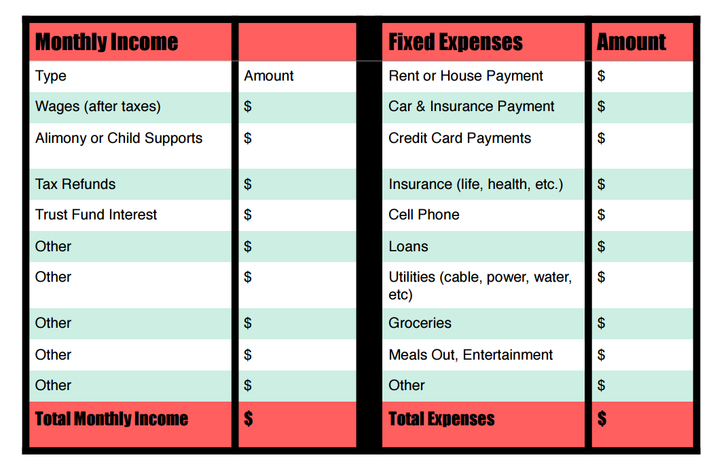
Impact of Losses on Budget
Understand the Client’s Income
What was the Loss?
What does this mentally represent for the Client?
What % of the Overall Income is unavailable due to this loss?
  0.5%
  5.0%
  55.5%
Notes:
As a gambling counselor, it is important to understand the client’s income. What was the loss? What does this mentally represent for the client? What percentage of the overall income is unavailable due to this loss? This is often a confusing conversation with a gambling client, as their way of describing wins and losses leads to a grandiose understanding of the events which occurred. There is a tendency to inflate wins and minimize losses within these conversations. It will be important for you to develop instincts related to discussing budgeting needs and challenging these fantasies to help the client learn to use a more grounded understanding of their money and money used in the flow of a gambling outing.

Slide 77
Suicide / Hopelessness Risk
Negative Impacts
How Much Time?
History
Ability to Stop
Who Knows?
Type of Consequences
Shame / Guilt Feelings
Notes:
The risk of suicide and hopelessness is a threat which counselors must be aware of at all phases of treatment. Gambling threatens the financial stability AND mental health of our clients. As a result, the negative impacts of losses in gambling can be wide-reaching. How much time are they spending gambling? What is their history and ability to stop? Who knows and how accurate is what they know about the gambling acts in this person’s life? What types of consequences are being experienced? How is the client handling the experience of shame or guilt feelings as the gambling flow continues?

Slide 78
Suicide Risk
Anxiety
Mood Disorders
Trauma
Family History
Substance Abuse
Personality Disorders
Prior Attempts
Severity of Consequences
Notes:
Suicide risk is high when treating problem gamblers. Without financial security and losing freedom that comes from a functioning bank account, it can be easy to slip into despair with a gambling problem. Be aware of your strategies for assessing clients for suicidal or homicidal ideation. All the factors for making a suicide attempt are similar as with other comorbid issues across the treatment spectrum. Do not hesitate to have these important conversations with your gambling clients. It can save lives to make every one of these risk factors safe topics in the therapy room. These topics include anxiety, mood disorders, trauma history and family history, prior attempts, the growing severity of gambling consequences, co-occurring substance abuse issues, and the presence of any personality disorders the client might be experiencing.

Slide 79
Professional Concern in Recent Years
Empirical treatment approaches for suicidal individuals
National Suicide Hotlines
Funding for the study of suicide and suicidal behavior
  Increased attention focused on youth and elderly
Counselor Education
  Morality issues & “Right to Die” perspectives
Notes:
Professional concerns have become more focused on these issues in recent years. This has led to the development of more Empirical treatment approaches for suicidal individuals. National Suicide Hotlines are available 24/7, and it is god practice to share these phone lines and online resources with your client any time there is risk or a history of self-directed violence in your client’s background. You also want to make sure your ethical stance on issues related to client safety are present in your approach and that any limits to confidentiality in relation to the client and those around them is fully understood at the onset of treatment.

Slide 80
Response of the Field
Due to the Threat of Client Suicide, there have been….
  Increases in Malpractice Claims
  Increased Technology for Suicide Prevention / Intervention
  Ethical Guideline Development
  Publications of Standards of Care
Notes:
Due to the threat of client suicide, there have been increases in malpractice claims and stronger development of ethical guidelines. There is now a greater attention to use of technology for suicide prevention as described on the previous slide. Make sure you stay current on professional publications concerning standards of care for your clients being treated for all clinical issues including problem gambling.

Slide 81

Suicide Attempt Rate: 15-27%
“Suicide attempts among pathological gamblers are higher than for any of the addictions and second only to suicide attempt rates among individuals with major affective disorders, schizophrenia and a few major hereditary disorders.”
Dr. Rachel A. Volberg
President of Gemini Research, Ltd.
Notes:
The suicide attempt rate for problem gamblers has been estimated to be at a rate of 15-27% depending on the study and categorization of terms and severity. Dr. Rachel Volberg, President of Gemini Research, Ltd.,
has stated “Suicide attempts among pathological gamblers are higher than for any of the addictions and second only to suicide attempt rates among individuals with major affective disorders, schizophrenia and a few major hereditary disorders.”

Slide 82

Suicide Risk
IF WARNING SIGNS ARE PRESENT, ALWAYS BE SURE TO MONITOR YOUR CLIENT FOR POTENTIAL RISK OF SUICIDE, AND TAKE PROPER PRECAUTIONS
Notes:
IF WARNING SIGNS ARE PRESENT, ALWAYS BE SURE TO MONITOR YOUR CLIENT FOR POTENTIAL RISK OF SUICIDE, AND TAKE PROPER PRECAUTIONS

Slide 83


Potential Vulnerabilities
Client Variables
Past Attempts
SES
ENV
Culture
Genetics
Diagnosis
Family
(Fowler, 2012)
Notes:
There are many potential vulnerabilities which will help you notice the opportunity to be more aware of suicide risk for your gambling clients. These include but are not limited to past attempts, family and genetic considerations, socioeconomic status, client environment, cultural understandings, and diagnostic impression.

Slide 84
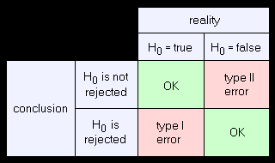
Assessment Errors
Type I Error
  Clinician Screen Positively (+) identifies Suicidality
  Client is not Suicidal / Has No Intent, Plan, Means, etc.
Type II Error
  Clinician Screen yields a Negative (-) result for Suicidality
  Client is considering taking suicidal action on their self
  Has Means and Plan
  Is actively showing signs of Intent to end their life
  No Clinician Response
Notes:
Assessment errors are important to consider in a wide range of clinical activities including screening, assessment, diagnosis, and crisis intervention. There are two types of errors we will highlight in this portion of the training. It is important to minimize the risk that these errors could result in inaccuracies form the clinician. Type I error occurs when the clinician screens the client positively (+) and identifies the presence of suicidality, but the client is not suicidal or has no intent, plan, means, etc. By contrast, type II error occurs when the clinician screen yields a negative (-) result for suicidality, but the client is considering taking suicidal action on their self. This means the clinician thinks they are safe to go home unmonitored with no follow-up but the client does have means and a plan or is actively showing signs of intent to end their life. The lack of clinician response with this error can prove fatal.

Slide 85
Risk of Type I Error
Suicide
Comorbidity
Diagnosis
Genetics?
Demographics
!!!
Algorithms of Domains
Severity
Past Attempts*
Notes:
Several raisk factors can indicate the clinician should be careful of committing a Type I error. These include Diagnosis and Comorbidities, Genetics and family history, Demographics, Severity of their issue, and Past Attempts.

Slide 86

Warning Signs: Be Attentive
One study found that 78% of individuals (n=76) who committed a completed suicide act denied the presence of ideation or intent during their last human contact
Look out for…
  Stressful / Traumatic Life Events
  Transition: Post-hospitalization / Baker-Act
  Describing a Suicidal Plan / Ideation
(Busch, Fawcett, & Jacobs, 2003)
Notes:
One study found that 78% of individuals in a small sample size that committed a completed suicide act denied the presence of ideation or intent during their last human contact.
Look out for signs that your clients could be at risk for behaving in this way. Predispositions for these tendencies can include stressful and traumatic life events, transition from hospital observation to being free in their normal living environment, or outright describing a suicidal plan or series of detailed ideations

Slide 87
Common Factor Model
Mental Health
Suicide
Substance Abuse
Suicide Attempts
Gambling Disorder
(Hodgins, Mansley, Thygesen, 2006)
Notes:
Dr. David Hodgins and colleagues identified a common factor model for understanding suicide attempts and suicidality. The presence of mental health concerns along with co-occurring gambling disorder and substance abuse dramatically increase the probability of an eventual suicide attempt. Without appropriate clinical intervention or a change to the client's disposition this can often relate to a completed suicide attempt, and the end of the client's life.

Slide 88
Suicide Risk Factors: Problem Gambling
Treatment History / Comorbid Mood-Disorder
Low Self-Esteem / Hopelessness
Impulsivity / Previous Suicidal Behaviors
Debt & Spending Habits
Relationship Difficulties
Drug Abuse (Not Alcohol Abuse)
Severity Of Gambling Problem
Notes:
Problem gambling comes with a set of specific risk factors for suicidality. The severity of the gable and problem factors into the degree of consequences and plans the gambler can identify for relieving the pressure of these situations. Treatment history and other comorbid conditions such as mood disorders are also a factor. Low self-esteem and hopelessness leave the gambler feeling that there is no life-based path where they could relieve the pressures of desperate gambling. Previous suicidal behaviors are always a risk factor for this kind of problem. Other factors include debt and spending habits, relationship difficulties, in the presence of other drug use.

Slide 89


Challenges in Assessment
“Research on suicide is plagued by many methodological problems…Definitions lack uniformity…reporting of suicide is inaccurate…”
- Institute of Medicine, 2002
Translating risk factors from research with many distal variables onto interaction with single individuals fails because suicide predictors are found among many individuals who are not suicidal, resulting in high false-positive prediction
- Fowler, J. C. (2012)
Notes:
There are multiple challenges in the assessment of suicidality with clients of varying presenting dispositions. When looking at a small sample size, a few positive responses can seem like a common occurrence. However, the reality is that the amount of people at risk of an attempt are spread across the rest of the population who is experiencing a gambling problem but is not at risk for suicide. Assessment methods and consistency from mental health professionals are the only way to attempt to identify who is at risk and take the proper actions to preserve their safety.

Slide 90
Assessment Approaches for Suicide Risk
Suicide Assessment Five-Step Evaluation and Triage (SAFE-T)
  Substance Abuse & Mental Health Services Administration
Self-Directed Violence Classification System (SDV)
Collaboration: Veterans Affairs / Center for Disease Control & Prevention
Columbia-Suicide Severity Rating Scale
  Columbia University Medical Center
Notes:
The following slides will review assessment tools for suicidality with our clients. These include the Suicide Assessment Five-Step Evaluation and Triage (SAFE-T) from the Substance Abuse & Mental Health Services Administration, the
Self-Directed Violence Classification System (SDV) from a Collaboration between Veterans Affairs and the Center for Disease Control & Prevention, and the Columbia-Suicide Severity Rating Scale coming from Columbia University Medical Center.

Slide 91
Resources
Information related to the C-SSRS can be found at the following website:
http://cssrs.columbia.edu/
Information related to the SDV can be found at the following website:
http://www.mirecc.va.gov/visn19/education/nomenclature.asp
Information related to the SAFE-T can be found at the following website:
http://store.samhsa.gov/
Notes:
Resources for each of these tools can be found at the websites displayed on the slide.

Slide 92

C-SSRS Screen
Notes:
the Columbia-Suicide Severity Rating Scale

Slide 93
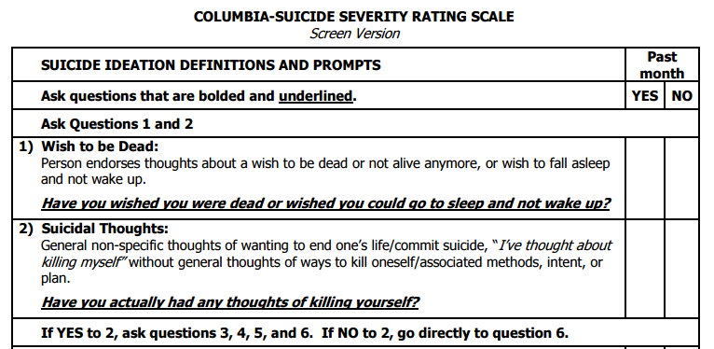
Notes:
The CCRS starts with two questions. The first question is if they have wished to be dead as a yes or no question. The second question is if they have had general nonspecific thoughts about wanting to end their own life.
If the client answers yes to question number two they will proceed to the following questions. If they say no to question two they will proceed directly to question six.

Slide 94
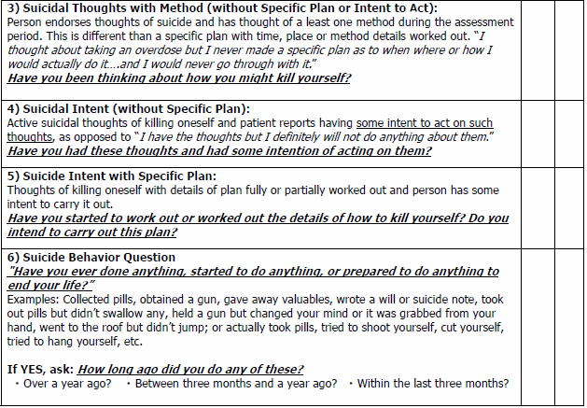
Notes:
Questions three through five of this assessment are designed to identify whether the client has a specific plan and in intentionality to act out the specific plan. Question six is the end of the assessment and identifies if the person has ever exhibited suicidal behavior. If they answer yes to this question you ask about the time period where it happened. When using this tool is important to discuss with your client any concerns over terminology and what examples are provided in the assessment if they need clarification.

Slide 95





Professional Issues
Suicidal ideation is any self-reported thoughts of engaging in suicide-related behavior. Ideation subtypes depend on the presence or absence of suicidal intent. For someone to have suicidal intent, they must have suicide (deliberate self-killing) as their goal.
Intent is not viewed the same across the professional communities of Treatment and Law or Court Systems
Notes:
Suicidal ideation is any self-reported thoughts of engaging in suicide-related behavior. Ideation subtypes depend on the presence or absence of suicidal intent. For someone to have suicidal intent, they must have suicide (deliberate self-killing) as their goal.
Intent is not viewed the same across the professional communities of Treatment and Law or Court Systems

Slide 96


SDV Classification System
Collaboration: Veterans Affairs / Center for Disease Control & Prevention
Notes:
The self-directed violence classification system

Slide 97
Terminology
Self-Directed Violence: Behavior that is self-directed and deliberately results in injury or the potential for injury to oneself.
Suicidal Intent: There is past or present evidence (implicit or explicit) that an individual wishes to die, means to kill him/herself, and understands the probable consequences of his/her actions or potential actions. Suicidal intent can be determined retrospectively, and in the absence of suicidal behavior.
Notes:
Self-directed violence is defined as a behavior that is self-directed and deliberately results in injury or the potential for injury to oneself.
Suicidal intent in this assessment is identified as any time when there is past or present evidence (implicit or explicit) that an individual wishes to die, means to kill him/herself, and understands the probable consequences of his/her actions or potential actions. Suicidal intent can be determined retrospectively, and in the absence of suicidal behavior.

Slide 98
Terminology
Preparatory Behavior:
Acts or preparation towards engaging in Self-Directed Violence, but before potential for injury has begun. This can include anything beyond a verbalization or thought, such as assembling a method (e.g., buying a gun, collecting pills) or preparing for one’s death by suicide (e.g., writing a suicide note, giving things away).
Notes:
Preparatory behavior is when there are acts or preparation towards engaging in self-directed violence, but before potential for injury has begun. This can include anything beyond a verbalization or thought, such as assembling a method or preparing for one’s death by suicide.

Slide 99
Terminology
Physical Injury:
  A (suspected) bodily lesion resulting from acute overexposure to energy (this can be mechanical, thermal, electrical, chemical, or radiant) interacting with the body in amounts or rates that exceed the threshold of physiological tolerance.
  In some cases, an injury results from an insufficiency of vital elements, such as oxygen.
  Acute poisonings and toxic effects, including overdoses of substances and wrong substances given or taken in error are included, as are adverse effects and complications of therapeutic, surgical and medical care.
  Psychological injury is excluded in this context.
Notes:
Physical Injury is when a (suspected) bodily lesion resulting from acute overexposure to energy (this can be mechanical, thermal, electrical, chemical, or radiant) interacting with the body in amounts or rates that exceed the threshold of physiological tolerance.
In some cases, an injury results from an insufficiency of vital elements, such as oxygen. Acute poisonings and toxic effects, including overdoses of substances and wrong substances given or taken in error are included, as are adverse effects and complications of therapeutic, surgical and medical care. Psychological injury is excluded in this context.

Slide 100
Terminology
Interrupted By Self or Other: A person takes steps to injure the self but is stopped by self / another person prior to fatal injury. The interruption may occur at any point.
Suicide Attempt: A non-fatal self-inflicted potentially injurious behavior with any intent to die as a result of the behavior.
Suicide: Death caused by self-inflicted injurious behavior with any intent to die as a result of the behavior.
Notes:
Interrupted By Self or Other occurs when a person takes steps to injure the self but is stopped by self / another person prior to fatal injury. The interruption may occur at any point.
A Suicide Attempt occurs when a non-fatal self-inflicted potentially injurious behavior is present along with any intent to die as a result of the behavior.
Suicide is defined as death caused by self-inflicted injurious behavior with any intent to die as a result of the behavior.

Slide 101
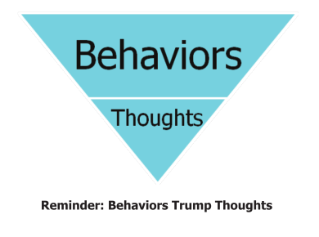
Using the SDV
Begin with the following 3 questions:
  Is there any indication that the person engaged in self-directed violent behavior that was lethal, preparatory, or potentially harmful?
  Is there any indication that the person had self-directed violence related thoughts?
  Did the behavior involve any injury or did it result in death?
Notes:
When using the SDV system a clinician will start with the following three questions:
Is there any indication that the person engaged in self-directed violent behavior that was lethal, preparatory, or potentially harmful?
Is there any indication that the person had self-directed violence related thoughts?
Did the behavior involve any injury or did it result in death?

Slide 102
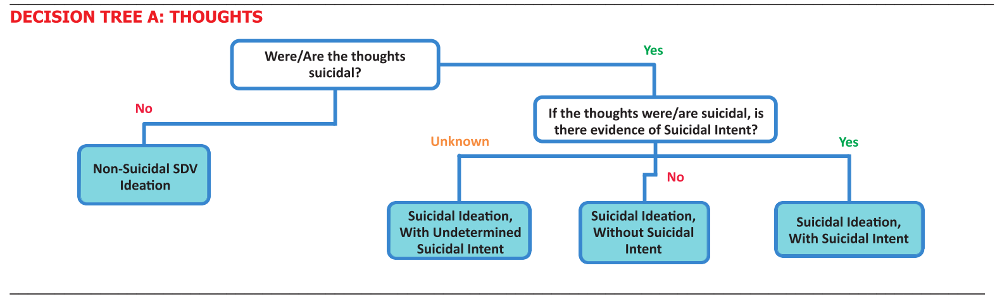
Notes:
Take a chance to review decision tree a which focuses on thoughts. If the person answers no to the first question, then there are no suicidal ideations. Answers of yes at any point on the tree could lead to the need to use the next decision tree.

Slide 103
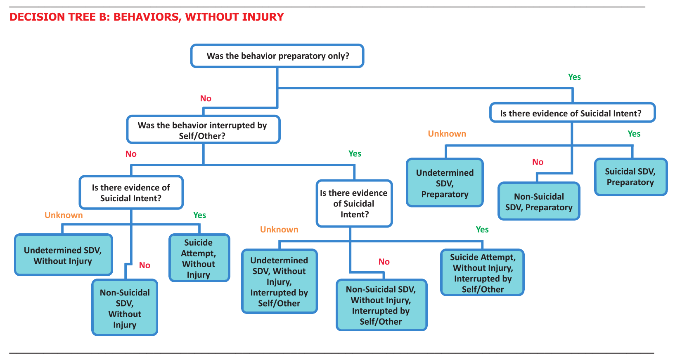
Notes:
Take a chance to review decision tree B. This tree focuses on behaviors without injury. Answers of know throughout this tree can lead to identifications that the client is not having thoughts and behaviors about self-directed violence. Answers of yes throughout this tree can identify the presence of a suicide attempt or other harmful behaviors and can result in the need to use decision Tree C.

Slide 104
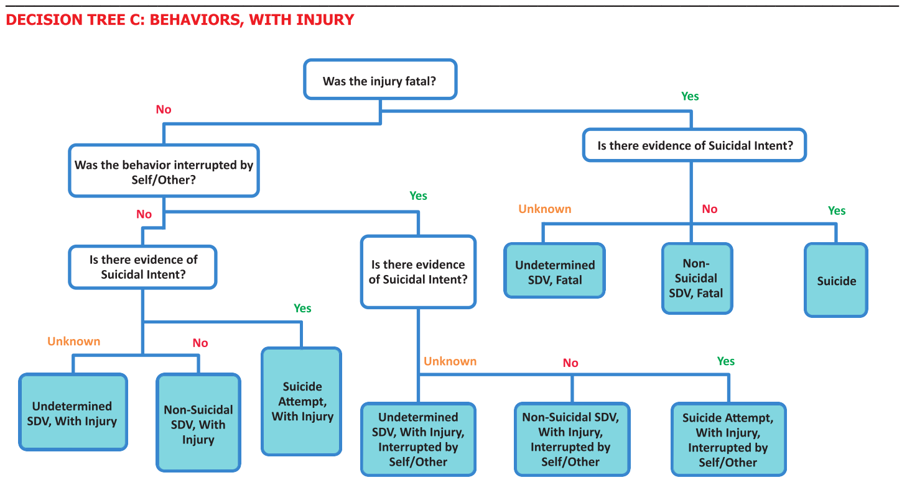
Notes:
Take a chance to review decision tree C. This tree covers behaviors with injury present. If the client answers no to questions throughout this tree it can indicate that there are behaviors but there are no injuries or that they lived through the injuries that they experience. Answers of yes on this tree indicate the attempted suicide in which case proper precautions must be taken to preserve the client’s life based on our ethical codes and desire to preserve our client’s life and autonomy.
This tree creates a reliable process for understanding the connection between thoughts behaviors and injuries in our clients and can be used as a decision-making process to help clinicians become consistent in their interaction with these topics.

Slide 105

SAFE-T Screen
Substance Abuse & Mental Health Services Administration
Notes:
The SAFE-T Screen

Slide 106
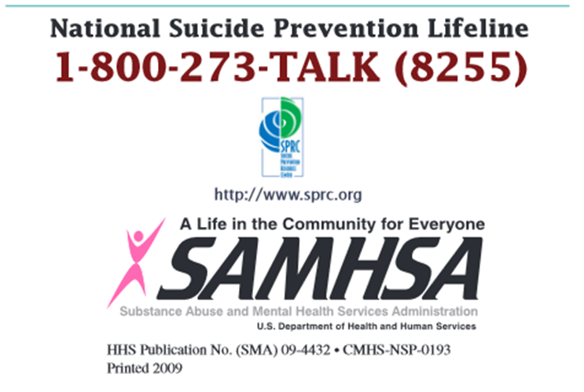
SAFE-T
1 - Identify Risk Factors
Note those that can be modified to reduce risk
2 - Identify Protective Factors
Note those that can be enhanced
3 - Conduct Suicide Inquiry
Suicidal thoughts, plans, behaviors, and intent
4 - Determine Risk Level / Intervention
Determine risk. Chose appropriate Intervention to address and reduce risk
5 - Document
Assessment of risk, rationale, intervention, and follow-up
Notes:
The SAFE-T screen is used to provide a step-by-step process for clinicians to become more comfortable interacting with the risk of suicide in the clients. The first step is identifying risk factors. The second step is identifying protective factors. The third step is conducting a suicide inquiry. The fourth step is determining level of risk and appropriate intervention methods. The fifth step is documentation.

Slide 107
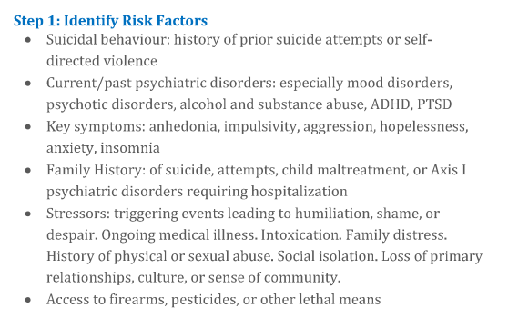
Step 1: Identify Risk Factors
(SAMHSA.gov, 2017)
Notes:
Take a moment to review all of the bullet points for step one of the SAFE-T Screen. These steps are important for understanding the factors that make it more of a risk for your current client that they would attempt suicide at some point in the treatment process or afterwards.

Slide 108
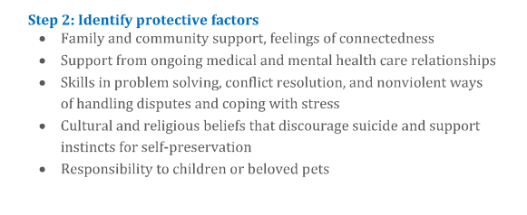
Step 2: Identify Protective Factors
(SAMHSA.gov, 2017)
Notes:
Take a moment to review all of the bullet points in step two of the SAFE-T screen. This step gives the clinician and client an opportunity to review all of the positive elements of the clients life that help them have a more secure connection to life, support, and hope for the future.

Slide 109
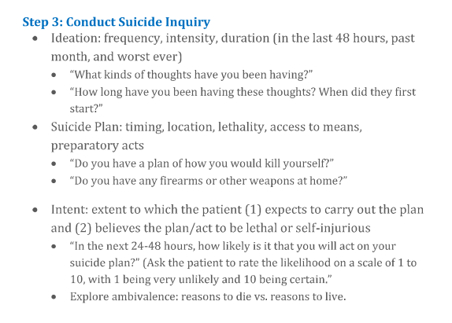
Step 3: Conduct Suicide Inquiry
(SAMHSA.gov, 2017)
Notes:
Take a moment to review all the bullet points for step three of the SAFE-T Screen. These bullet points involve the suicide inquiry where you will ask questions to identify the presence of ideation, a plan, intent, and behaviors. This step is crucial for identifying the correct course of action with your client if the risk of suicide is imminent, probable, possible, or hinted at during the course of therapy.

Slide 110
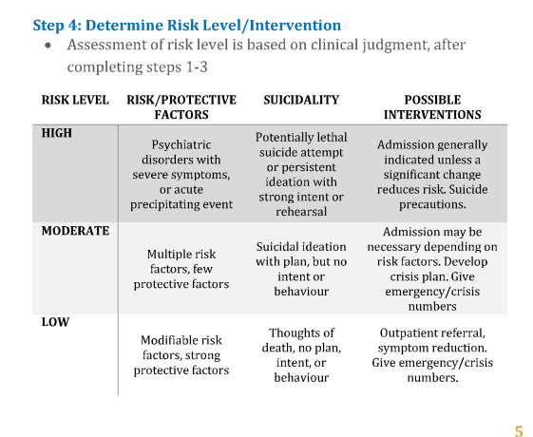
Step 4: Determine Risk Level / Intervention
(SAMHSA.gov, 2017)
Notes:
Take a moment to review step four of the SAFE-T screen. The chart present in this step identifies the difference between high, moderate, and low risk for suicidal action. This chart breaks down the differences between client populations with different level of risk and protective factors, history of suicidality, and also encourages the client to understand their possible interventions for each of these scenarios.

Slide 111
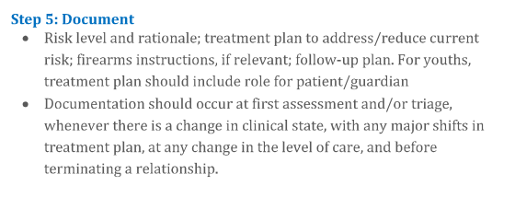
Step 5: Document
(SAMHSA.gov, 2017)
Notes:
Make sure to document everything when you are dealing with issues such as those assessed in the SAFE-T Screen. It is important to protect your professional livelihood by having thorough and complete record of these conversations in the event that something catastrophic happens to your client or those around them. It is also important to be diligent in following up on these concerns to make sure that your client is improving and that indications of these improvements are genuine.

Slide 112
Summary on Crisis Assessment
“It appears that at the very time we have become most aware of specifically what we need to know about suicidal patients, it has only become more and more obvious what we do not know.”
(Rudd & Joiner, 1998)
The current approach is to synthesize a model of Best Practices from across literature on Suicidality & Gambling Disorders
There are several empirically supported protocols for encountering potentially fatal client situations
Remain attentive and exercise clinical judgment
Notes:
Information about best practices is constantly evolving in this field. A quote from Rudd & Joiner (1998) states “It appears that at the very time we have become most aware of specifically what we need to know about suicidal patients, it has only become more and more obvious what we do not know.”
The current approach to crisis intervention is to synthesize a model of Best Practices from across literature on Suicidality & Gambling Disorders. There are several empirically supported protocols for encountering potentially fatal client situations. Remain attentive and exercise your best clinical judgment .

Slide 113
End of Session 2 Topics
1. Typology Of Problem Gamblers
2. Comorbidity & Co-Occurring Disorders
3. Family Counseling
4. Crisis Intervention
Notes:
This is the end of session 2.

