Slide 1
Module 1: Introduction to Gambling Issues
Presentation Year 2020
Notes:
Welcome to module one of the Arizona Department of problem gambling training on mental health treatment for gambling issues. This module is titled introduction to gambling issues.

Slide 2
Session 1 Topics
1. Overview & Basic Knowledge
2. History & Scope of Gambling
4. Describing Gambling Disorder
5. Screening & Assessment
3. National Prevalence of Gambling Issues
Notes:
Your topics for this module include overview and basic knowledge, history and scope of gambling, national prevalence of gambling issues, describing gambling disorder, and screening and assessment.

Slide 3
Supplemental Reading and Resources for this section includes:
The 1999 National Prevalence Study
Blaszczynski, A., & Nower, L. (2002)
South Oaks Gambling Screen
SOGS – Revised for Adolescents
NODS
Brief Biosocial Gambling Screen
Notes:
Supplemental Reading for this section includes: Links
The 1999 National Prevalence Study: https://dpgtraining.az.gov/Portals/0/Resources/National%20Gambling%20Prevalence%20Study%20(1999).pdf
Blaszczynski, A., & Nower, L. (2002): https://dpgtraining.az.gov/Portals/0/Resources/Blasczynski%20(2002)%20-%20Pathways%20Model%20of%20Problem.pdf
South Oaks Gambling Screen: https://dpgtraining.az.gov/Portals/0/Resources/SOGS.pdf
SOGS – Revised for Adolescents: https://dpgtraining.az.gov/Portals/0/Resources/SOGS_RA.pdf
NODS: https://dpgtraining.az.gov/Portals/0/Resources/nods_full.pdf
Brief Biosocial Gambling Screen: https://dpgtraining.az.gov/Portals/0/Resources/BBGS%20Questionnaire.pdf?ver=H25T-SDZihmldcs_LOkBdA%3d%3d

Slide 4
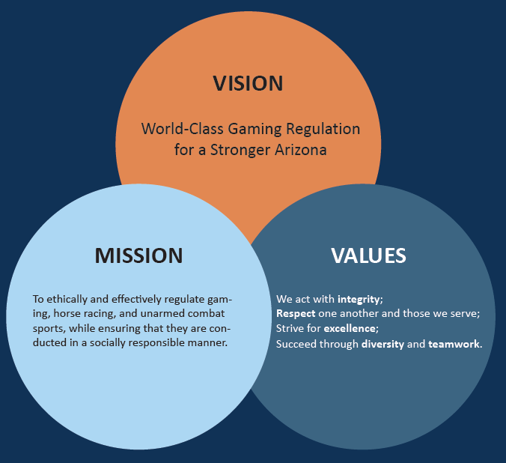

The Arizona Department of Gaming uses their mission statement to:
  Promote Fair and Effective Regulation While Fostering Social Responsibility;
  Strengthen Resource Networks;
  Provide a World-Class Customer Experience;
  Increase Operational Effectiveness, Compliance, and Efficiency; and
  Develop a World Class Team.
Notes:
The Arizona Department of gaming uses their mission statement to promote fair and effective regulation while fostering social responsibility, strengthen resource networks, provide a world-class customer experience, increase operational effectiveness, compliance, and efficiency, and develop a world-class team. You’re able to read our vision mission and values on the slide. Once you have completed reading through our organizational goals and qualities please feel free to advance to the next slide.

Slide 5

ADG Programs & Services
Operates the 24/7 Helpline for Problem Gambling in the state of Arizona
Manages Self-Exclusion from gambling locations across the state
Organizes the Tribal & State Funded Treatment Program for problem gambling
Offers training for treatment providers
Conducts outreach efforts to expand awareness of gambling issues
Implements funds for Prevention of At-Risk Populations across Arizona
Notes:
The Arizona Department of gaming provides various services to our residents in our state. We operate the 24 seven helpline for problem gambling for the state of Arizona. We also manage the self exclusion process for gambling locations across the state. This allows people to sign themselves out legally from being able to gamble as a form of self-directed control over their gambling behavior. We organize the tribal and state-funded treatment program for problem gambling. This allows callers of the helpline or people who view our website to reach out to qualified counselors in our state and be able to receive treatment at a subsidized rate or free of charge. We offer training for treatment providers throughout the year in order to assist them with their continuing education needs as well as their specialization in treating gambling related issues. We conduct outreach efforts to expand awareness of gambling issues in our communities across the state. Finally, we implement the funds for prevention of at-risk populations to gambling issues across the state.

Slide 6
Enrollment & Structure
This training is designed for Licensed Professional Counselors and other Master’s-level clinicians or Certified Addiction Professionals and Bachelor’s level clinicians working to aid problem gamblers
This training occurs in Two Phases:
  PHASE I: Basic Knowledge & Understanding
  PHASE II: Application and Professional Competency
Completion of both phases makes you eligible to pursue the International Certification in Gambling Counseling (ICGC-I & -II)
Notes:
This training is designed for licensed professional counselors and other Master's level clinicians or certified addiction professionals as well as bachelors level clinicians working with problem gamblers.
This training occurs in two phases: the first phase covers basic knowledge and understanding of gambling issues. The second phase includes applications and professional competencies for treating gambling disorder and its related problems.
Completion of both phases makes you eligible to pursue the international certification gambling counseling which can be known as the ICGC-I and ICGC-II.

Slide 7

Phase I: Basic Knowledge & Understanding
Topics to be covered during Phase 1 Modules:
  Session 1: Overview & Basic Knowledge
  Session 2: Understanding Problem and Pathological Gambling
  Session 3: Research and Client Care
  Session 4: Gambling Counseling Practice
Notes:
Phase 1 covers basic knowledge and understanding. The topics to be covered during phase 1 will occur across four sessions. The first session will include an overview and basic knowledge of gambling issues. The second session will cover understanding problem and pathological gambling. The third session will cover researching client care. The fourth session will cover gambling counseling practice.

Slide 8

Phase II: Application & Professional Competency
Topics to be covered in Phase 2 Modules:
  Session 5: Special Populations and Gambling Treatment
  Session 6: Examination of Women, Older Adults, and Spirituality
  Session 7: Treatment Skills and Treatment Design
  Session 8: Professional Issues
Notes:
Phase 2 covers application and professional competency. The topics that will be covered in the phase 2 modules include sessions five through eight. Session 5 will cover special populations in gambling treatment. Session 6 will cover examination of women older adults and spirituality issues in gambling. Session 7 will cover treatment skills and treatment design. In session 8 we will cover professional issues as a gambling counselor.

Slide 9
Training Requirements
This training includes 60 Continuing Education Units delivered as 30 CEU’s for Phase I Modules and 30 CEU’s for Phase II Modules
In order to earn the full amount of CEU’s and have adequate preparation for the…
International Certification Examination for Gambling Counselors
The following steps MUST be completed during your training participation
Review all attachments in full
Prepare a binder with printouts of all attachments for review and test preparation
Watch or review all elements of the online training as you participate
Complete all training activities identified in the modules
Notes:
This training includes 60 continuing education units delivered as 30 CE use for phase 1 modules and 30 CE use for phase 2 modules. In order to earn the full amount of CE use and have adequate preparation for the international certification examination for gambling counselors the following steps must be completed during your training participation. 1. Review all attachments in full. 2. Prepare binder with printouts of all attachments for review and test preparation. 3. Watch and review all elements of the online training as you participate. 4. Complete all training activities identified in the modules.

Slide 10
Preparatory Readings for Gambling Counselors
The following books are helpful to review in your preparation for becoming a Certified Gambling Counselor…
Pathological Gambling: Etiology, Comorbidity, & Treatment
  By Nancy Petry (2006)
Counseling Problem Gamblers
  By Joseph Ciarrochi (2002)
When Luck Runs Out
  By Robert Custer (1986)
The Gamblers Anonymous Combo Book
  www.gamblersanonymous.org
The Gambling Addiction Client Workbook (3rd Edition)
  By Robert Perkinson (2017)
Gambling Patient Placement Criteria (GPPC): A Guide to Placing Problem Gamblers at the Optimum Level of Care
  Quirk et al. (2010)
Notes:
The following books are helpful to review in your preparation for becoming a certified gambling counselor. It is recommended that you think about your competencies as a clinician before beginning this training and purchase these materials as a starting point for your journey towards specializing as a gambling counselor. Reading through these materials will support and supplement the information you interact with during the training.
Pathological Gambling: Etiology, Comorbidity, & Treatment
By Nancy Petry (2006)
Counseling Problem Gamblers
By Joseph Ciarrochi (2002)
When Luck Runs Out
By Robert Custer (1986)
The Gamblers Anonymous Combo Book
www.gamblersanonymous.org
The Gambling Addiction Client Workbook (3rd Edition)
By Robert Perkinson (2017)
Gambling Patient Placement Criteria (GPPC): A Guide to Placing Problem Gamblers at the Optimum Level of Care
Quirk et al. (2010)

Slide 11
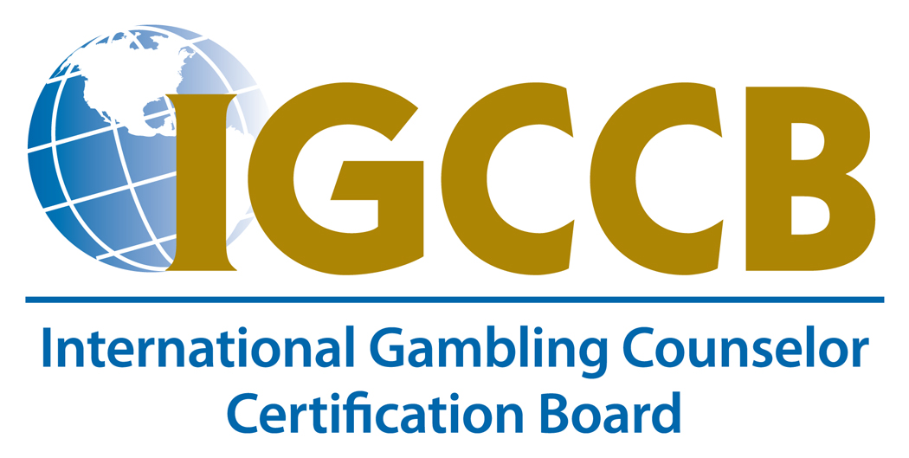
Preparation
In order to fulfill the 60-hour requirement, prepare for the certification process and the national exam, the following instructions must be completed:
  Attachments
    Review and print for future reference
  Prepare binder with all attachments
    This binder serves as review of the training and study guide for national exam
    COMPLETE THE INTERNATIONAL
    CERTIFICATION!
Notes:
In order to fulfill the 60-hour requirement and prepare for the certification process and the national exam you must complete the following goals during the training
You will want to review and print your attachments from the training for future reference, and you will want to prepare a binder with all the attachments, so you have one location to keep track and organize the materials. Being able to review information from the training is a important step as you prepare yourself for the exam and move closer towards completing all requirements for the international certification.

Slide 12
Module Quiz Expectations
Quizzes will be included at the end of each module to measure learning and retention of information.
Preparatory Readings will be included in the question selection during quizzes following modules 4 and 8.
The reading materials with test items associated are:
  The Gamblers Anonymous Combo Book
  Counseling Problem Gamblers
Notes:
Quizzes will be included at the end of each module to measure learning and retention of information. Preparatory readings will be included in the question selection during quizzes following modules four and eight. These questions assume you are completing the required readings outside of the training and adding them to your knowledge of counseling or gambling issues. The reading materials with test items associated are they gamblers anonymous combo book and counseling problem gamblers.

Slide 13
A Public Health Perspective of Problem Gambling
Notes:
A public health perspective of problem gambling

Slide 14
What are “Public Health Issues?”
Public Health research explores the distribution and determinants of disease, disability, and death in a defined population
These studies inform public policy to help prevent, eliminate, or control the problem’s occurrence and rate of escalation across the defined group of people
Notes:
Public-health research explores the distribution and determinants of disease disability and death in a defined population
These studies inform public policy to help prevent eliminate or control the problems occurrence and rate of escalation across the defined group of people.

Slide 15
Gambling as a Public Health Issue
Gambling affects the person placing the bets and numerous people in their lives
Gambling activity can influence the development of multiple pathologies in addition to Gambling Disorder
There is a need to improve prevention strategies for those who are at-risk of developing a gambling problem
Society will benefit from efforts to acknowledge the health impacts of gambling activity and further support activities that enhance life satisfaction and developing adaptive coping strategies
Notes:
Gambling affects the person placing the bets and numerous people in their lives. Cabling activity can influence the development of multiple pathologies in addition to gambling disorder. This can include depression, anxiety, relationship problems, and many other problem categories that take the extent of the gambling problem far beyond the financial decision to place a bet.
There is a need to improve prevention strategies for those who are at risk of developing a gambling problem. Society will benefit from efforts to acknowledge the health impacts of gambling activity and further support activities that enhance life satisfaction in developing adaptive coping strategies.

Slide 16
Conceptualizing Gambling Behavior
Gambling is conceptualized on a continuum ranging from non-gambling, healthy gambling, and then problem gambling.
Healthy Gambling
Problem Gambling
Notes:
As we seek to conceptualize gambling behavior, is important to realize that many people have a healthy relationship to gambling and that gambling activity enhances the amount of enjoyment they have as they play or watch different styles of games. Gambling is currently conceptualized on a continuum ranging from non-gambling, healthy gambling, and then problem gambling. Is important to get to know your client and understand the many ways gambling is affecting them. It is often not as simple as expecting that stopping the gambling activity will automatically lead to a fulfilling and healthy life experience. Because gambling is more nuanced than this, the point where gambling stops is often the place where the true therapeutic work begins.

Slide 17
How Can Gambling Be Healthy?
Healthy Gambling is generally…
A well-informed choice regarding probabilities of winning
A pleasurable experience involving low personal and financial risk
Done by involving affordable / sensible amounts
Mostly serve to improve a gambling person’s well-being or satisfaction with life
Involves a lack of negative consequences.
Notes:
You may be asking yourself “how can gambling be healthy?”
Healthy gambling is generally a well-informed choice regarding probabilities of winning, a pleasurable experience involving low personal and financial risk. It is often done by involving affordable and sensible amounts in the wagering process. Healthy gambling mostly serves to improve the gambling person’s well-being or satisfaction with life, and as such will involve a lack of negative consequences for the individual, their family and friends, and others around them.

Slide 18
How Does Gambling
Become Unhealthy?
Notes:
With this in mind, how does gambling become unhealthy?

Slide 19
Session 1 Topics
1. Overview & Basic Knowledge
2. History & Scope of Gambling
4. Describing Gambling Disorder
5. Screening & Assessment
3. National Prevalence of Gambling Issues
Notes:
This question brings us back to our list of session 1 topics. We will be working through these topics for the rest of the session.

Slide 20
Overview &
Basic Knowledge
Notes:
We will begin with overview and basic knowledge of gambling.

Slide 21
Defining Addiction
Addiction
Salience
Withdrawal
Tolerance
Conflict
Relapse
Mood Modification
“Historically, addiction has been understood in various ways—a sin, a disease, a bad habit—each a reflection of a variety of social, cultural, and scientific conceptions.”
(Hammer et al., 2012, p. 713)
Notes:
In any lineup of clinicians, the definition for addiction can vary. “Historically addiction has been understood in various ways —a sin, a disease, a bad habit—each a reflection of a variety of social, cultural, and scientific conceptions.”
The components of addiction remain recognizable, and can include salience, withdrawal, tolerance, conflict, relapse, and mood modification. After understanding addiction in terms of historical understanding and components recognition, what is it about gambling that leads us to understand it in terms of addiction terminology?

Slide 22
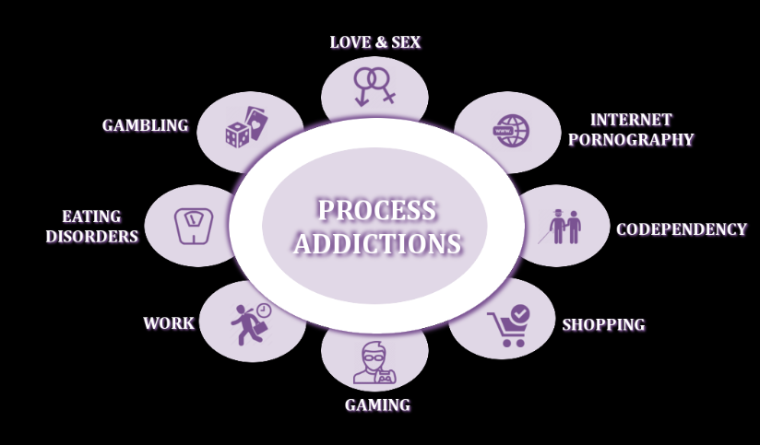
What is a Process Addiction ?
“[When a person experiences] The compulsion to continually engage in an activity or behavior despite the negative impact on the person’s ability to remain mentally and/or physically healthy and functional in the home and community.”
American Addiction Centers, 2019
Notes:
Gambling does not in itself include elements of digestion, inhalation, or injection the way that many more common and historically accepted addictions what. This is because gambling is understood as a process addiction. A process addiction is . . . “[When a person experiences] The compulsion to continually engage in an activity or behavior despite the negative impact on the person’s ability to remain mentally and/or physically healthy and functional in the home and community.”
Right now, gambling disorder stands as one of the first examples in the professional community of a process addiction being recognized as a psychiatric disorder. However, it is likely not the only process addiction. Many behaviors result in a rewarding experience in the brain chemistry of an individual that leads to ongoing and uncontrolled interaction with the behavior. These behaviors include things such as video games, shopping, pornography viewing, eating disorders, and sometimes work. This list is not complete. As society continues to change new behaviors will raise professional questions for addiction professionals across the fields of mental health.

Slide 23
Defining Gambling
Any time you bet money or RISK something of value on an event of uncertain outcome, you are
GAMBLING.
Gambling is among the most popular pastimes, and most people enjoy the activity without any harm. However, for many Arizonans, gambling becomes a
PROBLEM.
Notes:
In order to define gambling, it is important to identify an understanding that all gambling activities can connect with in a basic way. In order to do this, the national Council on problem gambling continues to adhere to the following definition:
Any time you bet money or RISK something of value on an event of uncertain outcome, you are
GAMBLING.
Gambling is among the most popular pastimes in recorded human history, and most people enjoy the activity without any harm. However, for many Arizonan's gambling becomes a problem.

Slide 24
Recreational Gamblers
Recreational Gamblers
Sets Limits
Wagers are Affordable
No Negative Consequences
Plays just for Fun
Gambling Is Just A Game
Has Realistic Expectations
Fun is not just from Gambling
Notes:
For those people who do not experience a problem related to their gambling behavior, we can classify them as recreational gamblers. A recreational gambler does several things differently than a problem gambler. They will set limits, their wagers will be affordable to them, the players just for fun and feels like a game, the bettor has realistic expectations for how their bets will resolve themselves. As a result, there are no negative consequences to this gambling behavior and is also not the only source of fund that this kind of gambler will experience across the areas of their life.

Slide 25





The Continuum of Gambling Activity
No Gambling
Casual / Social Gambling
Serious Social Gambling
Problem Gambling
Compulsive / Pathological Gambling
Notes:
Gambling becomes a problem over time. Sometimes the problems arise quicker for some than others. The phases in which problems become apparent occurs on a continuum going from no gambling to compulsive gambling. The sequence goes as follows: no gambling – the person does not gamble and so they cannot have a problem with gambling; casual or social gambling – the person gambles with friends and social acquaintances at times when it is appropriate to have fun; serious social gambling – a person is beginning to take their bets more seriously and is putting more of their financial capital into their bets. They also seem more driven to win and begin gambling on their own instead of using gambling as a social occasion; problem gambling – this person is beginning to exhibit symptoms similar to the diagnostic criteria for gambling disorder. This could include preoccupation, plotting out the way their next bet is going to go, and connecting more with gambling as if it is a defining feature of their life. People may have no idea that gambling has grown to be this much of a fixation for the person, and because of these many things the gambling can result in consequences in their life; compulsive and pathological gambling – this person meets criteria for a DSM-V diagnosis for gambling disorder and will score higher values on various gambling addiction screens. Their process for gambling activity is reckless and results in numerous consequences.

Slide 26
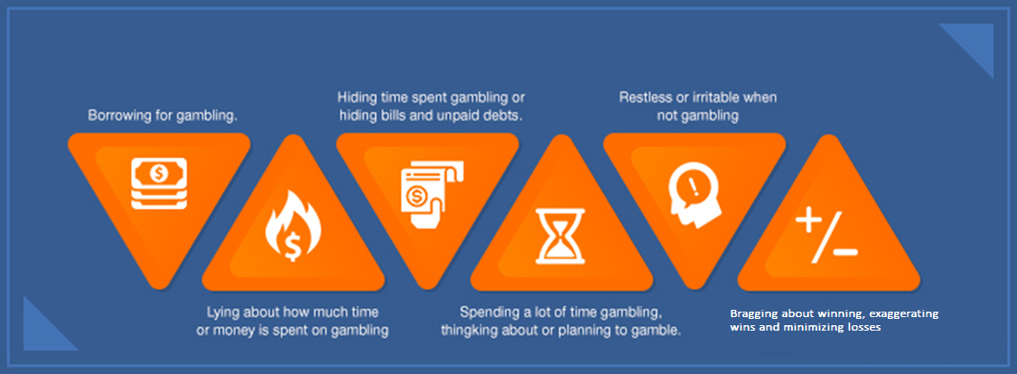
Warning Signs of Problem Gambling
Notes:
The warning signs for problem gambling can be wide-ranging and individualized from person-to-person. The themes that we see regardless of the individual and their circumstance include some of the following: borrowing for gambling, lying about how much time or money is spent on gambling, hiding time spent gambling or hiding bills and unpaid debts in order to free up more money for gambling, spending a lot of time gambling thinking about or planning to gamble, restless or irritable this when not gambling including treating people that matter to them poorly because they start to see them as an obstacle to their gambling activity, bragging about winning exaggerating and or minimizing losses

Slide 27
View of Health vs. Dysfunction
Healthy Gambling
Unhealthy Gambling
Well-informed
Enjoyable
Low potential for penalizing consequences
Risk is calculated and reasonable
The person can afford losses
Loss does not impact life satisfaction or well-being
Gambling decisions appear reckless
Lacks feeling of joy regardless of outcome
Consequences are serious
Losses threaten well-being
Changes to person and their value system are present
Satisfaction and well-being are affected
Notes:
Healthy gambling and unhealthy gambling carry with them noticeable differences. If a person is truly engaging in healthy gambling their decisions are well informed and result in enjoyment. There is also a low potential for penalizing consequences because the risks are calculated and reasonable. If the person loses, although not preferred, it is acceptable because the person is able to afford their losses. As such, the loss does not impact life satisfaction or well-being.
Unhealthy gambling looks quite different. The gambling decisions appear to be reckless and the person begins to lack joy in their gambling regardless of whether they win or lose. When consequences occur they are serious and the gambler will often consider ways to cover up their losses so that other people will not realize the extent of the damage. This eventually changes the person and their value system and people that used to be quite comfortable with the gambler will start to take notice and feel as if their friend or family member is different. Across multiple life areas the person will report their satisfaction with life and their well-being are being affected but may be hesitant to admit how much a role gambling plays in these negative shifts.

Slide 28

Forms of Gambling
Notes:
The next section will explore various forms of gambling.

Slide 29
Forms of Gambling
Lottery
Land-based casinos
Bingo
Slot, poker, or other gambling machines (not at a casino)
Office pools, raffles, or charitable small stakes gambling
Trading or “chase” cards
Flipping coins
Native American casinos
Numbers
Floating casinos
Jai-Alai
Stock or Commodities trading
Cards for money, not at a casino
Sports
Internet (not legal in U.S.)
Dares
Horse/Dog racing
Dice games, not at a casino
Games of skill for money
Other
Notes:
Gambling occurs in many forms. There are multiple categories of different styles of games for which chance prompts people to place wagers to make the outcome of the game more exciting. The list above is an example of all the different ways people can place bets in the locations for where these bets can be placed. These include the lottery, casinos whether on land or on boat, slot machines and other electronic video machines, poker and other card style games, office pools, raffles, or charitable small stakes gambling, coin tosses, Native American casinos, highlight, stocks or commodity trading, in-home card games or card games not located at a casino, sports betting including fantasy sports, wagering on the Internet which is not legal in the US, completing dares with other people, horse and dog racing tracks, dice games, and wagering money on any game of skill where the victor will receive an allotment of money from the other wagers placed.

Slide 30
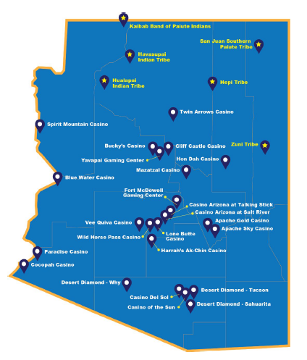
Review of Arizona
Details from the 2020 Department of Gaming Annual Report
Arizona contains 22 Compacted Tribes (16 with casinos)
Arizona Lottery: $1.08 billion in sales for 2019
  Scratcher Games amounted to $750.3 million in sales
Division of Racing
Arizona Division of Problem Gambling
  Involved in Prevention, Education, & Outreach
  Treatment: DPG coordinated services for 887 distinct clients in 2019
  Self-Exclusion: 2,423 active participants at close of FY20
Notes:
This slide provides a brief synopsis of the 2020 Department of gaming annual report. Arizona currently contains 22 compacted tribes, 16 of which operate casinos. The Arizona lottery was able to receive $1.08 billion in sales for 2019, with scratcher games amounting to 750 million of those sales. Arizona also contains a division of racing. The Arizona division of problem gambling who is hosting this training is involved in prevention education and outreach services for the state. In addition, they operate the treatment program which gamblers can benefit from by getting their counseling process endorsed at varying levels by the division’s treatment program. The ADP/DPG also operates the self exclusion list for the state of Arizona, which at the time of programming in this training had over 2400 active participants.

Slide 31


Overview of
Arizona
Also provides regulation for
Racing
Boxing & Mixed Martial Arts
Notes:
The Arizona Department of gaming also provides regulation for the state lottery, racing, and fighting sports such as boxing and mixed martial arts. This slide contains a graphic which shows the names and seals for the tribal nations who inhabit the state of Arizona and notes which casinos exist in connection with tribal operations. This amounts to around 20 casinos being operated through this relationship with the state and tribal nations. You will note there are six tribes that do not operate a casino indicated on the right side of the graphic.

Slide 32
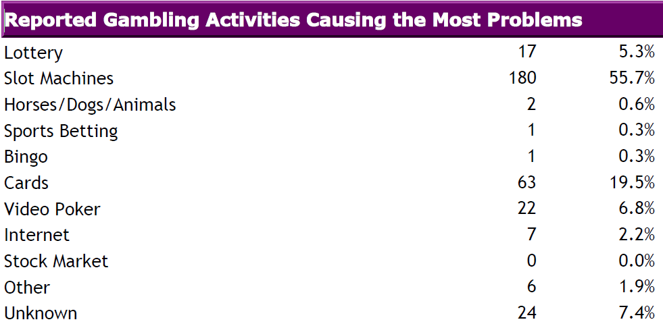
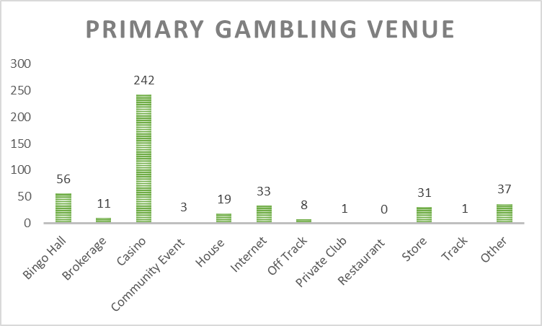
Primary Gambling Problems
(Arizona statistics)
Clients Served (FY 2020):
  N=774
Average Time-Course: 13 Sessions
Notes:
For fiscal year 2020 the primary gambling problems for residents of Arizona are listed in the chart on the left. The treatment program operated by the Arizona division of problem gambling had upwards of 750 clients participate in treatment during this fiscal year. The primary issue reported was slot machines, followed by cards, video poker, and then the lottery. The primary gambling venue were casinos by an overwhelming margin. The average time a person would participate in the treatment process was 13 sessions.

Slide 33
Problem Gambling (AZ Descriptive Stats)
(Gender)
Top 5 Activities (2018/19)
Slots (55%)
Lottery (9%)
Poker (7%)
Blackjack (19%)
Sporting Events (2%)
Notes:
In relation to descriptive statistics for treatment participants in Arizona during the 2018 and 19 fiscal year, 55% of treatment participants were female, with 45% being male. The top five activities for this group of participants was slot machines, blackjack, lottery, poker, and wagering on sporting events. Although you do not have to enjoy these activities or understand all of the details for participating in play, it can be helpful as a clinician to have a basic understanding of how these games work and how they appeal to your client who gambles. This helps in developing empathy which will be discussed during the clinical skills portions of this training.

Slide 34
Anecdotal Reasons for Problem Gambling
(Arizona Examples)
Why gambling became a focus for you?
(ct. Cara W): “I was in a casino in Vegas when I learned from a friend that my husband had been cheating. This triggered my gambling. I was at the wrong place at the wrong time. Until then, gambling was not a big deal to me. I was so hurt & in shock, & I did not want to feel the pain, & the slots were right there in front of me.”
How did it become a problem for you?
(ct. Cara W): “Learning about the cheating was a very traumatic event, & I associated it w/gambling going forward. I wanted to get even w/my husband for the cheating, & losing money was what hurt him the most. This is how gambling became a problem. After the divorce, my ex-husband made me feel undeserving of the settlement money, & I gambled until I lost everything.”
Notes:
The following slides provide anecdotal testimonies from problem gamblers in Arizona who have shared their experience with understanding they had a gambling problem and sharing some of their awareness as they gain from treatment and calling the helpline.
A client named Cara shared her experience to the following two questions:
Why gambling became a focus for you?
(ct. Cara W): “I was in a casino in Vegas when I learned from a friend that my husband had been cheating. This triggered my gambling. I was at the wrong place at the wrong time. Until then, gambling was not a big deal to me. I was so hurt & in shock, & I did not want to feel the pain, & the slots were right there in front of me.”
How did it become a problem for you?
(ct. Cara W): “Learning about the cheating was a very traumatic event, & I associated it w/gambling going forward. I wanted to get even w/my husband for the cheating, & losing money was what hurt him the most. This is how gambling became a problem. After the divorce, my ex-husband made me feel undeserving of the settlement money, & I gambled until I lost everything.”

Slide 35
Anecdotal Reasons for Problem Gambling
(Arizona Examples)
Why gambling became a focus for you?
(ct. William): “Gambling started out as something fun to do, betting recreationally at the racetrack. One-thing lead to another, & I thought that I could make money gambling, & supplement my income. I got a lot more serious about gambling, & the losses started piling up. I started chasing losses, & got stuck in this vicious & awful cycle.”
How did it become a problem for you?
(ct. William): “Gambling became a problem after having a big win. I got hooked on the feeling of winning. Gambling became an escape from everyday problems, & I wanted the adrenaline rush from winning. The gambling & chasing losses became a vicious cycle. I could not stop gambling. I would lose, & go to the ATM, & lose more, & go back to the ATM. I would plan to gamble for 2-hours, but that would turn into 4-hours, & then 6-hours, & then then the whole day, & I would feel awful about all of the time & the money, & then I would gamble more to escape those feelings..”
Notes:
A client named William has shared his responses to the following two questions as well:
Why gambling became a focus for you?
(ct. William): “Gambling started out as something fun to do, betting recreationally at the racetrack. One-thing lead to another, & I thought that I could make money gambling, & supplement my income. I got a lot more serious about gambling, & the losses started piling up. I started chasing losses, & got stuck in this vicious & awful cycle.”
How did it become a problem for you?
(ct. William): “Gambling became a problem after having a big win. I got hooked on the feeling of winning. Gambling became an escape from everyday problems, & I wanted the adrenaline rush from winning. The gambling & chasing losses became a vicious cycle. I could not stop gambling. I would lose, & go to the ATM, & lose more, & go back to the ATM. I would plan to gamble for 2-hours, but that would turn into 4-hours, & then 6-hours, & then then the whole day, & I would feel awful about all of the time & the money, & then I would gamble more to escape those feelings..”

Slide 36
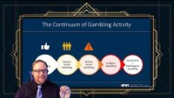
Lecture Video 1
Notes:
https://youtu.be/ssBDDgZ5gmM
Lecture on progression from Recreational Gambling to Problem Gambling **

Slide 37
History & Scope of Gambling
Notes:
The next section of the training will cover the history and scope of gambling.

Slide 38
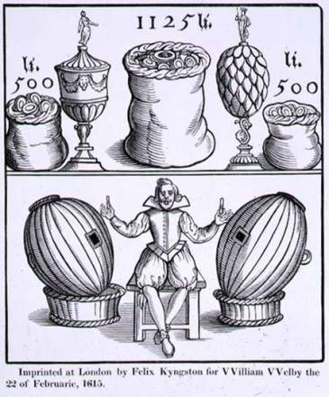
The History Gambling in the U.S.A.
Lottery financed colony of Jamestown, Virginia
Lotteries operated in each of the 13 colonies to fund development
1830’s: Anti-gambling legislation begins to appear
1931: Trend continues until Nevada legalizes gambling
Notes:
Gambling is ingrained in the DNA of the United States. Jamestown Virginia, our first colony on the continent of North America was largely financed by pooling resources of its inhabitants via a lottery. This allowed the organizing figures of the colony to receive money from all inhabitants while promising a seemingly large amount to a single person who wins while keeping the bulk of the money to fund the development of the colony itself. Lotteries eventually operated in each of the 13 colonies to fund development in a similar way. Starting as early as the 1830s anti-gambling legislation began to appear in states across the country. In 1931 Nevada legalize gambling which established a counterculture argument for the benefits of allowing gambling activity in defined locations and in specific ways.

Slide 39
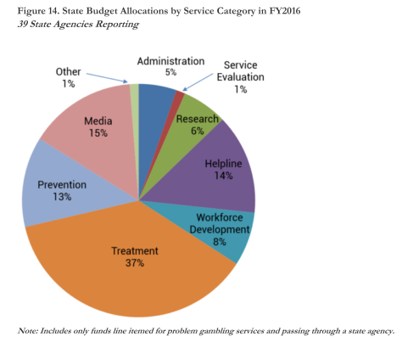
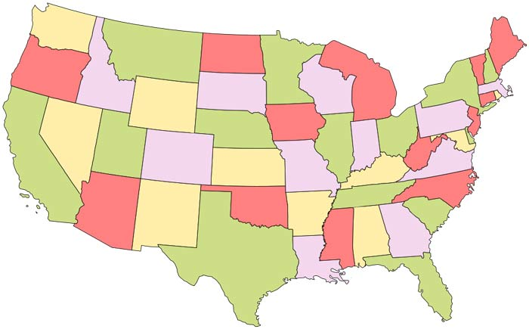
State-by-State Survey
Funding for gambling problems occurs on a state-by-state basis
In 2016, total funds for problem gambling services totaled $73 million
  Low: Washington D.C. = $0.00
  High: California = $8.47 million
40 states receive treatment investments
(Problem Gambling Solutions, 2016)
Notes:
Funding for gambling problems occurs in this country on a state-by-state basis. Enjoy 16 the total funds for problem gambling services totaled 73 million and continues to grow on a percentage level each year. At the time of creating this training, 40 states receive treatment investments to enable the development of programs as a response to the existence of gambling across the state boundaries.

Slide 40
Defining Gambling
Any time you bet money or risk something of value on an event of uncertain outcome, you are GAMBLING.
Per the National Council on Problem Gambling (2020):
  Problem gambling–or gambling addiction–includes all gambling behavior patterns that compromise, disrupt or damage personal, family or vocational pursuits.
Notes:
Let’s return to our definition for gambling from the previous slides: anytime you bet money or wrist something of value on an event of uncertain outcome or gambling. The national Council on problem gambling further states the problem gambling – or gambling addiction – includes all gambling behavior patterns that compromise, disrupt or damage personal, family, or vocational pursuits. It is also clearly stated in the diagnostic criteria that the problems experienced from gambling must create significant impairment in order to be considered for diagnosis.

Slide 41
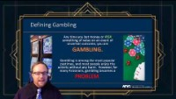
Lecture Video 2
Notes:
https://youtu.be/WuR7uV391b8
Lecture on the range of activities that fit into the definition of gambling **

Slide 42
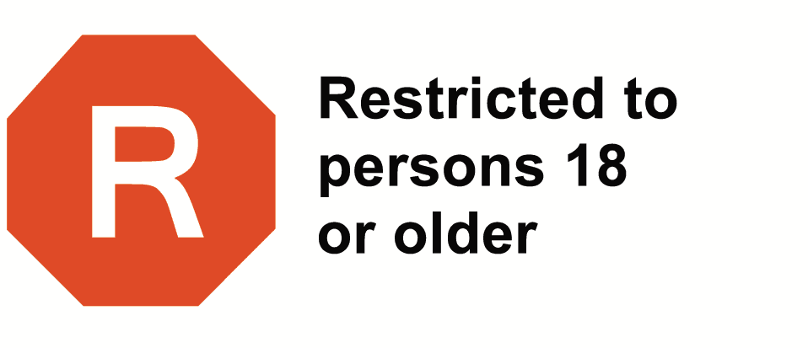
Gambling Concerns & Age Groups
Top Forms Of Gambling In Arizona Differ By Age Group...
  Access and gambling are illegal for anyone under the age of 18
Persons must be 21 years of age or
  older to gain access to a Native American
  casino in Arizona or to play slot machines
  at designated pari-mutuel facilities.
Notes:
Age groups are affected differently when it comes to experiencing of gambling problems. Most people think of gambling as something that is experienced by people who are 18 years of age or older. Legally speaking, access to gambling is illegal for people under the age of 18. However, there are certain kinds of gambling that do occur in childhood and adolescence for most people. Persons must be 21 years of age or older to gain access to a Native American casino in Arizona or to play slot machines at designated pari-mutuel facilities.

Slide 43
General Forms of Gambling
Adult Population
Adolescent Population
  Lottery
  Poker / Cards
  Raffles
  Casino Gambling
  Floating Casinos (where available)
  Fantasy Sports
  Games of skill
    (pool, bowling, basketball, golf)
  Video Games
  Raffles
  Sports
  Charitable Games
  Cards
  Dice
Notes:
Going back to different gambling games appealing to different age ranges, adults and adolescents will often gambling in very different ways. Adults will gamble at establishments designed for gambling activity. As a result, you may consider poker games, slot machines, casino gambling, and fantasy sports or other activities that require a debit or credit card to be adult activities. Lottery tickets also are not supposed to be legally purchased for people who are a minor in age.
Adolescents still find ways to gamble outside of these societal expectations. This occurs via games of skill like playing pool, bowling, golf, or making certain shots in basketball. It can also occur via video games where money or goods are on the line as an outcome for certain matches. Raffle sports charitable games cards and dice are also used in various ways across childhood and adolescence, and some of these methods of presentation encourage relying on chance as a feature of the game thrill. This can encourage future gambling activity without proper oversight from adults to understand the features of conditioned responses involved in the play of these games.

Slide 44
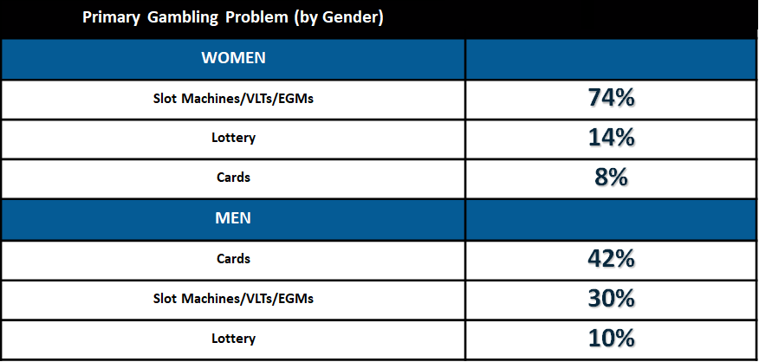
Primary Problem Gambling Issue (By Gender)
Florida Council on Compulsive Gambling (2013)
  Based upon 1,945 help calls regarding the caller’s primary gambling problem.
Notes:
The likelihood of certain gambling problems reaching a primary status in the mind of the individual often can relate to gender. For example, research conducted by the for the Council on compulsive gambling in 2013 surveyed helpline collars from their state and identified that women identified slot machines as their primary gambling problem 74% of the time which was met by men only at 30%. For men the highest primary gambling problem was attributed to cards. Likewise, cards only accounted for 8% of female helpline callers.

Slide 45
National Prevalence of
Gambling Issues
Notes:
The following section will review national prevalence of gambling issues coming from dad in the most recent prevalence study and related research works.

Slide 46
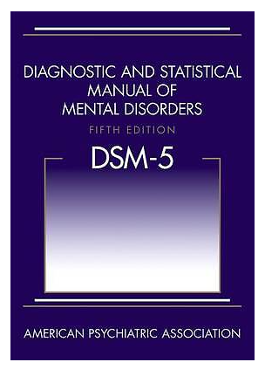
Understanding Prevalence
Gambling opportunities in the United States continue to increase year to year (Horvath & Papp, 2012)
The two primary sources of measuring Gambling Disorder prevalence are the:
  South Oaks Gambling Screen (SOGS)
  Diagnostic & Statistical Manual of Mental Disorders, 5th Edition (DSM-5)
Notes:
Gambling opportunities in the United States continue to increase year-to-year. In fact, there are many gambling style activities that did not exist just 10 years ago. As technology advances are access to gambling style games, is important for clinicians to understand how the creation of new styles of gambling games can impact the population from year-to-year.
At present, two of the most featured ways of measuring gambling disorder prevalence are through utilizing the South Oaks gambling screen (or SOGS) and three using the disorder criteria found in the diagnostic and statistical manual of mental disorders fifth edition (or DSM-5).

Slide 47
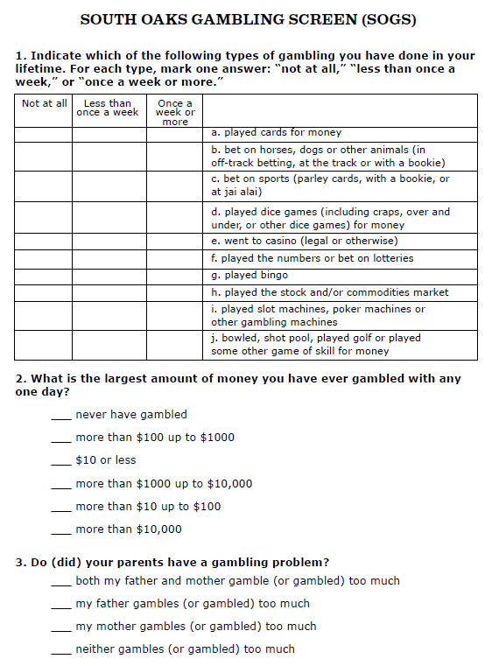
Problem vs. Pathological
Using the phrase pathological gambling connects with the original name of the DSM diagnosis as an “Impulse Control Disorder”
  This term is now used to state the patterns of gambling behavior led to a diagnosable problem
The term problem gambling does not necessarily indicate diagnosability.
  It does indicate the patterns of behavior lead to noticeable impairment which could lead to a diagnosable concern if left unchecked
Notes:
Understanding the development of problematic gambling moving into diagnosed pathological gambling is an important series of phases of personal experience that clinicians are encouraged to understand. If we use the phrase pathological gambling, this philosophically connects us to the name used in earlier editions of the DSM to diagnose a significant level of problem gambling categorized as an impulse control disorder.
The term problem gambling does not necessarily indicate diagnose ability. It simply means in layman’s terms that the gambling behavior being acted out is creating problems. It does however indicate the parent a behavior lead to noticeable impairment which could lead to a diagnosable concern if left unchecked.

Slide 48
Problem vs. Pathological
2-3%
Problem Gambling
  DSM-5: Client has 2-3 confirmed criteria
  SOGS: Client is approaching 3 confirmed symptoms
Pathological Gambling
  DSM-5: Client has 4+ confirmed criteria
  SOGS: Client has 4+ confirmed symptoms
Notes:
Problem gambling is being indicated if the following scores occur: a score of 2 to 3 or more on the DSM-V, or a score on the South Oaks gambling screen that confirms three symptoms.
Pathological gambling is being indicated if the following scores occur when the client has four or more confirm criteria in the DSM-V or has identified four or more confirmed symptoms on the South Oaks gambling screen
At any given time, anywhere from 2 to 3% of the general population would have assessment scores indicating problematic (or potentially problematic) gambling in the last 12 months of time

Slide 49
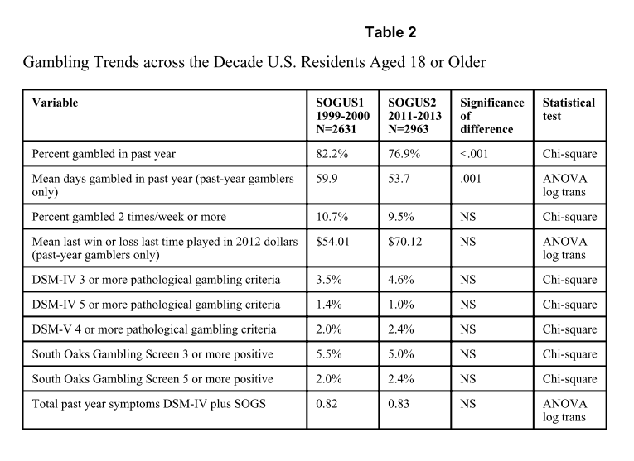
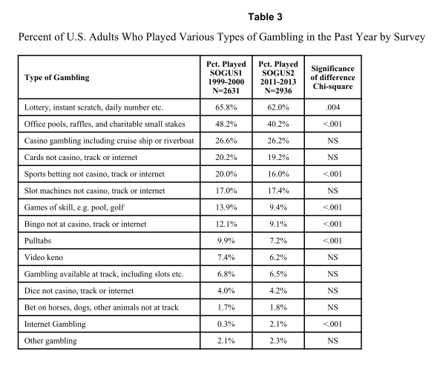
National Trends
Notes:
This slide presents two of the most prominent data charts from the last national prevalence replication study which occurred in 2015. As you can see, around 82% of the population reported they had gambled within the last year. These participants estimated that there gambled an average amount of nearly 60 days out of the calendar year. When it comes to measuring diagnostic criteria, anywhere from 2 to 3% indicated scores that could indicate problematic gambling in the last 12 months of time. The most often played type of gambling was the lottery, followed by office pools, and then casino gambling.
As part of your preparation for the gambling counselor exam, is recommended that you keep your copy of the 1999 national prevalence study and the 2013 replication study published in 2015. These are included as attachments in this module of the training.

Slide 50
Describing Gambling
Disorder
Notes:
The next section will focus on describing gambling disorder

Slide 51
Understanding Addiction Issues
Addiction
Salience
Mood Modification
Tolerance
Withdrawal
Conflict
Relapse
Components Model of Addiction (Griffiths, 2005)
  Addiction variables are used to create diagnostic criteria and list the symptoms of the problem
  Model used to describe addiction for problems which do not involve ingestion of a drug.
  Education on each component can be useful to better identify the reach of each addiction in a person’s life
Notes:
In order to organize our thoughts about what is an addiction, it can be helpful to define addictions from a context that works for both substance-based and behavior-based conditions. One method of accomplishing this goal is to use the components model of addiction established in 2005 by Mark Griffiths. These components become the addiction variables which are used to create diagnostic criteria and list out the symptoms of a problem like gambling. This method can be used to describe process addictions as well.
The components identified in this publication were salience – the unique quality of enjoying a specific thing more than other things available to act upon, mood modification – using the activity to increase a move that is otherwise not in a comfortable range for the individual experiencing it, tolerance, withdrawal, experiencing conflict related to the activity, relapse or consistent inability to curb or discontinue the activity. Education on each of these components can be useful to better identify the reach of each addiction in a person’s life.

Slide 52
History of the Issue: DSM-III
Included with the Impulse Control Disorders (ICDs)
Features included:
  Not resisting impulses
  Feeling rising tension before play
  Experiencing pleasure during, followed by guilt after play sessions
  1st time pathological gambling included in DSM
  7 Criteria involved (5 of which related to money or getting money for gambling)
(Rugle & Franklin, 2013)
Notes:
Pathological Gambling was first included as a diagnosis in the DSM-III, and was located in the Impulse Control Disorder category. This initial description included features of the client not resisting impulses to gamble, feeling rising tension before play, and experiencing pleasure during, followed by guilt after play sessions.
This was the 1st time gambling was included as a diagnosable condition in the DSM, and it consisted of seven criteria, five of which related to money, or getting money for gambling purposes.

Slide 53
History of the Issue: DSM-III to DSM-IV
1987 – DSM III-R
  Basically re-applied substance dependence criteria to pathological gambling
  Increased total criteria to 8 (Requires 4 to confirm diagnosis)
1994 – DSM-IV
  Based on empirical review of multiple variables for diagnosis
  New set of 9 items best differentiated between self-identified pathological gamblers and a group of substance-abusing controls
  This manual added the “loss of control” item based on feedback from treatment professionals specializing in gambling areas
(Rugle & Franklin, 2013)
Notes:
DEFINING PROBLEM AND PATHOLOGICAL GAMBLING: In 1987, the DSM-III recreated the substance dependence criteria for pathological gambling. This resulted in an increase to eight criteria, with a minimum of four to be a diagnosed condition. The next manual update in 1994, the DSM-IV, increased the empirical validity on multiple items in the criterion list. This diagnostic version created a new set of 9 items differentiated between self-identified pathological gamblers and a control group consisting of substance abusers. A final criteria, “loss of control” was added through the feedback of gambling treatment professionals.

Slide 54
History of the Issue: DSM-IV
  “The essential features of the disorder are
  a continuous or periodic loss of control over
  gambling; a progression, in frequency and in
  amount wagered, and in the preoccupation
  with gambling and with obtaining money
  with which to gamble; irrational thinking;
  and a continuation of the behavior despite
  adverse consequences.”
(APA, 1994)
Notes:
This version of the DSM explained pathological gambling in the following way: “The essential features of the disorder are a continuous or periodic loss of control over gambling; a progression, in frequency and in amount wagered, and in the preoccupation with gambling and with obtaining money with which to gamble; irrational thinking; and a continuation of the behavior despite adverse consequences.”

Slide 55
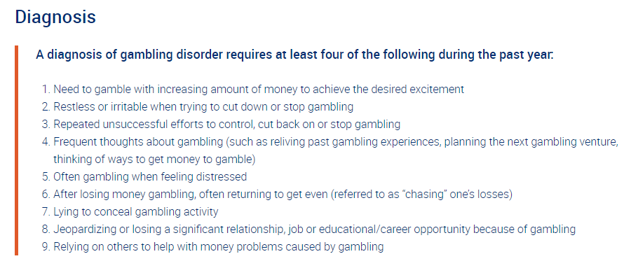
DSM-5: Defining Gambling Disorder
Notes:
The screenshot depicted in this slide is an overview of the diagnostic criteria we currently use to identify gambling disorder as defined in the DSM-V. This list of criteria includes tolerance, withdrawal, loss of control, preoccupation, escape, chasing, lying, risking significant relationships or opportunities, and bailout. This diagnostic listing no longer identifies illegal acts as a contributing factor to the diagnosis of gambling disorder. This is because illegal acts were often only admitted when a client was involved in legal consequences for their gambling which altered their frequency of correctly applying the criteria to many counseling cases.

Slide 56
Defining Gambling Disorder for the DSM-5
Persistent and recurrent problematic gambling behavior leading to clinically significant impairment or distress, as indicated by four(or more) of the following in a 12-month period:
  Tolerance
    Needs to gamble with increasing amounts of money in order to achieve the desired excitement.
  Withdrawal
    Is restless or irritable when attempting to cut down or stop gambling.
  Loss of control
    Has made repeated unsuccessful efforts to control, cut back, or stop gambling.
  Preoccupation
    Is often preoccupied with gambling (e.g., having persistent thoughts of reliving past gambling experiences, handicapping or planning the next venture, thinking of ways to get money with which to gamble).
Notes:
DEFINING Gambling Disorder: DSM-5. In the DSM-5, diagnostic criteria for Gambling Disorder is explained as a Persistent and recurrent problematic gambling behavior leading to clinically significant impairment or distress, as indicated by four(or more) of the following in a 12-month period:
Tolerance: Needs to gamble with increasing amounts of money in order to achieve the desired excitement.
Withdrawal: Is restless or irritable when attempting to cut down or stop gambling.
Loss of control: Has made repeated unsuccessful efforts to control, cut back, or stop gambling.
Preoccupation: Is often preoccupied with gambling (e.g., having persistent thoughts of reliving past gambling experiences, handicapping or planning the next venture, thinking of ways to get money with which to gamble).

Slide 57
Defining Gambling Disorder for the DSM-5
  Escape
    Often gambles when feeling distressed (e.g., helpless, guilty, anxious, depressed).
  Chasing
    After losing money gambling, often returns another day in order to get even (“chasing” one’s losses).
  Lying
    Lies to conceal the extent of involvement with gambling.
Notes:
Escape: Often gambles when feeling distressed (e.g., helpless, guilty, anxious, depressed).
Chasing: After losing money gambling, often returns another day in order to get even (“chasing” one’s losses).
Lying: Lies to conceal the extent of involvement with gambling.

Slide 58
Defining Gambling Disorder for the DSM-5
  Risked Significant Relationship
    Has jeopardized or lost a significant relationship, job, educational or career opportunity because of gambling.
  Bailout
    Relies on others to provide money to relieve desperate financial situations caused by gambling.
    B. Not better accounted for by a Manic Episode.
Notes:
Risked significant relationship: Has jeopardized or lost a significant relationship, job, educational or career opportunity because of gambling. Bailout: Relies on others to provide money to relieve desperate financial situations caused by gambling.
Gambling Disorder cannot be diagnosed if the gambling behavior is better accounted for as a symptom of a Manic Episode.

Slide 59
Defining Gambling Disorder for the DSM-5
  Course Specifiers include:
    Episodic
    Persistent
    In Early Remission
    In Sustained Remission
  Specify Current Severity:
    Mild: 4-5 criteria met
    Moderate: 6-7 criteria met
    Severe: 8-9 criteria met
Notes:
Course specifiers include: Episodic: Meeting diagnostic criteria at more than one time point, with symptoms subsiding between periods of gambling disorder for at least several months. Persistent: Experiencing continuous symptoms to meet diagnostic criteria for multiple years. In Early Remission: after full criteria for gambling disorder were previously met, none of the criteria have been met for at least 3 full months, but less than 12 months. In sustained remission: after full criteria for gambling disorder were previously met, none of the criteria have been met during a period of 12 months or longer.
Severity can also be specified in the diagnosis of Gambling disorder. A diagnosis of mild severity means the client met four to five criteria at the time of diagnosis. A diagnosis of moderate severity means the client met six to seven criteria at the time of diagnosis. Finally, a diagnosis of severe gambling disorder means the client met eight to nine criteria at the time of diagnosis.

Slide 60
Considerations from DSM-5 Update
Part of “Substance-Related Disorders,” which has been renamed Substance-Related and Addictive Disorders
At present, gambling is the only “behavioral” addiction included in the “Addictive Disorder” category.
“Pathological Gambling” is renamed “Gambling Disorder”
Only 9 symptoms are included in the diagnostic criteria.
  Eliminates “illegal acts”
  The cut-off for diagnosis is now 4 out of 9 criteria
  (previously 5 out of 10 in DSM-IV)
Notes:
Changes from DSM-IV to 5: Gambling Disorder is now found as Part of the “Substance-Related Disorders,” which has been renamed Substance-Related and Addictive Disorders to accommodate the reality that many addictive behaviors may not be connected to the intake of a substance. At present, gambling is the only “behavioral” addiction included in the “Addictive Disorder” category.
“Pathological Gambling” has been renamed “Gambling Disorder” as part of it’s relocation to the addiction category rather than the Impulse-Control Disorders.
Only 9 symptoms are included in the diagnostic criteria.
Illegal acts related to gambling has been eliminated from the criteria list, changing the cut-off to 4 of 9 rather than 5 out of 10.

Slide 61
Features Associated with DSM-5 GD
Distortions in Thinking
Personal Traits
Prone to Stress
Many individuals with Gambling Disorder believe that money is both the cause of and solution to all their problems.
They may be overly concerned with the approval of others and may be generous to the point of extravagance.
When not gambling, they may be workaholics or “binge” workers who wait until they are up against deadlines before really working hard.
Increased rates of Mood Disorders, Disorder, ADHD, Substance Abuse or Dependence, and Antisocial, Narcissistic, and Borderline Personality Disorders have been reported in individuals with Gambling Disorder.
Of individuals in treatment for Gambling Disorder, 20% are reported to have attempted suicide.
Highly competitive, energetic, restless, and easily bored.
(Rugle & Franklin, 2013)
Notes:
DSM-5 Associated Features: Distortions in thinking may be present in individuals with Gambling Disorder. Many individuals with Gambling Disorder believe that money is both the cause of and solution to all their problems.
Individuals with Gambling Disorder are frequently highly competitive, energetic, restless, and easily bored. They may be overly concerned with the approval of others and may be generous to the point of extravagance. When not gambling, they may be workaholics or “binge” workers who wait until they are up against deadlines before really working hard.
They may be prone to developing general medical conditions that are associated with Stress such as peptic ulcer disease, or migraines. Increased rates of Mood Disorders, Disorder, ADHD, Substance Abuse or Dependence, and Antisocial, Narcissistic, and Borderline Personality Disorders have been reported in individuals with Gambling Disorder. Of individuals in treatment for Gambling Disorder, 20% are reported to have attempted suicide.

Slide 62
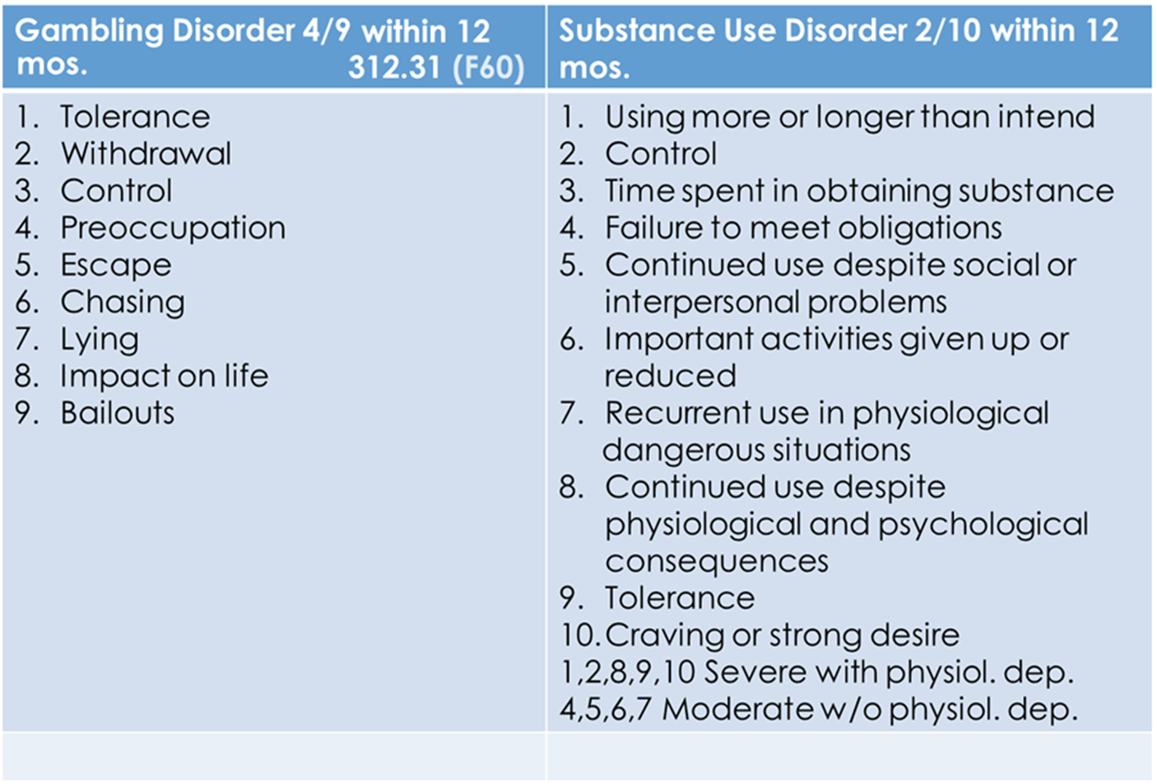
Notes:
Here is a chart listing the addiction treatment terminology for the symptoms in the current diagnostic criteria for Gambling Disorder. As you can see, the nine symptoms for Gambling Disorder closely reflect the symptoms listed in consideration of Substance Use Disorders. Whereas the cut-off point for Substance Use disorders is set at 2 out of 10 criteria in a 12 month period, Gambling Disorder requires the presence of 4 criteria acted out by the individual in a 12 month span.

Slide 63
Evaluating the DSM-5 Changes
Subjects
  2,417 randomly selected US household residents
  450 gambling patrons
  149 gambling treatment programs
  375 in brief intervention studies
Measurement
  NORC DSM-IV screen (NODS) using both 10 and 9 item criteria
Conclusions
  Illegal acts does not appear to be a necessary criterion for the diagnosis of pathological gambling since it only measures people who have been caught being involved in illegal acts.
  With this criterion eliminated, the cut-point for a diagnosis is reduced to 4.
  This results in more consistent diagnoses relative to the current classification system.
(Petry, Blanco, Stinchfield & Volberg, 2012)
Notes:
Evaluation of DSM-5 Changes on Diagnosis: Leading up to the changes in the DSM-5 diagnostic criteria for Gambling Disorder, efforts were made to explore the necessity for each of the criterion to best allow clinicians the ability to accurately identify person’s requiring treatment related to the impact of their gambling behaviors. 2,417 randomly selected US household residents were surveyed, with 450 being gambling patrons, 149 having participated in gambling treatment programs, and 375 involved in brief intervention studies. The instrument used was the NORC DSM-IV screen, or the NODS, and people were asked for responses based on the 10 criteria list, which included illegal acts, and the 9 criteria set, which removed it due to the intended DSM-5 changes. The study concluded that the inclusion of the illegal acts criterion does not appear necessary for the diagnosis of pathological gambling and, it has been eliminated, reducing the cut-point to 4 results in more consistent diagnoses relative to the current classification system.

Slide 64

Progressive Features of Addiction
Loss of Control
Preoccupation
Negative impact on major life areas
Tolerance
Notes:
Current clinical data indicates significant differences in progression among various populations. Gambling disorder is progressive in nature, causing the individual to experience a psychologically uncontrollable preoccupation to gamble, resulting in damage to vocational, family, and social interests. It is characterized by a chronic inability to resist the impulse to gamble.

Slide 65
Relationship with Other Addiction Issues
Similarities
Differences
Withdrawal Symptoms
Self-help / 12-Step experiences
Biopsychosocial Factors
Systemic Considerations
Gambling is systemically impactful
Behavior is unrelated to intoxication
Intensity of shame and guilt
Convenient denial
Lack of awareness as health issue
Notes:
Gambling Disorder in comparison to substance abuse, has the following similarities: loss of control, preoccupation, negative impact on major life areas, and tolerance. Other similarities include: Withdrawal symptoms, self-­‐help groups, biopsychosocial or spiritual disorders, family involvement.
The Differences between substance abuse treatment and working with a gambler include the following facts : Gambling is not self­‐limiting. Behavior is not attributable to intoxication, More intense sense of shame and guilt, greater denial and stronger defenses.

Slide 66
Differences in Problem Processes
Unpredictable outcome
Fantasies of success
No biological test
Easier to hide
Greater financial problems
Intensity of family anger
Less public awareness and acceptance
Notes:
Additional differences in the two disorder types include: Unpredictable outcomes, fantasies of success, no biological testing is possible, and gambling is often easier to hide. There are often greater financial problems, higher intensity from family anger, and less public awareness and acceptance that gambling can be a severe addictive problem.

Slide 67
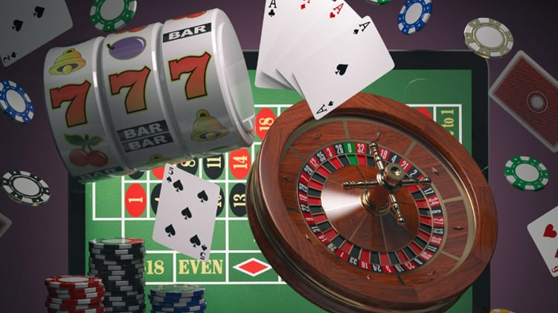
IN PROBLEM GAMBLING,
THE PERSON BELIEVES
THE PROBLEM IS THE
SOLUTION TO THEIR PROBLEM
Notes:
Finally, for gamblers, the solution to the problem is the problem. This means, in order to get out of the consequences of gambling, people often feel they need to gamble more, and win. This often leads to greater problems, but the person continues because this feels to them like the only logical solution.

Slide 68
Screening for
Comorbidity
Notes:
The following section will focus on screening for comorbidity with clients who gamble.

Slide 69
Screening for Potential Co-Occurring Issues
Gambling Disorder has a high overlap with many other treatment issues:
Depression
Anxiety
Alcohol Use
Personality
Bipolar
Mania / Mood
ADHD
ICD
(NCRG; Black & Shaw, 2008)
Notes:
Co‐occurring disorders and gambling treatment. Categories which often appear in studies of this kind can range from depression and other mood disorders, anxiety, problems with the flow of energy such as ADHD and impulse control disorders, pairing with alcohol, and concerns for personality disorders.

Slide 70
Mood Disorders
Depression often existed prior to the beginning of gambling behavior.
Diagnoses include:
  Major Depression
  Dysthymia
  Bipolar 1 & Bipolar II
Research indicates addicted gamblers are at least 3x’s more likely to meet diagnostic criteria for: depression, schizophrenia, & alcoholism.
Certain studies identify a problem gambler may be around 75% likely to meet criteria for a comorbid affect disorder.
Notes:
Research indicates addicted gamblers are at least three times more likely to meet criteria for: depression, schizophrenia, and alcoholism. Also, the depression is often found to have preceded the gambling problems; In one study, 76% of addicted gamblers in treatment met criteria for a major affect disorder. Depression often existed prior to the beginning of the gambling behavior, but can adjust and increase to problematic levels as gambling consequences pile up.

Slide 71
Suicide Risk
  Literature reports a strong relationship with suicide and P.G.
    12-36.7% of GA sample had attempted suicide, and 40-92% had thoughts of committing suicide.
    One Canadian study found a 13.3% attempt rate for problem gamblers vs. 4% for the general population.
  Limitations
    Studies completed without controls and generally lack multivariate analysis
    Connections between problem gambling and suicide must be viewed with caution.
(Moran ’69, McCormick et al, ’84, Ladouceur et al, ’94, Frank ’91, Petry ‘05)
Notes:
Suicide risk. Literature reports a strong relationship with suicide and problem gambling. 12–36.7% of GA sample had attempted suicide, and 40 – 92% had thoughts of committing suicide. One Canadian study from Alberta found a 13.3% attempt rate for compulsive gamblers vs. 4% for the general population. Studies done with only treatment populations, no controls and generally without multivariate analysis means connections of problem gambling must be viewed with caution.

Slide 72
Research Findings
    Lifetime substance use rates among problem gamblers ranged from 35%-63% (review by Crockford and el-Guebaly ’98, Petry ‘05).
    Rates of Gambling Disorder among substance abusers was 9%-30% (Lesieur ’86, McCormick ’93).
    Compulsive gamblers who were addicted to cocaine were:
      Two times more likely to overdose
      Have greater history of past addiction treatment
      Have increased drug use in the past month over non-gambling cocaine addicts (Steinburg '92).
Notes:
Research has been found to indicate the following prevalence for gamblers with co-occurring concerns: Lifetime rates of substance abuse among addicted gamblers ranged from 35%–63%. Rates of gambling disorder among substance abusers was 9%–30%. Compulsive gamblers who were addicted to cocaine were found to be two times more likely to overdose, have greater history of past addiction treatment, and had more drug use in the past month than non-­gambling cocaine addicts.

Slide 73
Research Findings
  ADHD research suggests a higher incidence of ADHD among problem gamblers
    Limitation: Samples were statistically relevant.
  Needs a longitudinal view to “determine the progression from attention problems to other problems, including Gambling Disorder” (NRC –’99)
Notes:
ADHD evidence suggests a higher incidence of ADD or ADHD among addicted gamblers, although samples were too small to establish statistical relevance. Research needs a longitudinal view to determine the progression from attention problems to other problems including Gambling disorder.

Slide 74
Psychiatric Comorbidity with Diagnosed Gambling Disorder
Affect
Disorders
~33-76%
~9-40%
Anxiety
Disorders
~5-30%
Trauma
Gambling
Disorder
Attention Deficit
Disorder
Substance Use
Disorders
~25-63%
Personality
Disorders
~20-40%
40-93%
Notes:
Psychiatric comorbidity in pathological gamblers. Summary of Gambling Disorder Patients in treatment. The chart below lists the potential overlap of comorbid psychiatric conditions when treating a person meeting criteria for Gambling Disorder. Affect disorders: 33%­‐76%. Trauma: 5%­‐30%. Substance use disorders: 25-%‐63%. Personality disorders: 40-%‐93%. Attention deficit disorder: 20 %-40%. And Anxiety disorders: 9%–40%.

Slide 75
Key Findings on Comorbidity
Past-Year, Lifetime Problem, and Diagnosed Problem Gamblers
are significantly more likely to:
  Use drugs for non-medical reasons
  Report negative life events
Notes:
Past­‐year, lifetime problem, and compulsive gamblers are significantly more likely to: use tobacco, alcohol, cocaine, and tranquilizers for non-­medical reasons. They also report higher rates of depression, arrests, treatment for alcohol and drug abuse, and troubled personal relationships.

Slide 76
South Oaks
Gambling Screen
(SOGS)
Notes:
The following section will cover the use of the South Oaks gambling screen for screening and identifying issues for problem gamblers.

Slide 77
Using the South Oaks Gambling Screen (SOGS)
The SOGS is a 16-item instrument.
Not all questions are counted within the SOGS scoring system because they
  Include people who gamble in a healthy way, or
  Do not provide a distinction between problematic and healthy behavior
  These items do provide important information and insight.
Notes:
The South Oaks gambling screen is one of the most often used screening instruments for identifying information related to a person’s gambling problem. Is a 16-item instrument with certain questions containing sub questions. Not all questions are counted towards a diagnosis score because these questions also relate to people who gamble in a healthy way, do not provide a distinction between problematic and healthy behavior, but these items do provide important information and insight and so they are included in the screening instrument.

Slide 78
Using the South Oaks Gambling Screen (SOGS)
Question 1: Please indicate which of the following types of gambling you have done in your lifetime. For each type, mark one answer: “Not at all,” “Less than monthly,” “Monthly,” “Weekly” or “Daily.”
  Played cards for money
  Bet on horses, dogs or other animals (at OTB, the track or with a bookie)
  Bet on sports (parlay games with a bookie or at Jai Alai)
  Played dice games (including craps, over and under or other dice games) for money
  Gambled in a casino (legal or illegal)
Notes:
Question 1: Please indicate which of the following types of gambling you have done in your lifetime. For each type, mark one answer: “not at all”, “less than monthly”, “monthly”, “weekly”, or “daily”. Played cards for money. Bet on horses, dogs, or other animals. Bet on sports. Played dice games including craps, over and under or other dice games, for money. Gambled in a casino legally or illegally.

Slide 79

Video Lecture 3: Reviewing the SOGS Instrument
Notes:
https://youtu.be/_Yvi5aJ3kbE
Lecture review for working through the entire SOGS with a client **

Slide 80
DSM-Style Scoring for SOGS
10+
6-9
4-5
1-3
No Problem
Severe Gambling Problem
Moderate Gambling Problem
Mild Gambling Problem
At-Risk
There is no concern for pathological gambling since the person does not gamble
Notes:
***
For clients who identify a SOGS score of zero, their responses indicate no difficulties are experienced related to gambling activity. For those who communicate they have a score of one to three, they may have some problem experienced in relationship to their gambling behavior. This would not automatically mean they are experiencing gambling disorder or are diagnosable at that time, but they may have potential for developing a future problem with gambling.
The questions in the South Oaks Gambling Screen are written to be sensitive to findings in research. The various clinical fields have identified terminology such as “at-risk” and “problem gambling” to be useful. However, these definitions do not appear in the DSM but are commonly used in the field. However, specifiers related to time course and severity are found in the DSM and can be useful for a clinician. A score of four or more would indicate that the client is probably experiencing some level of addiction to gambling. Now, why does it say probably? Because it’s just a screen and only the clinician can make this determination. It’s the clinician hearing what the client shares during the screening and in the collection of data, and then reviewing the yeses and no’s, they can determine whether a client does or does not have a diagnosable gambling problem? If they have a score of four or more on the SOGS, they probably meet criteria for Gambling Disorder. Therefore after you get a SOGS score your next step as a clinician is to consult the DSM. Does your client meet or not meet diagnostic criteria?
The screen is meant to help you find clients that need to undergo the diagnostic interview so you can make the determination and define where the client is on the continuum of the problem.

Slide 81
The Continuum of Gambling Activity
No Gambling
Casual / Social Gambling
Serious Social Gambling
Problem Gambling
Compulsive / Pathological Gambling
Notes:
***
Let’s review the Continuum of Gambling Activity again, this time with the South Oaks Gambling Screen in mind.
These are the Types of Gamblers we are describing in this module of the training
The Social Gambler tends to Gambles occasionally, for fun, and will normally stick to their limits.
The Serious Social Gambler will often Gamble as a hobby or vocation, and still does not spend more time or money than can afford, often sticking to their limits in the beginning in times when gambling is not contributing to a list of life problems.
The Professional Gambler - Gambles as a way of earning a living and is extremely rare. Many people who come to treatment profess to be professional gamblers as a way to cognitively justify their reckless behavior.
A Problem Gambler is beginning or has already started to have problems due to gambling. This person has communicated a score of 3 or more on the SOGS and exhibits 1 to 3 DSM-5 criteria.
The Compulsive or Pathological Gambler will experience major life problems due to gambling. These gamblers will score 4 or more on SOGS and meet DSM-5 criteria for Gambling Disorder.

Slide 82
Social Gambler
Serious Social Gambler
Professional Gambler
Primary source of income
Fun and entertainment
Controlled, infrequent gambling
Progression is rare and is usually linked to trauma or predisposing factor
Hobby, major source of entertainment
Could quit, but would miss the activity
Gambling is his business
Controlled, calculated betting
Antisocial Gambler
Gambling in a criminal capacity
Career of illegal gains
Cheating / Violating the rights and resources of others
Notes:
Types of Gamblers: as stated earlier in the session there are different kinds of gamblers. They are described briefly in the chart included on the slide:
Social Gambler - Gambles occasionally, for fun, sticks to limits.
Serious Social Gambler - Gambles regularly as a hobby or vocation, and still does not spend more time or money than can afford, sticks to limits.
Professional Gambler - Gambles as a way of earning a living, and is extremely rare.
The Anti-social Gambler gambles as part of an antisocial life style. However, it is possible to exhibit Antisocial Personality Disorder and Gambling Disorder in the same set of behaviors.
Clients must meet clinical criteria as established by the DSM-5 for their gambling behavior to be considered a clinical addiction.

Slide 83

Gambling Disorder as an Addiction
Meets diagnostic criteria for Gambling Disorder
  DSM-5 criteria (4+)
  SOGS score (5+)
  NODS (4+)
Disruptions in major life areas
Co-occurring disorders
Notes:
***
A person diagnosed with Gambling disorder meets the clinical criteria as defined in the DSM-­5. This diagnosis is located under the Substance-related and Addictive Disorders in the Non-Substance related category. The diagnosis is indicated by other assessments as well. For example, a score of 5 or more on the South Oaks Gambling Screen (referred to as the SOGS) indicates the display of the client’s condition is likely diagnosable. Additionally, the NORC DSM Screen for Gambling Problems (NODS) identifies a gambling related pathology with 4 scored responses in the 9-item measure. Gambling disorder is an addiction problem which is further characterized by disruptions in major life areas, high rates of suicide attempts, and is often being experienced alongside co-­occurring mental health disorders and drug abuse.

Slide 84
The Profile of Different Gambling Styles
More likely to wager on games of skill or the outcome of a sporting event
More likely to wager on games of chance
Action Gambling
Escape Gambling
Notes:
***
People who gamble may be broadly categorized as “action” or “escape” gamblers. Although this is a somewhat outdated approach to classification, it does highlight the importance of a helping professional understanding the motivation for of a gambler’s patterns of play and wagering decisions. Historically, action gamblers are more likely to be male, and will often wager on sports or games of skill such as poker, card games, and the outcomes of sporting events.
Females are more likely to participate in gambling as with the stance of an escape gambler. This style of play relies on using the game escape difficult or undesired emotions for a length of time. These games often consist of rapid engagement mixed with a component of chance. These games are found in the form of slot machines, but could be other activities such as the repetitive activity found in scratch-off lottery tickets.
These classifications are not evidence based and have been dropped from use in most current programming. Their only purpose is to help generate conversation and begin considering the motivation for playing a gambling game. An action gambler is interested in a progression and defeating the game or other players more so than an escape gambler would be. By contrast, the escape style of gambling is about mood modification and spending time in an activity to relieve tension or avoid the source of those tensions.

Slide 85
Winning Phase
Gambles infrequently and socially
Losing Phase
Gambles alone
Desperation Phase
Reputation is affected
Hopelessness
Wins lead to more play and developing tolerance
Begins to fantasize about the opportunity of more gambling
Personality changes; (Irritable, restless, withdrawn)
Losing care about family and work
Losses are causing financial problems
Alienation from Friends/Family
Tolerance
Blame, Panic, and Relying on possibility of winning
The Progression
of
Gambling Problems
Suicidal Ideation
Arrests
Substance Abuse
Emotional Breakdown
(Robert L. Custer, MD & Harry Milt, 1985)
Notes:
***
Robert Custer and Harry Milt (1985) detailed the progression a problem gambling issue in the book “When Luck Runs Out). This book expands on the concept of a person going from a non-gambler to developing a severe gambling problem. These stages create a basic conceptualization used in the treatment of problem gambling in the form of stages.
The Winning Phase is the first stage, and it describes a person who is new to gambling. This type of gambler gambles in ways that appear infrequent and are also mostly social. If they win early, they may go on to expect a payoff more often when they perform this new recreational activity. Since their only experience includes winning, they will likely develop grandiose fantasies about what will happen if they gamble more and contribute more of their money. This leads to Tolerance in the form of the person increasing their bets, playing more often, and staying longer in search of the Big Win.
This leads to the second stage. This is known as the Losing Phase. In this phase, the gambler will gamble alone, and become increasingly preoccupied about gambling activities. They will begin to prioritize their play despite the risk of obvious consequences. Experiencing lengthy periods without winning will further serve to justify poor decision-making. These rash decisions can include losing time from work, missing the payments for bills, and making reckless financial choices. Essentially, gambling begins to affect the persons reputation, and brings negative changes to the forefront of their interactions with others unless their activities are conducted in secret.
By continuing to play without focusing on their psychological health in the process, the person can slip into the third stage, known as the Desperation Phase. In this phase, the gambler is focused on winning to overcome their problems. They will sacrifice their reputation in service of this goal. They have often alienated themselves from the people in their lives and are making dramatic decisions to avoid serious life altering problems. They begin to see gambling as the only solution to their problem. Even when they do win it is not enough. Since they are relying on “winning big” to get out of the financial hole, they begin to feel extreme levels of guilt and shame when they reflect on the damage they have caused and fear they cannot maintain the patterns of play they need to achieve this kind of win. When confronted by others, they often resort to lies, rationalizations, and blaming others, or agreeing to things as a ruse in order to receive a bailout or so they can continue playing by any means necessary.
The Hopelessness phase occurs when a gambler pushes their limits beyond the desperation stage and seems to have no resources left. This phase consists of what many in the addiction field call “hitting rock bottom.” This stage can lead the person to have suicidal ideation, getting arrested for activities related to their gambling, increases in consumption of alcohol and other substances, withdrawal symptoms forced on them by no longer having the means to gamble, and emotional breakdowns. The lack of trust from people in their social and family circles can often lead to severe alienation, lack of support, and even homelessness. This is where the deepest consequences occur and represents the lowest level of resources a gambler will have access to due to the desperation and internal hopelessness hitting at the same time.

Slide 86
Growth Phase
Rebuild Phase
Critical Phase
Hopelessness
New Way of Life
Insight & Awareness
Helpful to Others
Faces Problems
Self-Respect Returning
Improved Relationships
Repairing Financial Situation
New Interests and Life Goals
Problem Solving & Decision Making
Honest Desire for Help
Realistic Steps to Stop Gambling
The Progression
of
Gambling Recovery
Suicidal Ideation
Arrests
Substance Abuse
Emotional Breakdown
(Robert L. Custer, MD)
Notes:
***
The companion piece to the progression of problem gambling is the process of recovery. This is how a problem gambler moves out of the hopelessness in their problem and works to repair relationships and turn their life around.
Once the hopelessness of the problem becomes too much to manage, a person will identify ways to overcome their problem, accept support, and accept powerlessness related to gambling. The benefit of completing these steps is that the person learns to dedicate themselves to living a life without gambling. The Critical Phase includes the first steps in using this newfound resolve to grow and restore the value system that was lost in the heavier gambling stages. This critical phase is characterized by the person making solution-oriented decisions for each situation that suffered gambling consequences. They are working to have an honest desire for help others, and an understanding that steps taken to start recovery need to be realistic. They may begin to do things through a positive lens. Examples of this can include a rededication to work or family life, and this can lead to deeper understanding of their life away from gambling activity. The person becomes more familiar with healthy concepts like honesty, clarity, and concern for others, although it will take time to fully reflect some of these values as they develop over time.
After moving through the critical phase, the Rebuilding Phase allows the person to identify new interests, enhance their relationships with friends and family, and begin setting right the wrongs they created in their addiction. A defining feature of this stage is increases in awareness related to their own strengths and weaknesses with their addiction. The levels of success the problem gambler is having in recovery away from gambling leads to higher levels of self-respect, and richer interactions with others. They will attempt to repair gambling damages by paying bills, establishing a family budget, facing their legal problems, and experiencing less irritation and stress involved in the problems from the addiction.
The final stage of the recovery progression is known as the Growth Phase. In this phase, the person embraces a new way of life. They will aim to keep the insight and awareness they have built through this difficult process as a message for themselves and others. This person is also able to face problems promptly, and head-on, and is experiencing less pre-occupation related to their past gambling, and risk of relapse. The goal of this phase is to continue to grow as a person and stay strong in all efforts that support a gambling free lifestyle. They can live for themselves and others around them and can be willing to sacrifice or support others in many areas of life. Family relationships continue to grow, and the recovering person can show affection in ways that had been lost in the addiction.

Slide 87
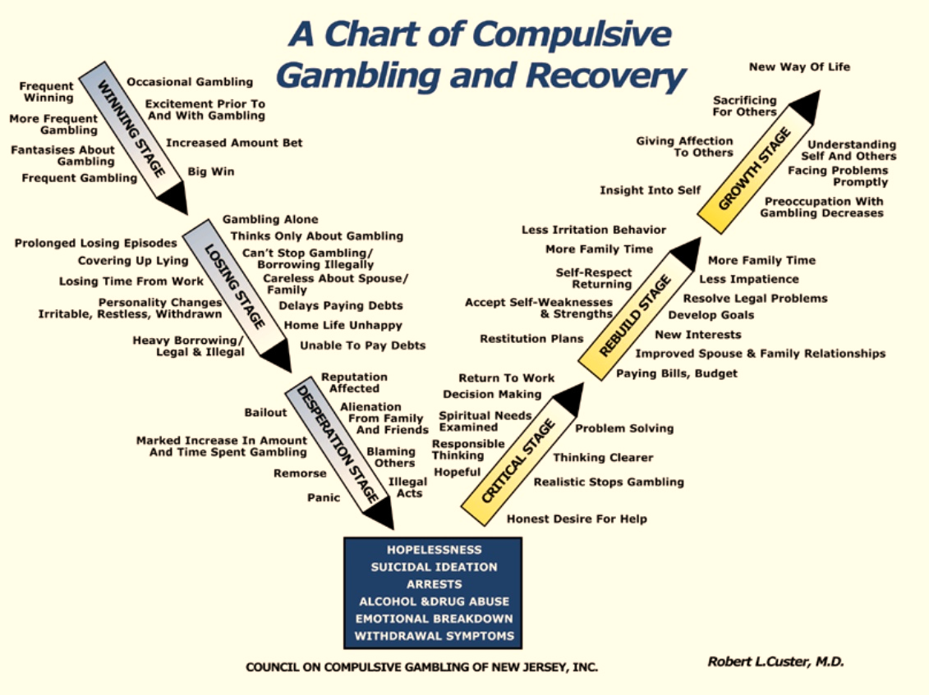
Notes:
***
By looking at the full spectrum, Custer established a V-chart that is considered a landmark theory in conceptualizing the unique progression of a gambling problem and a gambler’s phases of recovery. In your work with gamblers, it can be beneficial to educate them on how each of these stages may look and then spend time reflecting on the client’s specific situations. Once you have these details available for the clinical conversation, you can work through any of the deliberate choices they will be making and then plan for any high-risk situations that can be prepared for ahead of time. By using motivational interviewing and other clinical techniques you are comfortable with in working with addiction issues, this chart can be used to navigate through often difficult topics with your clients that may only come up as you become more knowledgeable with gambling issues. Finally, this is a critical theoretical concept for you to understand in your preparation for the National Gambling Counselor Exam and is influential in explaining the accepted progression of the problem used to describe other theories of gambling addiction.

Slide 88
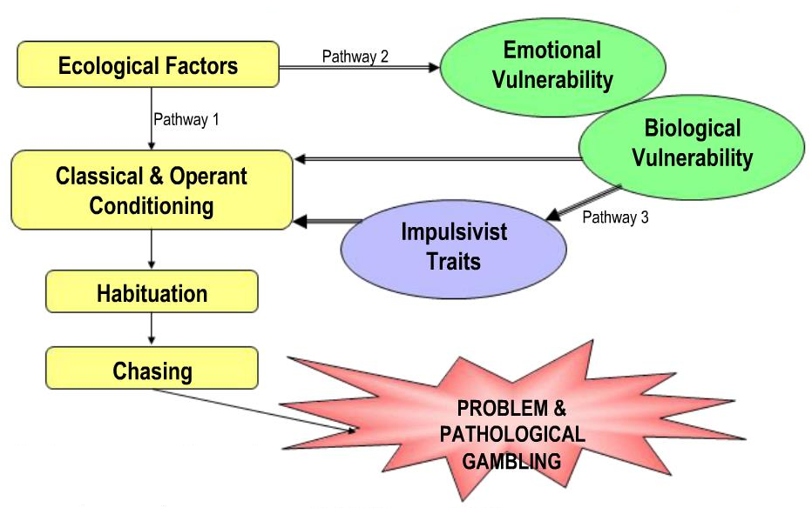
The Pathway Model of Problem Gambling
Resource:
“Overcoming Compulsive Gambling: A Self-help Guide Using Cognitive Behavioral Techniques.”
Alex Blaszczynski 1998
Notes:
***
The Pathway Model of Problem Gambling was established by Alex Blaszcynski to explain the various ways people encounter the gambling lifestyle. This model explores three distinct pathways explaining how a person could begin, experience, maintain, and then hopefully overcome their gambling problem.

Slide 89
The Pathway Model of Problem Gambling
Pathway One: The Normal Problem Gambler
Pathway Two: The Emotionally Disturbed Gambler
Pathway Three: The Impulsive Gambler
Alex Blaszczynski 1998
Notes:
***
The three pathways are as follows: Pathway one is known as “The Normal Problem Gambler.” Pathway two is known as “The Psychologically Vulnerable Gambler.” And lastly, pathway three is known as “The Impulsive Gambler.”

Slide 90
An Integrated Model of Problem Gambling
Problem gambling is not a unitary disorder
  It affects the person in multiple areas of their functioning
It affects several subtypes of people who share several features in common.
  Everyone will experience their own unique situations with commonalities from person to person
Impaired control in gamblers appears in holistically affecting ways
Notes:
***
The Pathway Model is designed to be an integrated model to explain problem gambling. Problem gambling is not a unitary disorder. It affects the person in multiple areas of their functioning.
It affects several subtypes of people who share several features in common. Everyone will experience their own unique situations with commonalities from person to person. Impaired control in gamblers appears in holistically affecting ways.

Slide 91
Path 1: “Normal” Problem Gambling
GAMBLING
ABSENCE
OF
PRE-MORBID
PSYCHOPATHOLOGY
PRESENCE
OF
PSYCHOSOCIAL
PROBLEMS
Blaszczynski’s Pathways Model (2000)
Notes:
The first pathway identified in this model is that of the normal problem gambler. The normal problem gambler begins with an absence of premorbid psychopathology with their gambling because they have not gambled yet. Once gambling is introduced, they develop over time the presence of psychosocial problems. These problems directly relate to the gambling activity and how it fits into the person’s life.

Slide 92

“Normal” Problem Gambling
Linked to Environment and Learning
  Opportunity , Availability, Accessibility
They start gambling and have positive feeling / rewarding experiences
Specific beliefs and attitudes are set down
  Notion of winning is possible
  Feeling good at the game
  Believing they are lucky
  Tendency to dismiss losses and think more about wins
Notes:
***
The normal problem gambler develops a desire to gamble and continue gambling through their environment and learning. For them, gambling occurs because it is available, there is opportunity, and the activity is accessible. This gambler often has experienced big wins early in their playing career and wins often enough to make them believe they are good at the activity or that they are lucky. They start to believe that winning is possible, that their skill at these games is above average and makes them more competent in their play than other gamblers, and that luck or winning is an eventuality. This type of gambler is more likely to fixate on winning as something they cause to happen and then losses are simply situational. They may even dismiss the experience of losses and the money involved as a non-concern because they are earning goodwill amongst their inner circle each play, and that makes their next win closer in their mind as well.

Slide 93
“Normal” Problem Gambling
Chasing begins
  Habit emerges
  Difficult to break due to financial pressures
No pre-existing conditions
  Signs of depression, anxiety and substance abuse
  Reactions are secondary
  Problems primarily generated by gambling
Entry down this pathway may begin at any age, in either gender
May be triggered by exposure to gambling, or family and friends inviting them to gamble
Notes:
Even though winnings are few and far between, this type of gambler will continue to chase in an effort to restore their belief that winning will eventually happen. Financial pressures related to their losses only serve to increase their playing habits. This person may have no pre-existing history of symptoms or treatment before their gambling career began. However, the increased pressures from losing will lead to visible signs of depression, anxiety, coping through increased use of alcohol or other substances. This path can begin at any age, and is often started through exposure to gambling locally, or through family and friends.

Slide 94
“Normal” Problem Gambling
Intensity and severity of problems are lower for this group vs. others
This person will likely…
  … have more insight into their problems
  … be more motivated to seek treatment on their own
  … be more likely to comply and have better outcomes
  … more likely to be able to use self-regulation
Notes:
Prognosis for this type of gambler can be more positive than with other types. This is attributed to this type of gambler being capable of deeper insight into how their problem works. These realizations make it more likely the normal problem gambler will seek treatment on their own, and also increases the chance of treatment compliance and success over time. One key positive element with this type of gambler is their ability to self-regulate their moods and coping strategies deliberately as they learn new concepts and educate themselves in treatment.

Slide 95
Path 2: “Emotionally Disturbed” Gambling
PROBLEMATIC AFFECTIVE STATES
MEETS NEEDS
THROUGH
GAMBLING
PREDISPOSED
PSYCHOLOGICAL
VULNERABILITY
Blaszczynski’s Pathways Model (2000)
Notes:
The second pathway is the “emotionally disturbed” gambler. These types of gamblers typically have a higher difficulty dealing with stress and crisis situations. They may suffer from anxiety or depression and use gambling to escape and avoid unwanted emotions rather than addressing their situation directly.

Slide 96

“Emotionally Disturbed” Gambling
Has difficulty dealing with stress or crisis situations
May suffer from anxiety or depression and use ways to escape problems rather than confronting them directly
Lack of ability to cope with stress and deal with problems may have been caused by:
    past traumas
    child abuse
    disturbed family upbringing
    inadequate role models
May have feelings of insecurity, low self-esteem and sense of rejection
Notes:
Their escape is often rooted in difficult personal histories, and they will often fail to effectively monitor their more difficult experiences, such as traumas or abuse they have experienced, troubled upbringings, and lack of adequate role models. Due to their history and environments, they typically will have high levels of insecurity, low self-esteem, and a hypersensitive perception of rejection.

Slide 97
“Emotionally Disturbed” Gambling
Gambling becomes path for emotional escapism
Way to forget problems through distraction and excitement
Dissociation often occurs
May immerse self in gambling to avoid depression- use gambling to self-medicate
May be an unconscious act of aggression directed at getting even with spouse, boss, etc.
Gambling tends to escalate during periods of stress or crisis
Abstinence may be best goal of treatment
Notes:
Gambling becomes an emotional escape for the psychologically vulnerable gambler. The playing becomes a source of distraction from their personal issues, and allows a rare feeling of enjoyment, excitement, or other positive emotions. This type of gambler will often dissociate, losing themselves in the experience of playing due to the positive nature of the emotions they only get when gambling. This escape becomes an unmonitored form of self-medication, and often has deep financial cost. This cost can become acceptable in the mind of the gambler, even going as far as rationalizing the expense as a way to get even with people they blame for their negative emotions. When they experience a crisis, gambling will become to go to activity, and way of preserving their safety or mental well-being, while at the same time causing more damage. Due to the extensive ramifications of their emotional detachment, abstinence is often the most effective goal for a treatment provider to work towards with this type of gambler.

Slide 98
Path 3: “Biologically Dysfunctional” Gambling
CONCENTRATION &
CONDUCT ISSUES
AFFINITY
FOR IMPULSIVE BEHAVIOR
NEUROLOGICAL
or
NEUROCHEMICAL
DYSFUNCTION
PERSONALITY
BASED
PATHOLOGY
PRESENCE of
GAMBLING
DISORDER
Blaszczynski’s Pathways Model (2000)
Notes:
The third pathway is that of the impulsive gambler. This small group of gamblers present with a history of wide-ranging impulsive behaviors beginning in childhood. They often have problems with learning or concentrating in school and may have struggled in academic settings due to an overactive thought process and a needs for excessive levels of mental stimulation. This is due to their predisposing factors regarding dysfunction at the neurological or personality levels, making it more likely a need would be met through involvement with gambling.

Slide 99

“Biologically Dysfunctional” Gambling
Small group of gamblers with wide range of impulsive behaviors from childhood
Often have problems with learning, concentrating and school
May find self overactive and needing lots of stimulation
Easily bored, like new activities, impulsive don’t consider consequences of actions
Notes:
The biological difficulties this kind of gambler experiences causes a variety of common complaints across normal life. They are easily bored, enjoy new activities, and don’t understand or consider the consequences of their actions. Boredom will also impact their life through the inability to maintain employment. They will often be used to the authority figures in their life reminding them they have difficulties with focus, which increases the mental reward they get from focusing on games such as those offered in gambling settings. This becomes expensive, since the cost of feeling normal is the time and hefty price of continuing to place bets and spend money on games like a slot machine, for example.

Slide 100
“Biologically Dysfunctional” Gambling
May experiment with drugs and alcohol at early age
May have difficulty holding job for any length of time
Gambling starts at much earlier age and can lead to financial trouble rapidly
Gambling may occur in binges; may be with drinking binges
Important they obtain counseling and are likely to benefit from treatment and possibly from medication
Notes:
The impulsive nature of their behavior often results in earlier exposure to drugs and alcohol, along with the typical consequences of underage substance abuse. As with their exposure to substances, gambling also tends to occur at a younger age for impulsive gamblers, and often coincides with drinking binges and other array of compulsive behaviors. The release from the pressures of being viewed as deficient in their abilities to make good choices and focus is a rewarding factor for this type of gambler. This becomes a dangerous mechanism for their ongoing wellness. It is important for this type to enter treatment as early as possible and are likely to benefit from an approach of consistent treatment with potential for medication integrated into the therapeutic approach.

Slide 101
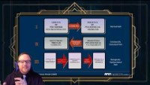
Video Lecture 4: The Pathways Model
Notes:
https://youtu.be/9sJhWqiW1Yk
Lecture on the Pathways Model **

Slide 102
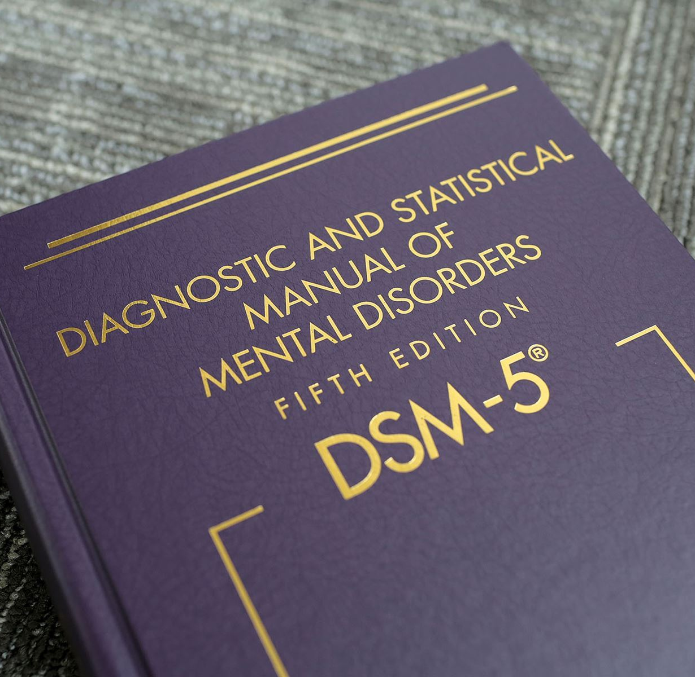
Screening & Assessment
Notes:
Screening & Assessment for Gambling Disorder

Slide 103

The Nine DSM-5 Diagnostic Criteria
As published in the DSM-5
The diagnostic code for Gambling Disorder is
312.31
(APA, 2013)
Notes:
Persistent and recurrent problematic gambling behavior indicated by the presence of four or more criteria, provided the gambling behavior is not better accounted for by the presence of a manic episode. Gambling Disorder is considered a Non-Substance Related Addictive Disorder. The DSM-­5 diagnostic code is 312.31.
Now we will review the 9 criteria of Gambling Disorder

Slide 104

Tolerance
Needs to gamble with increasing amounts of money in order to achieve the desired excitement
Notes:
Tolerance: Needs to gamble with increasing amounts of money in order to achieve the desired excitement.

Slide 105

Withdrawal
Is restless or irritable when trying to cut down or stop gambling.
Notes:
Withdrawal: Is restless or irritable when trying to cut down or stop gambling.

Slide 106

Loss of Control
Has made repeated unsuccessful efforts to control, cut back or stop gambling
Notes:
Loss of Control: Has made repeated unsuccessful efforts to control, cut back or stop gambling.

Slide 107

Preoccupation
Is often preoccupied with gambling (e.g., having persistent thoughts of reliving past gambling experiences, handicapping or planning the next venture, or thinking of ways to get money with which to gamble).
Notes:
Preoccupation: Is often preoccupied with gambling. Such preoccupations can include having persistent thoughts of reliving past gambling experiences, handicapping or planning the next venture, or thinking of ways to get money with which to gamble.

Slide 108

Escape
Often gambles when feeling distressed.
(e.g., helplessness, guilty, anxious, depressed)
Notes:
Escape: Often gambles when feeling distressed. Uses gambling as a way to relieve feelings of helplessness, guilt, anxiety, or depression.

Slide 109

Chasing
After losing money gambling, often returns
another day to get even
(Chasing One’s Losses)
Notes:
Chasing: After losing money gambling, often returns another day to get even

Slide 110

Lying
Lies to conceal the extent of involvement with gambling
Notes:
Lying: Lies to conceal the extent of involvement with gambling

Slide 111

Impact on Life Situation
Has jeopardized or lost a significant relationship, job, or educational or career opportunity because of gambling
Notes:
Impact on Life Situation: Has jeopardized or lost a significant relationship, job, or educational or career opportunity because of gambling.

Slide 112
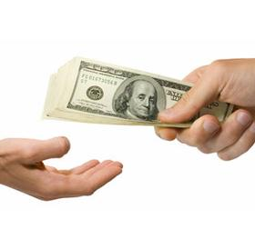
Bailout
Relies on others to provide money to relieve desperate financial situations caused by gambling
Notes:
Bailout: Relies on others to provide money to relieve desperate financial situations caused by gambling.

Slide 113

Second Requirement
In order to diagnose Gambling Disorder, . . .
  The gambling behavior is not better explained by a manic episode
Notes:
A second requirement for a diagnosis of Gambling Disorder is that the gambling behavior is not better explained by a manic episode.

Slide 114
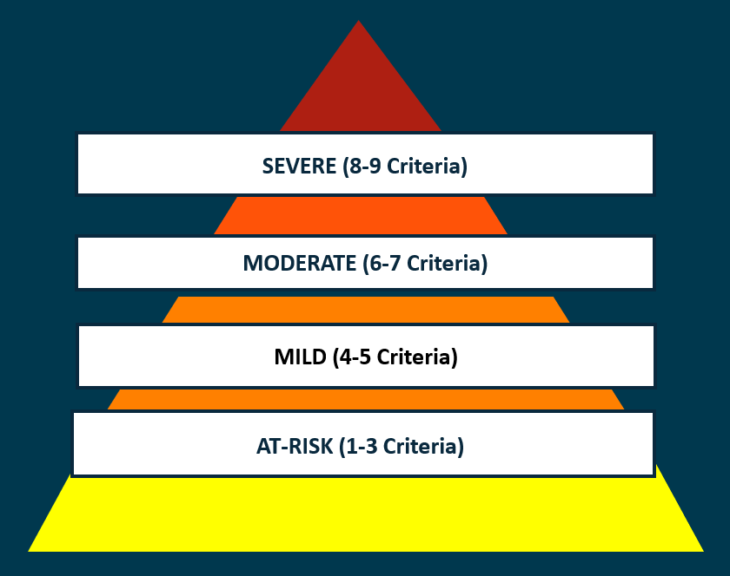
Severity Classifications Based on DSM-5 Criteria
Notes:
The DSM-­5 provides a framework for clinicians to indicate the severity of the client’s issue pertaining to their gambling behaviors. A mild addiction is a person meeting 4 to 5 criteria. A moderate addiction is a person meeting 6 to 7 criteria. Lastly, a severe addiction is a person exhibiting 8 to 9 of the DSM-5 criteria. The terms "at-risk" and "problem" gambling have long been used and recognized in clinical environments and research. These terms indicate the person does not presently meet diagnostic criteria but is at-risk for developing increasing levels of problems if their gambling behaviors continue to be left unmonitored.

Slide 115

Clinical Assessment
Discrete elements of a clinical process include
  Screening
  Evaluation
  Assessment
  Diagnosis
Course includes familiarization with instruments used at each stage of process
Notes:
Clinical Assessment: Screening, evaluation, assessment, and diagnosis are discrete elements of the clinical process. Each represents different elements in the process of examining an individual’s gambling history, and deciding what, if any, disorder might exist.

Slide 116
The SOGS: Research & Clinical Use
The South Oaks Gambling Screen is a screening tool, based upon the DSM, with utility in clinical settings and in research.
Given the changes in the DSM-5, today a person must only meet 4 or more of the criteria to be classified with a gambling disorder.
The cut-off score for a positive result on the SOGS is still 5 or more.
Persons receiving this score should be referred for further clinical assessment.
Notes:
Dr. Henry Lesieur’s perspective on the South Oaks Gambling Screen is important to recognize the screening tool’s relevance to the DSM, its history in clinical settings and in research, as well as its ongoing utility. Given the changes in the DSM-5, today a person must only meet 4 or more of the 9 criteria to be classified with a gambling disorder. The former DSM-IV, in effect until 2013, required at least 5 or more of 10 criteria. As mentioned earlier in this training, the cut-off for a positive result on the SOGS is a score of 5 or more.

Slide 117
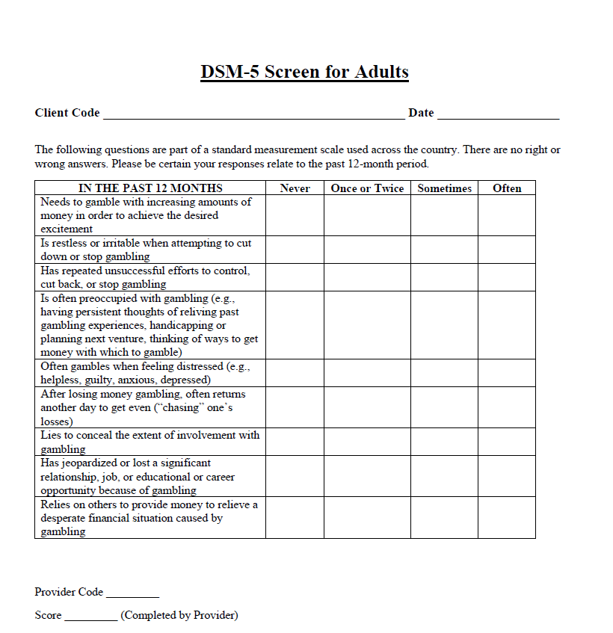
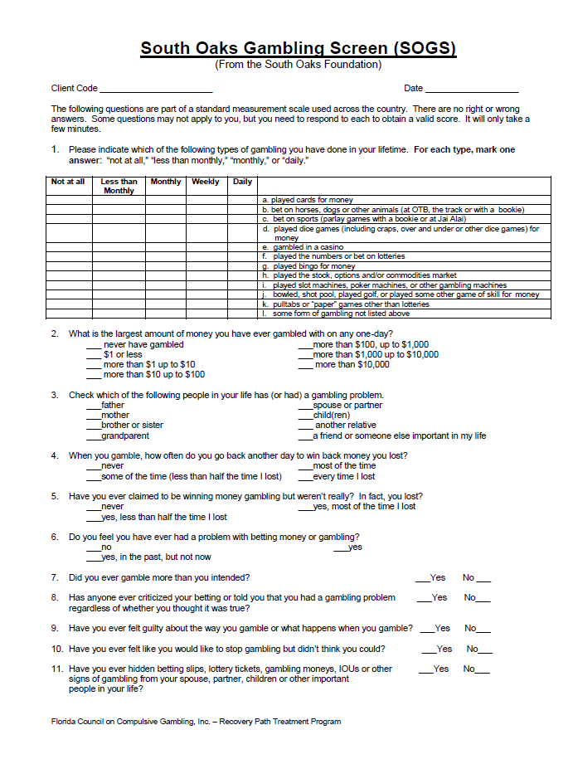
Common Screening Instruments
South Oaks Gambling Screen
South Oaks Gambling Screen – Revised Adolescents
NORC Diagnostic Screen
Notes:
Several screening assessments have been developed to assist in the identification of gambling problems. The South Oaks Gambling Screen has demonstrated the liability and validity, and the instrument may be self­‐administered. These characteristics plus ready accessibility have combined to make the SOGS the most widely used instrument for gambling screening. All of the instruments are available as attachments to this training course. To review the attachments, click the tab in the upper right corner of the screen.

Slide 118
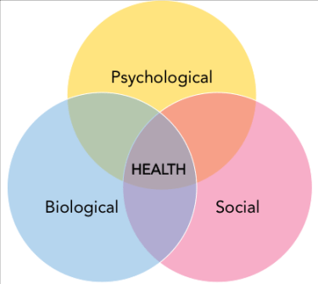
Evaluation and Assessment of Gambling Disorder
  Part of a complete bio-psycho-social evaluation
  Screening, evaluation, assessment and diagnosis
  Selection and use of instruments
  Sources of information, client and collateral
  Evaluating client readiness and motivation
Notes:
The process of evaluating a client for gambling disorder is done as part of a complete biopsychosocial evaluation. Through the process of screening, evaluating, and assessing, it is possible for a clinician to arrive at a diagnosis. During the evaluation process it is important to note the sources of information, whether it is through the client or collateral information such as a court order or police report. As with any screen, client responses may be subject to their motivations or their readiness to cooperate with the treatment process.

Slide 119
Evaluation and Assessment of Gambling Disorder
Assessment Instruments
  South Oaks Gambling Screen (SOGS)
  SOGS-RA Adolescent Screen
  NODS
  BBGS
Notes:
You will note a list of assessment instruments below these are all gambling specific instruments designed to identify who may be at risk or have already developed a problematic routine involving gambling behaviors. This is not a complete list, and other screens may be available upon your investigation. However, these are some of the most highly regarded, reliable, and valid testing instruments developed by the gambling treatment field. As a beginning gambling counselor, you may want to begin screening clients who report instances of gambling with the South Oaks Gambling Screen or the Brief Biosocial Gambling Screen.

Slide 120
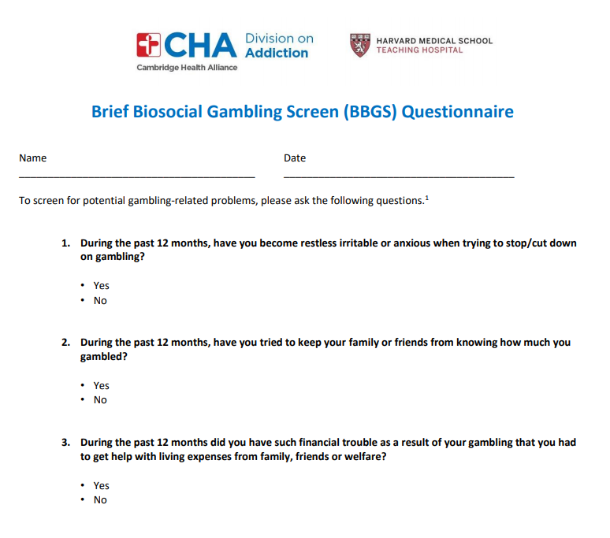
Evaluation and Assessment of Gambling Disorder
Brief Biosocial Gambling Screen
  3-Items
  Rule out for Gambling Disorder based on number of Yes responses
    Withdrawal
    Dishonesty
    Bailout
Notes:
The Brief Biosocial Gambling Screen consists of three items. A yes response on any item indicates the clinician will want to further understand how gambling fits into a person’s life. The diagnostic categories for these items includes withdrawal, dishonesty, and bailout. A no response on all three of these items makes it very unlikely that a diagnosis of gambling disorder would fit the clients presenting condition at the time of assessment.

Slide 121
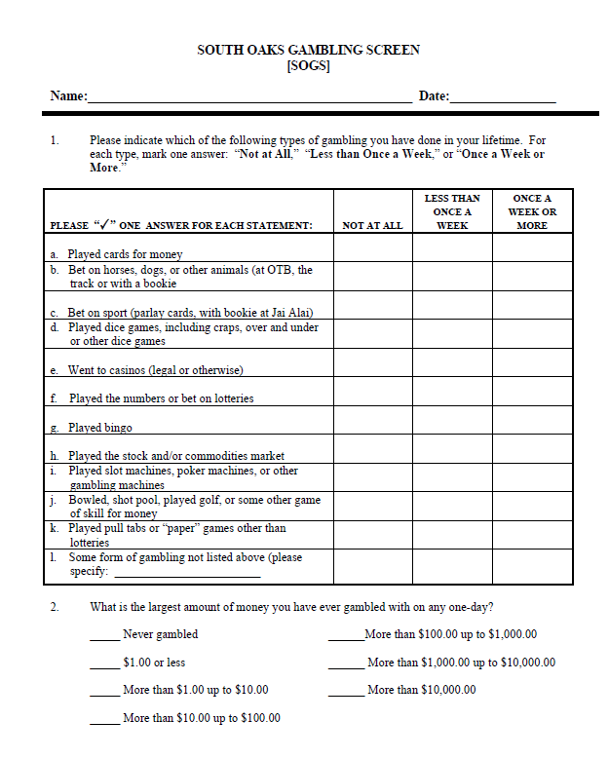
Evaluation and Assessment of Gambling Disorder
South Oaks Gambling Screen
  Valid and reliable instrument
  May be self-administered
  Most widely used screen
  First three questions, as well as questions 12,16j and 16k are not scored (for information and research purposes only)
Notes:
The SOGS is a highly valid and reliable instrument for identifying clients who may benefit from gambling specific interventions in their treatment, as well as consideration for a diagnosis of gambling disorder. The complexity of the test items in this instrument also avoid many complications from clients making repetitive no responses. In instances where a client scores higher than five on the SOGS, it is understood that clinicians will explore potential gambling related diagnosis further.

Slide 122

Treatment Planning
Includes relapse prevention and acceptance of responsibility for financial consequences
Requires knowledge of a gambler’s strengths, readiness to change, and history of trying to overcome gambling both inside and outside of treatment
Medication may be indicated for co-occurring disorders
Notes:
Treatment goals should be constructed with the knowledge of the type of gambler the clinician is treating. Effective treatment planning should include relapse prevention strategies as well as a focus on financial consequences as a critical step in the gambler’s acceptance of responsibility for his or her behavior. To do this effectively requires knowledge of a gambler’s strengths, readiness to change, and history of trying to overcome gambling both inside and outside of treatment
Medication may be helpful to treat depression and anxiety, but caution should be used when the client has a substance abuse or addiction history. In sessions 2 – 4, we will continue our discussion of treatment procedures for gambling disorder.

Slide 123


Treatment Choices
MENTAL HEALTH COUNSELING
Alternate Support Groups
Debt Management
Self-Exclusion
Gamblers Anonymous or Gam-Anon
Family Involvement
Notes:
Treatment for gamblers and their loved ones will often include twelve step programs and other supports in addition to treatment services. Self-help programs include Gamblers Anonymous for the gambler, and Gam-Anon for loved ones and family members. Treatment goals should be multifaceted in order to effectively address the gambler’s feelings of depression, experience of trauma, anxiety, guilt, and helplessness in an effort to identify determinants of their gambling behaviors. For family members, counseling may be helpful to establish boundaries, and to tend to their own psychological issues, abuse, or addiction history. In some instances, it may be helpful to incorporate a mixture of family sessions and individual therapy to increase accountability from the gambler and identify the extent of their effort to take responsibility for their actions, as well as include additional other members of their support system to maintain continuity between changes discussed in therapy and how they are implemented in their living situation. Due to location or availability Gamblers Anonymous or Gam-anon on may not always be available, making it helpful to consider alternate support groups that can also be used to provide support to the gambler in their recovery efforts. These can include support groups for other co-occurring situations or general addiction support groups such as Celebrate Recovery. Due to the financial element unique to treating gamblers debt management or financial counseling may be a helpful intervention to integrate into the approach of treatment. Self exclusion, the process of a gambler voluntarily and legally banning themselves from eligibility to gamble or even be on the premises of the casino floor, is an option many healthcare providers include as essential to their treatment planning process.

Slide 124
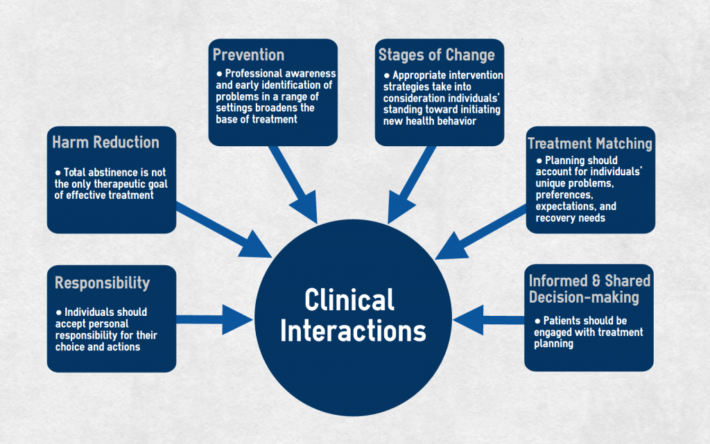
Notes:
There are many considerations to make when moving forward with the structure of treatment decisions with the gambling client. Many of these concepts will be discussed in future modules of this training. For a basic introduction it is important to understand the level of responsibility the client is taking for the gambling activity and how this factors into the decision of becoming abstinent or engaging in what is called harm reduction. The motivation the client possesses at the time of presenting for treatment can be conceptualized using the stages of change model made famous by Prochaska and DiClemente. Identifying the proper path for a client to modify their gambling behavior and developing successful report will aid the developing treatment process. It is not possible for counseling to be a positive impact in a person’s life if they do not attend counseling. For this reason, clinical interactions early in treatment and clearly presenting information about how treatment interacts with gambling behavior are a treatment priority.

Slide 125
Summary
Clinician’s knowledge of gambling prevalence, typology, diagnosis, and treatment is essential
  Creates awareness of problem’s likelihood
  Informs treatment planning, including assessments for co-occurring conditions
  Maximizes prospects for effective treatment
Notes:
A Clinician’s knowledge of gambling prevalence, typology, diagnosis, and treatment is essential. It helps to create awareness of problem’s likelihood when meeting with new clients, informs treatment decisions, and maximizes the prospects for effective treatment

Slide 126

Problem Gambling Summary: Just the Facts
Gambling is older than alcohol.
Before prehistoric people learned about rotten grapes turning into “joy juice” they were gambling.
Gambling has historically been the way we communicated with the gods - a way to divine the future.
The Bible has several references to gambling. Tossing of lots were how decisions were made.
Roman soldiers gambled at the foot of the cross for Christ’s robe.
Notes:
Problem gambling summary: Just the facts. Gambling is older than alcohol. Before prehistoric people learned about rotten grapes turning into “joy juice” they were gambling. Gambling has historically been the way we communicated with the gods – a way to divine the future. The Bible has several references to gambling. Tossing of lots was how decisions were made. Roman soldiers gambled at the foot of the cross for Christ’s robe.

Slide 127
Problem Gambling Summary: Just the Facts
Gambling games have been found in the ancient pyramids; the oldest game found is a stone game from Africa still played today.
Dice were found in the ruins at Pompeii- loaded dice were found in Pompeii.
The fathers of our nation used public lotteries to finance the building of public institutions like Harvard and Yale, churches and hospitals.
Notes:
Gambling games have been found in the ancient pyramids; the oldest game found is a stone game from Africa still played today. Dice were found in the ruins at Pompeii – loaded dice were found in Pompeii. The fathers of our nation used public lotteries to finance the building of public institutions like Harvard and Yale, churches, and hospitals.

Slide 128
Problem Gambling Summary: Just the Facts
The U.S. is going through the third wave of gambling now.
The first was in colonial days when a lottery funded public projects. Cheating at such drawings ended the legality of the early lottery - they were all banned.
Then pre-civil war we see the wild west, gambling halls, and riverboat gamblers plying their trade. More cheating and this too was banned.
About 11 gamblers who refused to stop gambling were hung in Vicksburg, Mississippi.
Notes:
The United States is going through the third wave of gambling now. The first was in colonial days when a lottery funded public projects. Cheating at such drawings ended the legality of the early lottery – they were all banned. Then, pre-­‐civil war we see the wild west, gambling halls, and riverboat gamblers plying their trade. More cheating and this too was banned. About 11 gamblers who refused to stop gambling were hung in Vicksburg, Mississippi.

Slide 129
Problem Gambling Summary: Just the Facts
The third, or current wave, began in the late 1930’s in a desert town called Las Vegas.
What makes the third wave different and likely “here to stay” is the strict regulation of gambling games today. States want/need the $.
Cheating, though possible, is very difficult.
Horse racing, lotteries, casinos, stock market are very strictly regulated and those who play legally can be assured of a “fair game.”
Today the gambling industry is part of corporate America.
Notes:
The third, or current wave, began in the late 1930’s in a desert town called Las Vegas. What makes the third wave different and likely “here to stay” is the strict regulation of gambling games today. States want and need the money. Cheating, though possible, is very difficult. Horse racing, lotteries, casinos, and the stock market are very strictly regulated and those who play legally can be assured of a “fair game.” Today the gambling industry is part of corporate America.

Slide 130
Problem Gambling Summary: Just the Facts
About 75-86% of all adults in the U.S. gamble at one time or another.
Legal gambling in the U.S. is over a $100 billion dollar industry.
However, gambling on the stock market, wagering online, gambling on cruise ships, as well as on illegal games, such as sports betting, is present in both Hawaii and Utah.
Over 41 states have lotteries, 6 states have river boats, 28 states have casino gambling (APGSA, 2006).
Notes:
About 75-86% of all adults in the U.S. gamble at one time or another.
Legal gambling in the U.S. is over a $100 billion dollar industry.
However, gambling on the stock market, wagering online, gambling on cruise ships, as well as on illegal games, such as sports betting, is present in both Hawaii and Utah.
Over 41 states have lotteries, 6 states have river boats, 28 states have casino gambling

Slide 131
Problem Gambling Summary: Just the Facts
The Indian Gaming Act of 1988 now allows tribal casino gambling in 28 states instead of what used to be limited to Nevada and New Jersey.
According to the NGISC* people that live within 50 miles of a casino are at higher risk for developing a gambling problem. *National Gambling Impact Study Commission 1999.
State Funded gambling treatment is available in about 30 states but is not keeping pace with gambling expansion efforts. (APGSA,2006; Franklin, 2010)
Notes:
The Indian Gaming Act of 1988 now allows tribal casino gambling in 28 states instead of what used to be limited to Nevada and New Jersey.
According to the National Gambling Impact Study Commission, people that live within 50 miles of a casino are at higher risk for developing a gambling problem.
State Funded gambling treatment is available in about 30 states but is not keeping pace with gambling expansion efforts.

Slide 132
Problem Gambling Summary: Just the Facts
TERMS:
Problem Gambling: A descriptive term used to define those individuals with problems in their lives due to gambling.
Gambling Disorder (312.31): The clinical diagnosis for the problematic gambling behavior as defined by 9 diagnostic criteria listed in the DSM-5. This diagnosis is listed in the Non-Substance Related Addictive Disorder category.
Prevalence- estimates indicate that about 1-3% of the adult population in the U.S. has a serious gambling problem. This may be 3-5 million people. An additional 3% are at risk for developing a serious gambling problem.
Notes:
TERMS:
Problem Gambling is A descriptive term used to define those individuals with problems in their lives due to gambling.
Gambling Disorder (312.31) is The clinical diagnosis for the problematic gambling behavior as defined by 9 diagnostic criteria listed in the DSM-5. This diagnosis is listed in the Non-Substance Related Addictive Disorder category.
Current Prevalence estimates indicate that about 1-3% of the adult population in the U.S. has a serious gambling problem. This may be 3-5 million people. An additional 3% are at risk for developing a serious gambling problem.

Slide 133
Problem Gambling Summary: Just the Facts
Just as in other substance-related addictions, Gambling Disorder effects young and old, male and female, all cultures, faiths and economic groups alike.
Gambling disorders are more common among males than females, though females are starting to catch up to males in states with machine gambling, such as slots, video lottery terminals, poker and other machines. (Volberg 1999, 2003)
The disorder seems to be more common among adolescents, occurring at a rate at least double that of adult prevalence rates. (Volberg, Deverensky, Shaffer)
Notes:
Just as in other substance-related addictions, Gambling Disorder effects young and old, male and female, all cultures, faiths and economic groups alike.
Gambling disorders are more common among males than females, though females are starting to catch up to males in states with machine gambling, such as slots, video lottery terminals, poker and other machines.
The disorder seems to be more common among adolescents, occurring at a rate at least double that of adult prevalence rates.

Slide 134
Problem Gambling Summary: Just the Facts
Co-occurring disorders and cross addictions are high among gamblers presenting for treatment.
Comorbidity: depression, anxiety and bipolar disorders are a concern, and should be ruled out in appropriate circumstances based on client presentation.
Substance Abuse Disorders seem unusually common to the problem gambling population. Among those seeking substance abuse treatment, problematic gambling behavior should be screened by the treating professional.
Suicide attempt rates have been reported as alarmingly high.
Notes:
Co-occurring disorders and cross addictions are high among gamblers presenting for treatment.
Comorbidity: depression, anxiety and bipolar disorders are a concern, and should be ruled out in appropriate circumstances based on client presentation.
Substance Abuse Disorders seem unusually common to the problem gambling population. Among those seeking substance abuse treatment, problematic gambling behavior should be screened by the treating professional.
Suicide attempt rates have been reported as alarmingly high.

Slide 135
Problem Gambling Summary: Just the Facts
Affect Disorders: Depression and Bipolar Disorder - 40-60% of gamblers presenting for care.
Anxiety - perhaps 10-15% of gamblers presenting for care.
30-60% of gamblers in treatment also require treatment for co-occurring Substance Abuse Disorders.
10-30% of addicts in treatment may have a gambling problem, with many cases being unreported.
Suicidal Ideation among GA members is as high as 80-97% in some studies.
  Suicide Attempt rate: 15-27%. (NRC, 1999; Franklin 2013)
Notes:
Affect Disorders: Depression and Bipolar Disorder - 40-60% of gamblers are found to present for care.
Among gamblers needing help with comorbid Anxiety - perhaps 10-15% of gamblers present for care.
30-60% of gamblers in treatment also require treatment for co-occurring Substance Abuse Disorders.
10-30% of addicts in treatment may have a gambling problem, with many cases being unreported.
Suicidal Ideation among GA members in some studies is as high as 80-97%.
The Suicide Attempt rate amongst that same population is 15-27%.

Slide 136
Problem Gambling Summary: Just the Facts
Growing numbers of gambling problems among:
  Adolescents
  Older Adults
  Women
  People of Color
  Lower Income populations
  Those with lower educations (high school or less than high school) (Volberg 2000)
Notes:
There are a growing numbers of gambling problems found among: adolescents, older adults, women, multicultural populations, lower income populations, those with lower educations (high school or less than high school)

Slide 137
Problem Gambling: Assessment and Care
To find the G.A. meeting or counselor closest to you call the problem gambling helpline at
Gamblers Anonymous offers free self-help meetings to anyone concerned they may have a gambling problem
Gam-anon offers free self-help support for the family and friends of the problem gambler
Notes:
To find the G.A. meeting or counselor closest to you call the problem gambling helpline at
1-800-NEXT-STEP
Gamblers Anonymous offers free self-help meetings to anyone concerned they may have a gambling problem
Gam-anon offers free self-help support for the family and friends of the problem gambler

Slide 138
Problem Gambling: Assessment and Care
Public Awareness messages, Prevention messages and Program Evaluation are areas still being developed in the problem gambling field
Though recognized by the NFL, NCAA, MLB, the Gaming Industry, Several Unions and large Businesses - the U.S. has no coordinated or federally funded comprehensive leadership in addressing problem gambling
Notes:
Public awareness messages, prevention messages and program evaluation are areas still being developed in the problem gambling field. Though recognized by the NFL, NCAA, MLB, the gaming industry, several unions and large businesses, the US has no coordinated or federally funded comprehensive leadership in addressing problem gambling.

Slide 139
Problem Gambling: Assessment and Care
The issue of insurance parity may affect some gamblers with jobs and insurance. Advocacy may be necessary in cases where the Gambling Disorder diagnosis is denied coverage under their mental health benefits.
Without federal protections gamblers with security clearances, licenses, bonds, etc. stay quiet about a disorder that would cost them their jobs if acknowledged.
Professional and college athletes stay quiet for fear of losing their careers.
The secret stays hidden, services go under-utilized, and lives, careers, families, and finances are disrupted or lost.
Notes:
The issue of insurance parity may affect some gamblers with jobs and insurance. Advocacy may be necessary in cases where the Gambling Disorder diagnosis is denied coverage under their mental health benefits.
Without federal protections gamblers with security clearances, licenses, bonds, etc. stay quiet about a disorder that would cost them their jobs if acknowledged.
Professional and college athletes stay quiet for fear of losing their careers.
The secret stays hidden, services go under-utilized, and lives, careers, families, and finances are disrupted or lost.

Slide 140
Problem Gambling: Assessment and Care
Recent gains for problem gambling services have come either directly or indirectly from lottery funding, casino or new state funding
The gaming industry has taken on the task of recommending responsible gaming by providing responsible play programs
Helpline funding, PSA’s, training programs, treatment funding, public awareness and prevention efforts contribute significant care in several, but not all, states
Notes:
Recent gains for problem gambling services have come either directly or indirectly from lottery funding, casino or new state funding. The gaming industry has taken on the task of recommending responsible gaming by providing responsible play programs. Helpline funding, PSA’s, training programs, treatment funding, public awareness and prevention efforts contribute significant care in several, but not all, states.

Slide 141
End of Session 1 Topics
1. Overview & Basic Knowledge
2. History & Scope of Gambling
4. Describing Gambling Disorder
5. Screening & Assessment
3. National Prevalence of Gambling Issues
Notes:
This is the end of Module 1.

